Slide 1
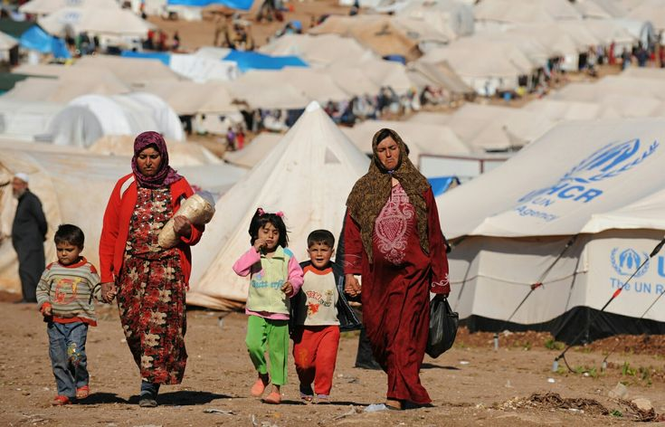
Refugees

Slide 2
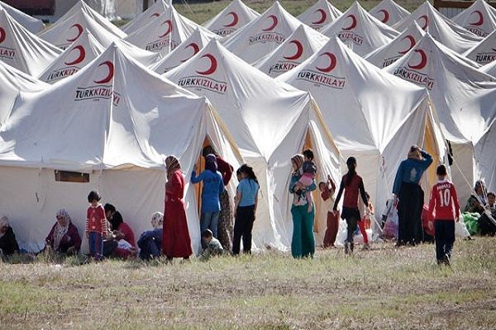
Who are Refugees?
Refugees are people who are forced to leave their homes
because of war, violence, or danger.

Slide 3

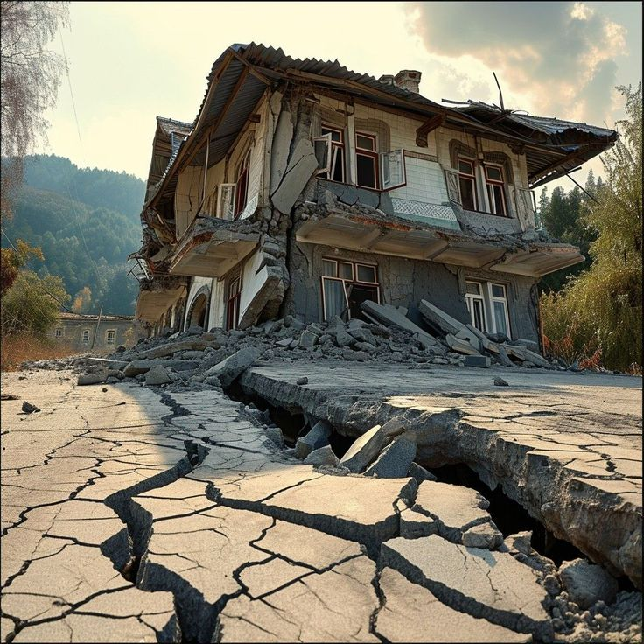
Why Do People Become Refugees?
- War and conflict
- Natural disasters
- Political problems
- To find safety and a better future

Slide 4
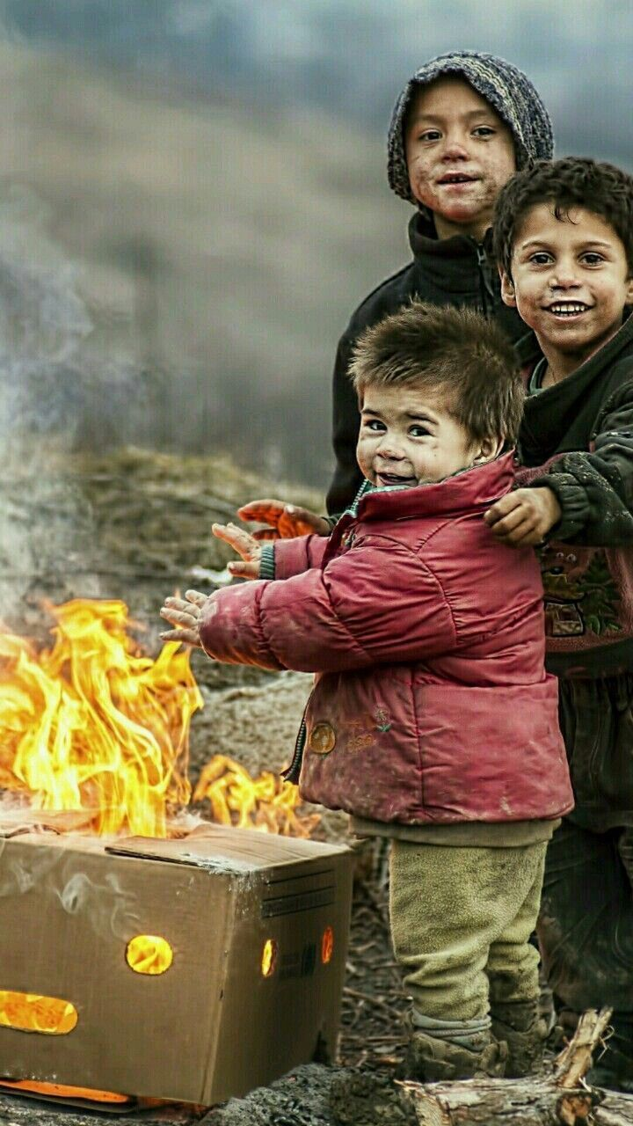
Challenges Faced by Refugees
- Lack of food and clean water
- No safe place to live
- Difficulty finding school or work
- Emotional and physical stress

Slide 5

How Can We Help Refugees?
- Respect and support them
- Donate clothes, food, or money
- Raise awareness
- Be kind and understanding

Slide 6
Thank you for listening 3>

