Slide 1






The Symbolism and Science of Light and Their Role in Adressing Global Challenges Like Education , Sustainability , or Health

Slide 2





what is light?
Light is a form of energy that allows us to see . it travels incredibly fast in straight lines and interacts with materials in predictable ways, such as reflection, refraction, and absorption.
The sun, stars, fire, candles, electric bulbs are all examples of light sources. As they radiate light, they are said to be luminous. Light sources can be natural or artificial.

Slide 3

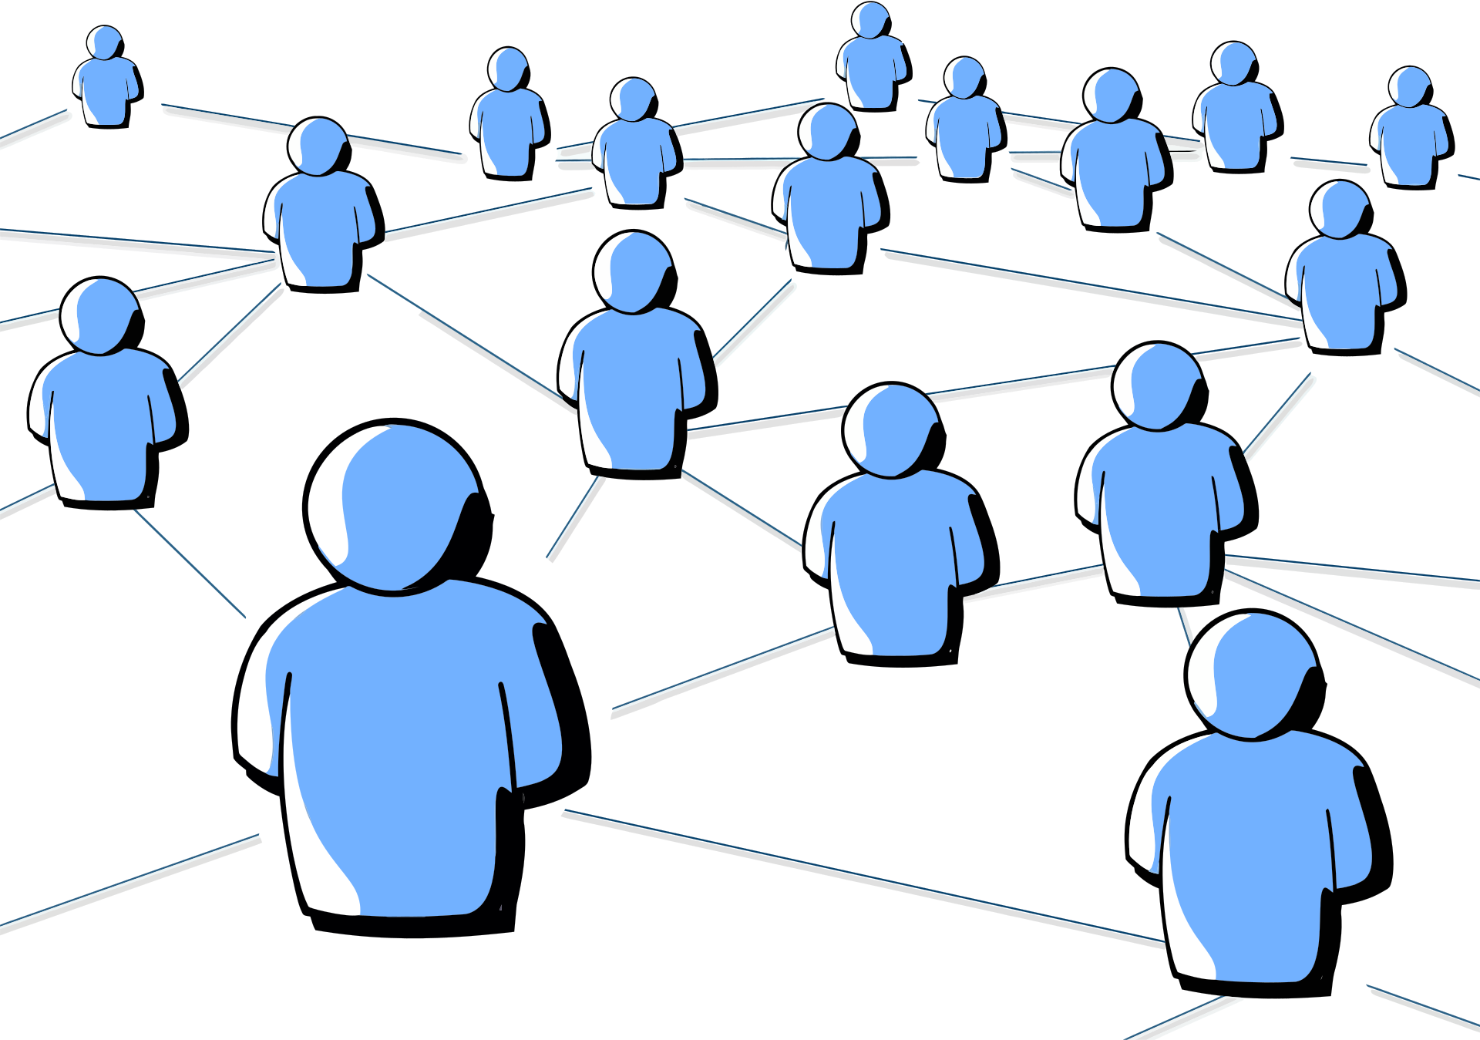
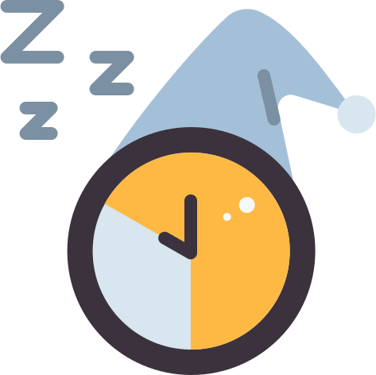

Light is the most important external factor affecting sleep. While most people intuitively know that it’s easier to sleep when it’s dark, the link between light and sleep goes much deeper. Light plays a central role in regulating circadian rhythm, the body’s internal clock that signals when to be alert and when to rest. Light also affects the production of melatonin, an essential sleep-promoting hormone.
How does light affect human biology ?
different lighting choices can impact our emotions, mood, and overall well-being. Warm lighting provides comfort and relaxation, fostering social connections and positive emotions, while cool lighting enhances alertness and concentration.
Light intensity, or brightness, is a crucial factor that affects how well we can see. The intensity of light is determined by the amount of energy carried by the light waves, and it influences the size of the pupil, the response of photoreceptors, and, ultimately, the clarity of the image.

Slide 4



How is light used in technology?
fiber optics
solar energy
Light in fiber optics acts as the messenger that carries information from one place to another. It is turned into tiny flashes that represent data, and these flashes travel through the thin glass fiber. As the light moves, it keeps bouncing off the inside walls of the fiber so it does not escape, allowing it to travel very fast and very far. In this way, light delivers the information until it reaches the other end of the fiber.
Light is used in solar energy by turning sunlight into electricity. When sunlight hits a solar panel, the panel absorbs the light and its energy makes tiny particles inside it move. This movement creates an electric current, which we can use to power homes, lights, and devices

Slide 5

What does light symbolize in different cultures and literary traditions and how do authors use light to convey meaning ?
Authors often use light to convey meaning by connecting it with ideas of knowledge, clarity, and goodness. Light can symbolize safety, truth, and understanding, helping readers feel that something is positive or enlightening is happening. In contrast, darkness is used to represent the unknown, the chaotic, or the harmful, creating a sense of fear, confusion, or danger. By contrasting light and darkness, authors show the difference between what is understood and what is hidden, allowing readers to feel the deeper message behind a scene or character.

Slide 6




Examples on the Symbolism of Light in Different Cultures
Western litreature
Asian litreature
African litreature
light usually symbolizes knowledge, truth, goodness, purity, and hope. It often represents positive forces, clarity, and the triumph of good over evil.
light often symbolizes enlightenment, inner peace, and harmony. It can also stand for wisdom, guidance, and the balance between nature and human life.
light represents life, community, guidance, and wisdom. It is often linked to growth, and the strength that comes from unity and tradition.

Slide 7



How does access to light affect learning environments ?
Natural Light: Exposure to sunlight increases serotonin levels, energy, and focus while regulating sleep cycles. Classrooms with sufficient daylight improve students’ academic performance, alertness, and sustained attention.
Artificial Light: When natural light is limited, artificial lighting becomes essential. Bright, cool tones promote alertness and concentration, while warmer tones create a relaxed atmosphere for reading and group activities. Poor or inadequate lighting can lead to fatigue or headaches.

Slide 8


light as a Metaphor
Light frequently serves as a metaphor for knowledge and comprehension, symbolising the progression from ignorance to enlightenment. Plato’s Allegory of the Cave illustrates this, with sunlight representing genuine wisdom and the clarity attained through learning. Even in contemporary language, expressions such as “a light bulb went off” and “shed light on the problem” demonstrate that light continues to be associated with insight and understanding.

Slide 9
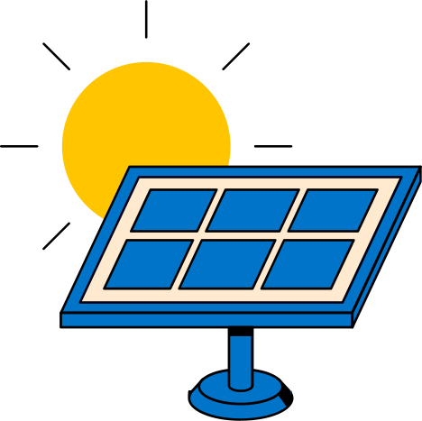
“How can the use of solar energy and efficient lighting, along with cultural stories about light, help reduce environmental impact and inspire environmental awareness?”
Solar energy and efficient lighting play an important role in protecting the environment. Using solar panels helps reduce pollution because they produce clean energy from the sun instead of burning fossil fuels. This means fewer greenhouse gases and a smaller carbon footprint. In addition, efficient lighting like LED bulbs uses less electricity and lasts much longer, which saves energy and reduces waste.
Cultural stories about light also inspire people to care for nature. In many cultures, light represents life, hope, and balance. These stories remind us that natural energy sources are gifts that we must protect. By connecting cultural values with modern technology, people become more aware of how their choices affect the planet and are encouraged to live more sustainably.

Slide 10

The Physical Role of Light in Mental Health and Its Symbolism in Cultures
Light exposure strongly influences mental health because it regulates the circadian rhythm, mood, and energy levels; this is why reduced sunlight can trigger Seasonal Affective Disorder, as explained in scientific sources such as psychology textbooks and medical studies from the American Psychological Association and National Institute of Mental Health. In literature, authors use light as a symbol of hope, clarity, and emotional healing, while darkness represents despair or confusion—a theme discussed in literary analysis resources like Literary Symbolism Guides, Oxford Literature Companion, and various cultural mythology references.

Slide 11
Resources
Science & Health
https://www.mdpi.com/1422-0067/24/8/7579 — (MDPI journal)
https://www.psychiatry.org/news-room/apa-blogs/light-sleep-and-mental-health — APA blog on light, sleep, and mental health
https://www.sleepfoundation.org — Sleep Foundation (sleep research and advice)
Technology / Fiber Optics
https://www.businessbroadbandhub.co.uk/blog/how-fibre-optic-broadband-works — How fibre optic broadband works
Environment / Sustainability
https://www.nationalgeographic.com/environment — National Geographic: Environment
https://lifestyle.sustainability-directory.com — Sustainability directory
Philosophy / Literary Symbolism
https://en.wikipedia.org/wiki/Black-and-white_dualism — Wikipedia article on light-dark symbolism
https://aithor.com/essay-examples/the-use-of-darkness-and-light-as-symbols-in-the-story — Essay on light and darkness symbolism
Education / Culture
https://www.unesco.org — UNESCO (culture, education, science)
Language / Dictionary
https://dictionary.cambridge.org — Cambridge Dictionary: “Light” English meaning
Other
https://openmedscience.com Open Medical Science site
https://www.vonn.com

Slide 12
THANK
YOU!

