Slide 1

Fundamentals of Investing Using Dave Ramsey’s 7 Baby Steps
This Photo by Unknown Author is licensed under CC BY-ND

Slide 2
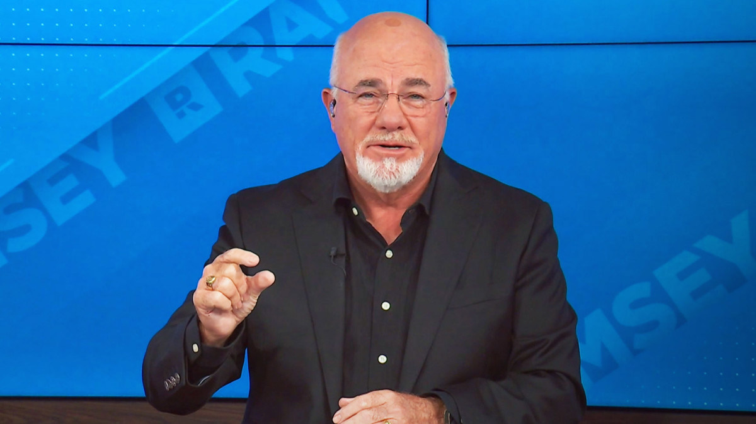
Introduction to Dave Ramsey
Brief explanation: Dave Ramsey is a personal finance expert known for simple step-by-step money management.
Emphasize: His “7 Baby Steps” provide a clear path to financial stability and investing.

Slide 3
Why Investing Matters
Define investing: using money to buy assets that grow over time.
Importance:
1-Beats inflation
2-Builds long-term wealth
3-Creates financial freedom

Slide 4
Overview of the 7 Baby Steps
1-Save $1,000 for a starter emergency fund
2-Pay off all debt (except mortgage) using the Debt Snowball
3-Save 3–6 months of expenses
4-Invest 15% of household income for retirement
5-Save for children's college
6-Pay off your home early
7-Build wealth & give generously
You will reach investing mainly at step 4.

Slide 5
Baby Step 1:
Starter Emergency Fund
Starter Emergency Fund (baby step 1) Includes:
1-Purpose: protection from small unexpected expenses
2-Why before investing: prevents using credit cards or loans
3-Target amount: $1,000 (or slightly more outside the U.S.)

Slide 6
Baby step 2:
Pay Off All Debt (Except Mortgage)
Pay Off All Debt Includes :
-Method: Debt Snowball (smallest balance first)
-Why before investing: debt interest eats investment profits
-Outcome: frees income for future investing

Slide 7
Baby step 3:
Fully Funded Emergency Fund
Fully Funded Emergency Fund Includes :
-Save 3–6 months of expenses
-Purpose: protects investments during job loss or emergencies
-Prevents panic selling in the market
-Helps create financial stability before investing heavily

Slide 8
Baby step 4:
Invest 15% of Income
Invest 15% of Income Includes :
-This is the core investing step
-Recommended accounts (depending on country):
-Importance of long-term investing
-Concept of diversification (spreading money across investments)

Slide 9
Baby step 5:
Save for Children’s College
-Save for Children’s College Includes :
-Only after investing 15% for retirement
-Options (example): education savings accounts, 529 plans (in U.S.)
-Purpose: reduce future student debt

Slide 10
Baby step 6 :
Pay Off Your Home Early
Pay Off Your Home Early Includes :
-Paying off early reduces decades of interest
-Frees up money for investing & giving
-Step usually overlaps with increasing investing

Slide 11
Baby step 7 :
Build Wealth and Give
Build Wealth and Give Include :
-Investing continues to grow even faster with no debts
Focus on:
Generosity
Legacy building
More advanced investing (real estate, business ownership, etc.)

Slide 12
Key Investing Principles to Remember:
-Start early
-Stay consistent
-Don’t try to time the market
-Diversify
-Think in decades, not months

Slide 13
Common Investing Mistakes
-Panic selling
-Following trends/social media hype
-Not having an emergency fund first
-Investing while still in high-interest debt
-Lack of patience

Slide 14
Conclusion
The Baby Steps create a safe foundation before investing
Investing (Step 4) is the turning point for building wealth
The process is simple, disciplined, and long-term focused
Final message: Anyone can build wealth with the right plan.

Slide 15
Thank You
Presented by : ahmad awni alqudah

