Slide 1
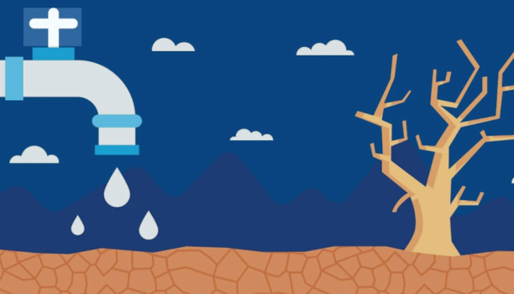
Water scarcity in Jordan
By the students:
1-Salma Abu Azam
2-Bana Hdaib
3-Jana Hussan
4-Ayla Azam
5- Selena AlQadah
Grade: 4th B

Slide 2
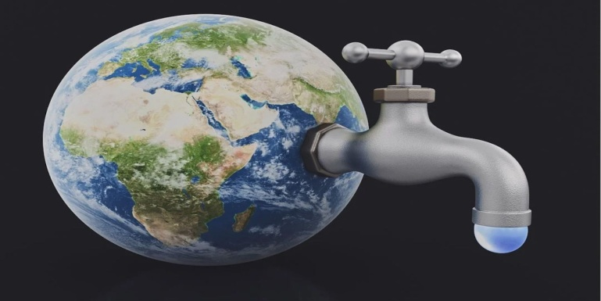
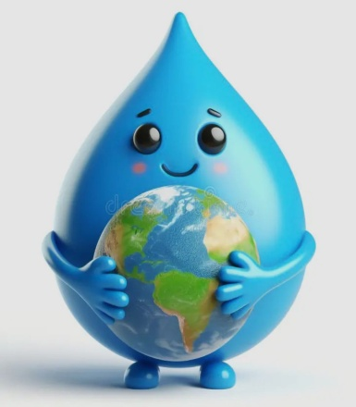
Water scarcity in Jordan (salma)
1. Jordan is one of the top five driest countries in the entire world, and its water supply is dangerously low.
2. This happens because extreme heat makes water evaporate quickly and the country receives very little rain to replace it.
3. Farms also use a huge amount of Jordan’s limited water, making the shortage even more serious.
4. To fight this crisis, Jordan can use efficient drip irrigation and repair leaky pipes to protect every precious drop.

Slide 3
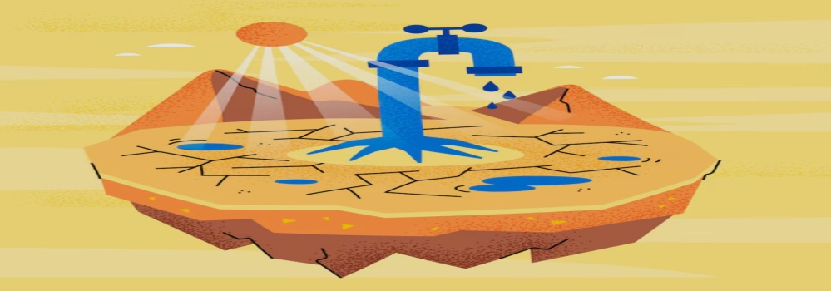
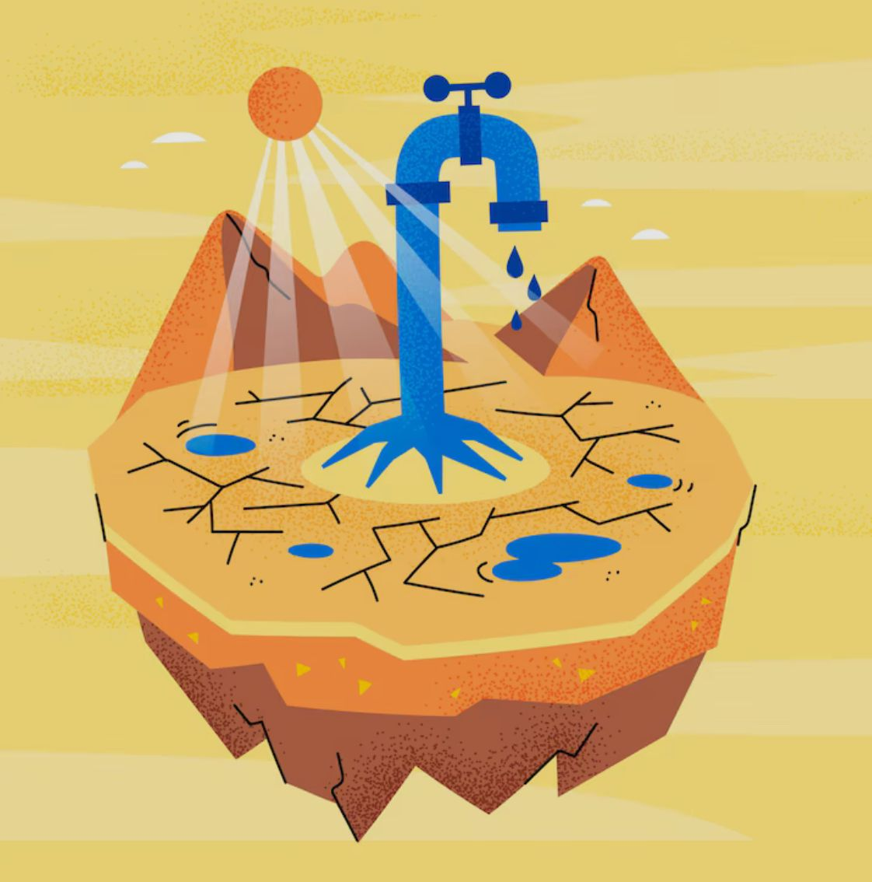
Continuing (ayla)
1. Jordan has one of the lowest amounts of water per person in the world.
2. This happens because Jordan gets almost no rain and its underground water is running low.
3. People must save water because the natural supply cannot meet everyone’s needs.
4. A good solution is to use only the water we need and collect rainwater when possible.

Slide 4
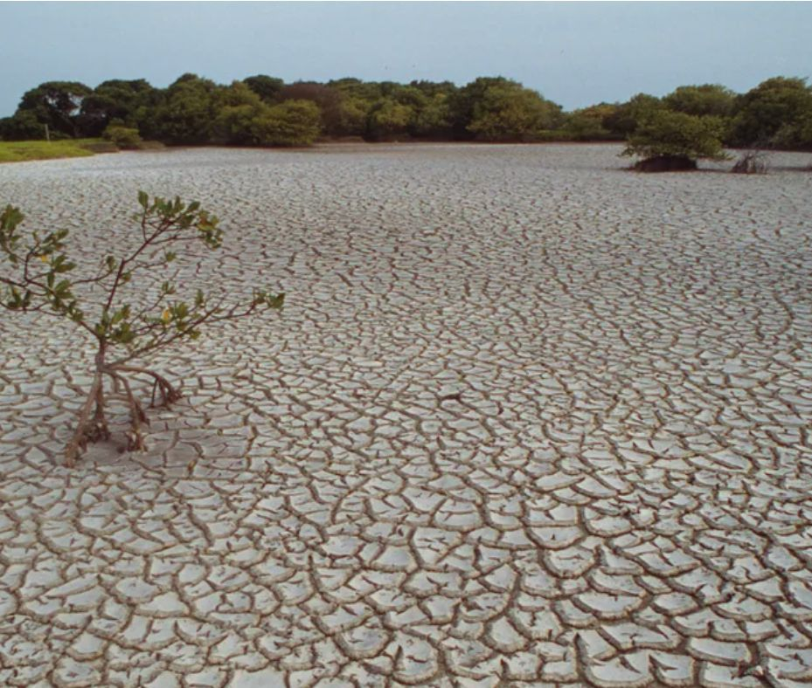
Continuing (jana)
1. The Jordan River is now much smaller than it used to be.
2. This is because there is not enough rain, and more people are using the same water sources.
3. Some towns only receive water once a week because of the shortage.
4. One solution is for Jordan to reuse cleaned wastewater to save more fresh water.

Slide 5
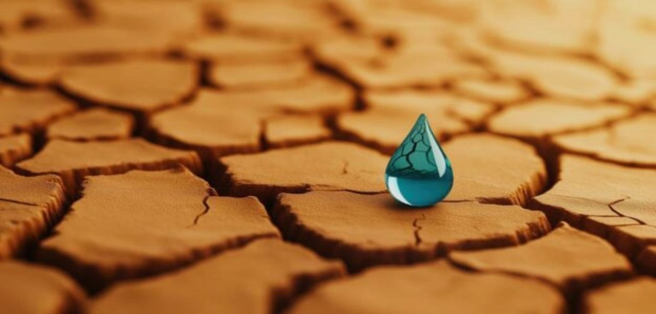
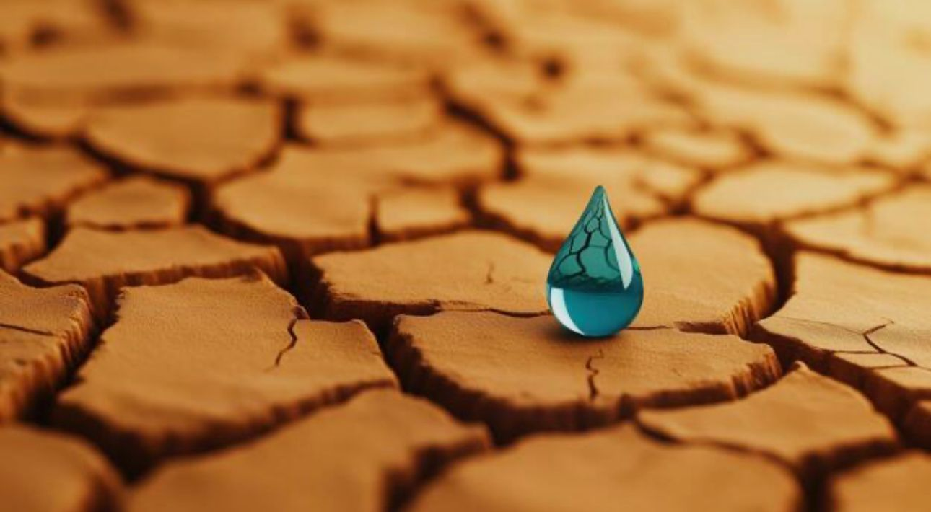
Continuing (selena)
1. Jordan has very little water, so families need to use it carefully.
2. This is because water can run out quickly if it is wasted at home.
3. To help, families can turn off taps, fix leaks, and collect rainwater.
4. Using less water for showers and cleaning helps protect Jordan’s limited water supply.uly

Slide 6
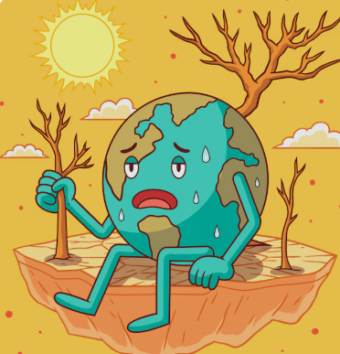
Continuing (bana)
1. Jordan’s water crisis is one of the most serious in the world.
2. Climate change is making the country hotter and reducing rainfall.
3. Jordan needs new ways to get enough clean water for its people.
4. A major solution is building desalination plants to make fresh water from seawater.

Slide 7
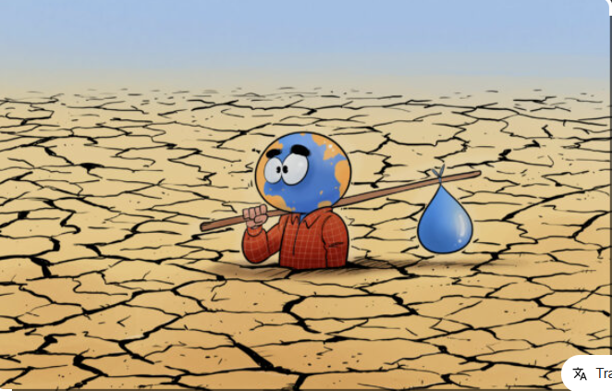
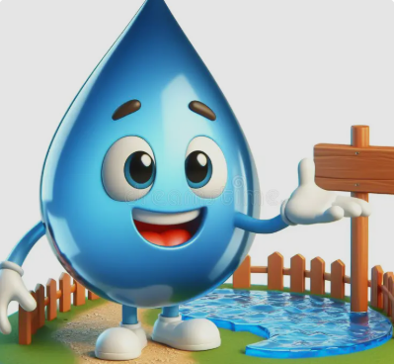
Thanks for listening

