Slide 1
The symbiotic relationship between the clown fish and the sea Anemone

Slide 2
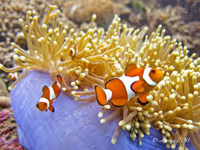
The Clownfish and the sea Anemone:
The Clownfish and the sea anemone have a symbiotic relationship and each one of them gets a benefit.

Slide 3
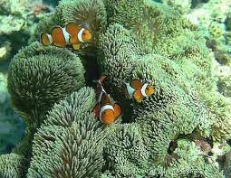
1:the benefit of the clownfish.
Protection: the sea anemone has stinging tentacles that protects the clownfish from predators,and these tentacles cant hurt the clownfish because they are immune to them.
Shelter: the sea anemone provides a safe home base where the clownfish can hide and lay eggs

Slide 4
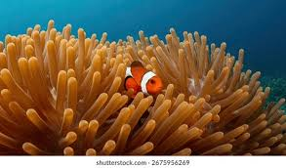
2:How the sea anemone benefits.
Food scraps: clown fish drop bits of food that the sea anemone can consume.
Cleaning: the clownfish eats parasites and dead tissue from the sea anemone.
Improved water flow: the clownfishs constant movement increases aeration around the sea anemone promoting health.

Slide 5
students work
Karam abusara
Karam abukhalaf
Adam abunaba
Yahya nahya

