Slide 1
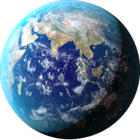
Cleanliness
Why it matters and how we can help

Slide 2
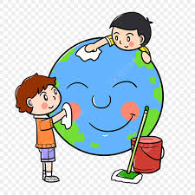
Cleanliness is Greart

Slide 3
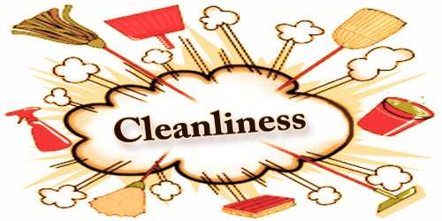
What does cleanliness mean?

Slide 4
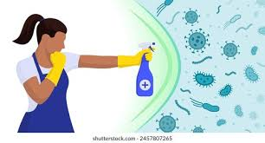
Definotion of cleanliness
Being free from dirt, germs, and sickness and keeping your body and your surroundings clean to stay healthy.

Slide 5
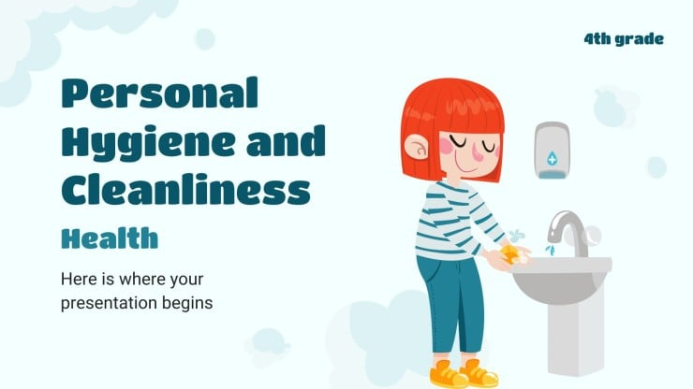
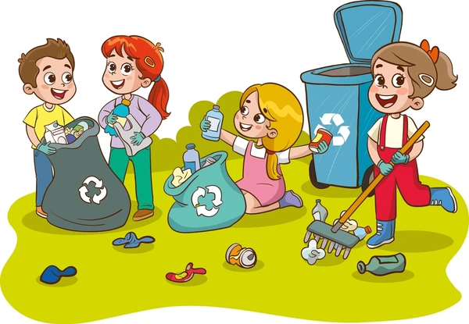
What are 2 types of cleanliness?
Personal cleanliness
Environmental cleanliness

Slide 6
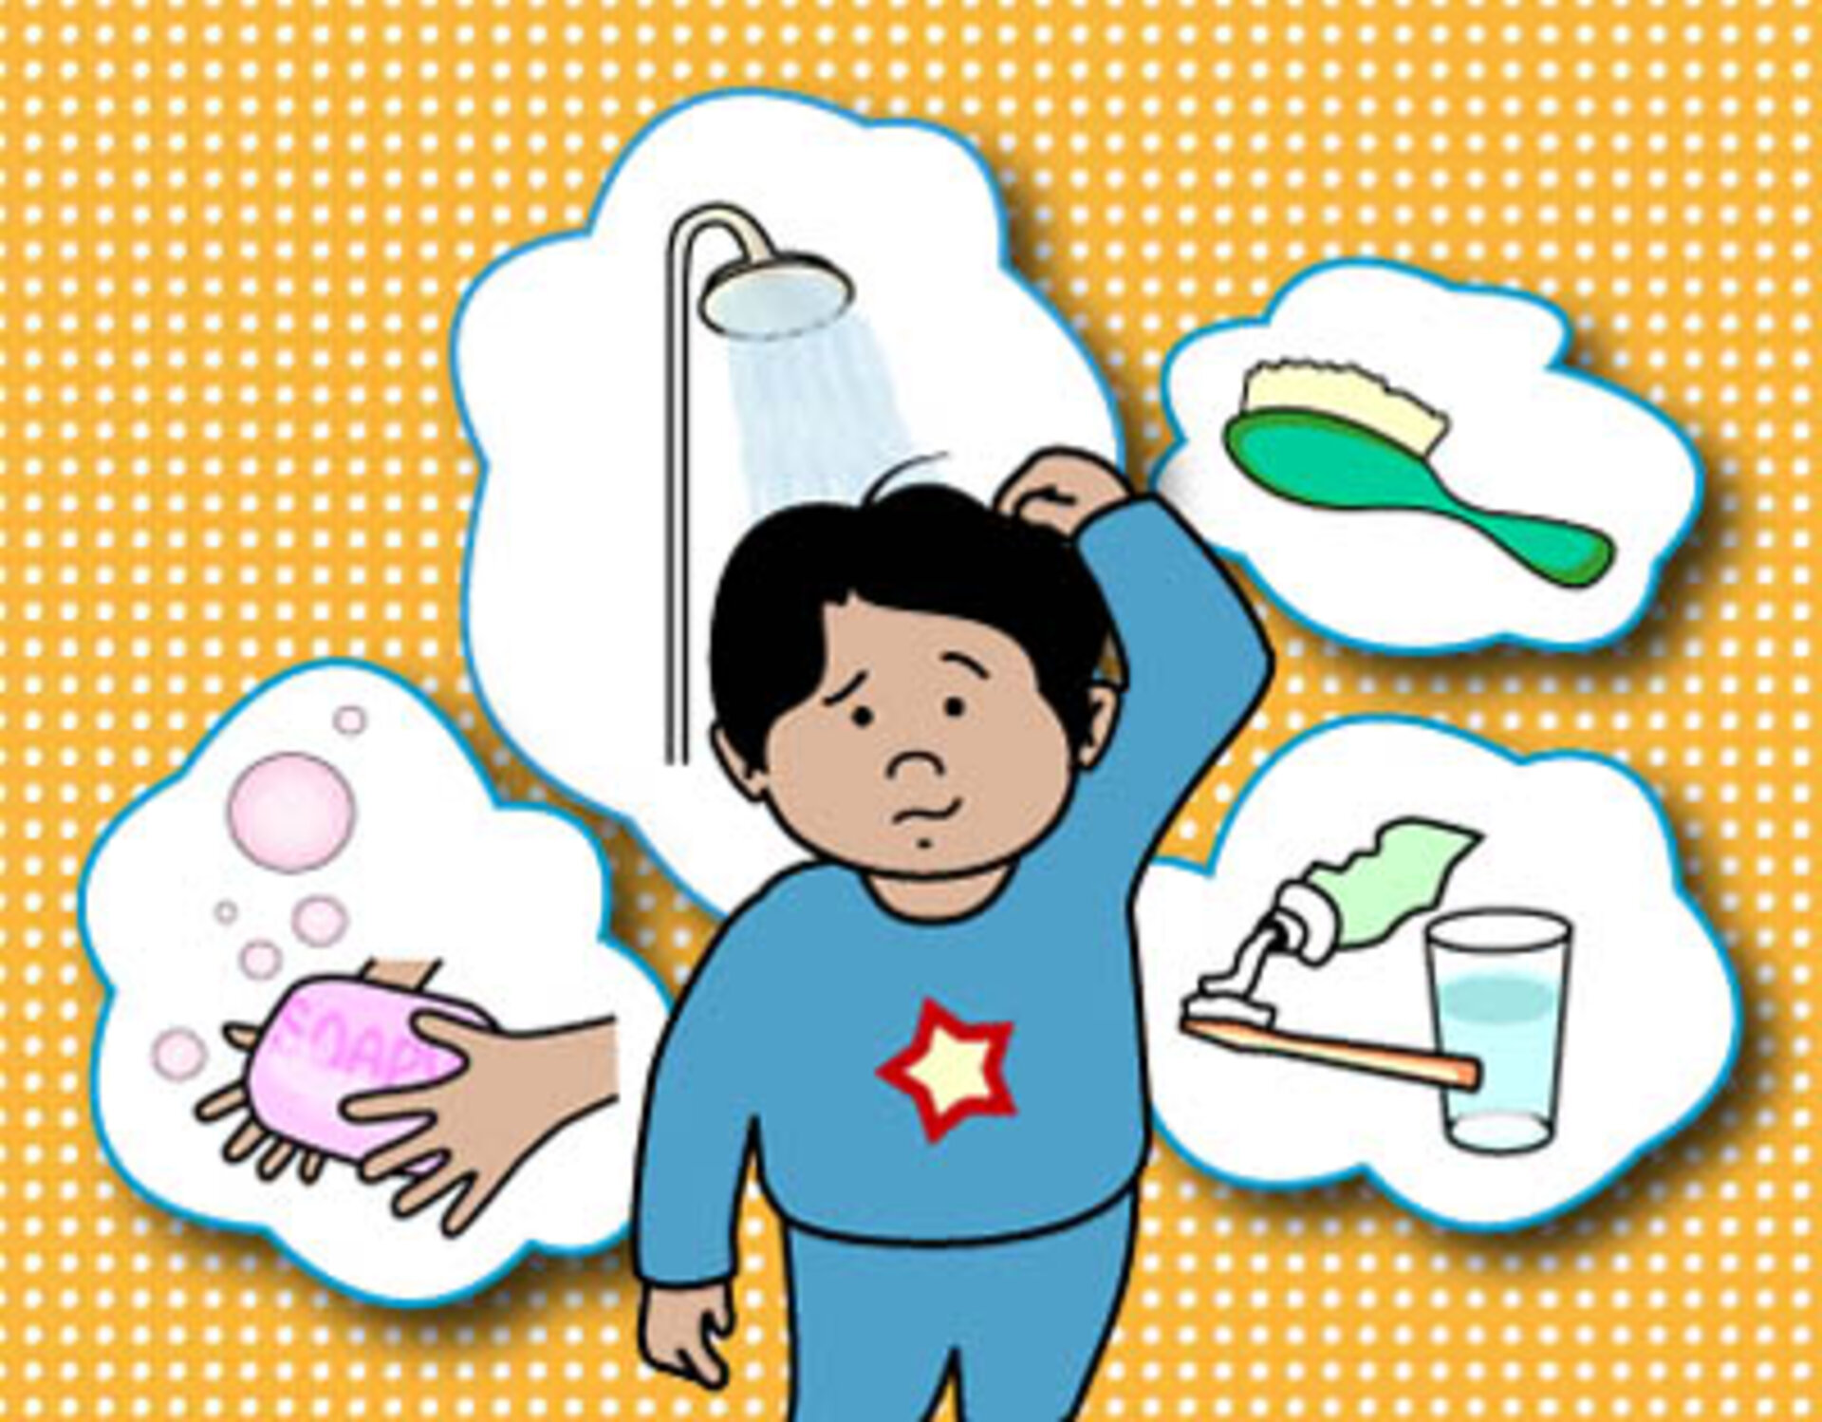
Personal cleanliness
Personal cleanliness( hygiene): is the practice of keeping yourself clean.

Slide 7
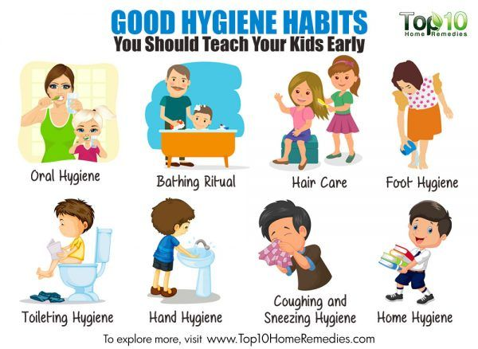
Personal hygiene

Slide 8
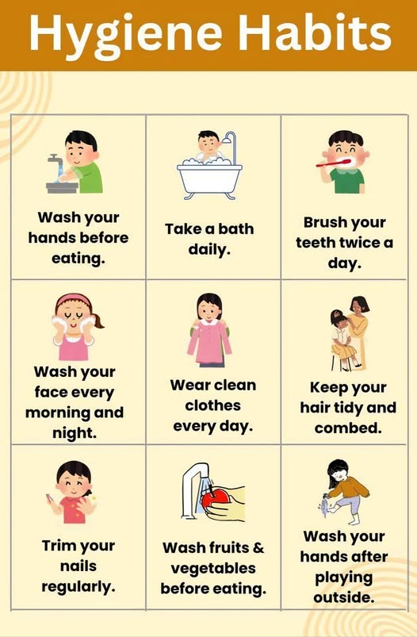

Slide 9
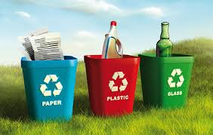
Enviromental cleanliness
This focuses on keeping the surrounding environment safe and clean.

Slide 10
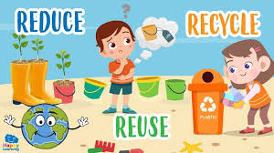
How We Can Keep Enviroment Clean?

Slide 11
How We Can Keep Enviroment Clean?
• Reduce, reuse, recycle
• Plant trees
• Use eco‑friendly products
• Save water and electricity

Slide 12
Main Causes of Pollution
• Plastic waste
• Air pollution from factories and cars
• Water contamination
• Deforestation

Slide 13
Why Does Cleanliness Important?
• Protects human health
• Keeps ecosystems alive
• Reduces pollution and waste
• Helps future generations

Slide 14
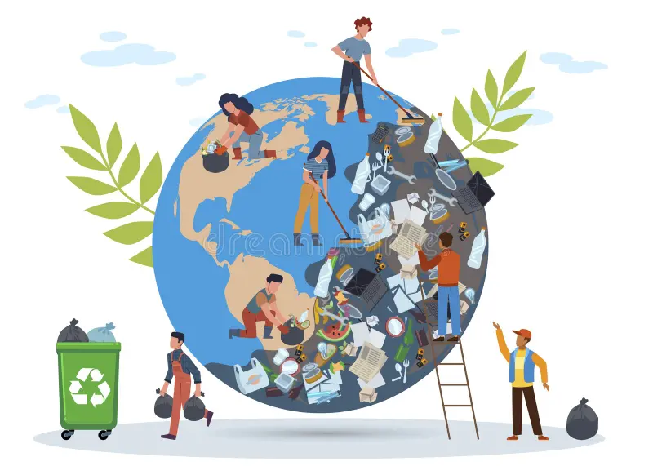
cleanliness

Slide 15
Conclusion
A clean Earth means a healthier and safer life.
Small actions from every person make a big difference.

Slide 16
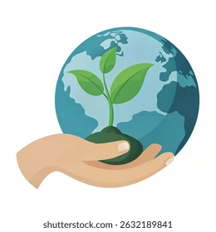
cleanliness

Slide 17
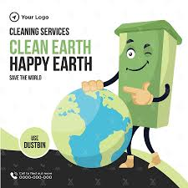
Thankyou for listening

