Slide 1
Third Months Project.
Qais alakhdar. 9th Grade ( B ).

Slide 2
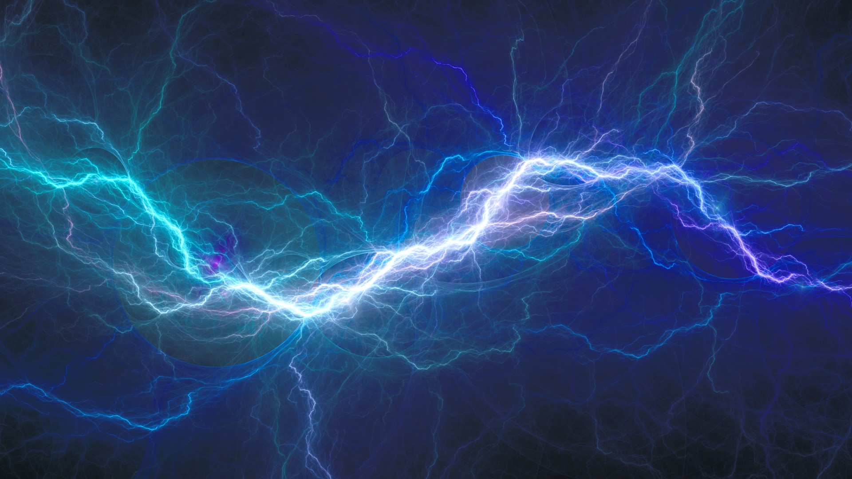
Electricity.

Slide 3
What electricity is:
Phenomenon: It's a fundamental part of nature associated with electric charge and its presence or motion.
Electron flow: In practical terms, it's the movement of electrons from one atom to another, creating an electric current.
Energy carrier: It's a secondary energy source, meaning it's produced from primary sources and can be converted into other forms of energy like light, heat, or mechanical motion.

Slide 4
How it's made:
Primary energy sources: Electricity is generated by converting primary sources such as fossil fuels, nuclear energy, or renewable sources like solar and wind power.
Mechanism: A common method is based on the principle that spinning a magnet inside a coil of copper wire generates an electrical current. In modern power plants, a force (from burning fuel, a turbine, etc.) is used to spin the magnets to produce large amounts of electricity.
Secondary source: Electricity itself is not a primary energy source; it is a way to transport and deliver energy from where it is generated to where it is used.

Slide 5
Types of electricity:
Static electricity: This is the buildup of electric charge on the surface of an object, like when you rub a balloon on your hair and it sticks to the wall.
Current electricity: This is the continuous flow of electric charge, such as the electricity that comes from a power plant or a battery.
It can be in the form of direct current (DC), which flows in one direction, or alternating current (AC), which reverses direction many times per second.

Slide 6
Its importance:
Versatility: It can be converted into many different forms of energy, making it extremely useful.
Essential for modern life: It powers our homes, offices, and industries, and is even used in our bodies to help our nervous system function.

