Slide 1
Speaking Exam.
Qais alakhdar. 9th Grade ( B ).

Slide 2
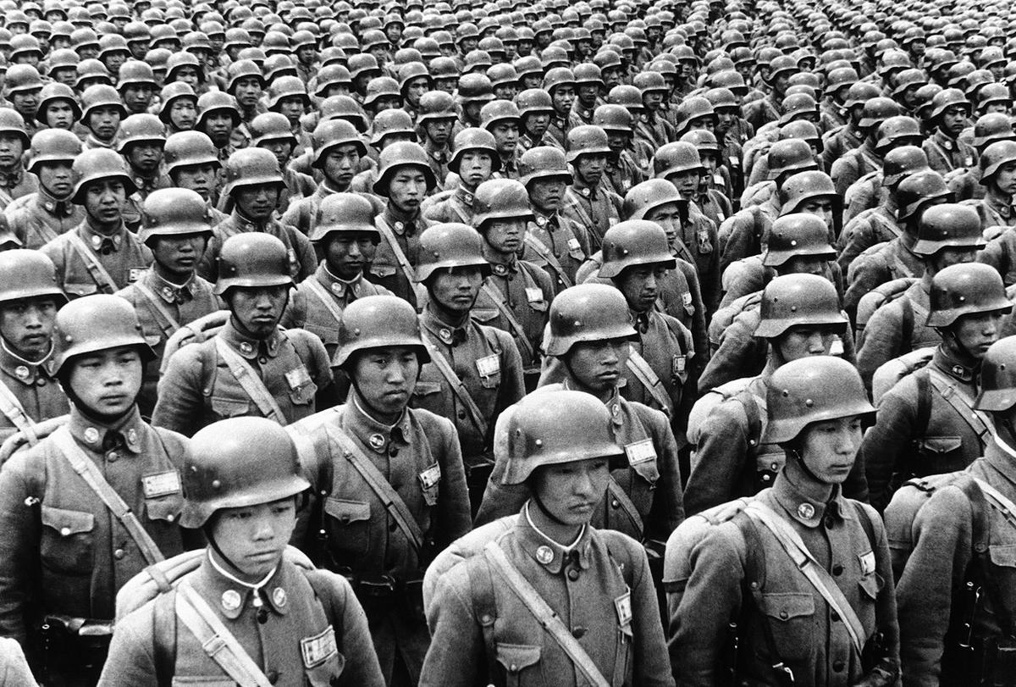
World War 2.

Slide 3
World War II (or the Second World War) was a global conflict that lasted from September 1, 1939, to September 2, 1945. It was the deadliest and largest war in history, involving more than 50 nations and an estimated 70 to 85 million deaths, the majority of whom were civilians.
Aftermath and Legacy:
World War II profoundly reshaped the world. The United Nations was established to foster international cooperation and prevent future conflicts. The war also led to the decline of European colonial empires and the rise of the United States and the Soviet Union as rival superpowers, setting the stage for the half-century Cold War. The conflict also exposed the horrors of genocide, most notably the Holocaust, in which six million Jews were systematically murdered by the Nazi regime.

Slide 4
Key Participants and Leaders:
The conflict pitted two major alliances against each other:
Allies: Primarily the United Kingdom, the United States (from 1941), the Soviet Union (from 1941), and China, along with France and other nations.
Axis Powers: Chiefly Nazi Germany, the Empire of Japan, and Fascist Italy.
Key leaders included Winston Churchill (UK), Franklin D. Roosevelt and Harry S. Truman (US), Joseph Stalin (USSR), and Chiang Kai-shek (China) on the Allied side, and Adolf Hitler (Germany), Benito Mussolini (Italy), and Hideki Tojo (Japan) on the Axis side.

Slide 5
Causes and Outbreak:
The causes of the war stemmed from unresolved tensions following World War I, the economic instability of the Great Depression, and the rise of aggressive, expansionist totalitarian regimes in Germany, Italy, and Japan.
Aggression and Appeasement: Imperial Japan invaded Manchuria in 1931 and China in 1937, while Italy invaded Ethiopia in 1935. Germany, under Adolf Hitler, began rearming in violation of the Treaty of Versailles and annexed Austria and parts of Czechoslovakia.
These aggressive moves were met with ineffective policies of appeasement from other world powers.
Invasion of Poland: The war officially began in Europe on September 1, 1939, when Germany invaded Poland. In response, Britain and France declared war on Germany two days later.

Slide 6
Major Events and Turning Points:
The war was fought on multiple fronts across the globe:
Early German Successes: Using "blitzkrieg" (lightning war) tactics, Germany quickly overran much of continental Europe.
After the fall of France in 1940, the war continued with the air campaign known as the Battle of Britain, where the Royal Air Force defeated the German Luftwaffe.
Expansion of the War: In June 1941, Germany invaded the Soviet Union (Operation Barbarossa), opening the extensive Eastern Front. In the Pacific, Japan's surprise attack on the U.S. naval base at Pearl Harbor in Hawaii on December 7, 1941, brought the United States into the conflict.
Turning Points: Key turning points included the Allied victory at the Battle of Midway in the Pacific (June 1942) and the Soviet victory at the Battle of Stalingrad on the Eastern Front (February 1943), which forced the Axis into strategic retreat.
Allied Offensives and the End of the War:
D-Day (June 6, 1944): The Western Allies launched a massive invasion of German-occupied France at Normandy.
Victory in Europe(V-E Day): Soviet and Western Allied forces converged on Berlin, leading to Hitler's suicide on April 30, 1945, and Germany's unconditional surrender on May 8, 1945.
Victory over Japan (V-J Day): The U.S. dropped atomic bombs on the Japanese cities of Hiroshima and Nagasaki in early August 1945. Japan formally surrendered on September 2, 1945, aboard the USS Missouri in Tokyo Bay, officially ending the war.

