Slide 1
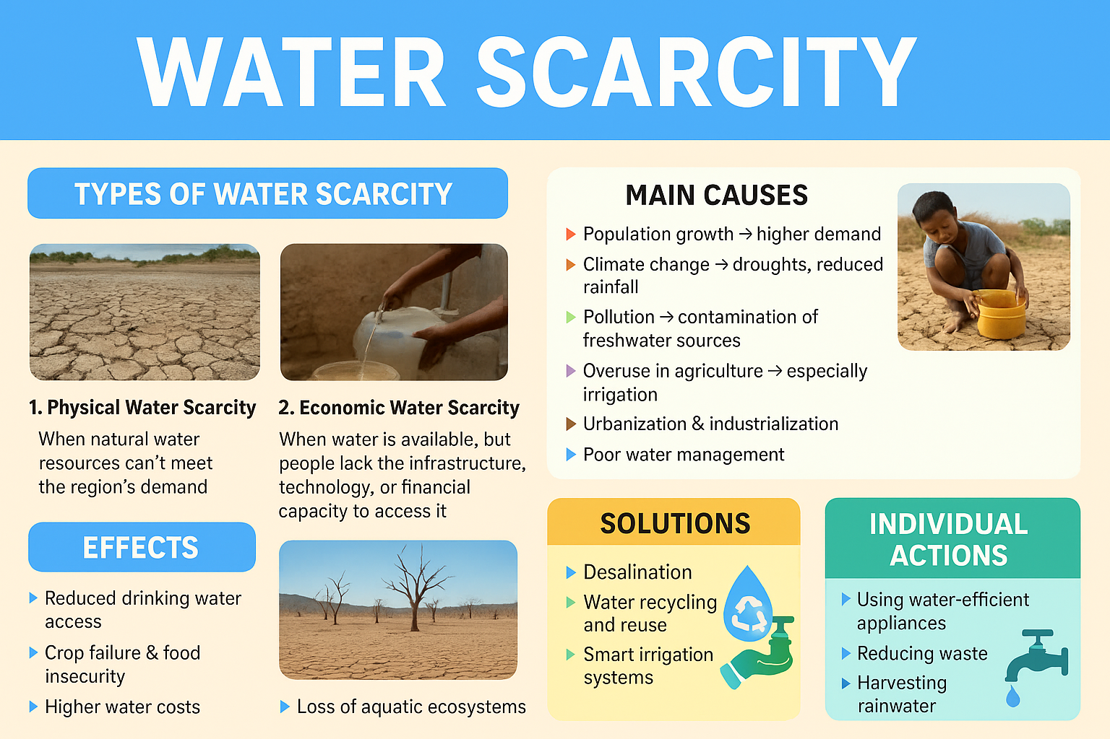

Slide 2
What is Water Scarcity?
Water scarcity means not having enough clean water for drinking, farming, and daily use.

Slide 3
Why Does Water Scarcity Happen?
• Climate change
• Pollution
• Wasting water
• Population growth

Slide 4
Effects of Water Scarcity
• Less drinking water
• Poor hygiene
• Health problems
• Affects farming and animals

Slide 5
Solutions
• Save water at home
• Fix leaks
• Use clean energy
• Protect rivers and lakes

Slide 6
How Kids Can Help
• Turn off the tap
• Take shorter showers
• Don't waste water
• Talk to others about saving water

Slide 7
Project Completed By
Enad Al Armouti
Grade Four "E"

