Slide 1
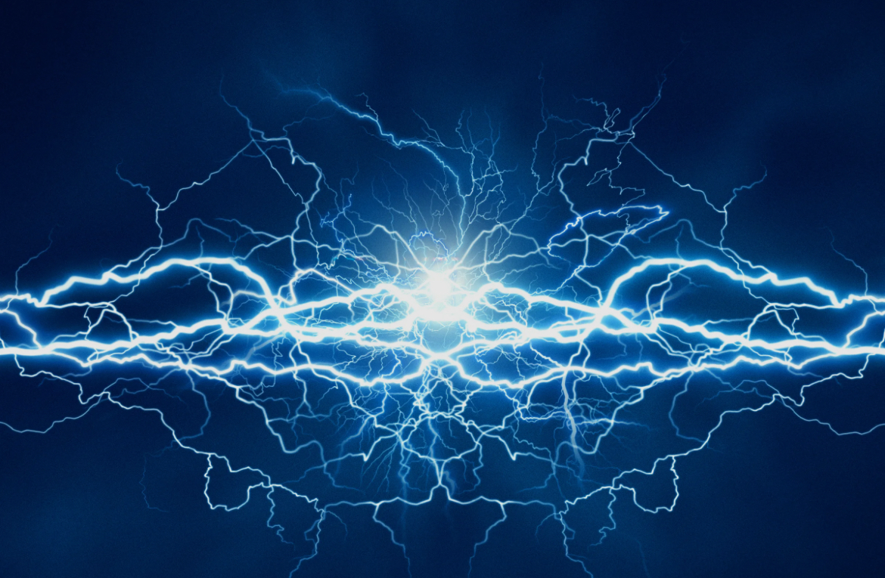
What is Electricity?
Electricity is a form of energy that comes from the movement of tiny particles called electrons. It powers almost everything around us, from lights and phones to computers and machines. Electricity can be made in many ways, like using sunlight, wind, water, or fuel.

Slide 2
How Electricity Works
Electricity moves through wires in a path called a circuit. When the circuit is complete, electricity can flow and power a device. Switches help control the flow, turning devices on or off. Batteries store electricity so we can use it anywhere.

Slide 3
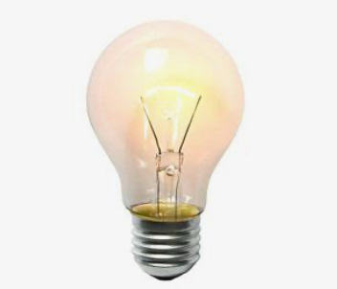
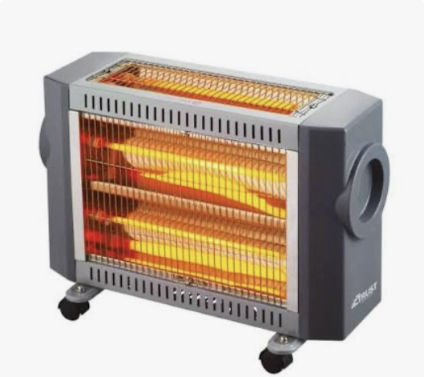
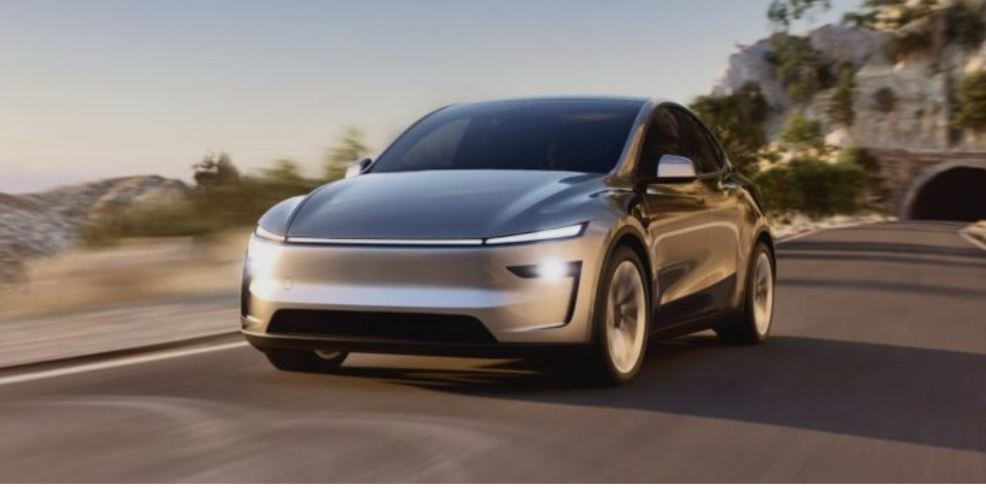
Uses of Electricity
Electricity is used for lighting, heating, cooling, cooking, and powering technology. Homes, schools, hospitals, and businesses depend on electricity every day. It also helps in transportation, like electric cars and trains.

Slide 4
Why Electricity is Important
Electricity makes life easier and safer. It helps us communicate, learn, work, and stay healthy. Without electricity, modern life would be very difficult, as almost every tool we use depends on it.

Slide 5

Staying Safe with Electricity
Electricity is useful but must be used carefully. Never touch exposed wires, keep devices away from water, and avoid overloading outlets. Using electricity safely protects us from danger.

Slide 6
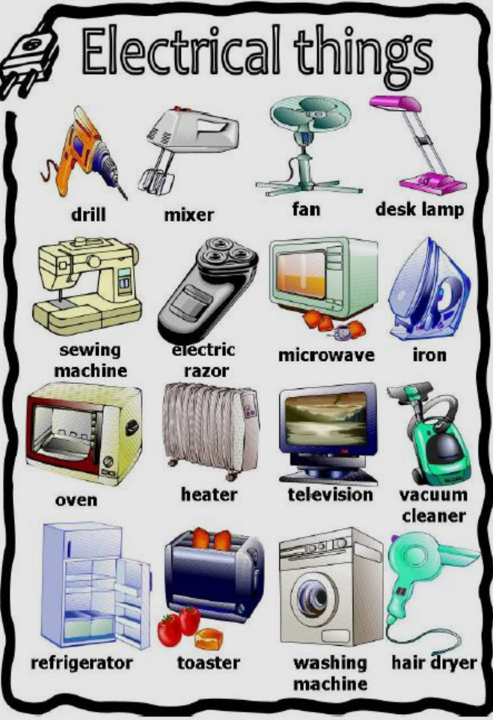
Some electric things:

