Slide 1
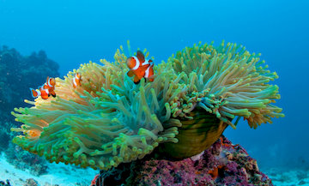
CLOWN FISH AND
SEA ANIMAL
BY:MOHAMMAD,JAD FAWAZ,ADAM,OMAR,YAZEED

Slide 2
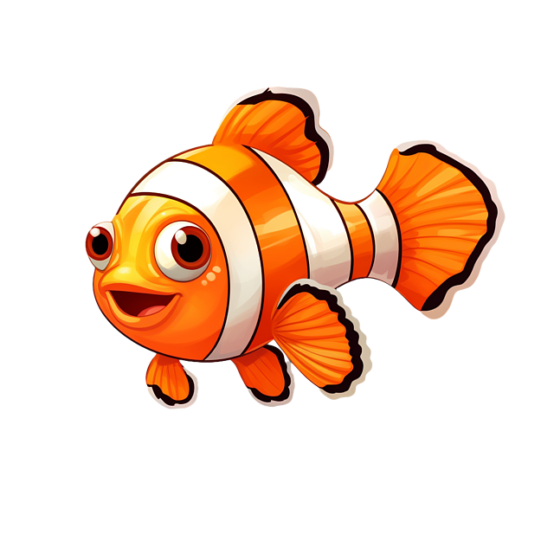
FACTS ABOUT CLOWNFISH
1:CLOWNFISH ARE SMALL,BRIGHTLY COLORED FISH THAT LIVE IN WARM OCEANS LIKE THE RED SEA AND PACIFIC.
2:THEY ARE GREAT SWIMMERS BUT STAY CLOSE TO THEIR HOME ANEMONE
3:THERE ARE ABOUT 30 SPECIES OF CLOWN FISH
4:THEY COMMUNICATE WITH POPPING AND CLICKING SOUNDS

Slide 3

FACTS ABOUS SEA ANEMONE
1:SEA ANEMONES LOOK LIKE UNDERWATER FLOWERS BUT ARE ACTUALLY ANIMALS
2:THEY HAVE STINGING TENTACLES THAT THEY USE TO CATCH SMALL FISH
3:THEY NORMALLY STING ANYTHING THAT TOUCHES THEM

Slide 4
HOW CLOWN FISH AND SEA ANEMONES HELP EACH OTHER
HOW CLOWNFISH HELPS THE ANEMONE
HOW THE ANEMONE HELPS THE CLOWNFISH
1:PROTECTION,CLOWNFISH CHASE AWAY FISH THAT TRY TO BITE OR EAT THE ANEMONE.
2:CLEANING,THEY EAT LEFT OVER FOOD AROUND THE ANEMONE
3:FRESH WATER FLOW,WHEN THEY SWIM AROUND,THEY MOVE THE WATER AND BRING MORE OXYGEN TO THE ANEMONE.
1:SAFE HOME,THE CLOWNFISH HIDES INSIDE THE TENTACLES WITHOUT GETTING STUNG
2:PROTECTION FROM PREDATORS,BIG FISH WONT COME CLOSE BEACAUSE THE TENTACLES STING
3:FOOD SCRAPS,THE ANEMONES LEFTOVER FOOD BECOMES FOOD FOR THE CLOWNFISH

Slide 5
SO NEXT TIME YOU SEE A CLOWNFISH SWIMMING AMONG ANEMONE TENTACLES,REMEMBER THE PERFECT BALANCE OF HELP AND PROTECTION THEY SHARE

