Slide 1
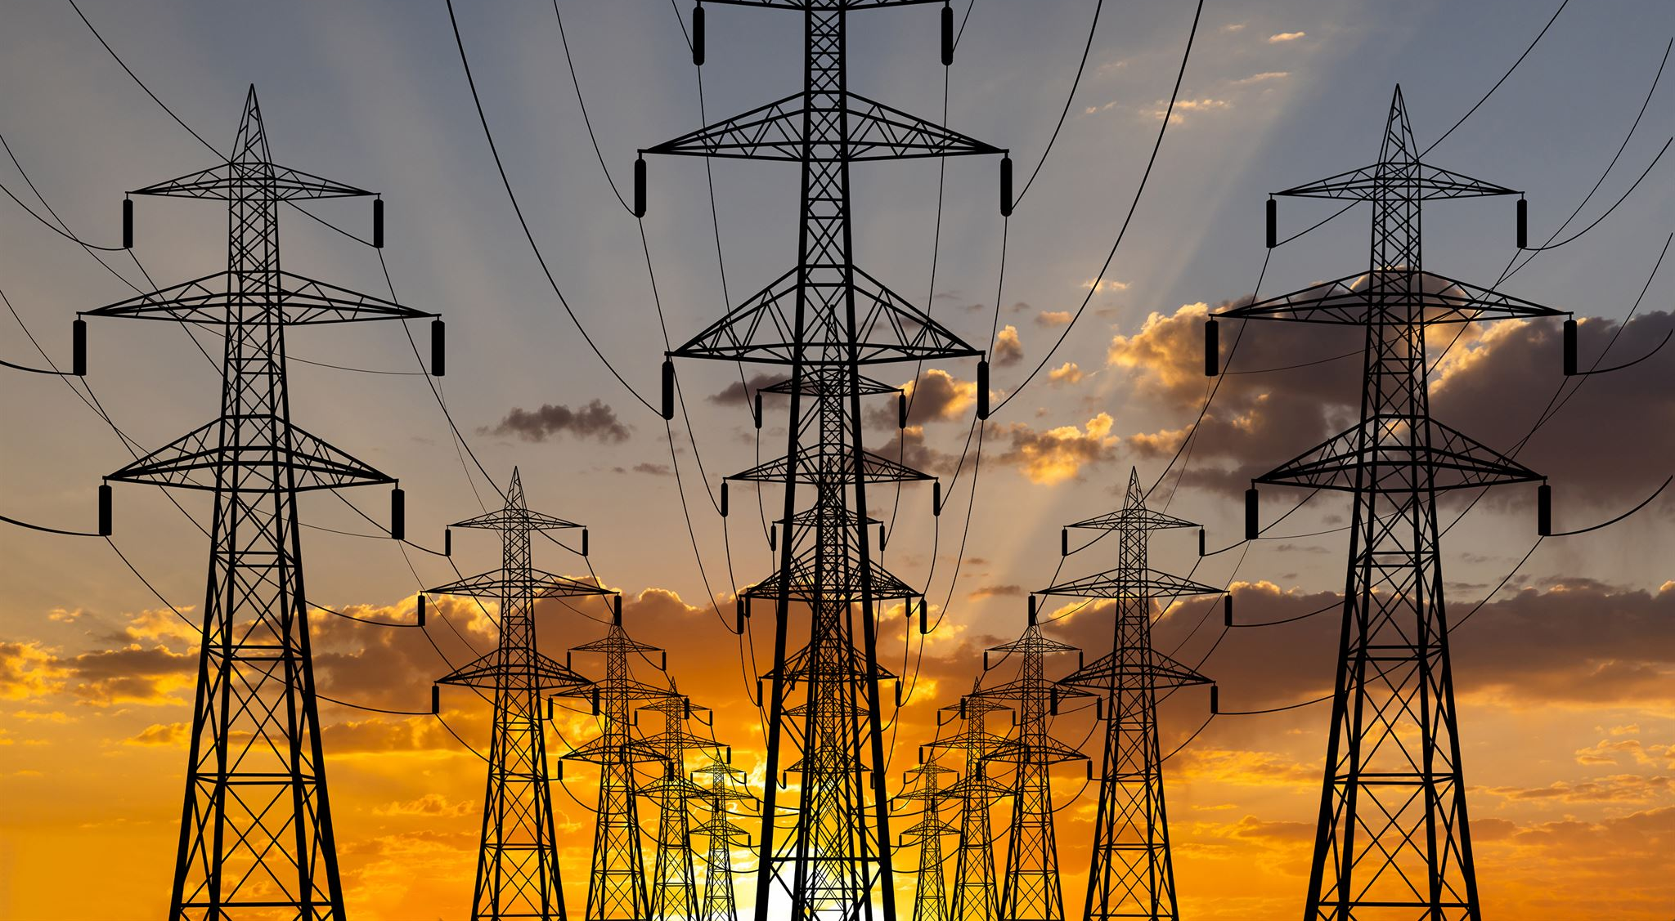
Electricity
By:ameer daraeen
Notes:
AI-generated content may be incorrect. ---

Slide 2
Introduction to Electricity
Notes:
Title Slide

Slide 3

Introduction to Electricity
Electricity is a fundamental science concept powering many devices and systems in daily life.
Presentation Overview
The presentation will cover types, sources, uses, and safety aspects of electricity in detail.
Notes:
This slide introduces the topic of electricity and includes the presenter's name. Electricity is a fundamental concept in science and technology, powering countless devices and systems that we rely on every day. The title slide sets the stage for understanding what electricity is, its types, sources, uses, and safety considerations. It emphasizes the importance of electricity in modern life and signals that the presentation will explore its essential aspects in detail. Including the presenter’s name personalizes the presentation and establishes ownership of the content.

Slide 4
Understanding Electricity
Notes:
What is Electricity?

Slide 5
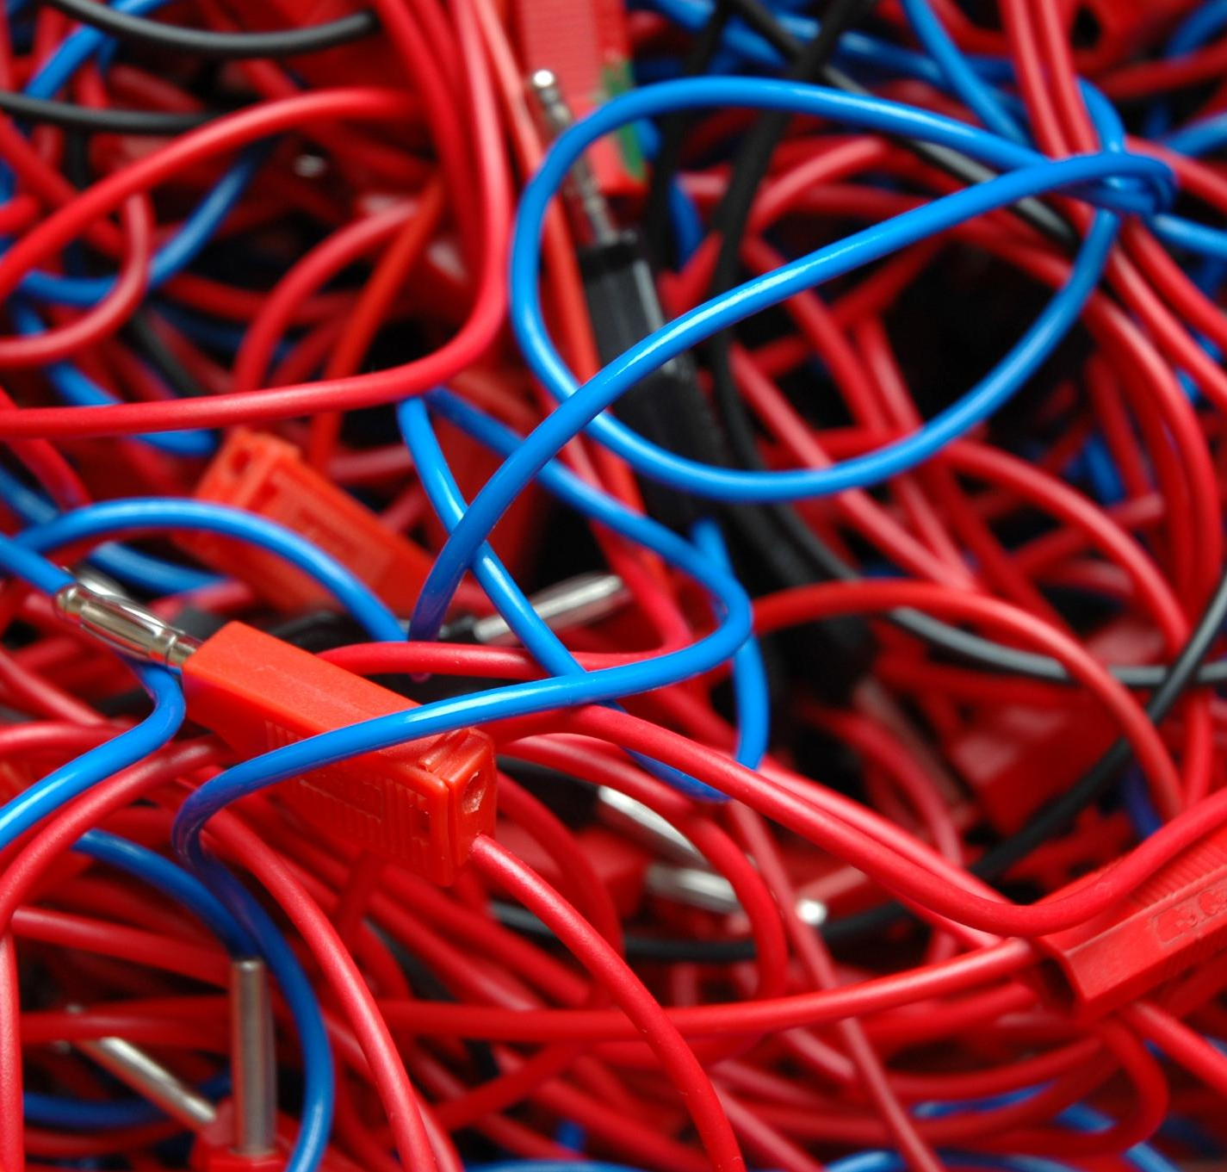
What is Electricity?
Electric Charge Flow
Electricity is the flow of electric charge through conductors like wires, enabling energy transfer.
Energy Conversion
Electricity converts into light, heat, and motion to power devices and systems in daily life.
Applications and Safety
Electricity is vital for homes, industries, and communication, requiring safe management and understanding.
Notes:
Electricity is the flow of electric charge, typically through a conductor such as a wire. It is a form of energy resulting from the movement of electrons and is essential for powering devices and systems in our daily lives. Electricity can be generated from various sources and converted into different forms of energy, such as light, heat, and motion. It plays a critical role in homes, industries, and technology, enabling communication, transportation, and countless conveniences. Understanding electricity involves learning about its properties, how it is produced, and how it behaves in circuits. This foundational knowledge is key to appreciating its applications and managing it safely.

Slide 6
Types of Electricity
Notes:
Static and Current Electricity

Slide 7
Static and Current Electricity
Static Electricity
Static electricity results from electric charges accumulating on material surfaces until discharged.
Current Electricity
Current electricity is the continuous flow of electric charge through a conductor powering devices.
Types of Current Electricity
Direct current flows in one direction, while alternating current periodically reverses direction.
Notes:
Electricity exists in two main forms: static electricity and current electricity. Static electricity occurs when electric charges build up on the surface of materials and remain stationary until discharged, often seen when rubbing certain objects together. Current electricity, on the other hand, involves the continuous flow of electric charge through a conductor, such as in electrical circuits powering devices. Current electricity is further divided into direct current (DC), where charges flow in one direction, and alternating current (AC), where the flow periodically reverses. Understanding these types helps explain how electricity behaves in different contexts and why certain applications require specific forms.

Slide 8
Sources of Electricity
Notes:
Renewable and Non-renewable Sources

Slide 9

Renewable and Non-renewable Sources
Renewable Energy Sources
Renewable energy sources include solar, wind, and hydro power that are sustainable and reduce environmental impact.
Non-renewable Energy Sources
Non-renewable sources like coal, natural gas, and oil are finite and pollute the environment significantly.
Impact on Environment
Energy source choices affect pollution levels, carbon footprint, and long-term environmental sustainability.
Energy Transition Importance
Switching to renewable energy is essential for reducing carbon emissions and ensuring energy security.
Notes:
Electricity can be generated from renewable and non-renewable sources. Renewable sources include solar energy, wind power, and hydroelectric energy, which are sustainable and environmentally friendly. These sources harness natural processes to produce electricity without depleting resources. Non-renewable sources, such as coal, natural gas, and oil, are finite and contribute to environmental pollution and greenhouse gas emissions. The choice of energy source impacts cost, availability, and environmental sustainability. Transitioning to renewable sources is crucial for reducing carbon footprints and ensuring long-term energy security. Understanding these sources helps in making informed decisions about energy use and conservation.

Slide 10
Applications of Electricity
Notes:
Uses of Electricity

Slide 11
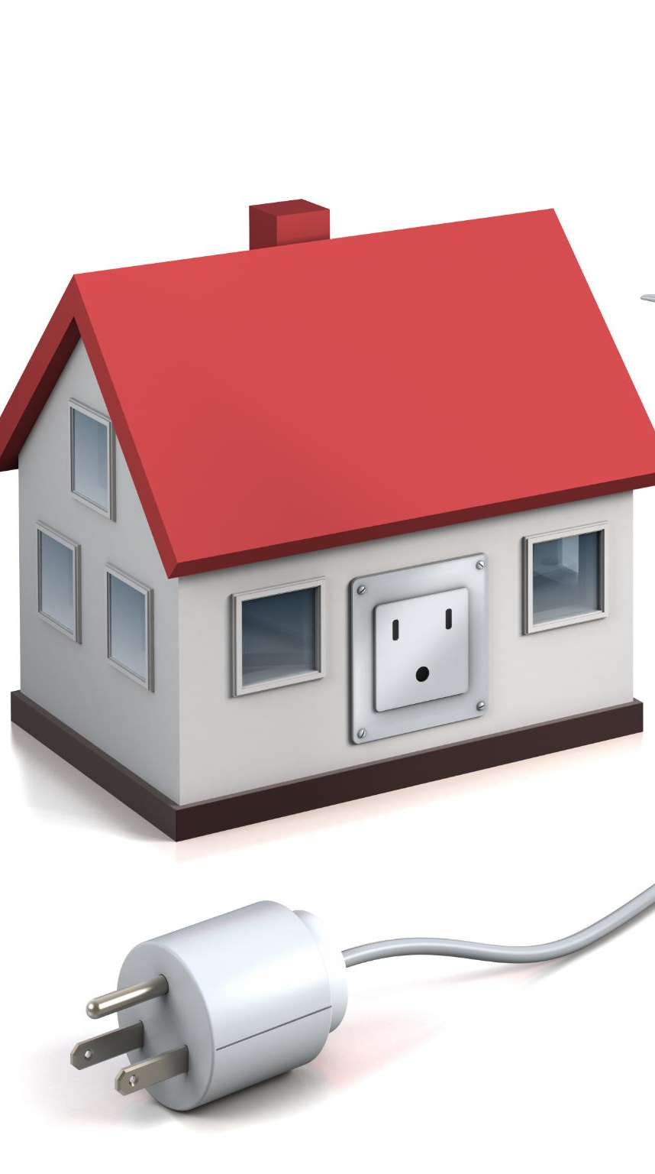
Uses of Electricity
Household Applications
Electricity powers lighting, heating, cooling, and essential appliances in homes, enhancing daily comfort and convenience.
Industrial and Automation Use
Electricity drives industrial machinery, production lines, and automation, increasing efficiency and mass production capabilities.
Transportation and Communication
Electricity powers transportation systems and communication networks, supporting connectivity and mobility worldwide.
Medical Equipment and Safety
Electricity is vital for medical devices and safety equipment, ensuring health services and emergency response.
Notes:
Electricity is indispensable in modern life, powering homes, industries, and technology. In households, it provides lighting, heating, cooling, and operates appliances such as refrigerators, televisions, and computers. In industries, electricity drives machinery, production lines, and automation systems, enabling mass production and efficiency. It also powers transportation systems, communication networks, and medical equipment, making it vital for health and safety. The versatility of electricity allows it to be converted into light, heat, and mechanical energy, supporting countless applications. Its widespread use underscores the need for reliable supply and efficient management to meet growing demands.

Slide 12
Safety and Precautions
Notes:
Safety Tips

Slide 13
Safety Tips
Avoid Water Contact
Never touch electrical devices or wires with wet hands to prevent electric shock risks.
Turn Off Unused Appliances
Always switch off appliances when not in use to avoid overheating and save energy.
Use Insulated Tools
Use insulated tools when working with electrical systems to reduce electrocution risk.
Prevent Overloading
Avoid socket overloading and ensure proper grounding for safe electrical installations.
Notes:
Electricity, while essential, can be dangerous if not handled properly. Safety measures include never touching electrical wires or devices with wet hands, as water conducts electricity and increases the risk of shock. Always turn off appliances when not in use to prevent overheating and reduce energy consumption. Use insulated tools when working with electrical systems to minimize the risk of electrocution. Avoid overloading sockets and ensure proper grounding of electrical installations. Regular maintenance and adherence to safety standards are critical for preventing accidents. Educating individuals about these precautions helps create a safer environment for using electricity.

