Slide 1
Electrical Inventions
By: Abdulhaleem Alsaaydeh
9B

Slide 2
Electrical inventions
Electrical inventions have not just brightened our nights and energized our days but have revolutionized how we perceive and interact with the world.
From the initial spark of harnessing electricity to the dazzling array of technological marvels that define our digital age, we owe our modern civilization to the genius of electrical innovation.

Slide 3
Who invented electricity, and in which year?
The first person to coin the term “electricity” was a British scientist, William Gilbert, who studied the effects of electricity and magnetism on amber.
The word electricity is derived from Gilbert’s new Latin, electricus, meaning “of amber” or “like amber.” But some of the most important work was conducted by Benjamin Franklin in the 18th Century.

Slide 4
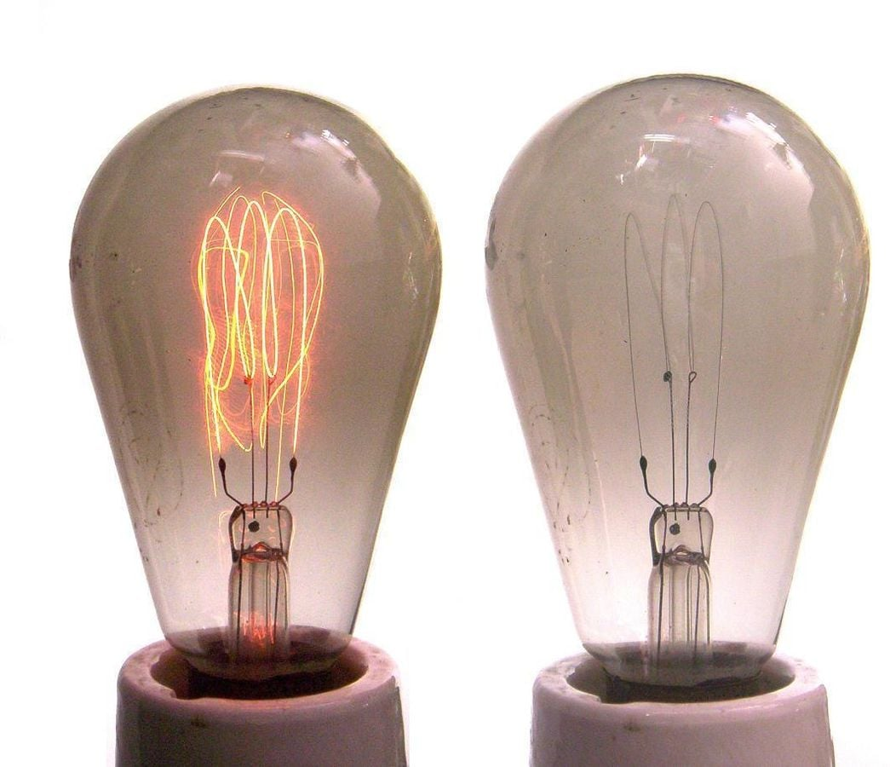
Who invented the light bulb?
In 1879, through trial and error, Thomas Edison hit on a combination of thin carbon filament design with better vacuums that were just right. This made him the first person to solve light bulb design’s scientific and commercial challenges.

Slide 5
But which electrical inventions have been the most significant for our species? Let’s find out some of hem.

Slide 6

1. The humble lightbulb was revolutionary
The invention of the lightbulb was one of the most significant developments in human history. Almost overnight, it enabled societies worldwide to extend the length of a working day and practically “banished the night.
Its development also helped usher in the electronic age and made streets worldwide much safer at night.

Slide 7
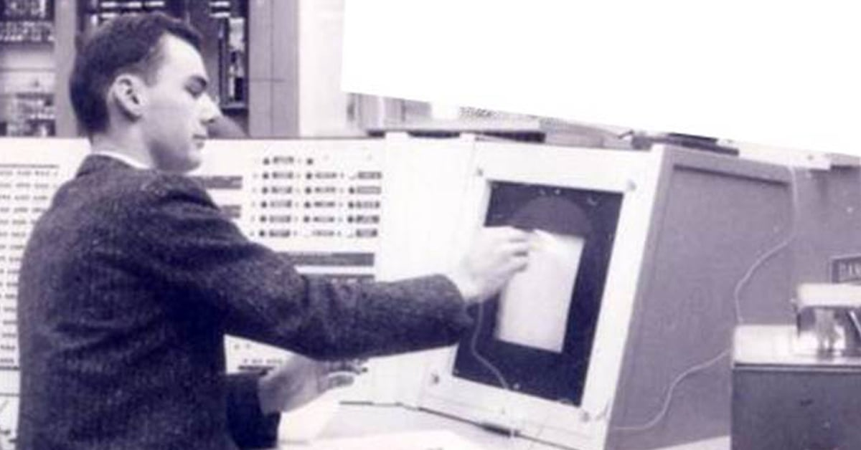
2. The Internet has changed the world forever
The Internet is hands down, one of the most important electrical inventions of all time. It has changed the world and how we live beyond all recognition before its development.
The way we work, access information, shop, and communicate have all been completely changed thanks to the net

Slide 8
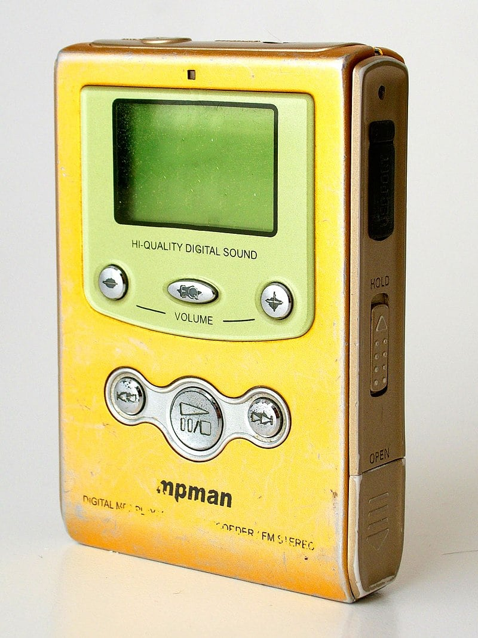
3. MP3 players changed how we all listen to music
MP3 players changed how millions of people would listen to music and other audio forever. Their development would, practically overnight, spell the end of older media forms like cassette tapes and CDs.

Slide 9
4. Digital cameras are another important invention
The concept of “filmless cameras” is nothing new, with early developments being made in the 1960s. But by 1975, one of the first electronic “digital” cameras was developed by Eastman Kodak’s.
Initially intended for scientific and later military purposes, it wasn’t until the mid to late 90s that digital cameras became common among consumers.
Today most new cameras are digital, and almost every smartphone has at least one as standard.

Slide 10
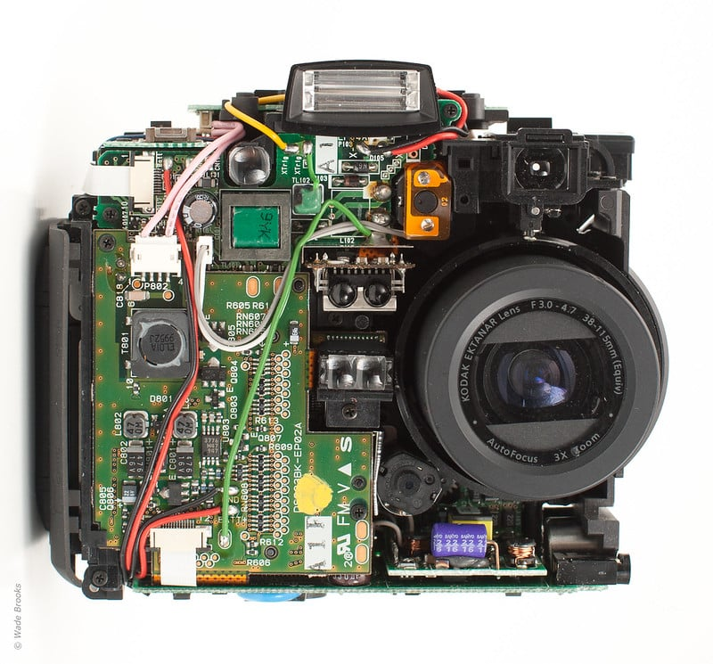

Slide 11
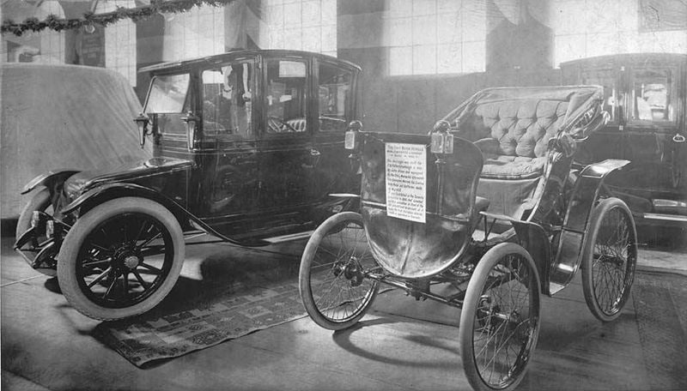
5. Electric Cars were groundbreaking
You might be surprised to hear that electric cars have a reasonably long history. Some of the earliest models were developed in the late 1880s, but the development of internal combustion-engined alternatives soon foreshadowed them.

Slide 12
6. The electric motor changed many industries forever
Electrical motors are another of the most important electronic inventions ever. By converting electrical energy into mechanical energy, electric motors have changed the face of many industries forever.

Slide 13
The invention of electricity opened up an entirely new expanse of invention, which many inventors were only too happy to explore.
Thank you

