Slide 1
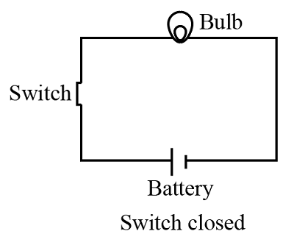



What is an Electric Circuit?
A closed loop through which electricity can flow from a power source, through conductors, to a load and back again.
Path for electric current
Powers electrical devices
Must be complete to work

Slide 2
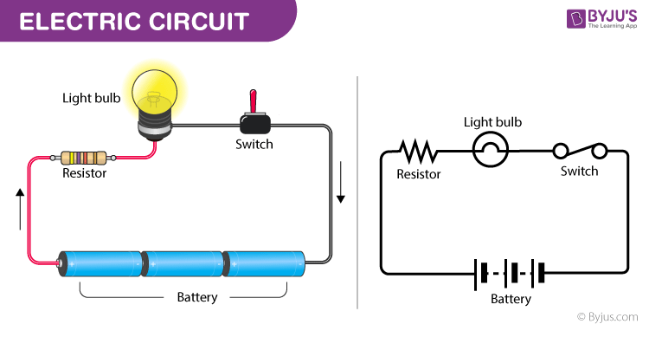



Basic Components of an Electric Circuit
Power Source
Conductors
Provides electrical energy (battery, generator)
Paths for electricity to flow (wires)
Load
Switch
Uses electrical energy (bulb, motor)
Controls current flow (on/off)

Slide 3



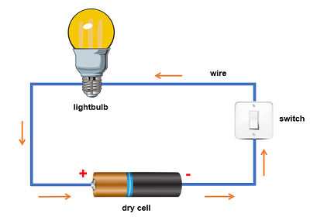
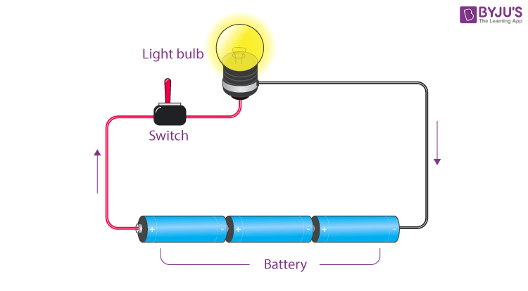
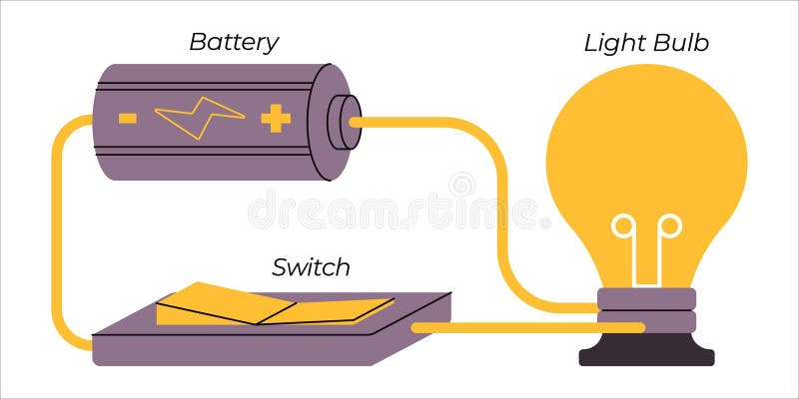









Types of Electric Circuits (Part 1)
Open Circuit
Closed Circuit
Short Circuit
Incomplete path
Complete path
Unintended path
No current flows
Current flows
Very low resistance
Device won't work
Device operates
Can cause damage

Slide 4

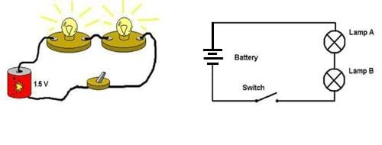
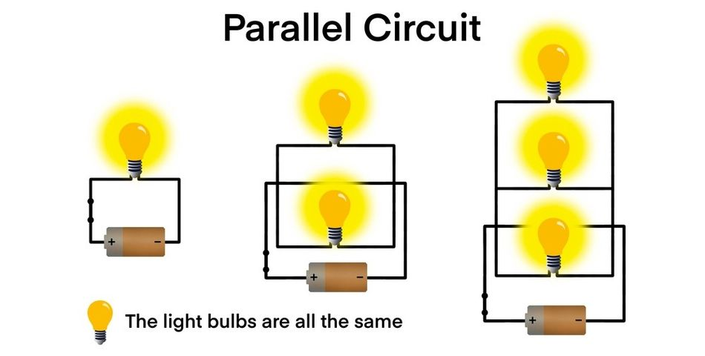






Types of Electric Circuits (Part 2)
Series Circuit
Parallel Circuit
Single path for current
Multiple paths for current
Resistance adds up
Total resistance decreases
One break stops all
One break doesn't affect others
Same current through all
Same voltage across all

Slide 5

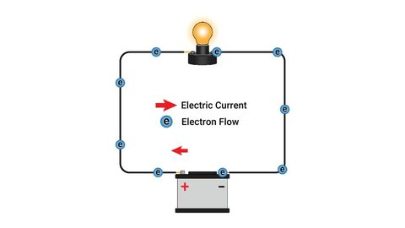





How Electric Circuits Work
Electron Flow
Negative to positive
Creates current
Driven by voltage
Through conductors
Energy Conversion
Electrical → Light
Electrical → Heat
Electrons flow from the negative terminal of the power source, through the circuit components, and back to the positive terminal, converting electrical energy into other forms.
Electrical → Motion
Electrical → Sound

Slide 6
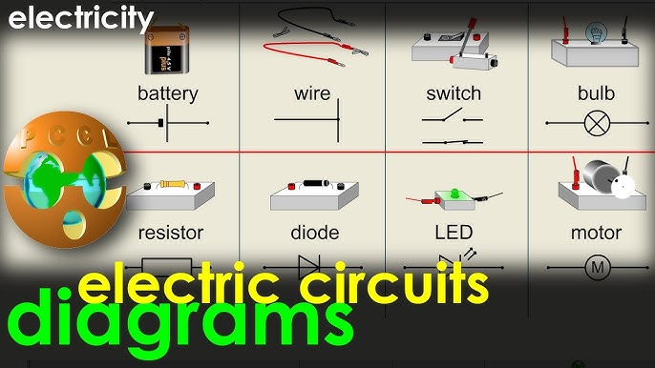





Simple Circuit Diagram
Common Circuit Symbols
Battery / Power Source
Wire / Conductor
Light Bulb / Load
Switch
Resistor
Motor
Circuit diagrams use standardized symbols to represent components, making it easier to understand and design electrical systems.
Diode
Ground

