Slide 1
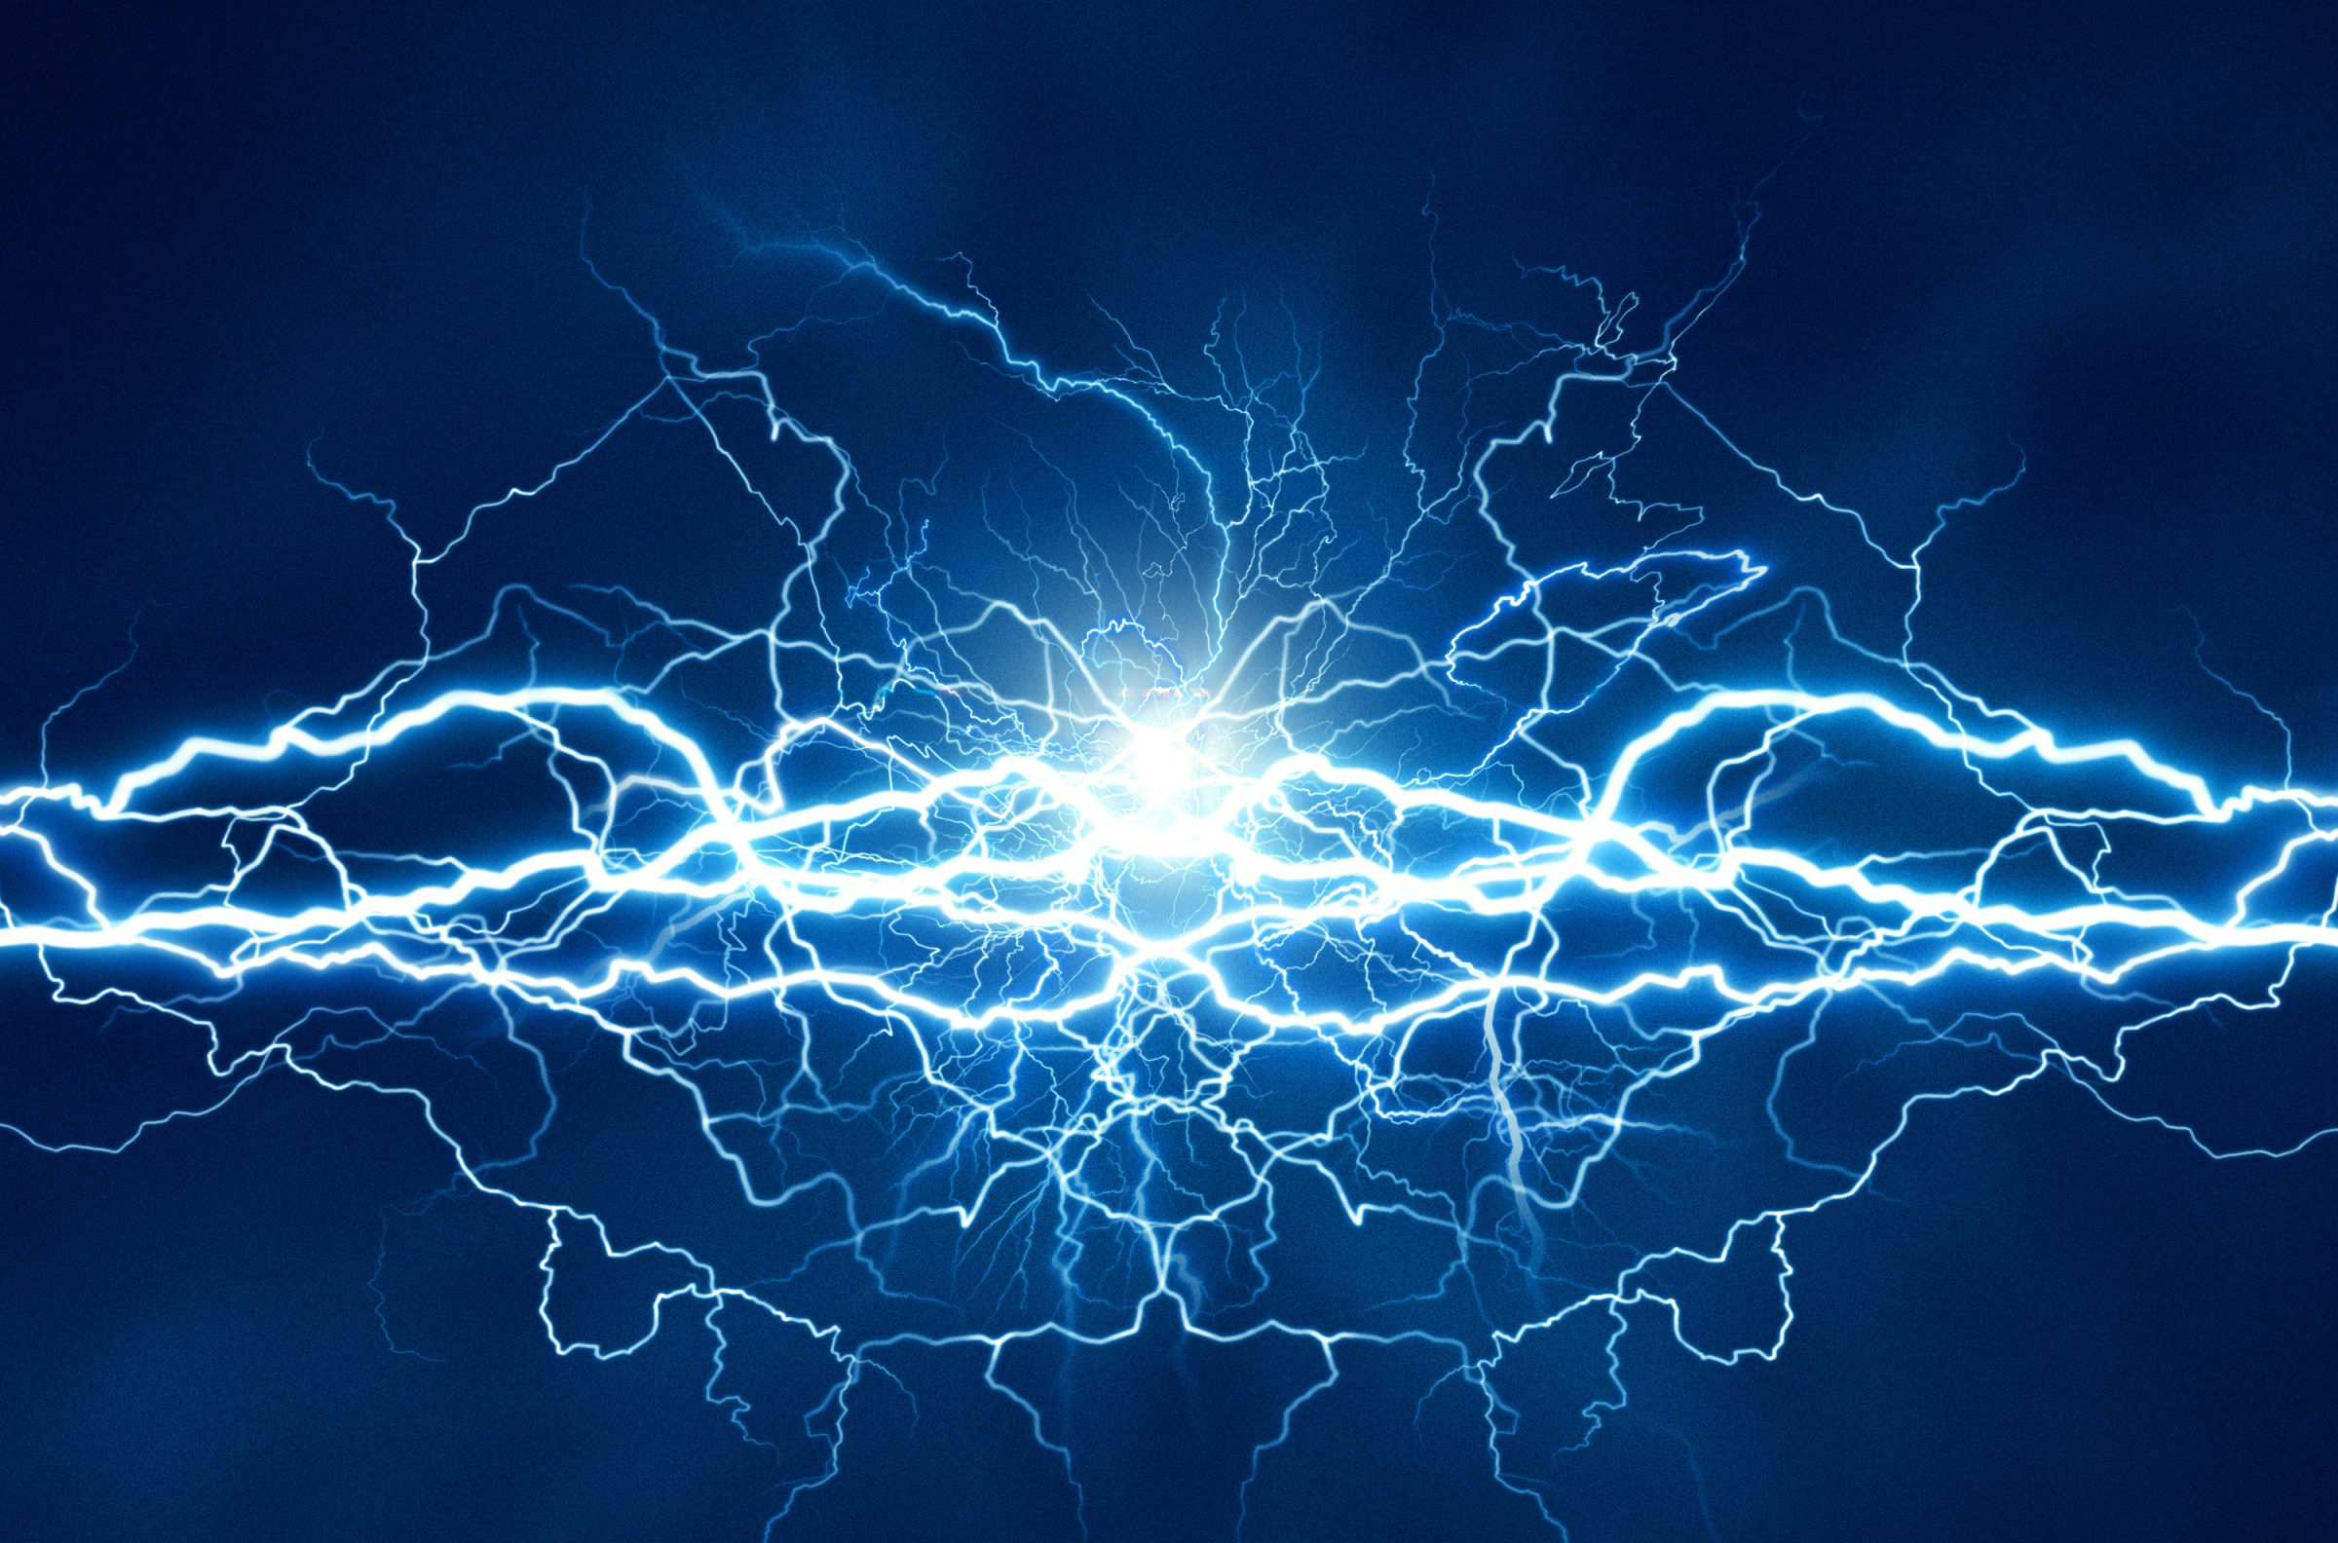
Title: Electricity
Subtitle: What It Is and Why It matters
Made by: Muthanna AL-Jazzazi

Slide 2
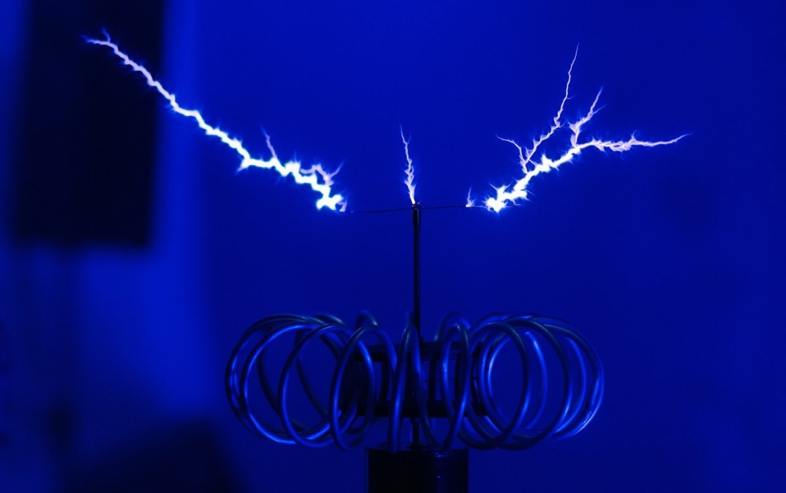
What Is Electricity?
Electricity is a form of energy that moves through wires and powers many devices. It can come from natural sources like the sun, wind, and water.

Slide 3
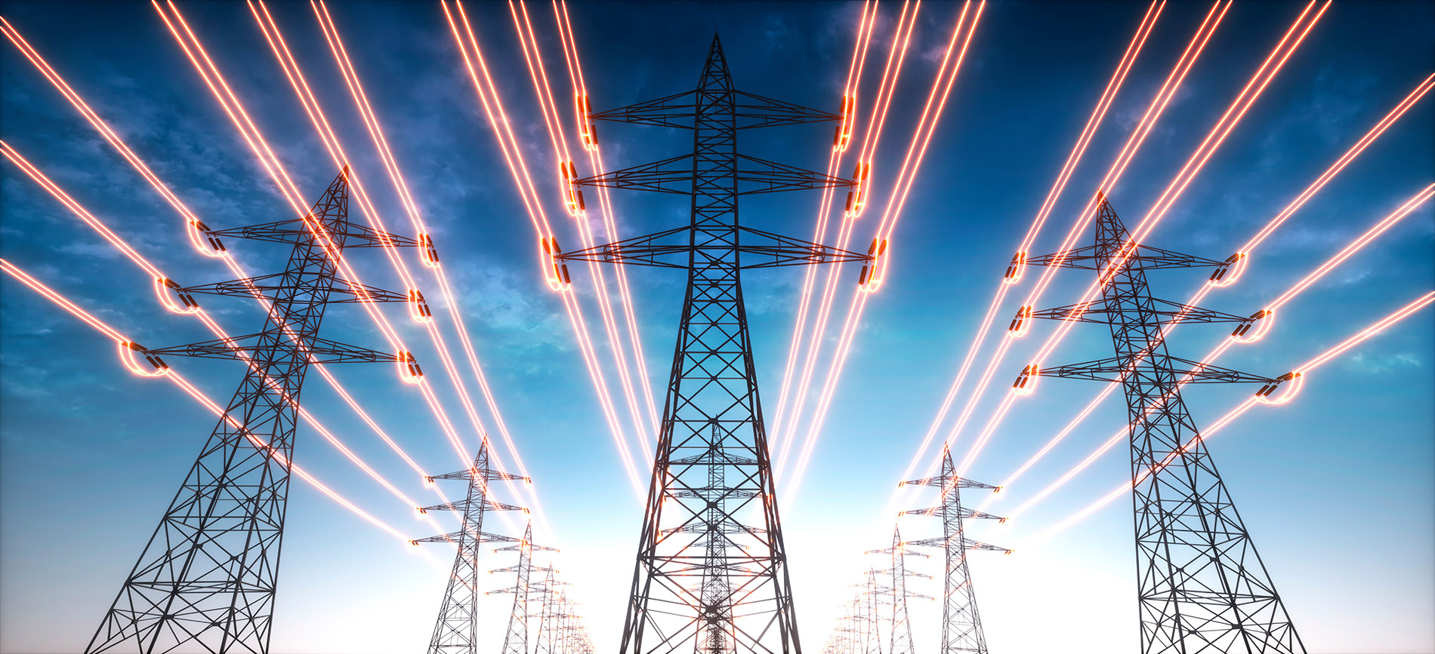
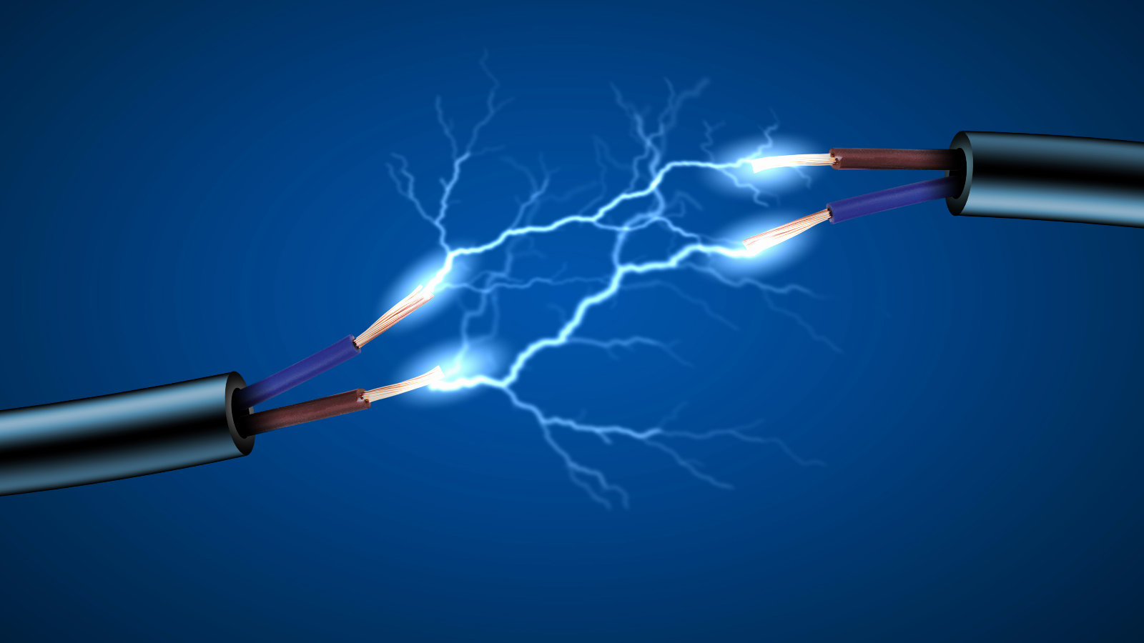
Types of Electricity:
Static Electricity: Builds up when objects rub together.
Current Electricity: Moves through wires to power devices.
AC (Alternating Current): Used in homes and buildings.
DC (Direct Current): Used in batteries and electronics.

Slide 4
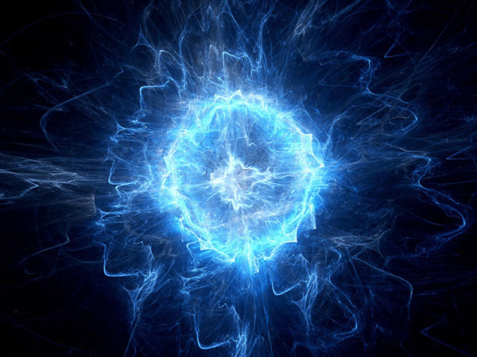
How Electricity Works:
Electricity flows in a circuit. A simple circuit includes:
Power source
Wires
Switch
Load (like a lamp)
Voltage pushes electricity, and watts measure how much power a device uses.

Slide 5
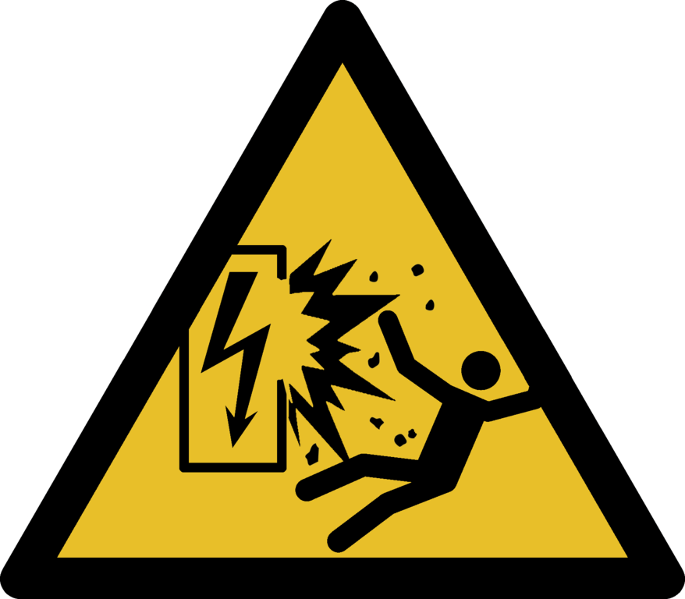
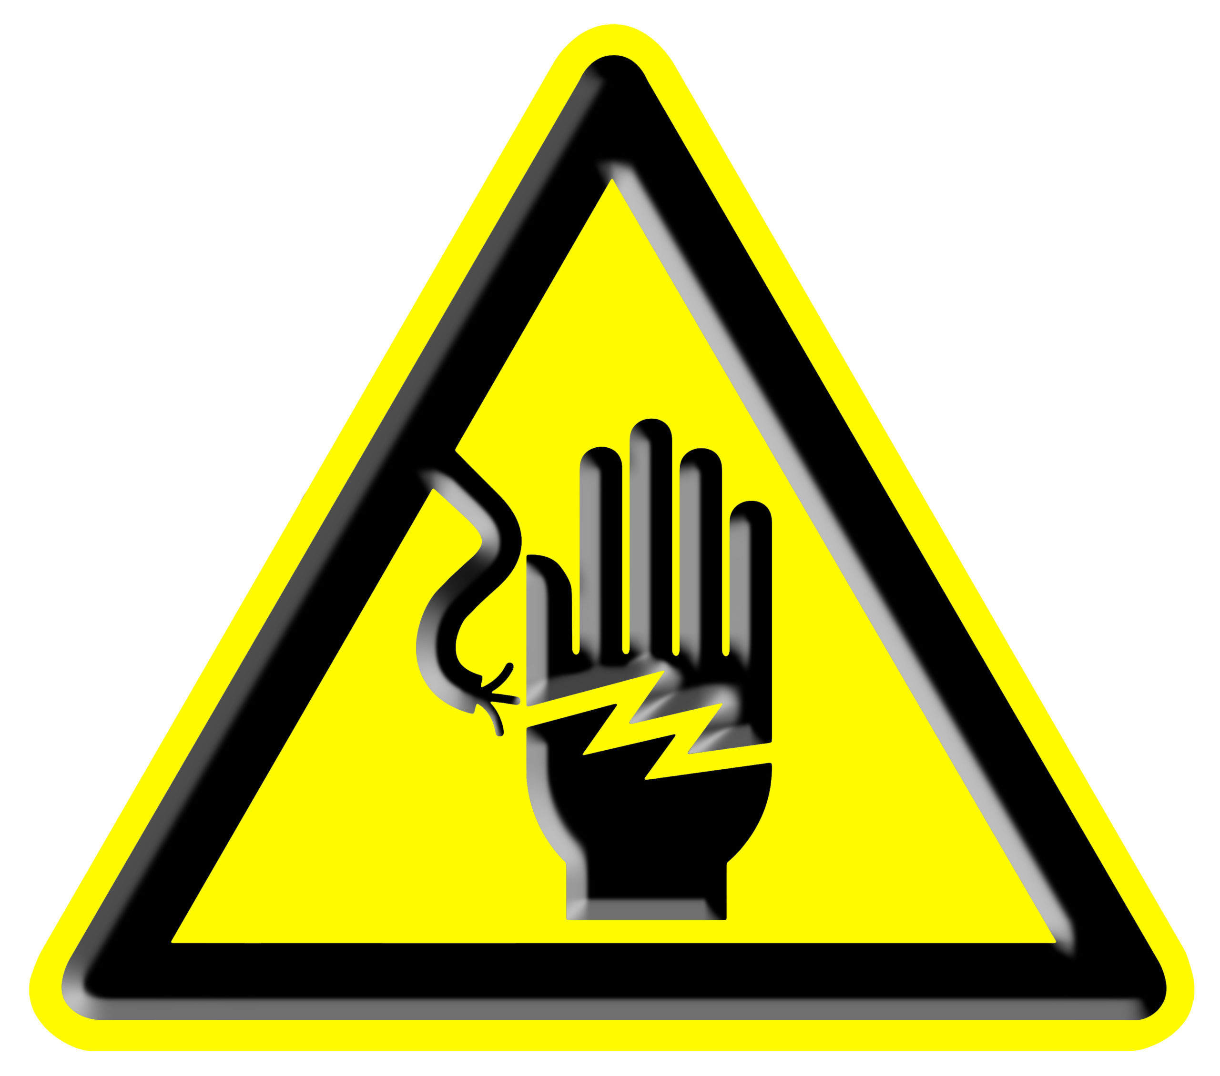
Uses & Safety
Uses:
Lighting
Heating and cooling
Charging devices
Running appliances
Safety Tips:
Keep water away from electrical devices.
Do not touch exposed wires.
Do not overload power socket

Slide 6
Conductors & Insulators
Conductors: Materials that allow electricity to pass easily (like: metals). Insulators: Materials that stop electricity (like: plastic, rubber, wood). These materials help keep electrical systems safe.

Slide 7
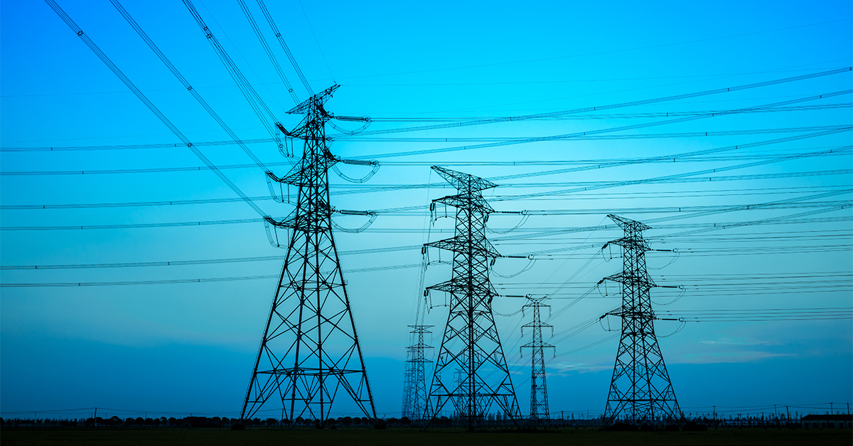
The Power Grid
The power grid is the big system that delivers electricity to homes, schools, and buildings. It includes:
Power plants
Transmission lines
Transformer stations
Distribution networks
It makes sure electricity reaches us safely and reliably.

Slide 8
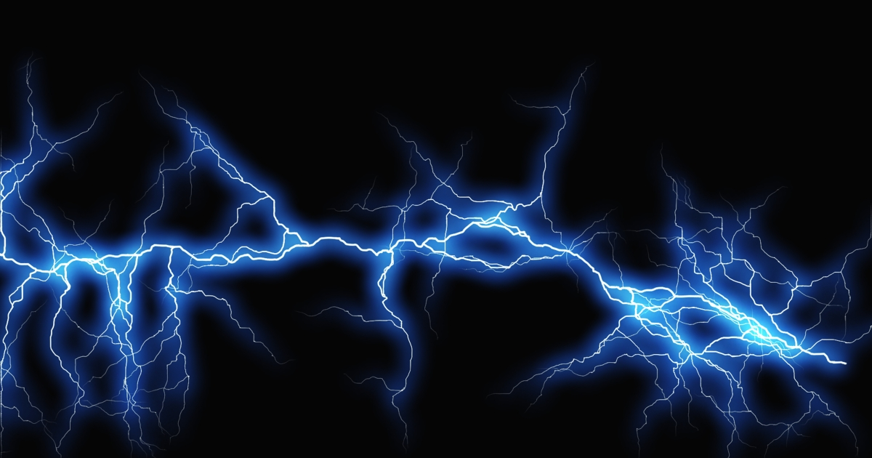
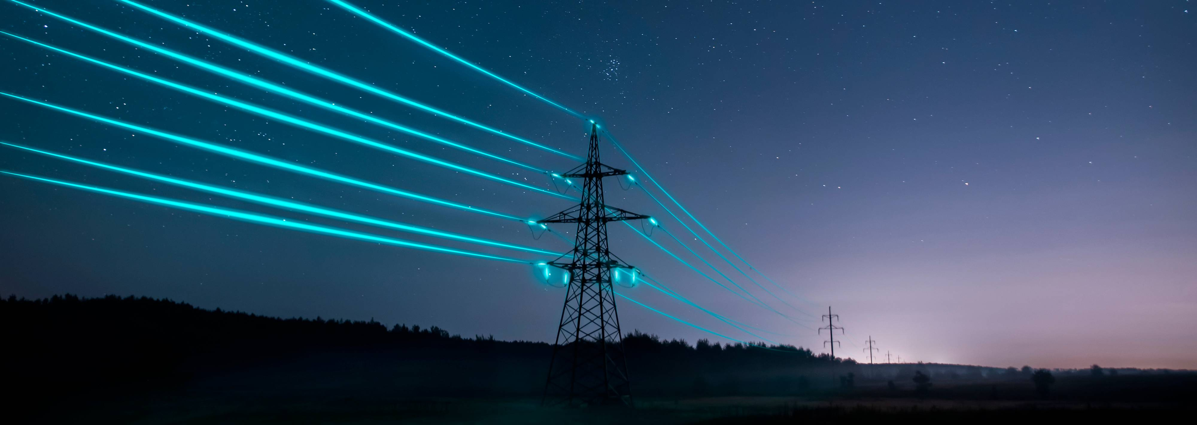
Thank you all For Listining

