Slide 1
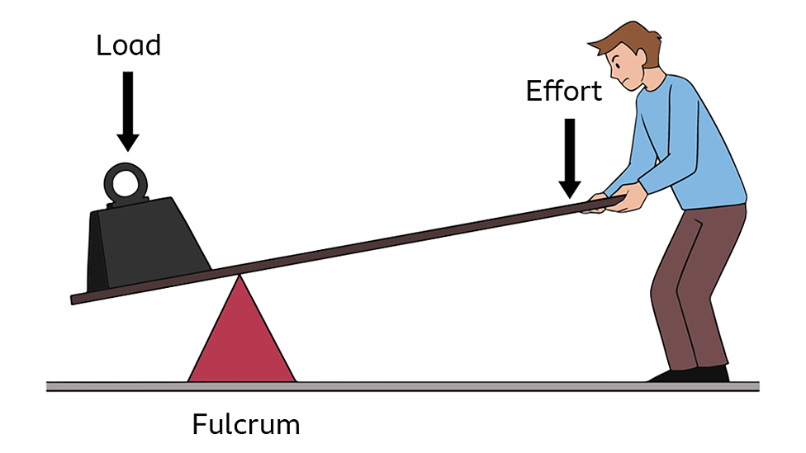
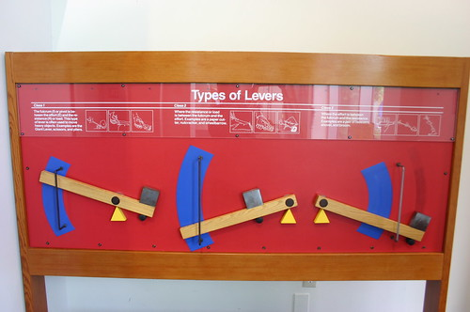
Levers in Physic
-Understanding how simple machines make work easier
-Focus on lever types, components, and real-world applications
By Ahmad ALQudah

Slide 2
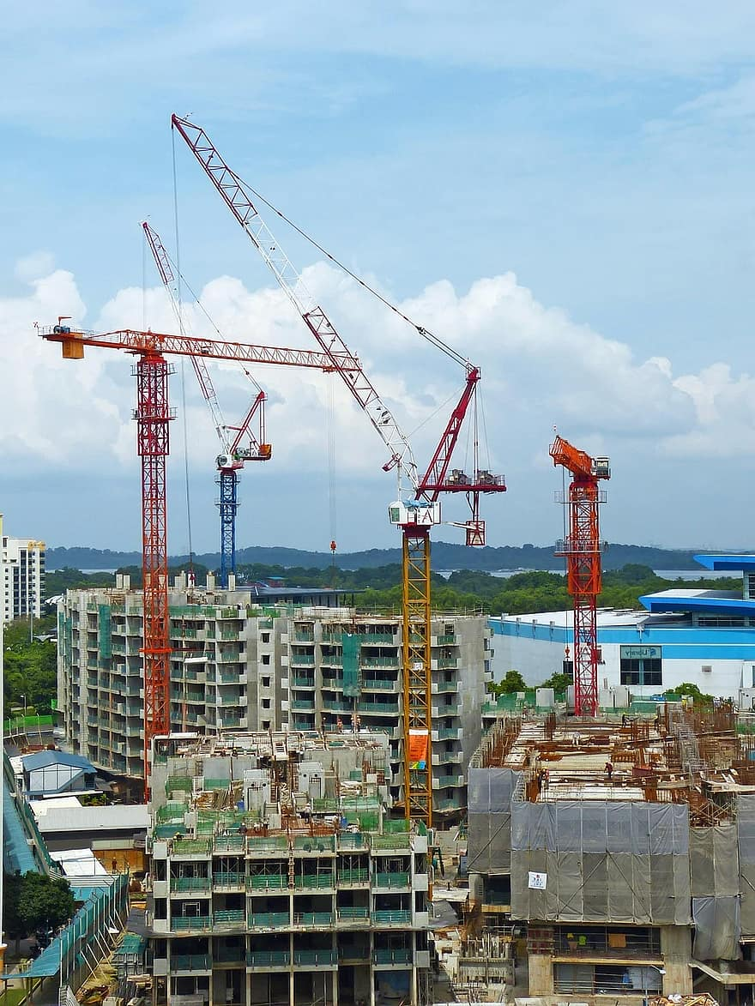
What Is a Lever ?
-A lever is a simple machine that helps lift or move loads
-Consists of a rigid bar pivoting around a point
-Reduces the amount of force needed to do work
-Used in everyday tools and machines

Slide 3
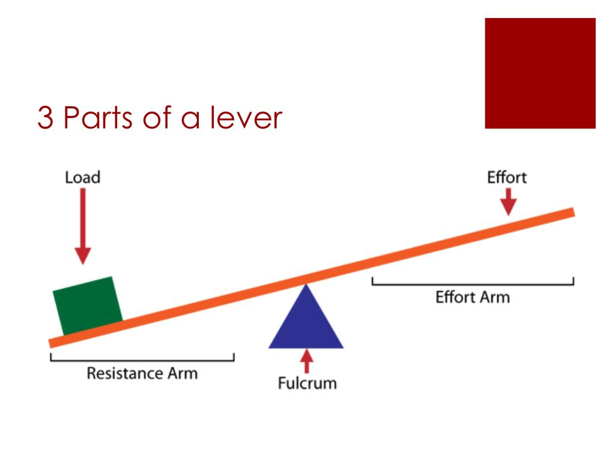
Parts of a Lever
Parts of a Lever IS :
1-Fulcrum: The pivot point
2-Effort (Input Force): The force applied
3-Load (Output Force): The resistance or weight being moved
(Arrangement of these three defines the lever class)

Slide 4

Mechanical Advantage
  -Levers multiply force, allowing small effort to lift heavy loads
  -Mechanical advantage (MA) = Effort Arm ÷ Load Arm
  -Longer effort arm = greater advantage
  -Key principle: trade force for distance

Slide 5
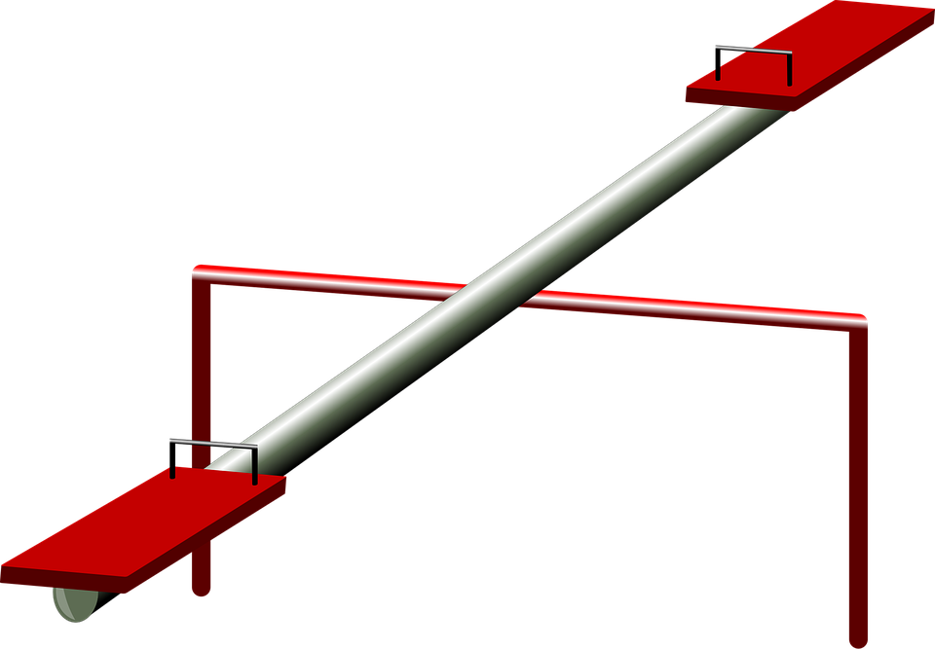
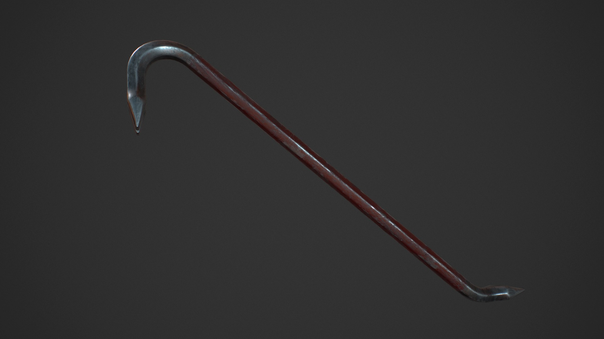
First-Class Levers
-Fulcrum is between effort and load
-Can multiply force or distance
-Examples: Seesaw, crowbar, scissors

Slide 6

Second-Class Levers
- Load is between fulcrum and effort
- Always multiplies force
- Examples: Wheelbarrow, bottle opener, nutcracker
- Effort arm is always longer than load arm → strong lifting power

Slide 7
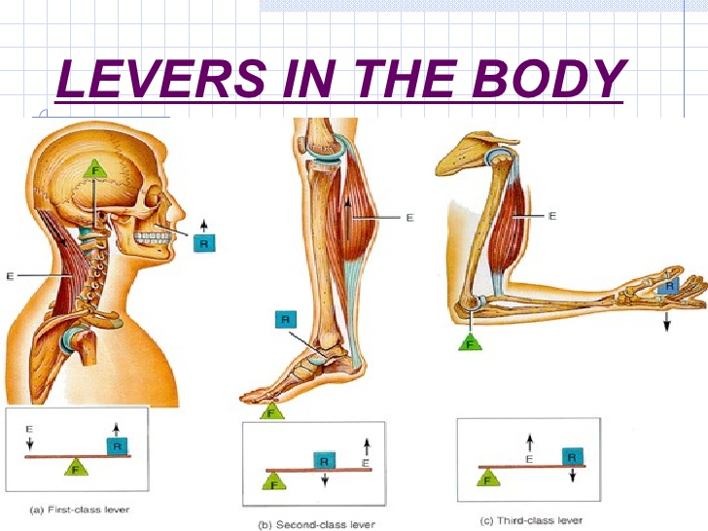
Third-Class Levers
-Effort is between fulcrum and load
-Multiplies distance, not force
-Examples: Tweezers, fishing rod, human arm
-Most common in the human body for speed and motion
This Photo by Unknown Author is licensed under CC BY-SA-NC

Slide 8
Where We See Levers
-Construction tools: crowbars, hammer
-Sports: tennis rackets, baseball bats
-Human anatomy: bones and muscles act as lever systems
-Transportation: pedals, brakes, gear controls

Slide 9
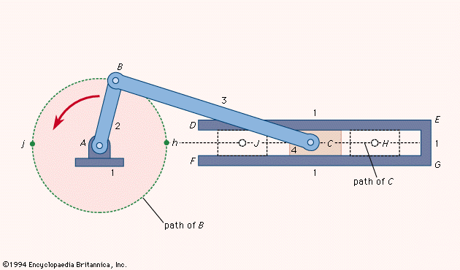
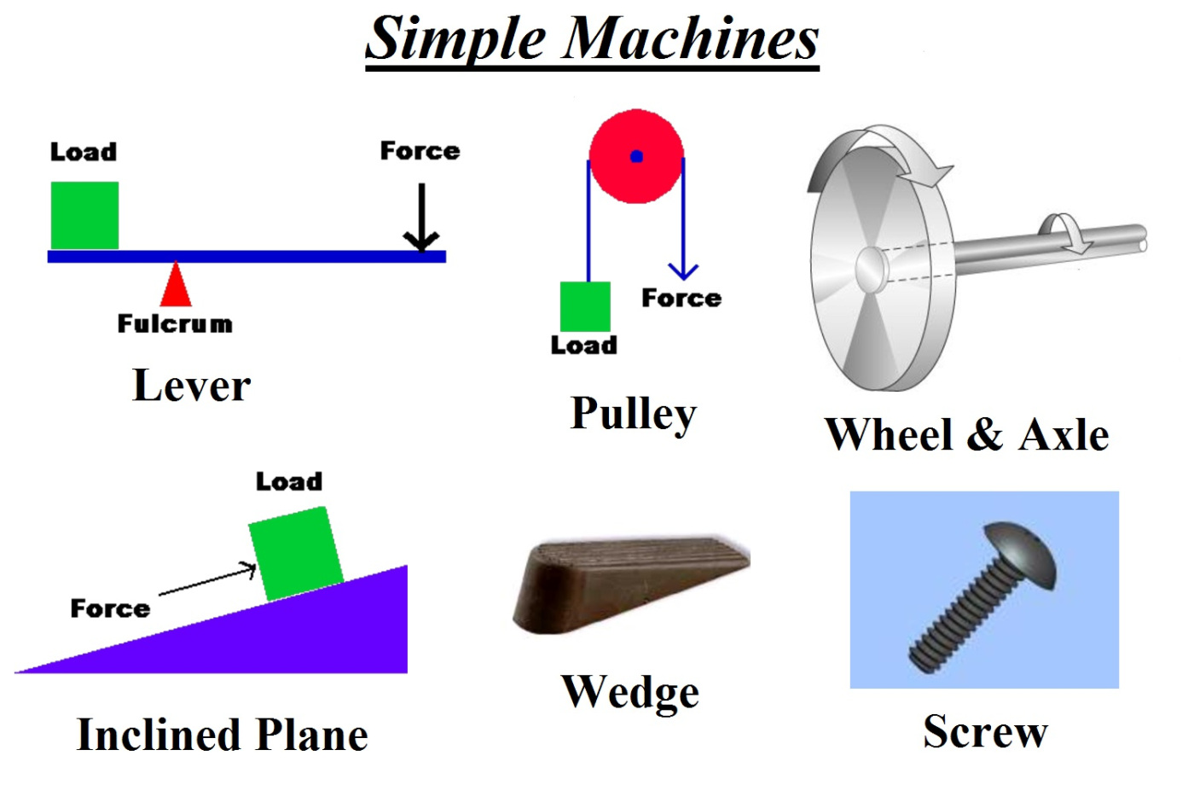
Why Levers Matter
There are many Advantages of Using Levers few of them :
1-Reduce human effort
2-Increase efficiency in work and movement
3-Foundation of many complex machines
4-mportant in engineering, medicine, and physical sciences

Slide 10
Conclusion
At the end we learned that :
- Levers are powerful simple machines used everywhere
- Understanding lever types helps explain motion and mechanics
- Key idea: arrangement of effort, load, and fulcrum determines function
- Levers remain essential in science, engineering, and daily life
The End

