Slide 1


Grade 9
Unit 1: Collocations
physical appearance

Slide 2


Islamic Educational College
English
Unit 1
Grade 9
Lesson’s Objectives
Learn some collocations for the physical traits and the personality traits and use them correctly .
Write a descriptive essay including all the information needed .

Slide 3
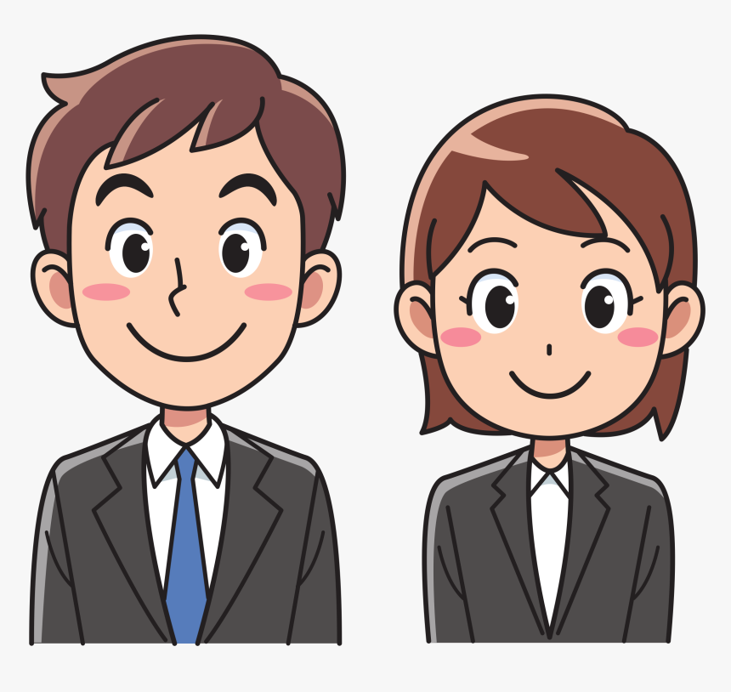
What do you look at when you want to describe someone’s appearance ?

Slide 4
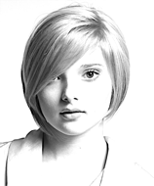
________ face .
Islamic Educational College
English
Unit 1
Grade 9
Round

Slide 5
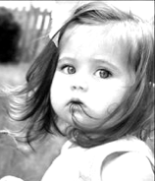
_______ cheeks
Chubby

Slide 6
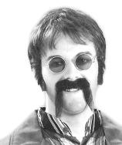
__________ moustache
Droopy

Slide 7
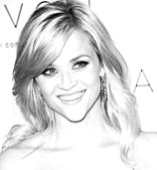
___________ face
Pointed
4.

Slide 8
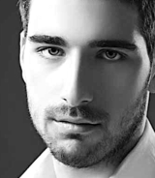
__________nose
Straight

Slide 9
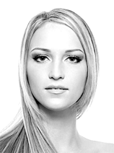
_________face
Oval

Slide 10
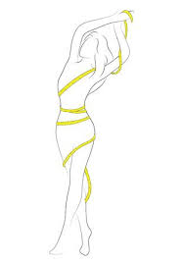
________ figure
Slim

Slide 11
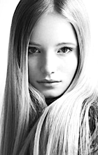
________hair
Sleek

Slide 12
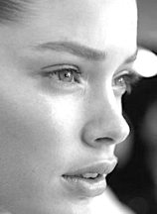
_______ nose .
Upturned

Slide 13
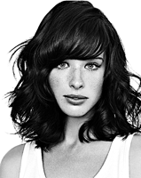
___________ hair .
Shoulder - length

Slide 14
1. My father has a round________ , with chubby____ and a droopy__________ . My mother has a more pointed ______ and a straight_____ . My younger sister is more like my father. She has an oval ______ and an upturned _______ . My older sister is like a model. She has a slim _______ and a slender ______ . She has beautiful sleek, shoulder-length ________. I feel so ordinary next to her , but she always says I look nice.
face
cheeks
moustache
face
nose
face
nose
figure
waist
hair

Slide 15
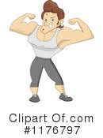
My brother is _________ and handsome .
well- built

Slide 16
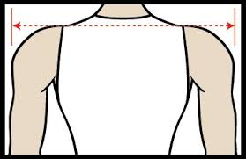
________ shoulders .
Broad

Slide 17
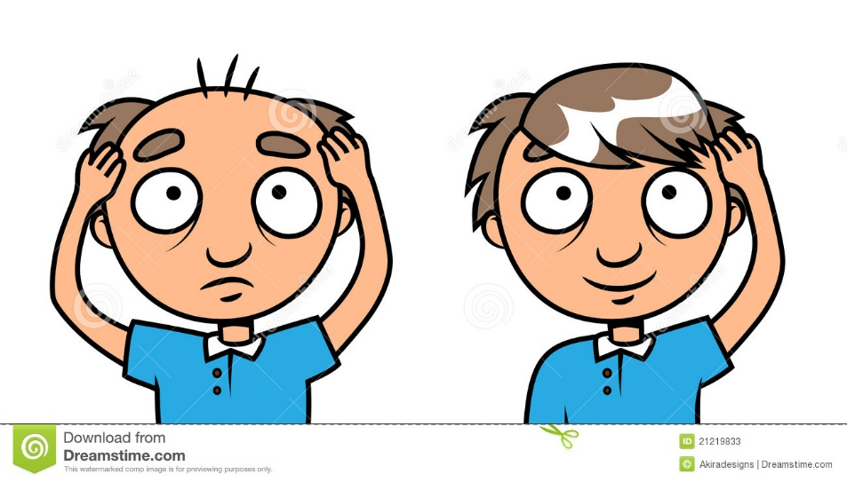
Going _______
bald

Slide 18
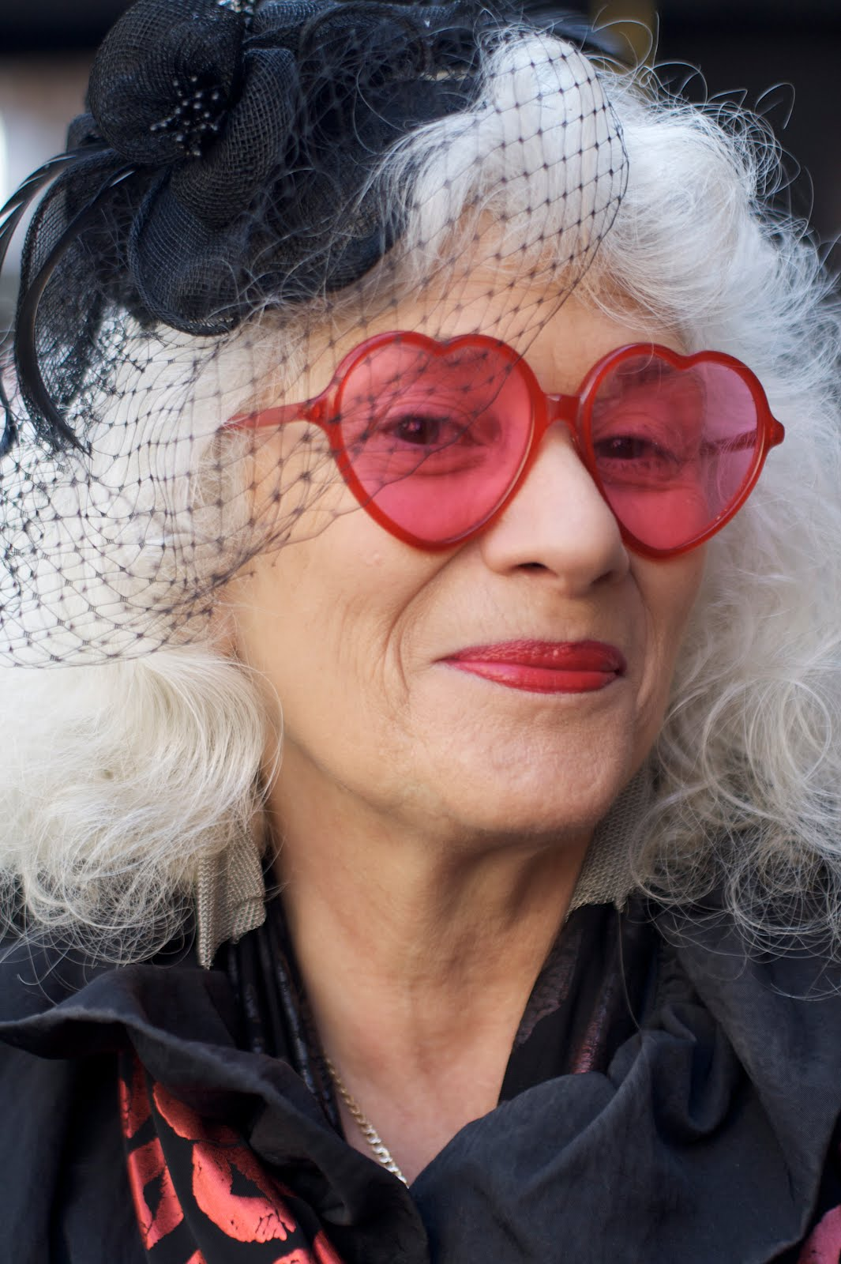
She tries to have a youthful ____________
appearance

Slide 19
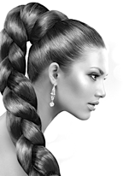
________ hair .
Thick

Slide 20
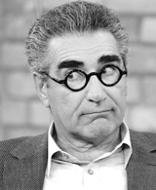
__________eyebrows .
Bushy

Slide 21
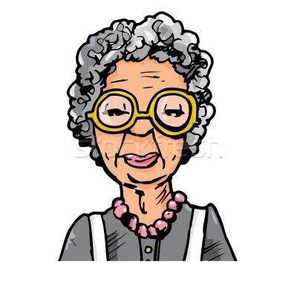
She used to have black hair before it________ grey .
went

Slide 22
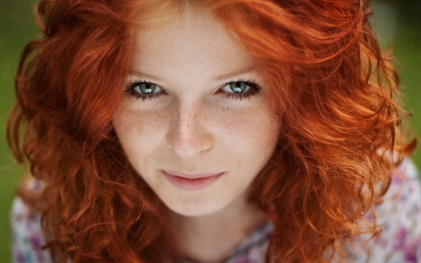
_________ hair
Ginger

Slide 23
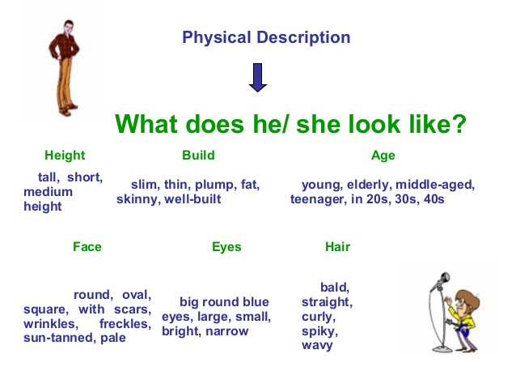

Slide 24
Islamic Educational College
English
Unit 1
Grade 9
2. My father and my two older brothers are all well-______ with ______ shoulders. My father is _______ bald but he still has a very youthful ____________ for someone who is forty. My brothers both have thick _____ and _____ eyebrows. My mother’s side of the family mostly have dark _____
in fact my mother had -black ______ when she was younger, before she went ______ — but on my father’s side some have fair hair and some have ginger______ .
built
broad
going
appearance
hair
bushy
hair
hair
grey
_________ hair

Slide 25
Grade 9
Unit 1: Descriptive Essay
In this lesson you will :
1- Describe a character’s physical appearance.
2- Describe the personality and physical appearance of others .
Value : your personality is way much important that the appearance

Slide 26

Are you with or against plastic surgeries ? Why?

Slide 28
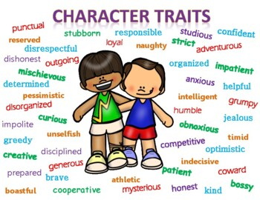

Slide 30
1- Have a tendency to exaggerate / lose his/her temper / make snap (quick) decisions
Ex: Peter’s a great guy, but he sometimes has a tendency to exaggerate.

Slide 31
2- Speak your mind – tell what you really think of something.
Ex: I like him because he always speaks his mind.

Slide 32
3- Have a sense of humor .
Ex: His jokes are so funny. He’s got a great sense of humor.

Slide 33
Strong personality – confident and assertive person.
Ex: He became a boss because he has a strong personality.

Slide 34
Outgoing personality – talkative and open person.
Ex: Gregory has an outgoing personality and he enjoys meeting new people.

Slide 35
Have a vivid imagination – the ability to imagine things easily.
Ex: Thanks to her vivid imagination, the novel she wrote won an award.

Slide 36
Good at keeping secrets .
Ex: Laura is good at keeping secrets.

Slide 37
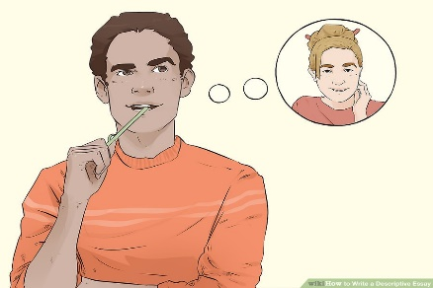
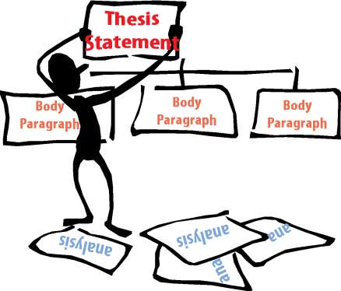
Title: Descriptive Essay / Describe a Character
Brainstorming Ideas for the Essay
Choose a person to describe. One option for a topic is to describe a person that you know well in your life. This could be a family member like your mother or your father. It could also be your best friend .
Outline the essay in sections. Organize the essay by creating a brief outline. Do this in sections: introduction, body, and conclusion:

Slide 38
The introduction
Start with a "Lead sentence" to hook your reader:
The Body
- Physical Traits:
What does he/she look like from outside?
Tall / short / has a round face / has long black wavy hair / has brown eyes ….etc.
B- Personality Traits:
What do you like about this person? Generous / helpful / friendly/ loyal .etc.
Characteristic #1
Examples and details of characteristic #1 (show how )
Characteristic # 2
Examples and details of characteristic # 2 ….etc
Conclusion: Wrap up the essay with a strong conclusion. Your conclusion should tie all the thoughts in your essay together. Restate your thesis statement in the conclusion and end with a strong final sentence. Do not add anything new to your essay in the conclusion.
.

Slide 39
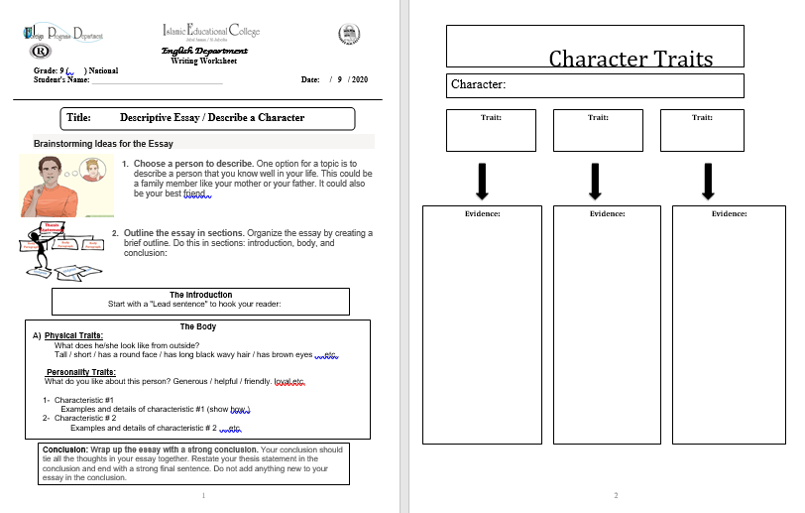

Slide 40
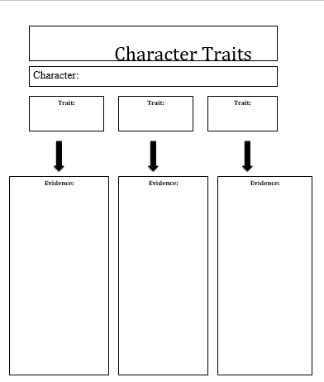
Yet , ...... More Moreover,…… ……. Further more, ..…..

