Slide 1

Back to School orientation
Islamic Educational College
Grade 5 National

Slide 2
Dear Parents,
Welcome back to a brand-new school year! We are truly excited to begin this journey together and to see our students return with fresh energy, curiosity, and smiles. This year, our focus is on creating a safe, supportive, and inspiring environment where every child can learn, grow, and shine. We deeply value your partnership and look forward to working hand in hand with you to make this school year a positive and successful experience for your child. Together, let’s make it a year filled with learning, laughter, and new achievements!
Best Wishes ,
English Dept.

Slide 3
Grade 5 National
Our Team
Miss Diana Sha’ban
Miss Asma’ Yacoub
Miss Lama Khawaja
Miss Ala’a Alshahrouri

Slide 4
Teacher promises …
Students expect..
to create a safe, respectful, and welcoming classroom environment for every child.
to encourage your child to think, explore, and develop a love for learning.
to celebrate each child’s strengths and support them in areas where they need growth.
to communicate openly and honestly with you about your child’s progress.
to listen carefully to your concerns and work together as a team.
to nurture not only academic skills but also kindness, confidence, and responsibility.
to set high expectations while providing the support each child needs to succeed.
to model respect, patience, and positivity every day.
to make learning engaging, meaningful, and enjoyable.
to care for your child as if they were my own.
to come to class prepared with your books, materials, and a positive attitude.
to listen carefully and follow directions the first time they are given.
to show respect to your classmates, teachers, and yourself at all times.
to raise your hand and wait for your turn to speak.
to try your best in every activity, even when it feels challenging.
to complete your homework and assignments on time.
to ask questions when you don’t understand—curiosity is part of learning!
to keep our classroom clean, safe, and organized.
to encourage and support your classmates—teamwork matters!
to believe in yourself and never give up.

Slide 5
School Supplies
sharpened pencils
coloring pencils
erasers + plastic rulers
scissors
small whiteboard +board markers
highlighters & sticky notes

Slide 6

English
Curriculum
About Cornerstone Grade 5
includes core ELA skills like reading comprehension, vocabulary building, and various writing styles such as narrative and informational. Cornerstone emphasizes active discussion and written reflection, and focuses on grammar, composition, and research skills.

Slide 7
Notebooks
Classwork (60 papers)
Writing Notebook (60 papers)
English Booklets

Slide 8
Units /1st semester
Unit 1: Helping Others /Reading 2
Unit 3: Technology / Reading 2 – A Robot’s Smile
Unit 2: Heroes / Reading 2 – Doctors Without Borders

Slide 9
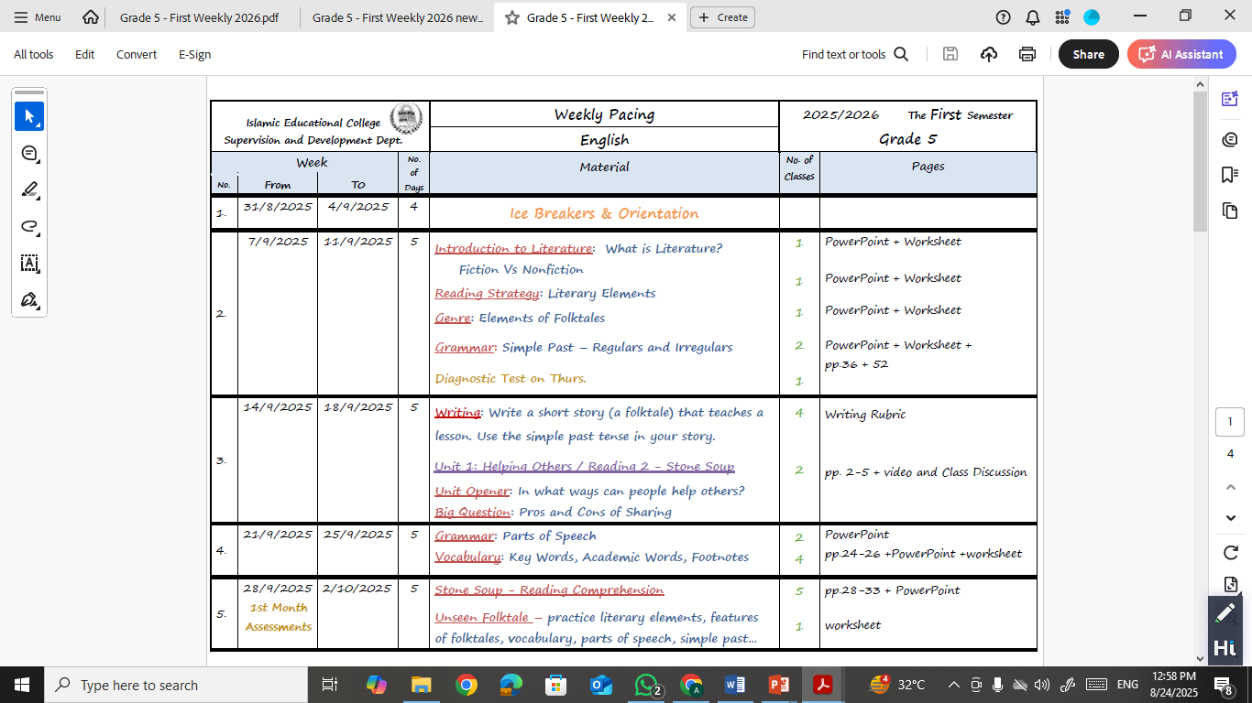
Weekly Plan

Slide 10
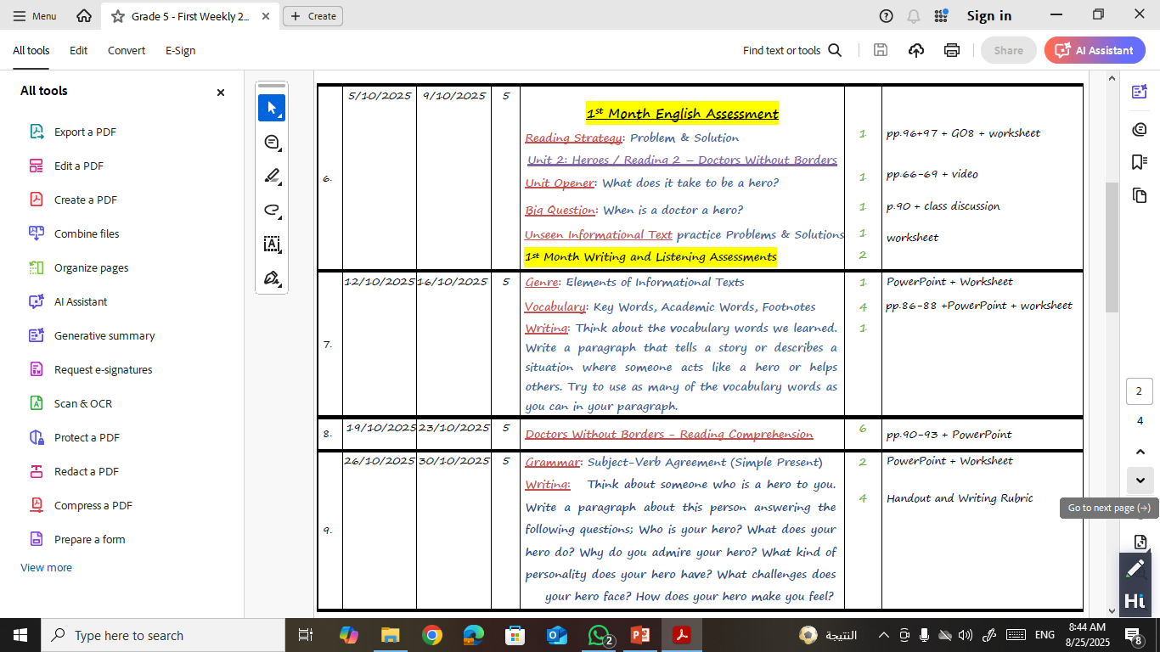
Weekly Plan
Please Note: Our weekly plan is flexible and may be adjusted to best support students’ learning needs and the flow of the teaching–learning process. All details will be sent on the IEC App.

Slide 11
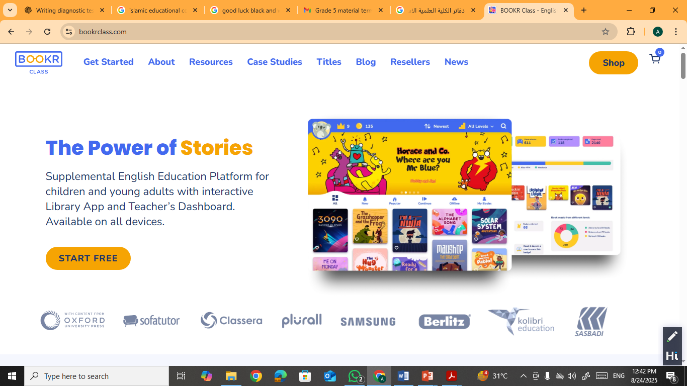
Reading Enrichment Program
As part of our Reading Enrichment Program, students will be assigned a story to read each week Using the
“BOOKR Reading Platform”. They will select 4 stories from the platform according to their reading level and complete enjoyable tasks connected to their reading. This program is designed to encourage a love for reading, build strong comprehension skills, and make learning both engaging and meaningful.

Slide 12
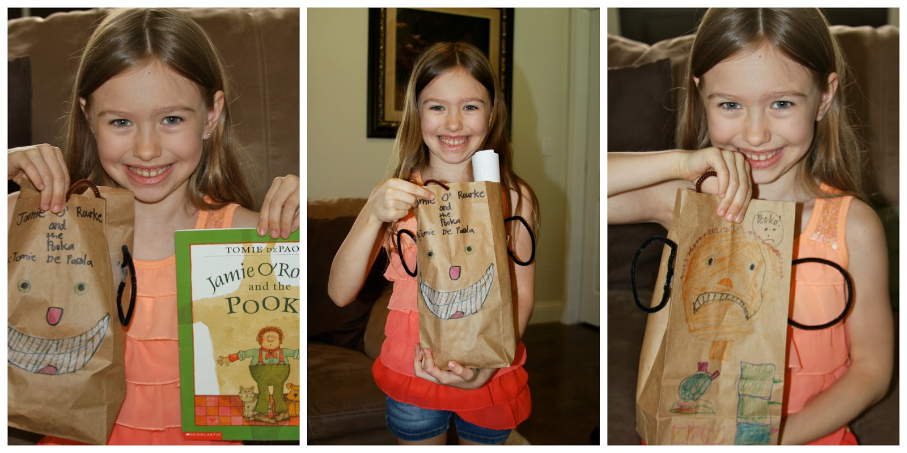

This semester, each student will complete one reading project. After reading four different stories, your child will choose their favorite and explore it in a creative way. They will show their understanding of the story by preparing “The Story Elements Bag” like (like characters, setting, problem, solution, etc.) , which highlights the main parts of the story in a fun, hands-on activity.

Slide 13

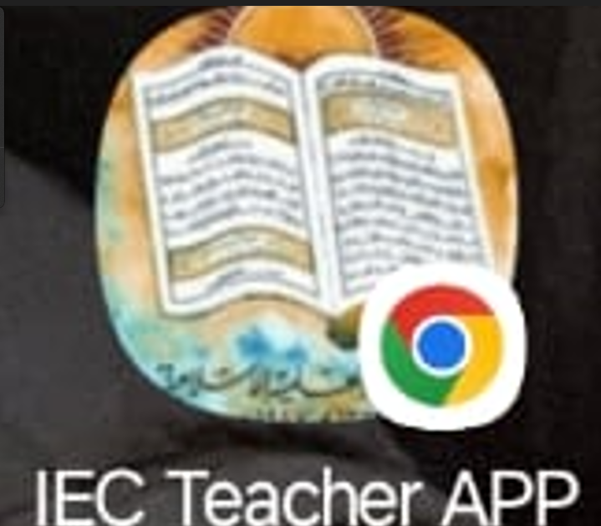
How to communicate
For any questions or further information, you are warmly encouraged to reach out to the teachers directly through the following:
* IEC App

Slide 14



