Slide 1

Unit : One
Lesson :Simple past
Major : English
Grade : Five

Slide 2


Islamic Educational College Date : / To /
Major:
Grade:
Unit:
Lesson:
Outcomes
01:00 minutes
Warm-Up
-Recognize the structure of simple past
Pre-assessment
Presentation
-Use the simple past to write sentences about actions happened in the past.
Formative assessment
Feedback
Differentiation
Linking to life
Critical Thinking
Summative assessment
Closure

Slide 3
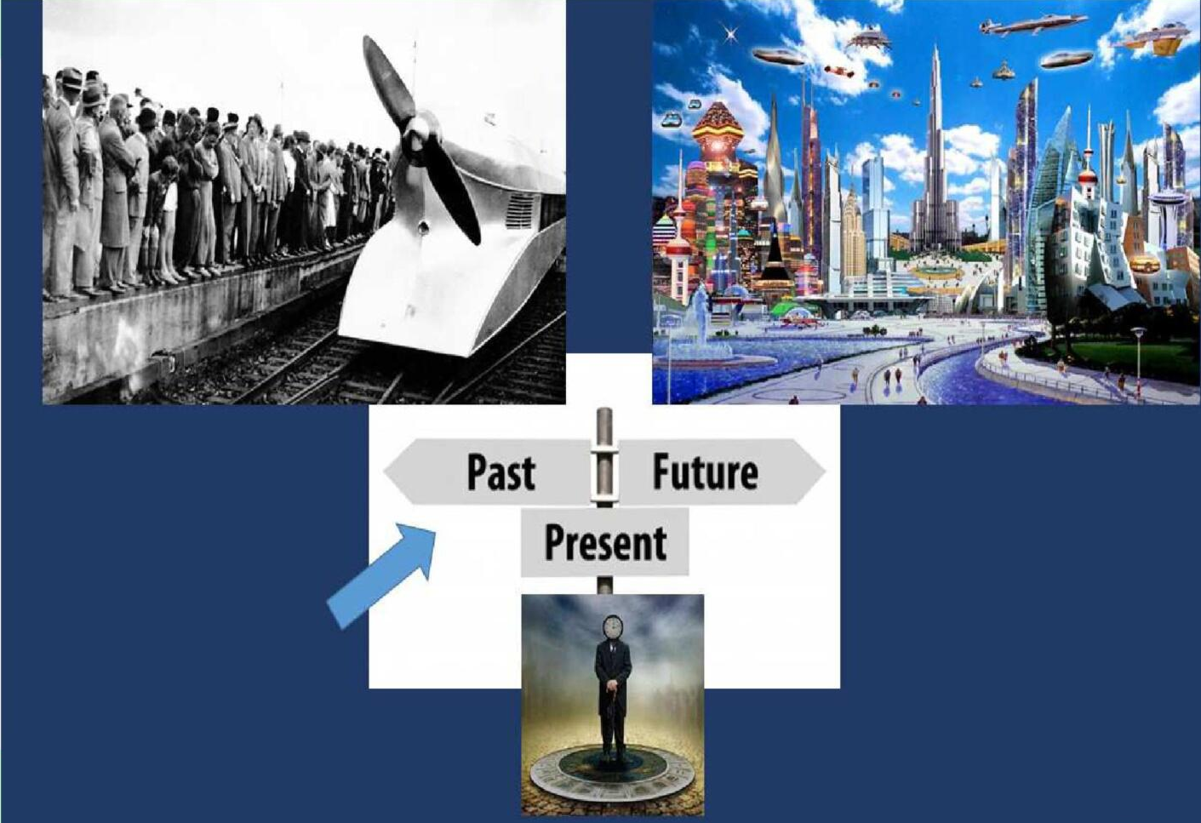

Islamic Educational College Date : / To /
Major:
Grade:
Unit:
Lesson:
Outcomes
02:00 minutes
Warm-Up
Pre-assessment
Presentation
Formative assessment
Feedback
Differentiation
Linking to life
Critical Thinking
Summative assessment
Closure

Slide 4

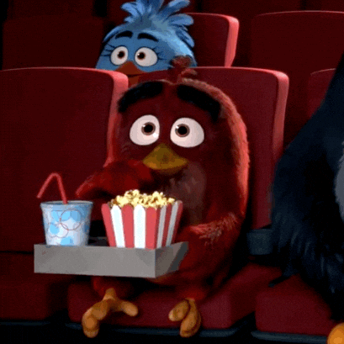
Islamic Educational College Date : / To /
Major:
Grade:
Unit:
Lesson:
Outcomes
1. Where did you go on vacation?
2. What did you do?
3. Who did you see?
4. Which movie did you watch on vacation?
03:00 minutes
Warm-Up
Pre-assessment
Presentation
Formative assessment
Feedback
Differentiation
Linking to life
Critical Thinking
Summative assessment
Closure

Slide 5

Islamic Educational College Date : / To /
Major:
Grade:
Unit:
Lesson:
Outcomes
02:00 minutes
Warm-Up
Pre-assessment
Presentation
Subject
Verb
Sentence
Formative assessment
Feedback
cereal for breakfast this morning.
Mary at school yesterday
on vacation to Spain this summer.
Differentiation
I
ate
Linking to life
I
met
Critical Thinking
I
went
Summative assessment
Closure

Slide 6
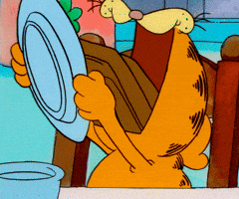
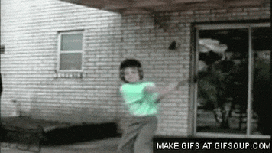
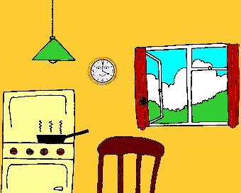
Islamic Educational College Date : / To /
Major:
Grade:
Unit:
Lesson:
Outcomes
03:00 minutes
Simple Past Use :
Actions that started and finished in the past.
Warm-Up
Pre-assessment
Presentation
Formative assessment
Feedback
Differentiation
Linking to life
Critical Thinking
The cat ate all the cake
The boy broke the window
Summative assessment
Closure

Slide 7
Islamic Educational College Date : / To /
Major:
Grade:
Unit:
Lesson:
Outcomes
Verbs in simple past
05:00 minutes
Warm-Up
Pre-assessment
Regular
Irregular
Presentation
We add (–ed ) to the end of regular verbs to form the past simple.
Some verbs are called irregular because their form in the past simple is different from their infinitive form.
Formative assessment
Feedback
Differentiation
Linking to life
play
played
go
went
Critical Thinking
Summative assessment
watch
watched
drink
drank
Closure

Slide 8
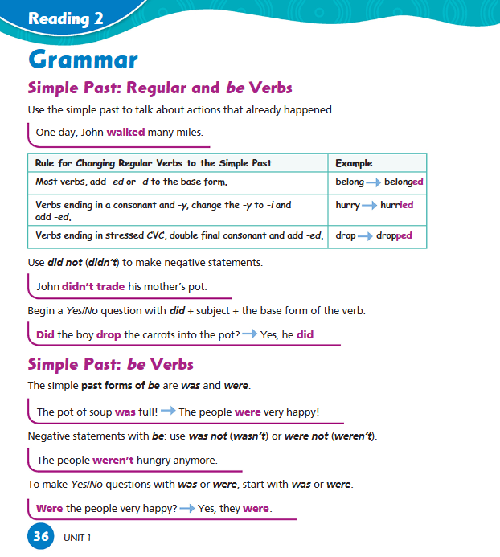
Islamic Educational College Date : / To /
Major:
Grade:
Unit:
Lesson:
Outcomes
07:00 minutes
Warm-Up
Pre-assessment
Presentation
Formative assessment
Feedback
Differentiation
Linking to life
Critical Thinking
Summative assessment
Closure

Slide 9
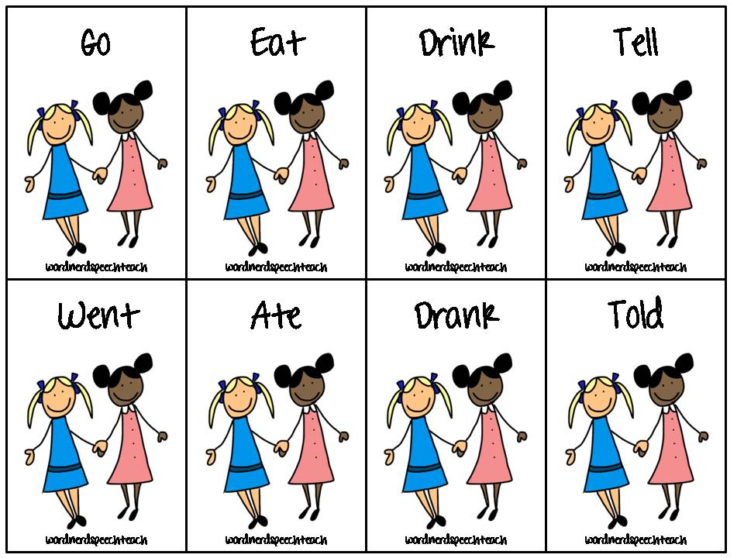
Islamic Educational College Date : / To /
Major:
Grade:
Unit:
Lesson:
Outcomes
Irregular verbs:
01:00 minutes
Warm-Up
Pre-assessment
Presentation
Formative assessment
Feedback
Differentiation
Linking to life
Critical Thinking
Summative assessment
Closure

Slide 10
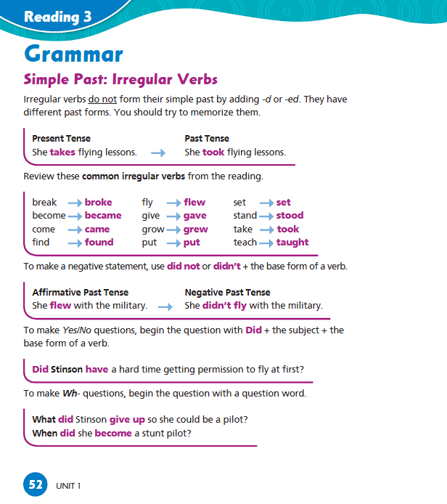
Islamic Educational College Date : / To /
Major:
Grade:
Unit:
Lesson:
Outcomes
7:00 minutes
Warm-Up
Pre-assessment
Presentation
Formative assessment
Feedback
Differentiation
Linking to life
Critical Thinking
Summative assessment
Closure

Slide 11
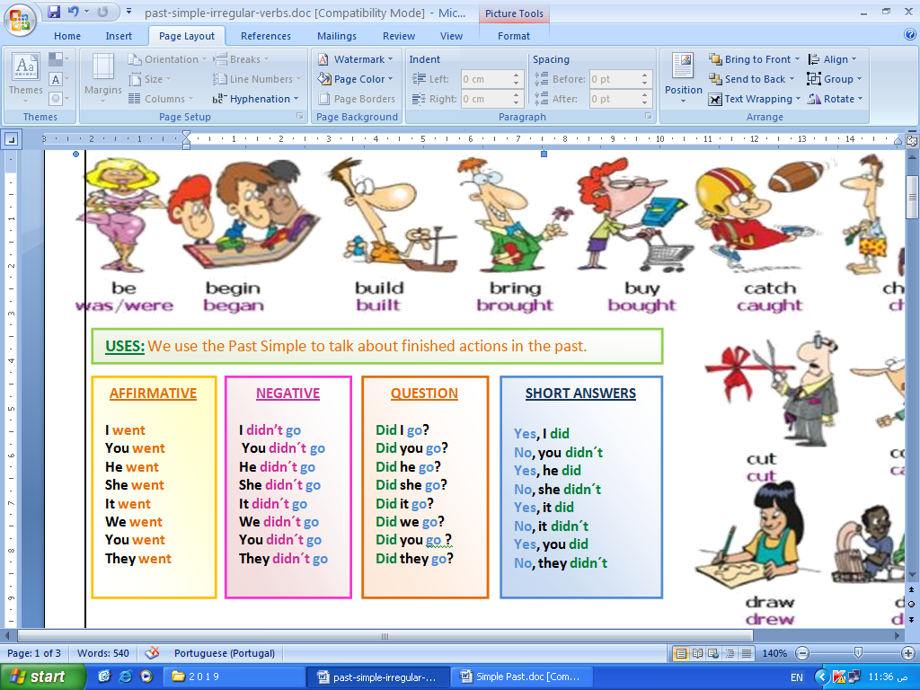
Islamic Educational College Date : / To /
Major:
Grade:
Unit:
Lesson:
Outcomes
04:00 minutes
Warm-Up
Pre-assessment
Presentation
Formative assessment
Feedback
Differentiation
Linking to life
Critical Thinking
Summative assessment
Closure

Slide 12
Islamic Educational College Date : / To /
Major:
Grade:
Unit:
Lesson:
02:00 minutes
Outcomes
Fill in the blanks with the missing verb in the past simple.
Yesterday Mary _____________ (go) to the concert.
. I ______________(visit) lots of interesting places in 2015.
Last night wasn't cold, but it _____________(be) rainy.
Last Tuesday morning, my friends _____________(bring) the car.
We really ____________(enjoy) the game last Sunday.
Warm-Up
Pre-assessment
Presentation
Formative assessment
Feedback
Differentiation
Linking to life
Critical Thinking
Summative assessment
Buzz in
Closure

Slide 13
Islamic Educational College Date : / To /
Major:
Grade:
Unit:
Lesson:
02:00 minutes
Outcomes
Fill in the blanks with the missing verb in the past simple
Warm-Up
Pre-assessment
6.He ________________ (stop) his car in front of the sports shop.
7. We _________________ (have) a picnic last weekend.
8. Mark and Sue _____________(do) their homework after lunch.
9. My friends ________________(come) over after dinner.
10. My parents ___________ (be) proud of me when they saw my report card.
Presentation
Formative assessment
Feedback
Differentiation
Linking to life
Critical Thinking
Summative assessment
Buzz in
Closure

Slide 14
Islamic Educational College Date : / To /
Major:
Grade:
Unit:
Lesson:
Outcomes
Fill in the blanks with the missing verb in the past simple.
Yesterday Mary __went ___ (go) to the concert.
. I __ visited____(visit) lots of interesting places in 2015.
Last night wasn't cold, but it ___ was ____(be) rainy.
Last Tuesday morning, my friends ___brought____(bring) the car.
We really __enjoyed____(enjoy) the game last Sunday.
Warm-Up
Pre-assessment
Presentation
Formative assessment
Feedback
Differentiation
Linking to life
Critical Thinking
Summative assessment
Buzz in
Closure

Slide 15
Islamic Educational College Date : / To /
Major:
Grade:
Unit:
Lesson:
Outcomes
Fill in the blanks with the missing verb in the past simple
Warm-Up
Pre-assessment
6.He ___stopped____ (stop) his car in front of the sports shop.
7. We ____ had____ (have) a picnic last weekend.
8. Mark and Sue _____did___(do) their homework after lunch.
9. My friends _____came____(come) over after dinner.
10. My parents ___were___ (be) proud of me when they saw my report card.
Presentation
Formative assessment
Feedback
Differentiation
Linking to life
Critical Thinking
Summative assessment
Buzz in
Closure

Slide 16
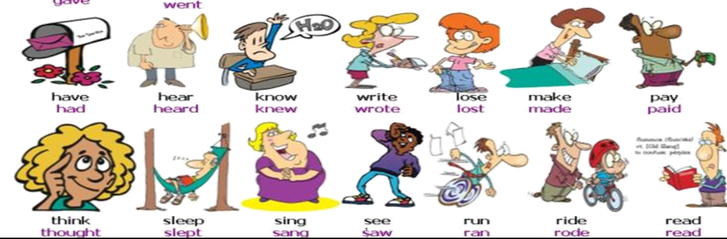
Islamic Educational College Date : / To /
Major:
Grade:
Unit:
Lesson:
Outcomes
04:00 minutes
Warm-Up
Random Pick
Pre-assessment
Presentation
Student’s number | Task
4 | Change the following regular verb to the simple past: Play listen cry
3 | Change the following irregular verb to the simple past: go drive come
2 | Make questions for these statements . I saw a big cat. Mark studied hard for the exam
1 | Build the following sentences with the words given and put the verbs in the past simple. 1. easy / test / the / be . 2. my book /under/ find / I / the bed
Formative assessment
Feedback
Differentiation
Linking to life
Critical Thinking
Summative assessment
Closure

Slide 17
Islamic Educational College Date : / To /
Major:
Grade:
Unit:
Lesson:
Outcomes
02:00 minutes
Warm-Up
What did you do during your last vacation?
Pre-assessment
Presentation
Formative assessment
Feedback
Differentiation
Linking to life
Critical Thinking
Summative assessment
Closure

Slide 18
Islamic Educational College Date : / To /
Major:
Grade:
Unit:
Lesson:
Outcomes
02:00 minutes
Warm-Up
Pre-assessment
Presentation
Describe a situation where you helped someone. How did that experience make you feel afterward?
Formative assessment
Feedback
Differentiation
Linking to life
Critical Thinking
Summative assessment
BUZZ IN
Closure

Slide 19
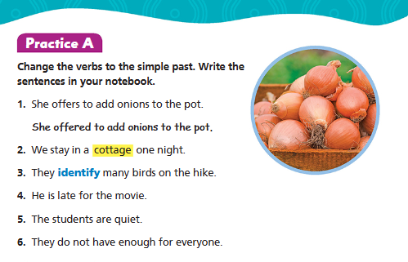
Islamic Educational College Date : / To /
Lesson:
Major:
Grade:
Unit:
02:00 minutes
Outcomes
BUZZ IN
Warm-Up
Pre-assessment
Presentation
Formative assessment
Feedback
Differentiation
Linking to life
Critical Thinking
Summative assessment
Closure

Slide 20
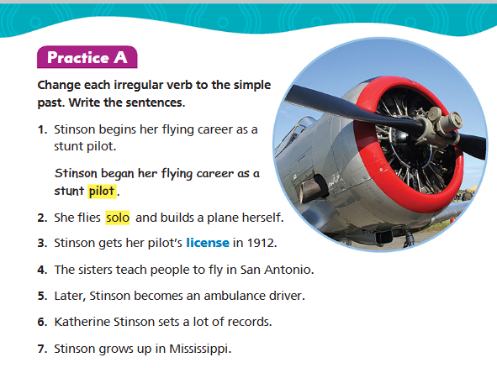
Islamic Educational College Date : / To /
Lesson:
Major:
Grade:
Unit:
02:00 minutes
Outcomes
BUZZ IN
Warm-Up
Pre-assessment
Presentation
Formative assessment
Feedback
Differentiation
Linking to life
Critical Thinking
Summative assessment
Closure

Slide 21
Islamic Educational College Date : / To /
Major:
Grade:
Unit:
Lesson:
Outcomes
02:00 minutes
Warm-Up
Pre-assessment
Presentation
What have we learnt in this lesson?
Formative assessment
Feedback
Differentiation
Linking to life
Critical Thinking
Summative assessment
Closure

