Slide 1
Taking Care Of The Young

Slide 2
OUTCOMES
By the end of today's class, students will: ​
1- read informational text about penguins.
2- answer text-based questions about informational passages.

Slide 3
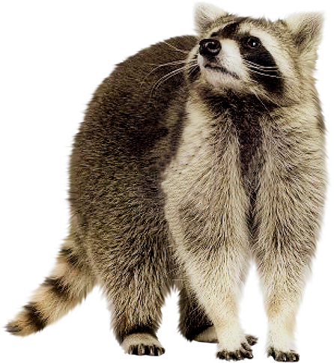
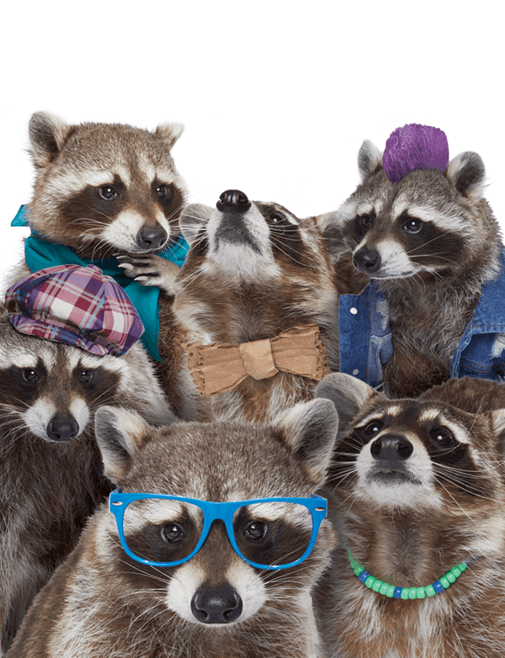

Examples:
1- Where do they live?
2-What do raccoons eat?
PRE-ASSESSMENT - 2 MIN
What do you know about raccoons?
Mini boards

Slide 4
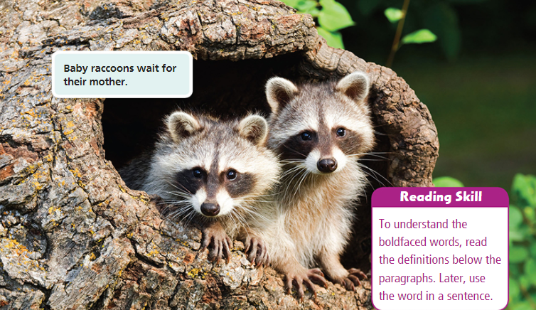
Task1: Look and describe: p (15)

Slide 5
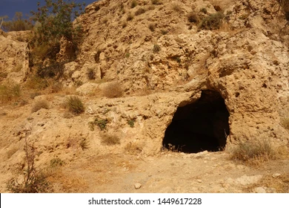
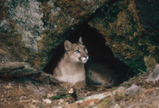
Task 2: Build Vocabulary
den
home for animals that is hidden

Slide 6


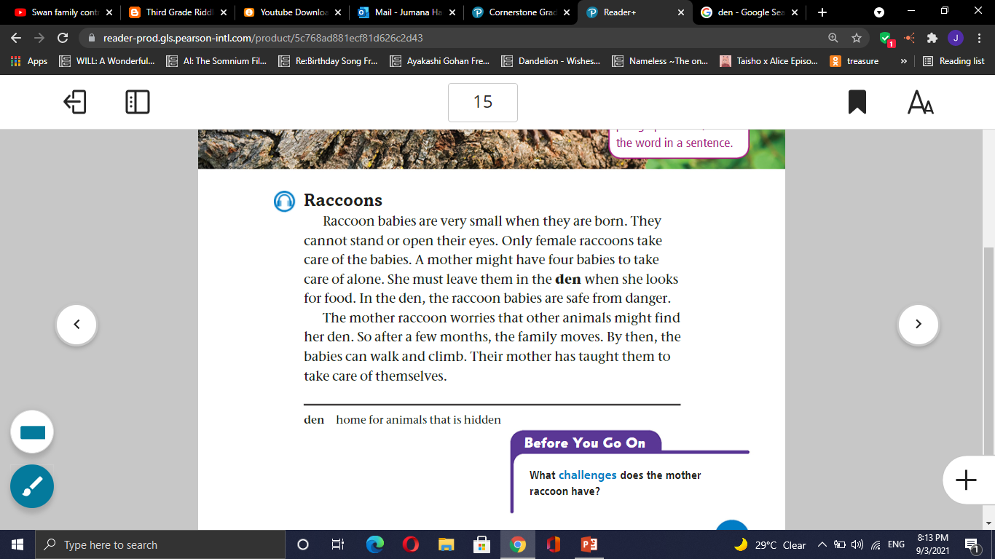
Task 4: Listen then read

Slide 7

Formative assessment l Rally Coach l 3 mins
Formative assessment l Rally Robin l 3 mins
1- Describe baby racoon using your own words.
2- Do male raccoons have any role in taking care of the babies?
3- Where does a raccoon mother leave
her babies when she looks for food?
4- Raccoons live in dens because they feel safe there. Explain.
5- Raccoons usually leave their dens regularly? Why and What may happen if they don’t?

Slide 8
Differentiation - 2 MIN
Students 1:
Why do raccoons need to leave their dens regularly?
Students 3:
Who takes care of baby raccoons?
Students 2:
Why do raccoons live in dens?
Students 4:
Baby raccoons can't stand or open their eyes. (T/F)

Slide 9
Real-life application - 30 seconds
Buzz in
If you see a raccoon in your yard, what can you do to keep it away?

Slide 10
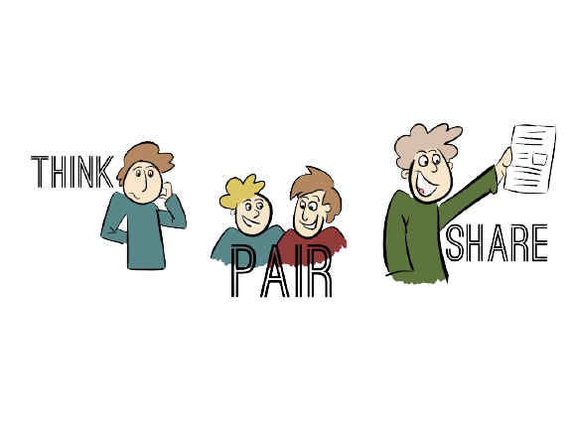
Critical Thinking - 30 seconds
Buzz in
Female raccoons can face many threats and challenges, mention some of them.

Slide 11
1- Raccoons live in dens to stay safe from other animals and weather
1-True
2-False
2- Both male and female raccoons take care of their young.
1-True
2-False
3- Raccoon mothers leave their babies in a safe place while they go out to find food.
1-True
2-False
Summative assessment - IRS

Slide 12
Exit Ticket - 1 min
write one sentence you've learned today about raccoons.
Mini-Boards

