Slide 1

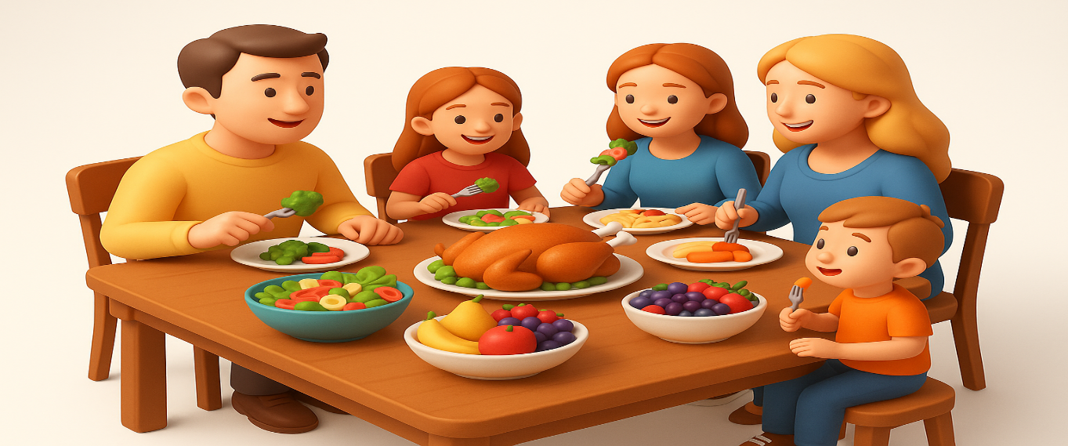
OBJECTIVES
WARM UP
Unit: Three
Lesson: Reading Comprehension
“CAN YOU EAT YOURSELF HAPPY”
Subject: Let’s eat
Grade: 10
PREASSESSMENT
PRESENTATION
FORMATIVE ASSESSMENT
FEEDBACK
DIFFERENTIATION
REAL LIFE APPLICATION
CRITICAL THINKING
EXIT TICKET

Slide 2


ISLAMIC EDUCATIONAL COLLEGE DATE:
SUBJECT Let’s eat
GRADE 10
UNIT 3
LESSON
Objectives
Identify key information and details in the article.
Understand how food affects physical and emotional health.
Practice reading strategies: skimming, scanning, and inference.

Slide 3
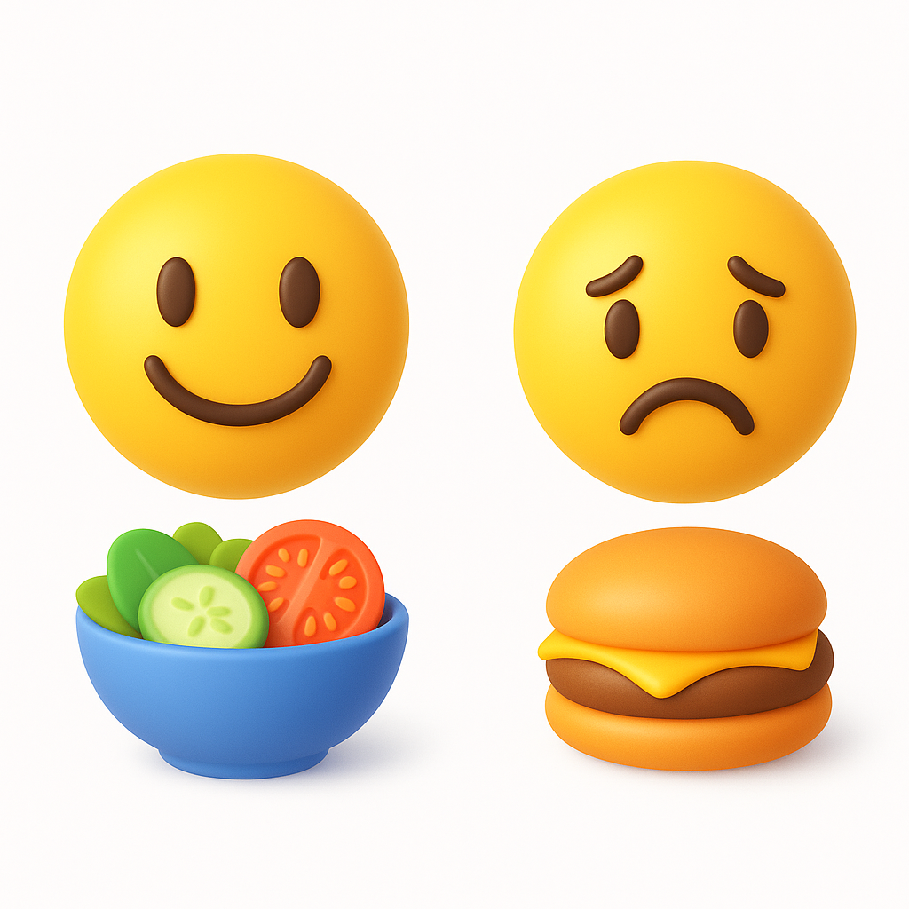
ISLAMIC EDUCATIONAL COLLEGE DATE:
SUBJECT
GRADE
UNIT
LESSON
WARM UP
03:00 minutes
(Think–Pair–Share)
Question: Do you think the food we eat can influence our mood? How?
Instructions: Students think individually, then share with a partner, then share with class.

Slide 4
ISLAMIC EDUCATIONAL COLLEGE DATE:
SUBJECT
GRADE
UNIT
LESSON
PRESENTATION
02:00 minutes
(Skimming ):
Read , identify the main idea , scan the code, type it
Q: What is the main idea of Paragraph 1?
https://padlet.com/alselaweamneh/main-idea-qw8knrtu9tyxobfh

Slide 5

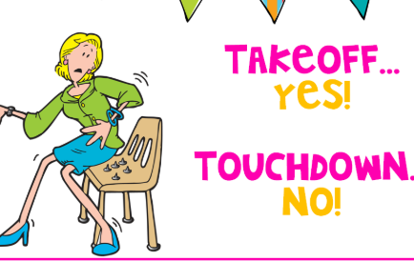
ISLAMIC EDUCATIONAL COLLEGE DATE:
SUBJECT
GRADE
UNIT
LESSON
05:00 minutes
PRESENTATION
1. It seems that food is an unavoidable topic of conversation these days. Whether you’re browsing online, flicking through a magazine, zoning out in front of the TV or chatting away to friends, someone will almost certainly be discussing food in one form or another. Favorite talking points include whether we are over- or underweight because of the type of food we eat; whether we eat too much junk and processed food; whether we ought to eat meat or not; and exactly which superfood or diet is going to save our lives and give us the body we want. These are all burning questions for those of us fortunate enough to be able to choose what we eat, and while diet-related issues are undoubtedly serious and potentially life-threatening, the effects of eating are not only physical. Recent research has been looking at how food affects our moods as well as our bodies.

Slide 6
Unavoidable → can’t be stopped; certain; inevitable
Flicking through → looking quickly; skimming; flipping pages
Zoning out → not paying attention; daydreaming; drifting off
Undoubtedly → surely; certainly; without question
Potentially → possibly; maybe; could happen
fortunate: lucky, blessed, having good luck.

Slide 7
ISLAMIC EDUCATIONAL COLLEGE DATE:
SUBJECT
GRADE
UNIT
LESSON
PRESENTATION
02:00 minutes
(Skimming Q):
Q: What is the main idea of Paragraph 2?

Slide 8

ISLAMIC EDUCATIONAL COLLEGE DATE:
SUBJECT
GRADE
UNIT
LESSON
06:00 minutes
PRESENTATION
2. First and foremost, flavour is a powerful conductor of memories and emotions. Strawberries may evoke a very special summer, a birthday cake may conjure a childlike wonder. In Proust’s Remembrance of Things Past, for example, the narrator depicts the ‘powerful joy’ that a tea-soaked madeleine awakes in him. When he is ‘dispirited after a dreary day, with the prospect of a depressing morrow’. It isn’t so much that the sweet cake tastes lovely, but that it transports him to his innocent youth, when his aunt in the country would feed him the very same treat on Sunday mornings. But the single most influential sense in flavour appreciation is the sense of smell. Unlike the other senses, smell is processed in a part of the brain that deals with strong emotional responses and memory. A particular smell can trigger both a memory of the time we first experienced it and a repetition of the feelings we had then. So for each of us, particular memories and feelings become associated with certain smells. These are just some of the many ways in which food can make us happy.
Listen carefully , highlight the new words, Answer the questions,

Slide 9
Conductor → carrier, transmitter, something that passes or leads something on
Evoke → bring out, call up, remind, stir (a memory or feeling)
Conjure → create, bring to mind, call forth (like an image or memory)
Depict → describe, show, illustrate, represent
Madeleine / Madeleine cake → a small sponge cake shaped like a shell, often linked with memory in literature Dispirited → sad, discouraged, low in spirits
Dreary → dull, boring, gloomy, depressing
Morrow (from the passage “a depressing morrow”) → the next day, tomorrow
Flavour appreciation → enjoying or valuing the taste and smell of food

Slide 10
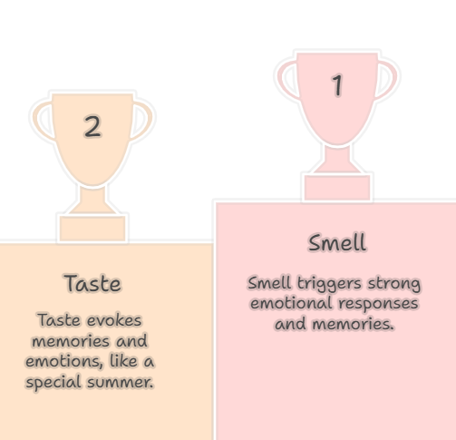
ISLAMIC EDUCATIONAL COLLEGE DATE:
SUBJECT
GRADE
UNIT
LESSON
02:00 minutes
REAL LIFE APPLICATION
When you have a cold and can’t smell well, how does this change the way food tastes?
What does this tell us about the role of smell in flavour?

Slide 11
ISLAMIC EDUCATIONAL COLLEGE DATE:
SUBJECT
GRADE
UNIT
LESSON
08:00 minutes
PRESENTATION
3. Of course, it does help if these foods are toothsome, delectable or in other words delicious. ‘Tasty food is one of the most universal routes to pleasure,’ reads an academic paper by the Oxford psychiatrist Morten Kringelbach on our understanding, so far, of the neuroscience of happiness. This is why eating forms the basis of much scientific experimentation into the mechanics behind that elusive, warm, fuzzy sense of well-being. Pleasure is widely viewed as an essential component of happiness. Food excites the reward system in the brain, stimulating desire and anticipation, and when we eat something we enjoy, it releases hormones which produce the sensation of pleasure.

Slide 12
Neuroscience → the study of the brain and nervous system; how the brain works.
Mechanics → the way something works or functions; the process behind it.
Elusive → hard to grasp, hard to define, or difficult to understand.
Fuzzy → soft, warm, or unclear; in this text, it describes a comforting, pleasant feeling.
Essential → very important; necessary.Anticipation → looking forward to something; expectation.
Stimulating → exciting, motivating, or causing interest or activity.
Sensation of pleasure → the feeling of enjoyment, happiness, or delight.
The reward system in the brain is a group of structures that make us feel pleasure, motivate us to repeat behaviors, and help us learn what is good or bad for survival. It mainly works through the release of the dopamine.

Slide 13
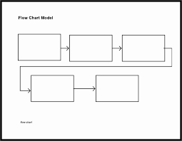
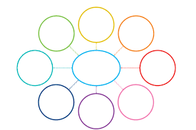
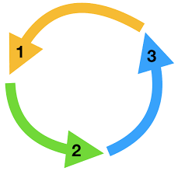
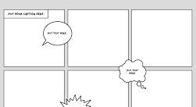
Instructions for Diagram Activity
Read the last paragraph about how food affects the brain and happiness.
Choose a type of diagram to show the process:
Flowchart
Mind map
Cycle diagram
Comic strip / illustration
Think about the important steps or ideas in the paragraph. What happens when we eat tasty food? How does it affect the brain and our feelings?
Draw your diagram showing these steps or ideas. Label each part clearly.
Optional: Add your own examples from personal experience to make the diagram more interesting.
Be ready to explain your diagram to the class in 1–2 minutes.

Slide 14
CRITICAL THINKING
How might understanding the neuroscience of pleasure help people make healthier or better eating decisions?

Slide 15
ISLAMIC EDUCATIONAL COLLEGE DATE:
SUBJECT
GRADE
UNIT
LESSON
PRESENTATION
02:00 minutes
(Skimming Q):
Q: What is the main idea of Paragraph 4?
Buzz In

Slide 16
ISLAMIC EDUCATIONAL COLLEGE DATE:
05:00 minutes
SUBJECT
GRADE
UNIT
LESSON
PRESENTATION
4. However, such pleasures are fleeting, and overconsumption of tasty but unhealthy foods may interfere with your reward system. You may also feel different. Psychologist Andrew Smith of Cardiff University suspects that our attitudes and beliefs about these foods cause us to feel low after consuming them. In a study he carried out, one group were given crisps and chocolate (foods we tend to consider unhealthy and only to be consumed occasionally as special treats) for their teatime snack over the course of ten days, while another group ate fruit. The results associated chocolate with greater depression, and those who ate chocolate and crisps reported greater cognitive difficulties and fatigue, whereas the fruit group had lower anxiety, depression and distress
(While Reading):
Q1: What did Andrew Smith discover about chocolate?
Q2: What do nutritionists suggest to regulate mood?
Buzz In

Slide 17
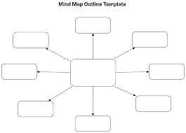
Chocolate and crisps

Slide 18
Fleeting → lasting for only a short time; quick and passing.
Fatigue → extreme tiredness, lack of energy.
Distress → great pain, sadness, or trouble (can be physical or emotional).
Cognitive difficulties → problems with thinking, memory, attention, or learning.
Example: After the accident, he experienced cognitive difficulties such as forgetting things easily.

Slide 19
ISLAMIC EDUCATIONAL COLLEGE DATE:
SUBJECT
GRADE
UNIT
LESSON
PRESENTATION
02:00 minutes
(Skimming Q):
Q: What is the main idea of Paragraph 5?

Slide 20
ISLAMIC EDUCATIONAL COLLEGE DATE:
SUBJECT
GRADE
UNIT
LESSON
07:00 minutes
PRESENTATION
5. Alongside pleasure, another contributor to happiness and well-being is a sense of meaningfulness – and this is where cooking, as opposed to eating food, comes in. Cooking is in fact an established occupational therapy for depression. According to Mark Salter, a consultant psychiatrist in Hackney, London, “The preparing, sharing and consuming of food is so precious,” he says, “because it lies slap at the heart of what it means to be human – to love, to relate, to plan, to feed, to enjoy and to share. It isn’t only a pleasure, but a life skill.” It’s elemental, caring for yourself and others. When choosing ingredients, combining flavours and creating a dish, you are imagining the health-giving or pleasurable impact it will have on those who will consume it. Cooking takes the focus away from yourself.
(While Reading ):
How is cooking more than just preparing food?

Slide 21
It lies slap at the heart of what it means to be human” means that something is central or fundamental to human nature
Occupational therapy (OT) helps people do daily activities they need or want, despite physical, mental, or cognitive challenges. It focuses on improving independence, adapting tasks or environments, and teaching skills for self-care, work, school, and leisure.

Slide 22

ISLAMIC EDUCATIONAL COLLEGE DATE:
SUBJECT
GRADE
UNIT
LESSON
03:00 minutes
DIFFERENTIATION
1+3
Q1. What is the main idea of paragraph 5 ?
Q2: Name two things people do when they cook, according to the paragraph.
2+4
Q1. How does cooking give people a sense of meaningfulness, according to the paragraph?
Q2.Explain how cooking shifts the focus away from yourself.

Slide 23
ISLAMIC EDUCATIONAL COLLEGE DATE:
SUBJECT
GRADE
UNIT
LESSON
PRESENTATION
02:00 minutes
(Skimming Q):
Q: What is the main idea of Paragraph 6?

Slide 24

ISLAMIC EDUCATIONAL COLLEGE DATE:
05:00 minutes
SUBJECT
GRADE
UNIT
LESSON
PRESENTATION
6. Combine the power of cooking to make us happy with the tendency for home-cooked food to be healthier, and you have a nutritional and psychological jackpot. Apart from being healthy, eating home-prepared food is also followed by more intense, positive emotions and less anxiety than consuming food away from home. If you go one step further and grow some food of your own, then you do even better. What with the established positive health effects of being active rather than sedentary, be outside and working with nature rather than cooped up inside all day, together with the satisfaction of growing food and the deliciousness of freshly harvested produce, the happy-making potential of eating is enormous.

Slide 25
Q1. What are the emotional benefits of eating home-prepared food compared to eating out?
Eating home-prepared food is also followed by more intense, positive emotions and less anxiety
Q2. How does growing your own food improve the benefits of eating?
It makes you active, lets you enjoy nature, gives satisfaction, and makes food taste better.
Q3. How can you increase the potential for happiness after eating food?
By cooking at home and growing your own food.
Q4. What is the main idea of the paragraph?
The health benefits of homegrown food

Slide 26
jackpot” means a big win or a great benefit
Cooped up is an idiom that means stuck in a small space or confined area, often feeling restless or frustrated.

Slide 27
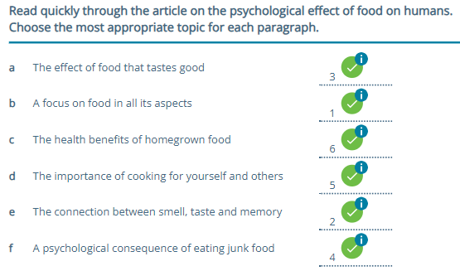
ISLAMIC EDUCATIONAL COLLEGE DATE:
SUBJECT
GRADE
UNIT
LESSON
FEEDBACK
01:00 minutes

Slide 28
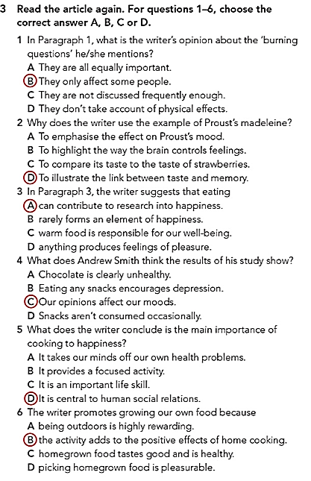

Slide 29

ISLAMIC EDUCATIONAL COLLEGE DATE:
SUBJECT
GRADE
UNIT
LESSON
03:00 minutes
DIFFERENTIATION
* Multiple choice (from book ex.3).
** Write a short paragraph( three sentences) on how food affects your mood.

Slide 30

ISLAMIC EDUCATIONAL COLLEGE DATE:
SUBJECT
GRADE
UNIT
LESSON
REAL LIFE APPLICATION
05:00 minutes
Think–Pair–Share

Slide 31
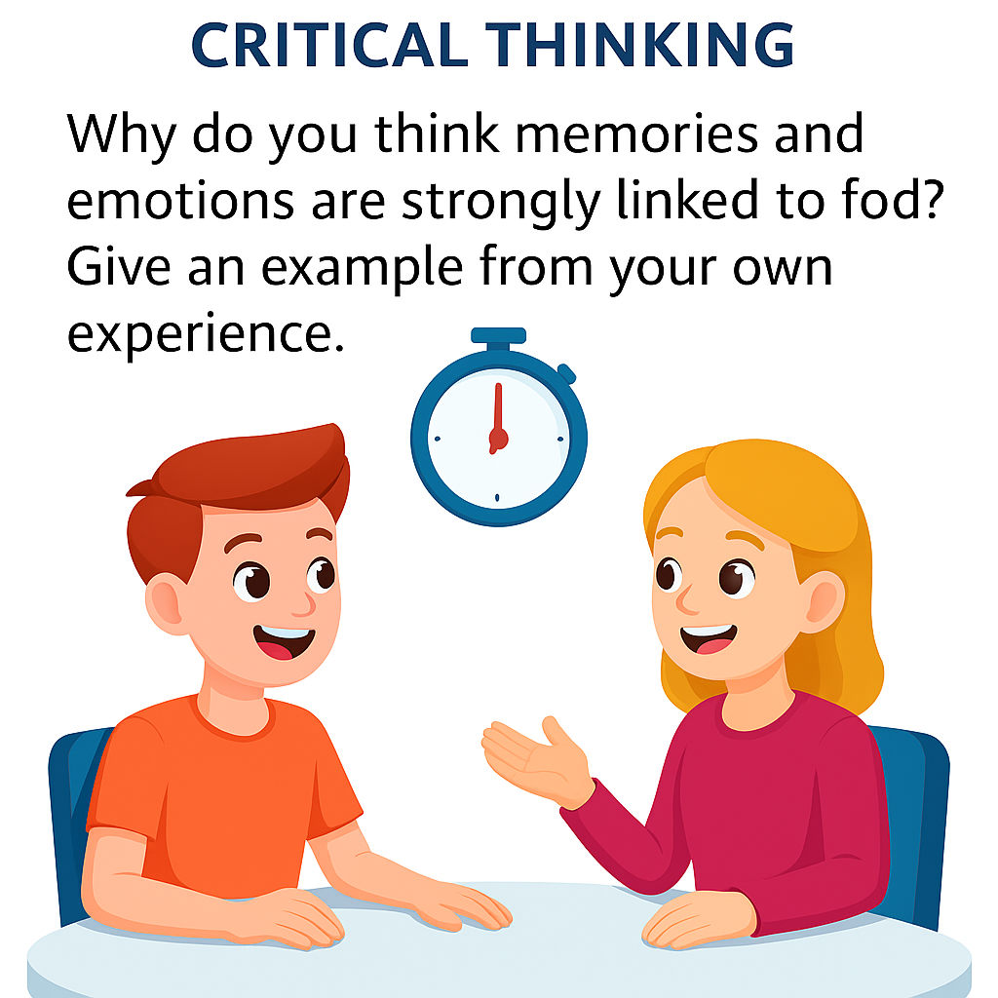
ISLAMIC EDUCATIONAL COLLEGE DATE:
SUBJECT
GRADE
UNIT
LESSON
CRITICAL THINKING
Timed Pair Share
05:00 minutes
The teacher asks the question.
Partner A speaks for 1 minute while Partner B listens.
Partner B speaks for 1 minute while Partner A listens.
Both partners thank each other and volunteer ideas to share with the class.

Slide 32

ISLAMIC EDUCATIONAL COLLEGE DATE:
SUBJECT
GRADE
UNIT
LESSON
EXIT TICKET
01:00 minutes
Task: One-minute paper – What new idea did you learn today about food and happiness?
Open your books P. 30. EX: 4,7,8.

