Slide 1

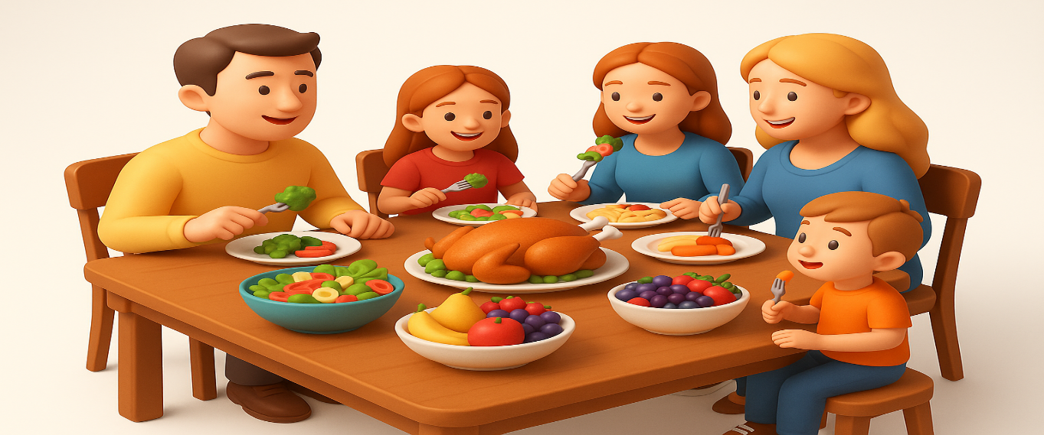
OBJECTIVES
WARM UP
Unit: Three
Lesson: Reading Comprehension
“CAN YOU EAT YOURSELF HAPPY”
Subject: Let’s eat
Grade: 10
PREASSESSMENT
PRESENTATION
FORMATIVE ASSESSMENT
FEEDBACK
DIFFERENTIATION
REAL LIFE APPLICATION
CRITICAL THINKING
EXIT TICKET

Slide 2

WARM UP
https://create.kahoot.it/details/8c81ec7c-7402-47a2-a580-94e5a4833d51

Slide 3

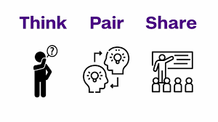
ISLAMIC EDUCATIONAL COLLEGE DATE:
SUBJECT: Grammar
GRADE: 9
UNIT: 1
Lesson: 1
OUTCOMES
02:00 minutes
REAL LIFE APPLICATION
WARM UP
PREASSESSMENT
Can you think of a time when a meal you prepared yourself gave you a sense of satisfaction or accomplishment? Explain.
PRESENTATION
FORMATIVE ASSESSMENT
FEEDBACK
DIFFERENTIATION
REAL LIFE APPLICATION
CRITICAL THINKING
EXIT TICKET

Slide 4

What is a suffix?

Slide 5
A suffix is a group of letters added to the end of a word

Slide 6

CRITICAL THINKING
Analyze
Look at the words ‘happy’, ‘happiness’,” happily” “unhappy” and ‘unhappiness’. How does adding a suffix/prefix change the word? Can you think of other words where adding a suffix/prefix changes the word

Slide 7

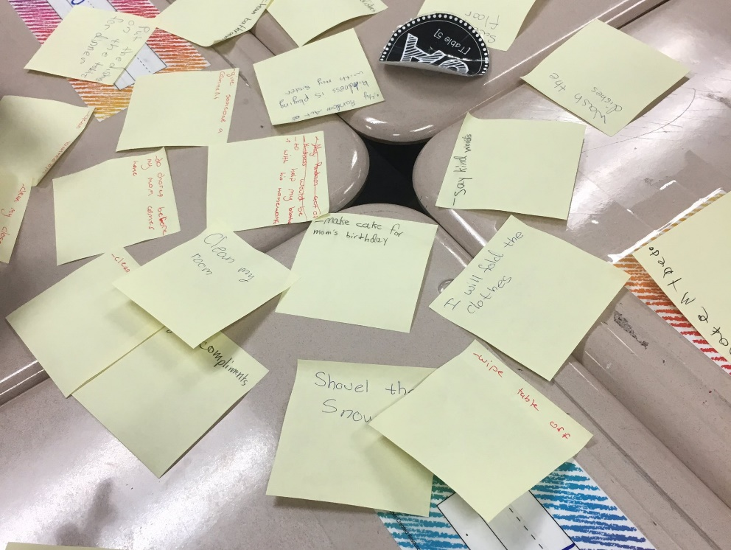
Adjectives ending in –al

Slide 8
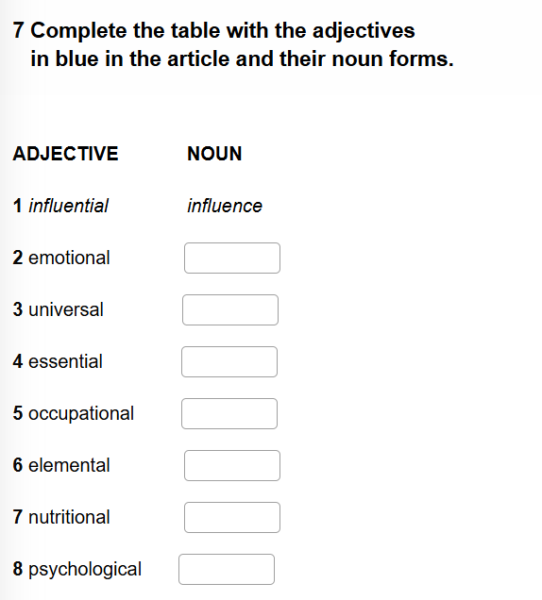


Slide 9
Emotion
Universe
Essence
Occupation
Element
Nutrition
psychology

Slide 10
: add -al
Emotional
Universal
Essential
Occupational
Elemental
Nutritional
psychological
Suffix al is used to form ____________ from _______________
It means “related to”
adjectives
nouns

Slide 11
Spelling rules for adding suffix “al”
General rule | Add “al” | Nation national Element elemental Nutrition nutritional
Nouns ending in -y | y i + cal | History historical Economy economical Psychology psychological
Nouns ending in -e | Drop the e | Nature natural Universe universal
Most nouns ending in -ce | e i + al | Finance financial
Some nouns ending in -ence | -ence ential | Essence essential Influence influential

Slide 12
Where to Use Nouns
1️⃣ After articles (a, an, the)
a book, an apple, the house
2️⃣ After adjectives (adjective + noun)
beautiful house, interesting story
3️⃣ Before another noun (noun + noun = noun modifier)
health benefits, coffee table
4️⃣ After “of” (noun + of + noun)
the roof of the house, a friend of mine
5️⃣ As subject or object
Subject: Dogs are friendly.
Object: I love chocolate.
6️⃣ After numbers or quantifiers (number/quantifier + noun)
three students, many books
7️⃣ After possessive adjectives (my, your, his, her, its, our, their)
my book, her bag, their house
8️⃣ With “no” + noun
No students came to class.
No food is left.
No good ideas were suggested.
Where to Use Adjectives
1️⃣ Before nouns (attributive position)Example: beautiful house, interesting story
2️⃣ After linking verbs (predicative position)Example: The house is beautiful. Example: She seems tired
3️⃣ After adverbs
Example: The bag is too heavy.
Adjective + enough → comes after the adjective
Enough + noun → comes before the noun

Slide 13
CRITICAL THINKING
Analyze
We usually add the suffix ‘-al’ to nouns to make adjectives, like ‘accident → accidental’. Can you find examples where ‘-al’ is added to other types of words? Give examples.

Slide 14
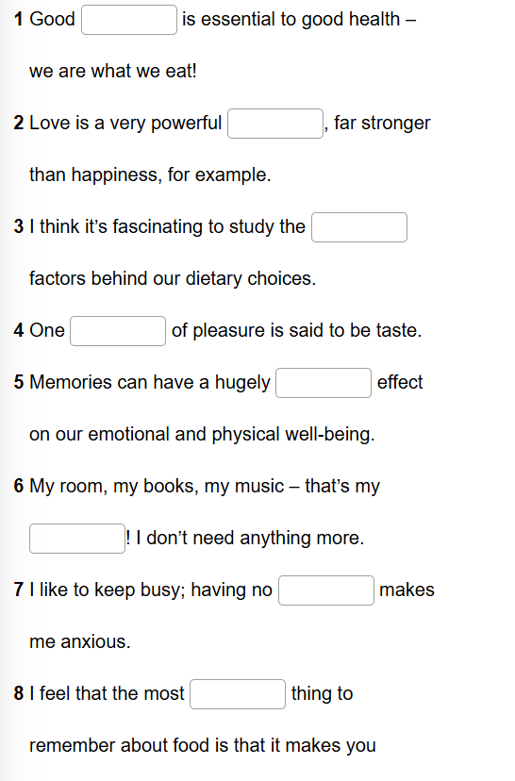
ISLAMIC EDUCATIONAL COLLEGE DATE:
SUBJECT: Grammar
GRADE: 9
UNIT: 1
Lesson: 1
OUTCOMES
02:00 minutes
Individual work
WARM UP
PREASSESSMENT
PRESENTATION
FORMATIVE ASSESSMENT
FEEDBACK
DIFFERENTIATION
REAL LIFE APPLICATION
CRITICAL THINKING
EXIT TICKET

Slide 15
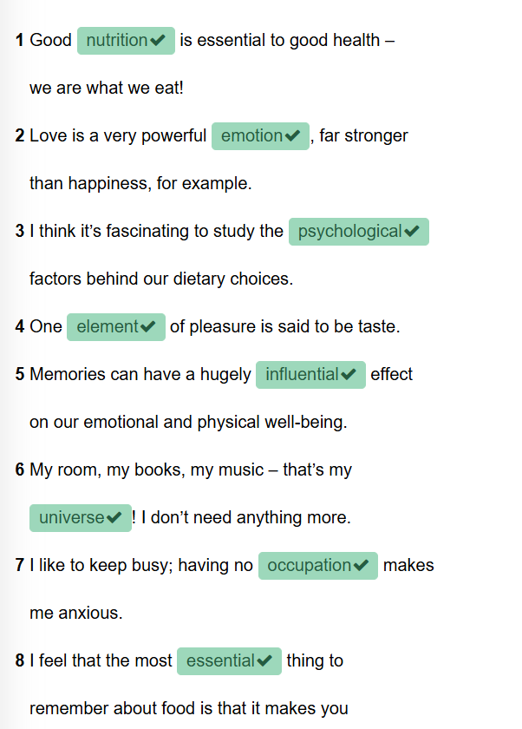

Slide 16


ISLAMIC EDUCATIONAL COLLEGE DATE:
SUBJECT
GRADE
UNIT
LESSON
EXIT TICKET
02:00 minutes
Task: One-minute paper – What new idea did you learn today?
https://padlet.com/alselaweamneh/what-did-you-learn-qw8knrtu9tyxobfh

