Slide 1

Unit: 1 “ Grandmother Spider Brings the Sun”
Lesson: Literary Words .
Subject: Onomatopoeia , repetition and Irony
Grade: 9

Slide 2
LESSON 2

Slide 3



SUBJECT: Vocabulary
GRADE: 9
UNIT: 1
Lesson: 1
LESSON
OBJECTIVES
00:30
WARM UP
Objectives
PREASSESSMENT
*Recognize the meaning of Onomatopoeia , repetition and Irony correctly and elicit them
PRESENTATION
FORMATIVE ASSESSMENT
FEEDBACK
DIFFERENTIATION
REAL LIFE APPLICATION
CRITICAL THINKING
EXIT TICKET

Slide 4

SUBJECT: Vocabulary
GRADE: 9
UNIT: 1
Lesson: 1
OUTCOMES
WARM UP
WARM UP
Real Life Application
PRESENTATION
Performance : Pair Work .
Task : match the words in column A with the actions in column B .
FORMATIVE ASSESSMENT
FEEDBACK
DIFFERENTIATION
REAL LIFE APPLICATION
CRITICAL THINKING
EXIT TICKET

Slide 5
Bang - Gun
Zoom - Rocket
Buzz - Bee
Chug - Train
Drip - Tap
Hiss - Snake
Plop - Splash (e.g., something falling into water)
Pop - Balloon
Roar - Lion
Splash - Splash (e.g., water)
Slurp - Drinking
Tick tock - Clock
Whoosh - Rocket

Slide 6
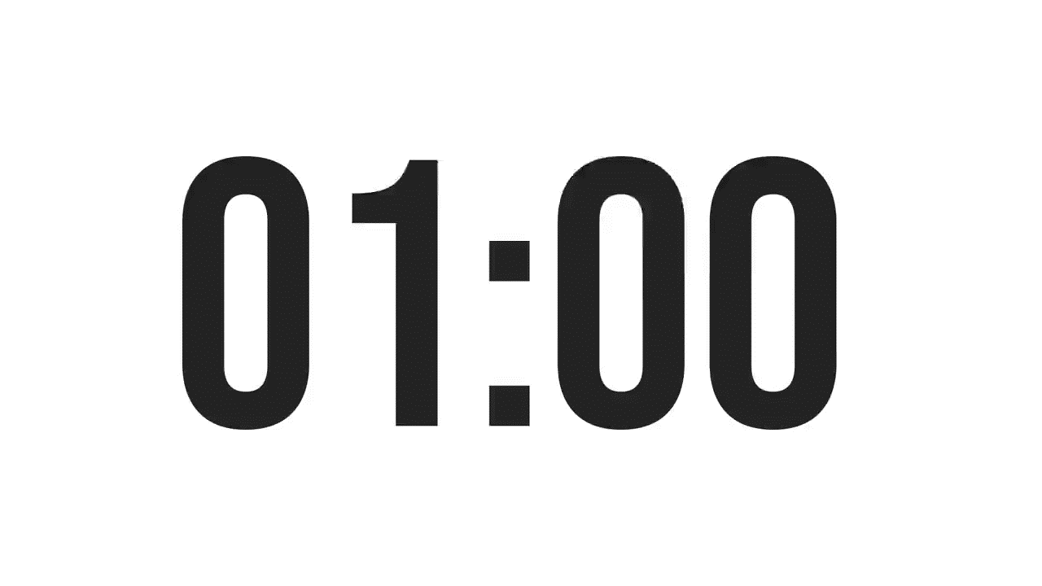
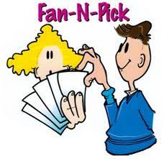
SUBJECT: Vocabulary
GRADE: 9
UNIT: 1
Lesson: 1
OUTCOMES
WARM UP
- What do these words have in common?
What do we call this type of words in English ?
Why do we use them specially in stories ?
Real Life Application
CRITICAL THINKING
FORMATIVE ASSESSMENT
FEEDBACK
DIFFERENTIATION
REAL LIFE APPLICATION
PRESENTATION
EXIT TICKET

Slide 7
ISLAMIC EDUCATIONAL COLLEGE DATE: // 2025
SUBJECT: Vocabulary
GRADE: 9
Unit: 1
Lesson: 1
Rally Coach
Performance : pair work
Task : Highlight the words that are examples of onomatopoeia :
Time :2 minutes
1. I ordered online proofreading services with the click of a mouse.
2. I could hear their buzzing, so I knew there was a bee’s nest around here somewhere.
4. I love the crunchy texture of fresh lettuce.
5. I couldn’t wait to escape the cold and sit by a warm, crackling fire.
6. I heard a knock at the door.
7. Swoosh, the basketball flew smoothly through the net and the game was won
OUTCOMES
📖 Myth for Class
WARM UP
REAL LIFE APPLICATION
CRITICAL THINKING
PREASSESSMENT
FEEDBACK
FORMATIVE ASSESSMENT
PRESENTATION
DIFFERENTIATION
EXIT TICKET

Slide 8

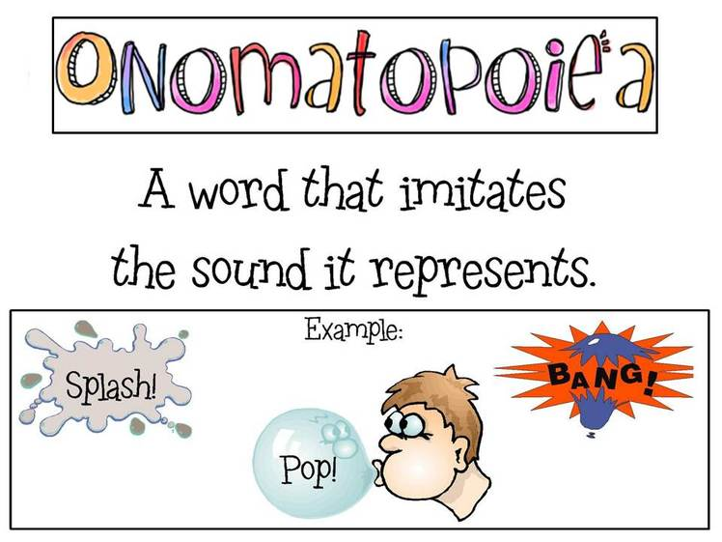
Islamic Educational College
English
Unit 1
Grade 9
Answers
A- I ordered online proofreading services with the click of a mouse.
B- I could hear their buzzing, so I knew there was a bee’s nest around here somewhere.
D- I love the crunchy texture of fresh lettuce.
E- I couldn’t wait to escape the cold and sit by a warm, crackling fire.
F- I heard a knock at the door.
G- Swoosh, the basketball flew smoothly through the net and the game was won

Slide 9
It can add excitement, action, and interest by allowing the reader to hear and remember your writing

Slide 10


Slide 11


Slide 12


Slide 13
ISLAMIC EDUCATIONAL COLLEGE DATE: / / 2025
SUBJECT: Vocabulary
GRADE: 9
UNIT: 1
Lesson: 1
OUTCOMES
Critical Thinking
WARM UP
REAL LIFE APPLICATION
For Students 1+3
Why do you think the author chose this particular onomatopoeic word instead of a normal verb? How does it change the reader’s experience or feeling?
Compare two onomatopoeic words in the text. How do they create different effects or moods? Why might the author use both?
For Students 2+4
What sound is this word trying to show? How does it help you imagine what is happening?
Can you think of another word that could make a similar sound in this sentence? Which word do you think works best and why?
CRITICAL THINKING
PREASSESSMENT
PRESENTATION
DIFFERENTIATION
FEEDBACK
FORMATIVE ASSESSMENT
EXIT TICKET

Slide 14
Repetition
Another technique storytellers use is repetition. In the story you are about to read, the character Coyote says, “Calm down, calm down, calm down.” Here, repetition shows how coyote is feeling about the situation. Repetition can also be used for emphasis or to create humor.
1. “Almost nothing was more annoying than having our wasted time wasted on something not worth wasting it on.”
2.
It was the best of times,
it was the worst of times,
it was the age of wisdom,
it was the age of foolishness,

Slide 15
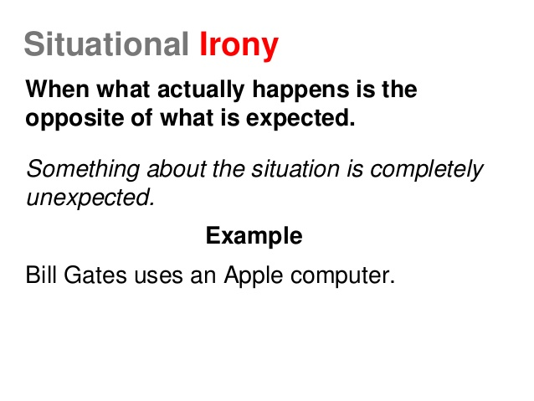
Examples on situational irony
A fire station burns down. This is unexpected because one would assume the fire chief would keep his own building safe.
The police station gets robbed. Again, the expectation is that professional crime fighters would be able to help themselves; in this case, by securing their own station.
A post on Facebook complaining how useless Facebook is. This is ironic because one would expect someone who dislikes Facebook to stay away from it instead of using it to make their point.

Slide 16
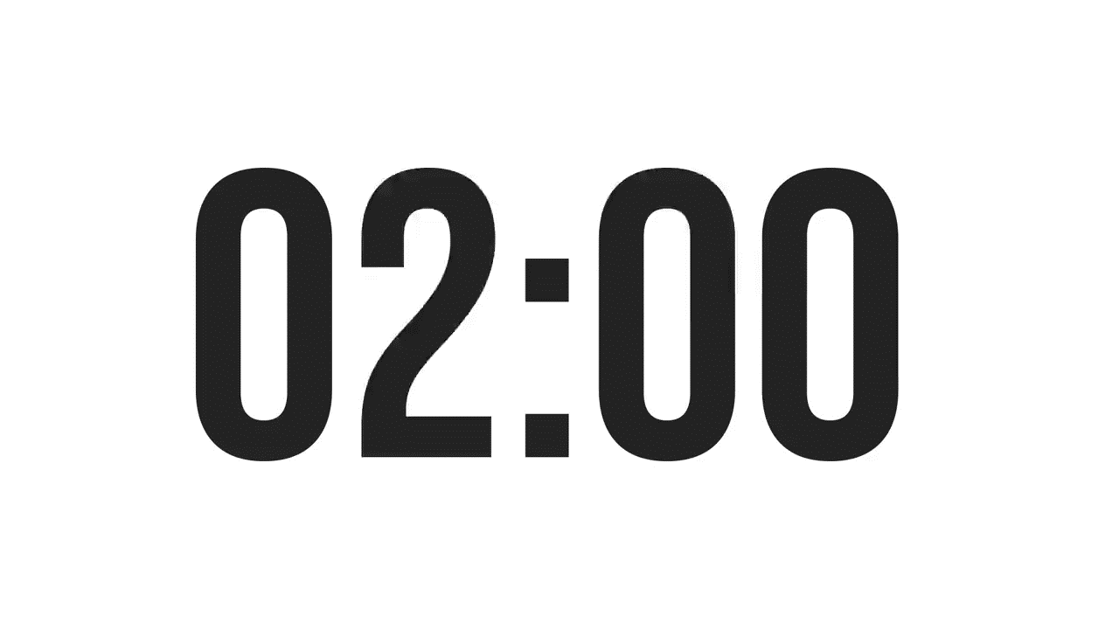
ISLAMIC EDUCATIONAL COLLEGE DATE: / / 2025
SUBJECT: vocabulary
GRADE: 9
UNIT: 1
Lesson: 1
OUTCOMES
Formative assessment
WARM UP
Performance : Pair Work .
Time : 2 Minutes.
PREASSESSMENT
PRESENTATION
Work together to answer the given questions from your teacher .
Students 2+4
Work together to answer the given questions from your teacher .
Students 1+4
FORMATIVE ASSESSMENT
FEEDBACK
DIFFERENTIATION
REAL LIFE APPLICATION
CRITICAL THINKING
EXIT TICKET

Slide 17









ISLAMIC EDUCATIONAL COLLEGE DATE: / / 2025
SUBJECT: Grammar
GRADE: 9
UNIT:4
Lesson: 1
OUTCOMES
3-2-1
WARM UP
Exit Ticket
REAL LIFE APPLICATION
Name
Date
CRITICAL THINKING
Things I learned today
3
PREASSESSMENT
PRESENTATION
Things I found interesting
2
DIFFERENTIATION
FORMATIVE ASSESSMENT
Question I still have
FEEDBACK
1
EXIT TICKET

