Slide 1

Unit: 1
Lesson: Vocabulary
Subject: Compound Words.
Grade: 9

Slide 2


ISLAMIC EDUCATIONAL COLLEGE DATE:
SUBJECT: Vocabulary
GRADE: 9
UNIT: 1
Lesson: 1
LESSON
OBJECTIVES
OBJECTIVES:
Define the new words and recognize their parts of speech .
Use the new words in sentences correctly .
Recognize the meaning of “compound words “.
Join words together to form correct compound words .
01:00 minute
WARM UP
PREASSESSMENT
PRESENTATION
FORMATIVE ASSESSMENT
FEEDBACK
DIFFERENTIATION
REAL LIFE APPLICATION
CRITICAL THINKING
EXIT TICKET

Slide 3

ISLAMIC EDUCATIONAL COLLEGE DATE: / / 2025
SUBJECT: Vocabulary
GRADE: 10
UNIT: 4
Lesson: 1
OUTCOMES
WARM UP:
https://wordwall.net/resource/2146384/english/compound-words
01:00 minute
WARM UP
PREASSESSMENT
PRESENTATION
FORMATIVE ASSESSMENT
FEEDBACK
DIFFERENTIATION
REAL LIFE APPLICATION
CRITICAL THINKING
EXIT TICKET

Slide 4


ISLAMIC EDUCATIONAL COLLEGE DATE:
SUBJECT: Vocabulary
GRADE: 10
UNIT: 4
Lesson: 1
OUTCOMES
01:00 minute
WARM UP
PREASSESSMENT
PRESENTATION
FORMATIVE ASSESSMENT
What is a compound word? What types of compound words can you think of ?
FEEDBACK
DIFFERENTIATION
REAL LIFE APPLICATION
CRITICAL THINKING
EXIT TICKET
BUZZ IN

Slide 5

Islamic Educational College
English
Unit 1
Grade 9
Word Study : Compound Words .
Compound Words
When two words are used together to produce a new meaning, a compound is formed.
Compound words can be written in three ways:
Open compounds (spelled as two words, e.g., ice cream),
Closed compounds (joined to form a single word, e.g., everyone)
Hyphenated compounds (two words joined by a hyphen, e.g., long-term). Sometimes, more than two words can form a compound (e.g., mother-in-law).

Slide 6
Islamic Educational College
English
Unit 1
Grade 9
Page :
Word Study : Compound Words .
Open Compound Word
Open compound words are formed when two words remain separate on the page but are used together to create a new idea with a specific meaning. For example, “high ” and “school” are used to form the open compound word “High school”. Other examples of open compounds include:
peanut butter
ice cream
living room
post office

Slide 7
Islamic Educational College
English
Unit 1
Grade 9
Word Study : Compound Words .
Closed-Form Compound Word
Closed compound words are formed when two fully independent, unique words are combined to create a new word. For example, you would combine “grand” and “mother” to create the closed-form word “grandmother”. In a sentence, this would look like, “My grandmother is coming over.” These are the most common types of compound words.
For example: snowball , mailbox , grandfather..

Slide 8
Islamic Educational College
English
Unit 1
Grade 9
Page : 7
Word Study : Compound Words .
Hyphenated Compound Word
Hyphenated compound words are formed when two separate words are joined together by a hyphen. Examples of hyphenated compound words include:
check-in
father-in-law
long-term
up-to-date
mother-in-law
one-half

Slide 9
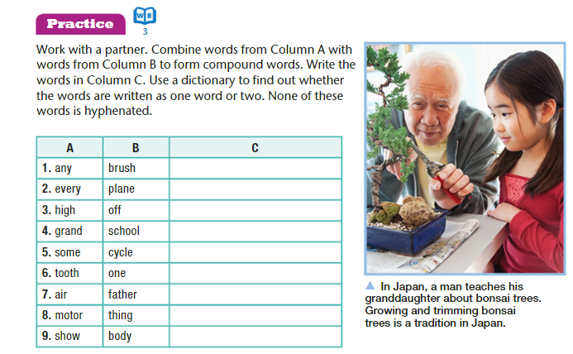


ISLAMIC EDUCATIONAL COLLEGE DATE: / / 2025
SUBJECT: Vocabulary
GRADE: 10
UNIT: 4
Lesson: 1
OUTCOMES
Differentiation
02:00 minutes
WARM UP
PREASSESSMENT
PRESENTATION
FORMATIVE ASSESSMENT
FEEDBACK
DIFFERENTIATION
REAL LIFE APPLICATION
CRITICAL THINKING
Students 1+3 :
Classify the following compound words
Students 2+4 :
Combine words from column A with words from column B to form compound words.
EXIT TICKET

Slide 10
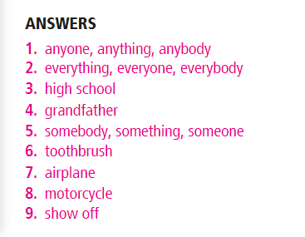
ISLAMIC EDUCATIONAL COLLEGE DATE: 9 + 10 /2/2025
SUBJECT: Vocabulary
GRADE: 10
UNIT: 4
Lesson: 1
OUTCOMES
WARM UP
PREASSESSMENT
PRESENTATION
FORMATIVE ASSESSMENT
FEEDBACK
DIFFERENTIATION
REAL LIFE APPLICATION
CRITICAL THINKING
EXIT TICKET

Slide 11
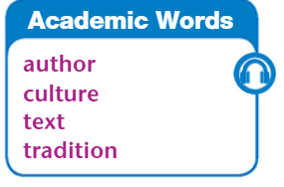
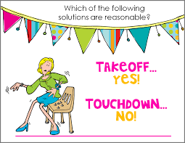
ISLAMIC EDUCATIONAL COLLEGE DATE: 9 + 10 /2/2025
SUBJECT: Vocabulary
GRADE: 10
UNIT: 4
Lesson: 1
OUTCOMES
WARM UP
PREASSESSMENT
PRESENTATION
FORMATIVE ASSESSMENT
FEEDBACK
DIFFERENTIATION
REAL LIFE APPLICATION
CRITICAL THINKING
EXIT TICKET

Slide 12
ISLAMIC EDUCATIONAL COLLEGE DATE: 9 + 10 /2/2025
SUBJECT: Vocabulary
GRADE: 10
UNIT: 4
Lesson: 1
OUTCOMES
01:30 minutes
WARM UP
What is the difference between “ culture and tradition”
Give examples from your country Jordan
PREASSESSMENT
PRESENTATION
FORMATIVE ASSESSMENT
FEEDBACK
DIFFERENTIATION
REAL LIFE APPLICATION
CRITICAL THINKING
EXIT TICKET

Slide 13
FEEDBACK
Culture (general way of life in Jordan):
Speaking Arabic
Strong family values
Hospitality to guests
Eating traditional food like mansaf
Appreciation for music and poetry
Traditions (specific practices in Jordan):
Celebrating Eid with special meals
Henna at weddings
Dabke dance at gatherings
Offering coffee and sweets to guests
Fasting during Ramadan

Slide 14
CRITICAL THINKING
Can reading about another culture change the way we think about our own? How?

Slide 15
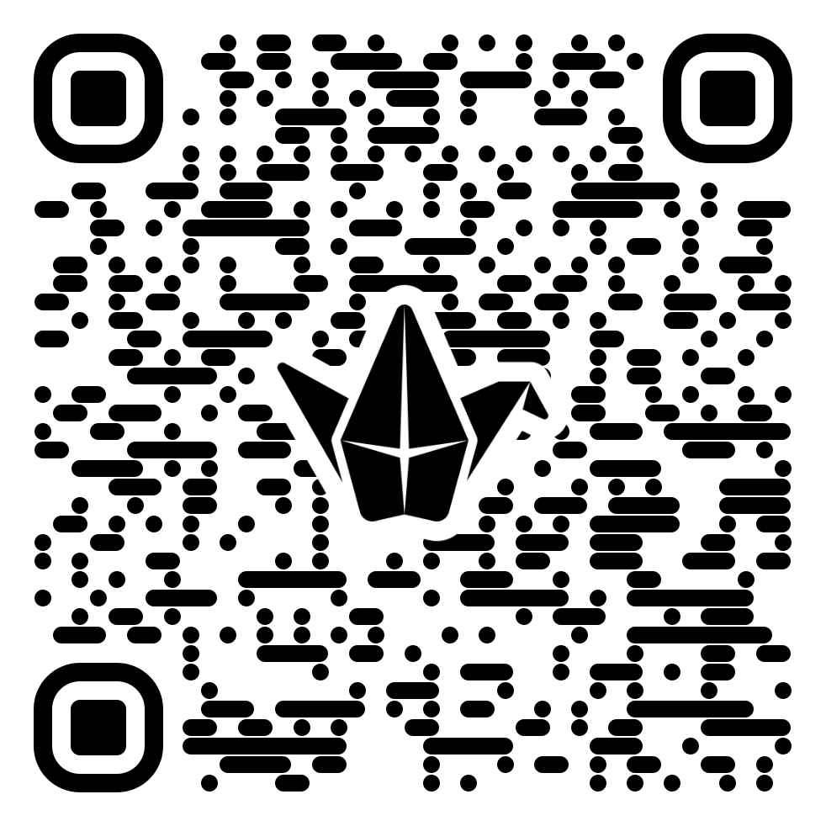


ISLAMIC EDUCATIONAL COLLEGE DATE:
SUBJECT: Vocabulary
GRADE: 10
UNIT: 4
Lesson: 1
OUTCOMES
EXIT TICKT
Write 2 things you have learnt today.
02:00 minutes
WARM UP
PREASSESSMENT
PRESENTATION
FORMATIVE ASSESSMENT
FEEDBACK
DIFFERENTIATION
REAL LIFE APPLICATION
https://padlet.com/alselaweamneh/bulletin-board-qlgm7pd39mp0q5za
CRITICAL THINKING
EXIT TICKET

