Slide 1

Unit: 1
Lesson: Grandmother Spider Brings the Sun.
Subject: Reading part 1
Grade: 9

Slide 2


ISLAMIC EDUCATIONAL COLLEGE DATE:
SUBJECT: Reading
GRADE: 9
UNIT: 4
Lesson: 1
LESSON
OBJECTIVES
OBJECTIVES:
1. to read for specific details in the myth
2. to identify the meanings of the new words in the text
3. to value the role of teamwork.
01:00 minute
WARM UP
PREASSESSMENT
PRESENTATION
FORMATIVE ASSESSMENT
FEEDBACK
DIFFERENTIATION
REAL LIFE APPLICATION
CRITICAL THINKING
EXIT TICKET

Slide 3
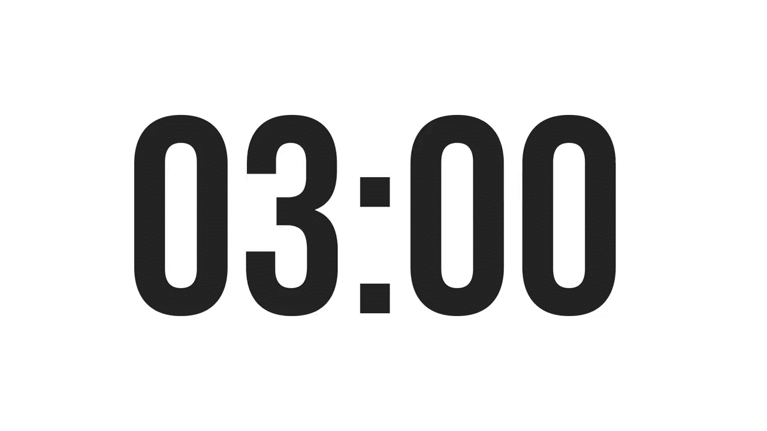
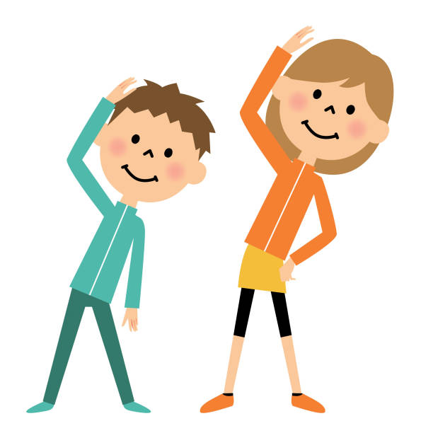

ISLAMIC EDUCATIONAL COLLEGE DATE:
SUBJECT: Reading
GRADE: 9
UNIT:1
Lesson: 1
OUTCOMES
03:00 minutes
“Imagine one side of the world has sunlight, and the other side is always dark. You live in the dark part, and it’s causing problems for everyone because they keep bumping into each other. You and the other animals must figure out how to bring some light to your side.”
WARM UP
PREASSESSMENT
PRESENTATION
FORMATIVE ASSESSMENT
FEEDBACK
Pair
1 min.
Think
I min.
Share
1 min.
DIFFERENTIATION
REAL LIFE APPLICATION
CRITICAL THINKING
EXIT TICKET

Slide 4
ISLAMIC EDUCATIONAL COLLEGE
SUBJECT: Reading
GRADE: 9
UNIT:1
Lesson: 1
OUTCOMES
PREASSESSMENT:
WARM UP
Question 1: Which of the following best defines a myth?
A) A humorous story passed down through generations. B) A traditional story explaining natural or social phenomena, typically involving supernatural beings or events. C) A factual historical account of significant events. D) A scientific explanation based on empirical evidence.
PREASSESSMENT
PRESENTATION
FORMATIVE ASSESSMENT
FEEDBACK
DIFFERENTIATION
REAL LIFE APPLICATION
CRITICAL THINKING
EXIT TICKET
IRS

Slide 5
ISLAMIC EDUCATIONAL COLLEGE
SUBJECT: Reading
GRADE: 9
UNIT: 1
Lesson: 1
OUTCOMES
PREASSESSMENT:
WARM UP
Question 2: One primary characteristic of myths is that they:
A) Are always written in poetic form. B) Involve gods, goddesses, or supernatural forces. C) Are set in the future. D) Focus exclusively on real-life events
PREASSESSMENT
PRESENTATION
FORMATIVE ASSESSMENT
FEEDBACK
DIFFERENTIATION
REAL LIFE APPLICATION
CRITICAL THINKING
EXIT TICKET
IRS

Slide 6
ISLAMIC EDUCATIONAL COLLEGE
SUBJECT: Reading
GRADE: 9
UNIT: 1
Lesson: 1
OUTCOMES
PREASSESSMENT:
WARM UP
Question 3: Myths often serve to:
A) Entertain without conveying any deeper meaning. B) Provide a literal account of historical events. C) Explain the origins of the world and human existence. D) Detail scientific discoveries.
PREASSESSMENT
PRESENTATION
FORMATIVE ASSESSMENT
FEEDBACK
DIFFERENTIATION
REAL LIFE APPLICATION
CRITICAL THINKING
EXIT TICKET
IRS

Slide 7
ISLAMIC EDUCATIONAL COLLEGE
SUBJECT: Reading
GRADE: 9
UNIT: 1
Lesson: 1
OUTCOMES
PREASSESSMENT:
WARM UP
Question 4: Myths are typically passed down through:
A) Scientific journals. B) Oral tradition and storytelling. C) Legal documents. D) Commercial advertisements.
PREASSESSMENT
PRESENTATION
FORMATIVE ASSESSMENT
FEEDBACK
DIFFERENTIATION
REAL LIFE APPLICATION
CRITICAL THINKING
EXIT TICKET
IRS

Slide 8
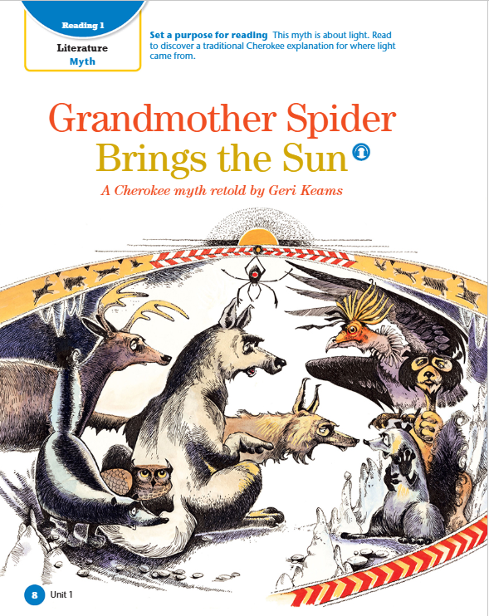
Before Reading questions :
• What do you think this selection will be about? Why do you think that?
• What characters do you think might be in this story?
• What do you know about the topic of this unit?
• What are you wondering about as you look at the pictures of this text?

Slide 9

What is meant by “Cherokee”?

Slide 10
A long time ago it is said that half the world had the sun, but the other side of the world was very dark. It was so dark that all the animals were always bumping into each other and getting lost. Wolf lived on this side of the world. He was tired of everybody bumping into him and asking him for directions, for you see, Wolf could see in the nighttime. Wolf gathered all the animals together in a big cave. He got up in front of them and crossed his arms, and he said, “I am tired of everybody bumping into me and asking me for directions.” “I have an idea,” he said. “I think we should go to the other side of the world and ask them for a piece of their sun. I think if we’re nice, they’ll give us a piece.” Another animal jumped up. This was Coyote, known as the trickster because he lies and cheats and steals. Coyote said, “No, no, no, no, no! I don’t think we should be so nice! If they’re so nice, how come they haven’t offered us a piece of their sun?” The other animals nodded in agreement. “I have a better idea,” Coyote said. “I think we should sneak over there and just steal a piece. ”Steal a piece!” said Wolf. “What are you talking about, Coyote?” “Calm down, calm down, calm down,” Coyote said. “We’re not going to steal a big piece. We’ll only take a little piece. They’ll never even miss it.”

Slide 11
Onomatopoeia (bumping) → shows the constant noise of animals hitting each other in the dark, which helps the reader hear and imagine the confusion they live in.
Repetition → phrases like “bumping into me and asking me for directions” and “no, no, no, no, no” show the character’s feelings clearly. It emphasizes Wolf’s frustration and Coyote’s insistence, making their emotions and personalities stand out.
Irony appears because Wolf, who can see in the dark, complains the most, and because he believes kindness will work even though the other side never shared the sun—this makes the reader see the contrast between expectation and reality.

Slide 12

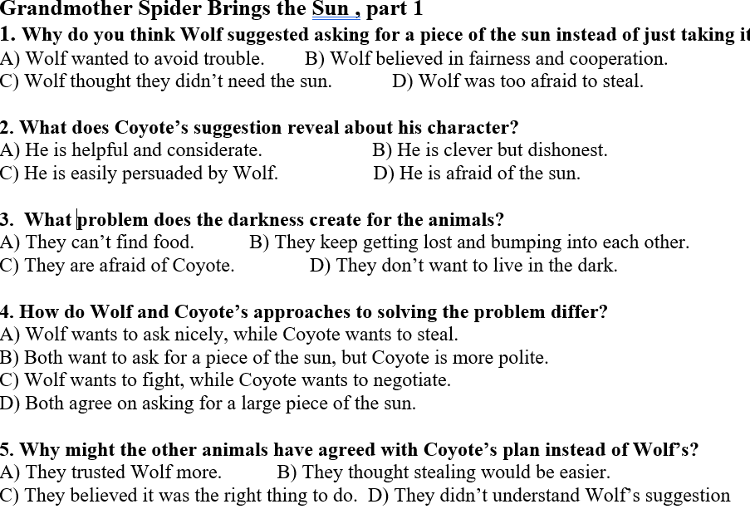

Answer , highlight the answers ,scan the code, type your names , take a picture , post on Padlet, celebrate
05:00 minutes
https://padlet.com/alselaweamneh/my-shiny-padlet-79o364n9hwxgsse7

Slide 13
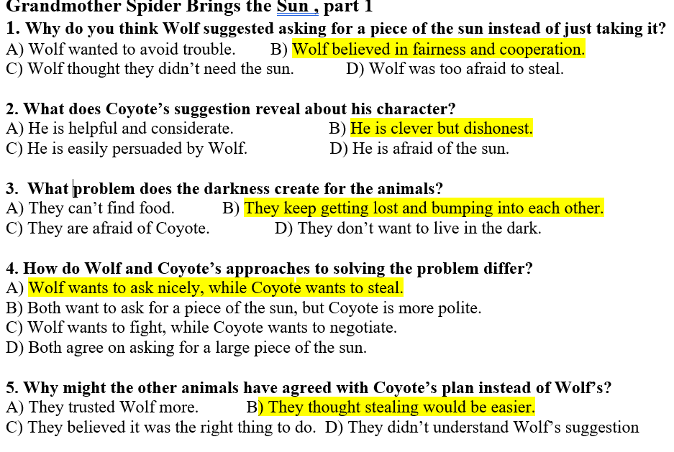

Slide 14
REAL LIFE APPLICATION
Choose a question , think about it AND THEN SHARE IT WITH YOUR GROUP
If you were in the animals’ place, what would you do differently and why? How does it connect to honesty and fairness in your life?
How did the other animals’ choice show that peer influence can affect decisions? Can you give a real-life example?

Slide 15
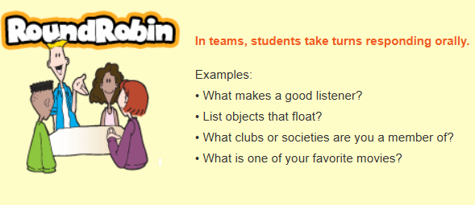
WARM UP
Story elements
Setting
Characters
Problem
Events
Theme/message
03:00 minutes

Slide 16
Story elements
Setting | * A long time ago, in a dark part of the world where there was no sun. * In a big cave where the animals gathered.
Characters | * Wolf → can see in the dark, feels annoyed, wants a fair solution. * Coyote → a trickster, clever but dishonest, suggests stealing. * Other animals → supporting group, listening and agreeing.
Problem | * Half the world has the sun, but the animals’ side is dark. * They keep bumping into each other and getting lost.
Events | * Wolf gathers the animals. * Wolf suggests politely asking for a piece of the sun. * Coyote interrupts, says they should steal instead. * The animals agree with Coyote.
Theme /message | * Different ways to solve a problem: kindness vs trickery. * Sometimes tricksters influence others with clever words.

Slide 17
Predict

Slide 18
Who will go
Describe the new character
How will the character steal a piece from the sun

Slide 19
As you read , highlight onomatopoeia , repetition, irony and compound nouns
Then all the animals began asking, “Who is going to go to the other side of the world? How will they get there?” Everybody had an idea, but none seemed quite right. Then from the back of the room came a small voice. “Hey, I’ll go! I’ll go!” Wolf said, “Who is that? Come down here. I can’t see you. ”Down to the front of the room came a little round animal with chubby cheeks. He was shy and quiet. He stood up in front of all the animals, and as he looked at all those hundreds of eyes looking back at him, he got kind of scared. He looked out over the crowd of animals and he said in his timid voice, “Hi. M-m-m-my name is Possum. I think I can go to the other side of the world. You see, I’ve got these long, sharp claws, and I think I can dig a tunnel. And when I go all the way to the other side of the world, I’ll take a piece of the sun and I’ll hide it in my big, bushy tail.” And Wolf said, “Oh, a tunnel! That’s the best idea yet!” So Possum went to the big wall of dirt at the back of the cave, stuck in his sharp claws, and began to dig and dig and dig and dig, faster and faster and faster and faster. Possum disappeared inside the tunnel, and soon he had gone all the way to the other side of the world

Slide 20
As you read , highlight onomatopoeia , repetition, irony and compound nouns
Then all the animals began asking, “Who is going to go to the other side of the world? How will they get there?” Everybody had an idea, but none seemed quite right. Then from the back of the room came a small voice. “Hey, I’ll go! I’ll go!” Wolf said, “Who is that? Come down here. I can’t see you. ”Down to the front of the room came a little round animal with chubby cheeks. He was shy and quiet. He stood up in front of all the animals, and as he looked at all those hundreds of eyes looking back at him, he got kind of scared. He looked out over the crowd of animals and he said in his timid voice, “Hi. M-m-m-my name is Possum. I think I can go to the other side of the world. You see, I’ve got these long, sharp claws, and I think I can dig a tunnel. And when I go all the way to the other side of the world, I’ll take a piece of the sun and I’ll hide it in my big, bushy tail.” And Wolf said, “Oh, a tunnel! That’s the best idea yet!” So Possum went to the big wall of dirt at the back of the cave, stuck in his sharp claws, and began to dig and dig and dig and dig, faster and faster and faster and faster. Possum disappeared inside the tunnel, and soon he had gone all the way to the other side of the world

Slide 21
Repetition
“I’ll go! I’ll go!” → shows eagerness and courage.
“Dig and dig and dig and dig, faster and faster and faster and faster” → emphasizes effort and speed.
M-m-m-my → imitates stuttering, sound of nervous speech.
speech-onomatopoeia because it imitates how someone speaks.
Possum is small and timid, yet he volunteers for a dangerous mission — contrast between appearance and action.

Slide 22
Go to kahoot, enter the pin , play
https://create.kahoot.it/details/67a0f0c9-8f10-4684-bb78-3fc671af4f08

Slide 23
REAL LIFE APPLICATION
Can you think of a time in real life when someone small or unlikely did something brave, like Possum?

Slide 24
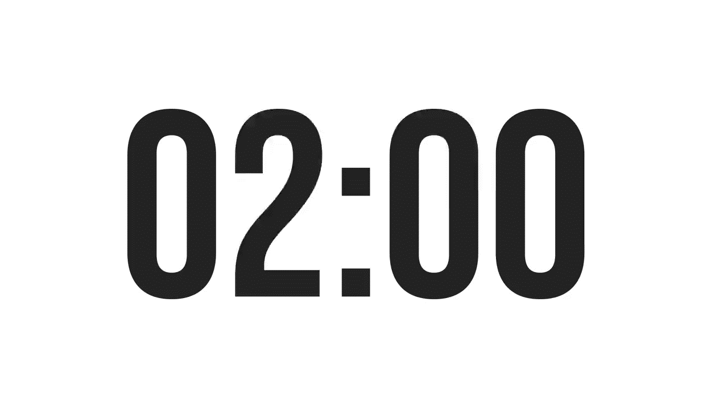
ISLAMIC EDUCATIONAL COLLEGE
SUBJECT: Reading
GRADE: 9
UNIT: 1
Lesson: 1
OUTCOMES
WARM UP
How does the description of the “hundreds of eyes” observing Possum enhance the tension, and what does it suggest about social pressure or peer observation?
PREASSESSMENT
PRESENTATION
FORMATIVE ASSESSMENT
FEEDBACK
Buzz in
DIFFERENTIATION
REAL LIFE APPLICATION
CRITICAL THINKING
EXIT TICKET

Slide 25
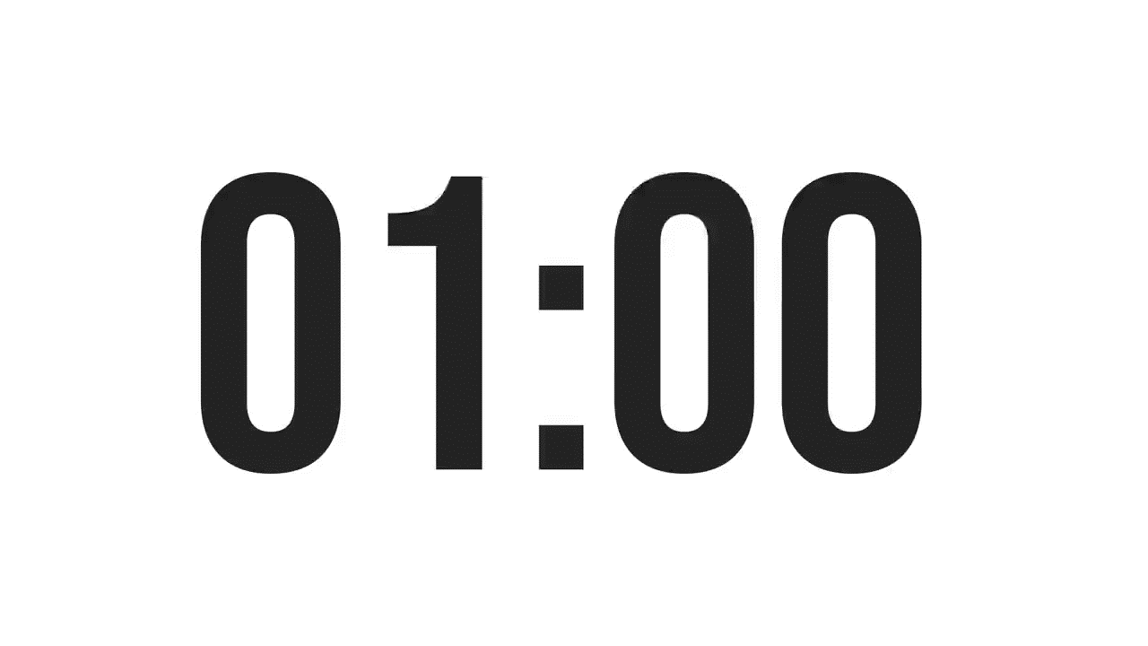
ISLAMIC EDUCATIONAL COLLEGE
SUBJECT: Reading
GRADE: 9
UNIT: 1
Lesson: 1
REAL LIFE APPLICATION:
Choose a question , think about it ND THEN SHARE IT WITH YOUR GROUP
Instructions: Read parts 1 and 2 of the story carefully. Then answer the questions below. Use examples from your own life or people you know.
Cooperation: How did the animals help each other in the story? Can you think of a time you worked with someone to solve a problem? What happened?
Jealousy or Envy: Did any animals act out of jealousy or selfishness? Have you ever felt jealous of someone? How did you handle it?
Problem-Solving: The animals had to find ways to help Grandmother Spider with the light. Can you describe a time when you or your friends had to solve a difficult problem together? What strategy did you use?
Consequences of Actions: How did the animals’ actions affect the story’s outcome? Can you give an example from your life where your choice made a positive or negative difference?
OUTCOMES
01:00 minute
WARM UP
PREASSESSMENT
PRESENTATION
FORMATIVE ASSESSMENT
FEEDBACK
DIFFERENTIATION
REAL LIFE APPLICATION
CRITICAL THINKING
EXIT TICKET
BUZZ IN

Slide 26
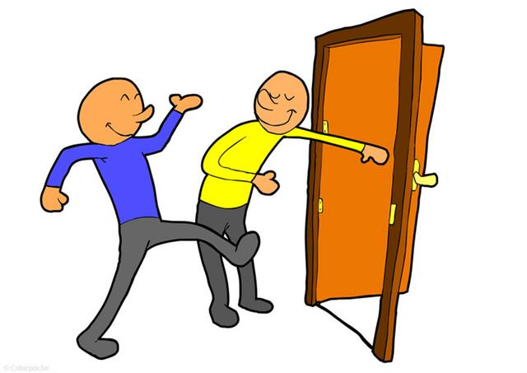
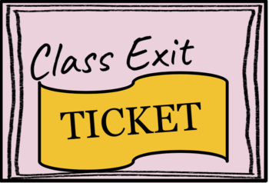
ISLAMIC EDUCATIONAL COLLEGE DATE:
SUBJECT: Reading
GRADE: 9
UNIT: 1
Lesson: 1
OUTCOMES
EXIT TICKT
What did you learn from today’s lesson ?
02:00 minutes
WARM UP
PREASSESSMENT
PRESENTATION
FORMATIVE ASSESSMENT
FEEDBACK
DIFFERENTIATION
REAL LIFE APPLICATION
CRITICAL THINKING
EXIT TICKET
BUZZ IN

Slide 27

ISLAMIC EDUCATIONAL COLLEGE DATE:
SUBJECT: Reading
GRADE: 10
UNIT: 1
Lesson: 1
OUTCOMES
Revise the previous material
03:00 minutes
WARM UP
PREASSESSMENT
PRESENTATION
FORMATIVE ASSESSMENT
FEEDBACK
DIFFERENTIATION
REAL LIFE APPLICATION
CRITICAL THINKING
https://create.kahoot.it/details/0d350b1a-01b0-497d-8e7d-dc9238255bb2
EXIT TICKET

Slide 28
As you read , highlight onomatopoeia , repetition, irony and compound nouns
Now, Possum had never seen the sun, so when he popped out on the other side, the light hit his eyes, and he was blinded. His eyes got all squinty and he rubbed them with his dirty fists, saying, “Hey! I can’t see!” Well, you know, Possum’s eyes have been squinty and ringed with dirt ever since.
Possum struggled over to the sun, took a little piece, and put it inside his big ol’ bushy tail. Then he turned around and came running back down the tunnel.
Possum ran faster and faster and faster and faster. Something started to get hot inside his tail, but Possum kept running, faster and faster. That something got hotter, and Possum kept running faster, and he soon ran into the room where all the animals were waiting. They all saw smoke coming out of his tail, and they screamed, “Possum! Your tail! Your tail!” an threw water on him. Whoosh! Whoosh! Whoosh! The light was gone .When the smoke had cleared, Wolf looked up and said, “Oh, no, Possum! Look at your tail! It’s all skinny!”
And you know, Possum’s tail has been this way ever since.

Slide 29
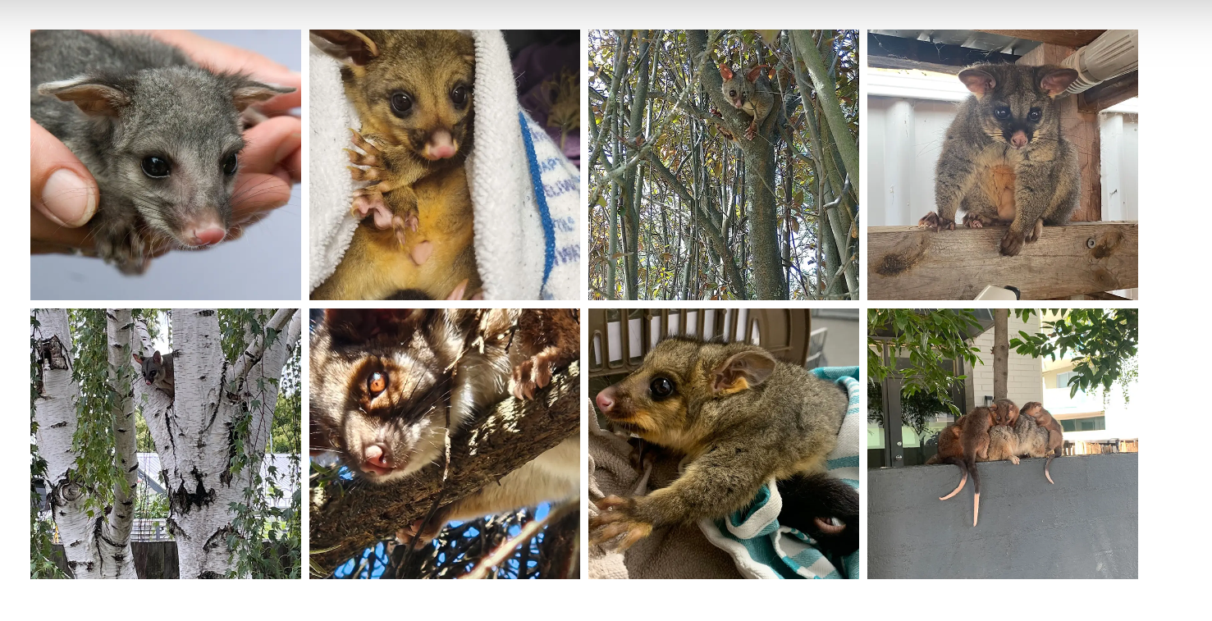
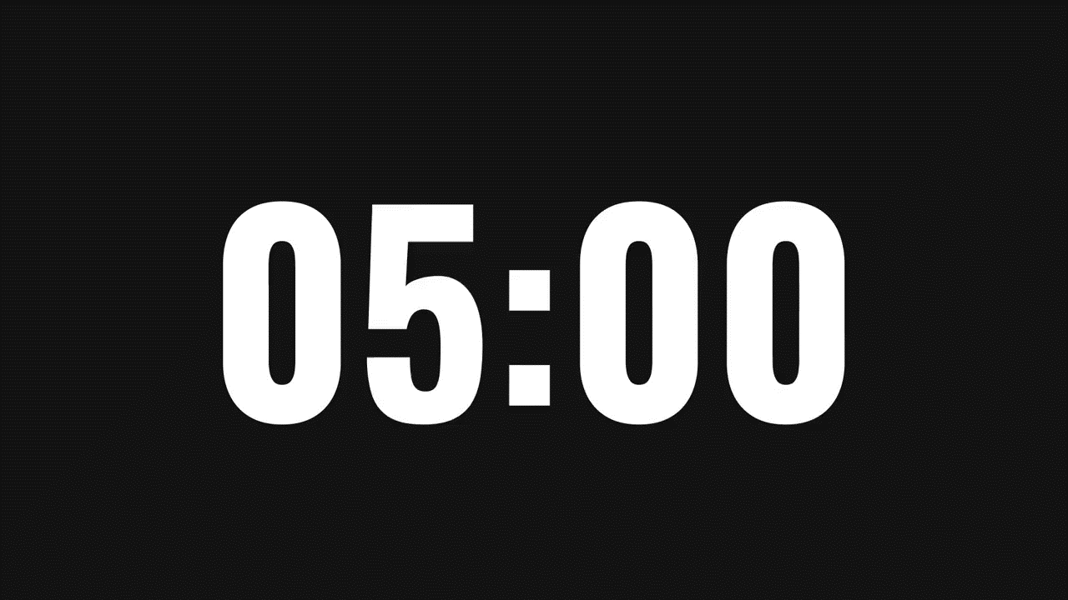
ISLAMIC EDUCATIONAL COLLEGE
SUBJECT: Reading
GRADE: 9
UNIT: 1
Lesson: 1
OUTCOMES
Part 3
05:00 minutes
WARM UP
PREASSESSMENT
Students 1+ 3 :
Read the previous Part of the text and then answer the given questions using rally coach strategy
Students 2+ 4 :
Read the previous Part of the text and then answer the given questions using rally coach strategy
PRESENTATION
FORMATIVE ASSESSMENT
FEEDBACK
DIFFERENTIATION
REAL LIFE APPLICATION
CRITICAL THINKING
EXIT TICKET

Slide 30
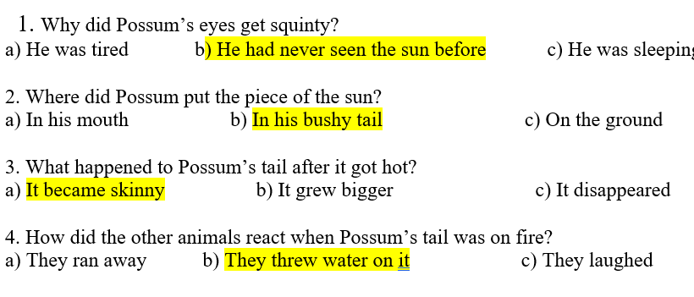

Slide 31
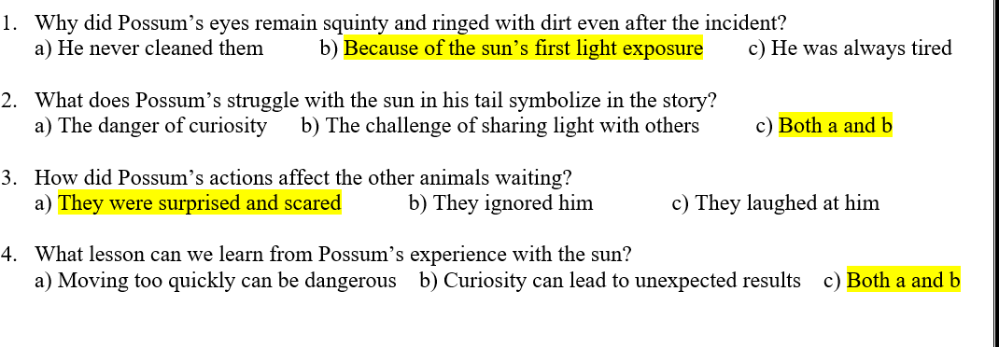

Slide 32
faster and faster and faster and faster. (Repetition emphasizes Possum’s urgency and the growing tension.)
Possum! Your tail! Your tail!” (Repetition emphasizes their panic.)
Whoosh! Whoosh! Whoosh! (Onomatopoeia imitates the sound of the smoke/fire, making the scene more vivid.)
(Irony: Possum tried to help by bringing back the sun, but instead he accidentally damaged his tail. The result is the opposite of his intention, creating humor and surprise.)

Slide 34
CRITICAL THINKING
How does this myth explain why possums have skinny tails? What does this tell us about the purpose of myths?

Slide 35
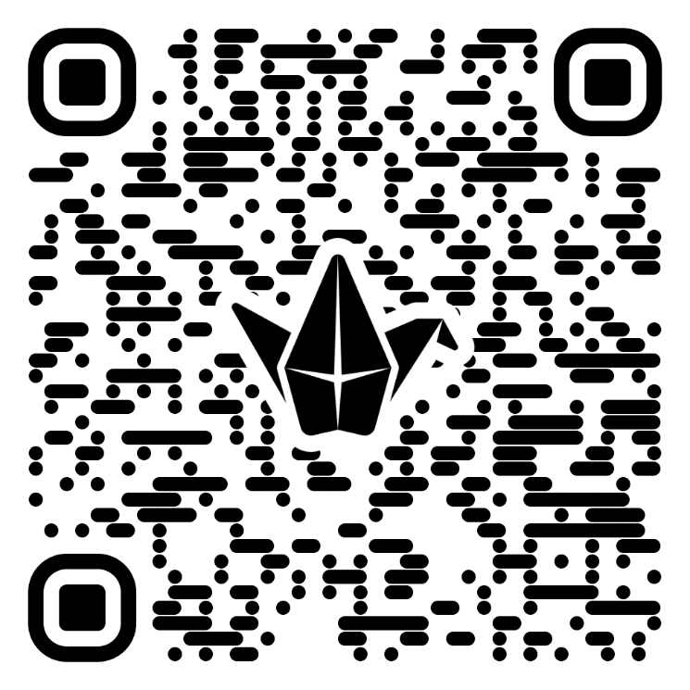
ISLAMIC EDUCATIONAL COLLEGE DATE:
SUBJECT: Reading
GRADE: 9
UNIT: 1
Lesson: 1
OUTCOMES
EXIT TICKT
What did you learn from today’s lesson ?
02:00 minutes
https://padlet.com/alselaweamneh/a-lesson-you-learned-ombexa33pnfjxh89
WARM UP
PREASSESSMENT
PRESENTATION
FORMATIVE ASSESSMENT
FEEDBACK
DIFFERENTIATION
REAL LIFE APPLICATION
CRITICAL THINKING
EXIT TICKET
BUZZ IN

Slide 36
Wolf said, “We still don’t have any sun. What are we going to do now? ”A loud voice from the back of the room said, “Send me! I’ll go! ”Down to the front stormed a large bird with long black feathers all over his body, and a crown of feathers on top of his head. He held his head high and stuck his chest out as he marched importantly past the other animals. You see, this bird was a show-off. He thought he was the most beautiful bird alive. He stood up in front of all the animal people and he said, “It’s me, Big Bad Buzzard. I’ll go to the other side of the world and it won’t take me long at all, but I wouldn’t be so dumb as to hide the light in my tail. I’m gonna hide it in my beautiful crown of feathers.”Buzzard jumped into the tunnel and soared through the darkness, and it didn’t take long at all until he came out on the other side. Buzzard took a little piece of sun, put it inside his crown of feathers, turned around, and soared back down the tunnel faster and faster and faster and faster. As he came down the tunnel, something started to get hot on top of his head. Buzzard soared faster and faster, and something got hotter and hotter. Faster he soared, and soon he came into the room where all the animals were waiting.

Slide 37
Repetition:
“faster and faster and faster and faster” – emphasizes Buzzard’s speed and creates tension.
“hotter and hotter” – emphasizes the growing danger of the sun’s heat.

Slide 38
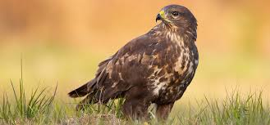
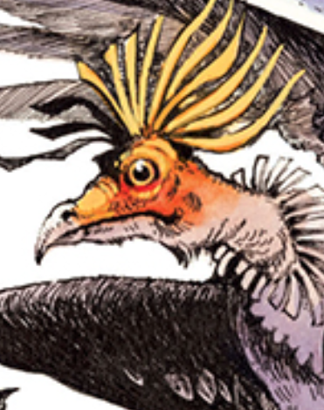

Slide 39
Q1. Why did Buzzard volunteer to go to the other side of the world? a) Because he was the strongest animal b) Because he thought he was the most beautiful bird c) Because Wolf asked him directly d) Because the other animals forced him
Q2. What does Buzzard’s choice of hiding the sun in his crown of feathers reveal about his character? a) He was clever and wise b) He was vain and proud c) He was humble and generous d) He was fearful and hesitant
Q3. What problem did Buzzard face on his way back? a) He got lost in the tunnel b) His wings became weak c) His head started to get hot d) The sun piece fell from his feathers
Q4. The repetition of the phrase “faster and faster” in the passage most likely shows: a) Buzzard’s growing fear b) Buzzard’s increasing speed and urgency c) The animals cheering for Buzzard d) The narrator’s confusion
Q5. What lesson can be learned from Buzzard’s experience? a) Teamwork is always better than working alone b) Pride and vanity can lead to problems c) Animals should never try to control the sun d) The fastest animal is always the most successful

Slide 40
ISLAMIC EDUCATIONAL COLLEGE DATE:
SUBJECT: Reading
GRADE: 9
UNIT: 1
Lesson: 1
OUTCOMES
03:00 minutes
Critical Thinking
WARM UP
PREASSESSMENT
PRESENTATION
Students 1+3 :
1. What does Buzzard’s behavior teach us about how pride can affect decision-making?
2. If you were one of the animals watching, would you have chosen Buzzard for this task? Why or why not?
3.How might the story be different if Buzzard had hidden the sun in a safer place, like his wings or tail?
Students 2+4 :
Why do you think Buzzard wanted to hide the sun in his crown of feathers instead of his tail?
What could happen if Buzzard dropped the piece of sun in the tunnel?Do you think the other animals trusted Buzzard to bring back the sun? Why or why not?
FORMATIVE ASSESSMENT
FEEDBACK
DIFFERENTIATION
REAL LIFE APPLICATION
CRITICAL THINKING
EXIT TICKET

Slide 41
ISLAMIC EDUCATIONAL COLLEGE
SUBJECT: Reading
GRADE: 9
UNIT: 1
Lesson: 1
OUTCOMES
Real Life Application
WARM UP
PREASSESSMENT
✨ Real-Life Application Question: Buzzard thought he was the most beautiful bird and wanted to show off, but his pride caused him trouble when the sun burned his crown of feathers.
Question for Students: Can you think of a time in school or daily life when someone wanted to show off or act better than others, but it ended up causing a problem? How could they have acted differently to avoid that mistake?
PRESENTATION
FORMATIVE ASSESSMENT
FEEDBACK
DIFFERENTIATION
REAL LIFE APPLICATION
CRITICAL THINKING
EXIT TICKET

Slide 42

Page 10
They looked up, and they saw smoke coming from
Buzzard’s head. “Oh, no! Buzzard! Your head! Your head!” They got water
and Whoosh! Whoosh! Whoosh! The light went out.
Wolf looked up and said, “Buzzard! You’re bald!”
All of Buzzard’s feathers crackled and fell down to the ground. Big Bad
Buzzard got so shy and quiet that he ran and hid in the back of the room.
And you know, Buzzard has been bald ever since, and he still doesn’t like
anybody looking at him

Slide 43
REAL LIFE APPLICATION
: Buzzard has been shy ever since. Can you describe a time you avoided people after feeling embarrassed, and what you did (or could do) to feel confident again?

Slide 44
Wolf said, “Possum’s burned his tail off and now Buzzard’s bald, and we still don’t have any sun. What are we going to do now?” A tiny voice from up above said, “Send me, I’ll go! Hey, send me, I’ll go! I’ll go!” Wolf looked all around, but he couldn’t tell where the voice was coming from. “Who is that? Where are you? Come down where I can see you.” Down from the corner of the ceiling squeaked the tiny voice: “Send meeeeeee!”And right there in front of Wolf landed a tiny spider. The spider looked up and Wolf looked down, and Wolf said, “Oh, no! Not you, Grandma! You can’t go to the other side of the world. You’re too old—and besides that, you’re too slow!” Well, this was Grandmother Spider. She had done many things to help the animals in her long life. She crossed her little arms and said, “I know I’m old. You don’t have to tell me I’m old. But I want to help my people one more time. I need a piece of clay about so big, and you’ll get me a piece, won’t you, son ?

Slide 45
Squeaked : made short high-pitched sound

Slide 46
WARM UP
Warm up
Recall events from the previous class
Who volunteered to go and get a piece of the sun after buzzard’s return??

Slide 47
Wolf went and got Grandmother Spider a piece of clay, and she sat in the middle of the room and began to chant. Soon she had worked the clay into a little bowl. She picked up that beautiful clay bowl and disappeared inside the tunnel. They say it took Grandma Spider a long, long, long, long time to get to the other side of the world. The Sun Guards were out now. They knew somebody was trying to steal some of their sun, and they stood in a tight circle around it. They weren’t going to let anybody through. The Sun Guards were mean-looking monsters. They had fire coming out of their heads. They had fire coming out of their mouths: Hissssss! And they held their weapons, ready for a fight. But Grandmother Spider was so tiny that they didn’t even see her. She sneaked between them, went up to the sun, took a little piece, put it in her clay bowl, and sneaked back past the Sun Guard.

Slide 48
Chant: to repeat or sings a word or phrase continuously

Slide 49
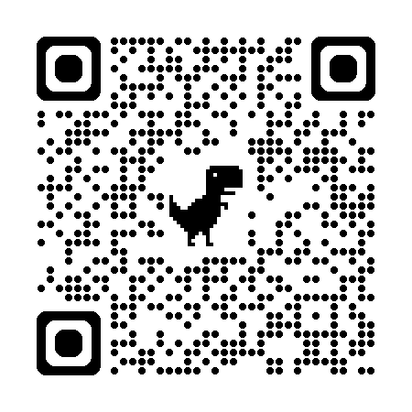
Onomatopoeia (words that imitate sounds)
“Hissssss!” → the sound of the Sun Guards’ fire
“squeaked the tiny voice” → the sound the spider makes
Irony (when the outcome is opposite to what is expected)
Grandmother Spider is tiny and old, yet she succeeds where big and strong animals (Possum and Buzzard) failed.
Expected: Only strong or fast animals could get the sun.
Reality: The tiny, old spider succeeds.
Repetition (words or phrases repeated for emphasis)
“long, long, long, long time” → shows how slow and patient she was
“Send me, I’ll go! Hey, send me, I’ll go! I’ll go!” → emphasizes her determination
Take the quiz..
https://pe.app/a/questions/933304557

Slide 50

ISLAMIC EDUCATIONAL COLLEGE
SUBJECT: Vocabulary
GRADE: 9
UNIT: 4
Lesson: 1
OUTCOMES
Part 3
05:00 minutes
WARM UP
PREASSESSMENT
Students 1+ 3 :
Read the previous Part of the text and then answer the given questions using rally coach strategy
Students 2+ 4 :
Read the previous Part of the text and then answer the given questions using rally coach strategy
PRESENTATION
FORMATIVE ASSESSMENT
FEEDBACK
DIFFERENTIATION
REAL LIFE APPLICATION
CRITICAL THINKING
EXIT TICKET

Slide 51

ISLAMIC EDUCATIONAL COLLEGE
SUBJECT: Vocabulary
GRADE:
UNIT: 4
Lesson: 1
OUTCOMES
FORMATIVE ASSESSMENT:
WARM UP
PREASSESSMENT
PRESENTATION
FORMATIVE ASSESSMENT
FEEDBACK
DIFFERENTIATION
REAL LIFE APPLICATION
CRITICAL THINKING
EXIT TICKET

Slide 52
She came back down the tunnel very slowly. It took her a long, long, long, long time to get to her side of the world. And as she got closer, something happened. The light inside her bowl began to grow. The little rays stretched out of the bowl. As she came out of the tunnel into the cave, that ball of light was growing. She could hardly even carry it. All the animals came running to help Grandmother Spider: blind Possum and bald Buzzard, Wolf and Coyote and Bear and Deer and all the others. But that ball of light just kept getting bigger and bigger and bigger and bigger, and it got so big that the animals had to squeeze it out of the cave, and as it squeezed out into the world it bounced up into the sky: Boingggg! It is said that from that day on, whenever Grandmother Spider would spin her web, the shape of the sun would be at the center. And you see, Grandmother Spider spins her web that way to this very day.

Slide 53
Onomatopoeia “Boingggg!” → This imitates the real sound of something springing or bouncing. The word sounds like the action itself, which is the essence of onomatopoeia.
2. Repetition “a long, long, long, long time” → Repeating long emphasizes how slowly she moved and how much effort it took.
“bigger and bigger and bigger and bigger” → Repetition here highlights the rapid growth of the ball of light and builds tension for the reader.
3. Irony: The animals tried and failed to bring the light, but the smallest and seemingly weakest (Grandmother Spider) succeeded. That’s situational irony because readers expect strong animals like Bear or Wolf to succeed, not a tiny spider.
Another layer: The ball of light was too heavy for her to carry alone, yet it ended up becoming the sun—something no one could ever “carry.”✨ So:

Slide 54
Differentiation in product
Performance : Group Work.
Task : Each group should add another animal character who tried to go the other side of the world to get a piece of the sun .Explain how the sun shaped that animal .
Time : 5 minutes .

Slide 55
ISLAMIC EDUCATIONAL COLLEGE
SUBJECT: Vocabulary
GRADE:
UNIT: 4
Lesson: 1
OUTCOMES
Padlet
WARM UP
PREASSESSMENT
🌿 Real-Life Application Task
Task: Think about Grandmother Spider. She was small, old, and slow, yet she succeeded because she was wise, patient, and determined.
👉 Question for Students: Can you give a real-life example (from school, family, or your community) where someone who seemed weak, small, or less powerful was able to succeed because of their cleverness, wisdom, or determination?
PRESENTATION
FORMATIVE ASSESSMENT
FEEDBACK
DIFFERENTIATION
REAL LIFE APPLICATION
CRITICAL THINKING
EXIT TICKET

Slide 56
EXIT TICKT
What did you learn from today’s lesson ?
https://padlet.com/alselaweamneh/a-lesson-you-learned-ombexa33pnfjxh89

Slide 57
Review and Practice
ANSWERS1. Wolf is tired of the darkness because the animals are always bumping into him and asking for directions. He proposes that they ask the other side of the world for a piece of the sun.
2. Coyote thinks Wolf’s idea is too polite and nice.
3. Buzzard changes from proud and boastful to shy and embarrassed.
4. The myth explains why possums have a tail without fur and why buzzards are bald.
5. The author wishes the reader to respect Grandmother Spider the most. She is wise, thoughtful, willing, and determined.
6. The author uses sound effects, such as repetition and onomatopoeia, and informal language to make the story sound as though it is being told by a storyteller.
7. Answers will vary.
8. Answers will vary.
Possible answers: This myth explains how the sun came to the world and why some animals (such as the possum) look the way they do

Slide 58


Summative assessment
* I know all the characters in the myth and their roles
* I know the sequence of events and I can tell the story from my mind.
* I know why it is called a myth .

