Slide 1

Unit: 1 “ Grandmother Spider Brings the Sun”
Lesson: Grammar .
Subject: Question Tags .
Grade: 9

Slide 2
LESSON 1

Slide 3



SUBJECT: Grammar
GRADE: 9
UNIT: 4
Lesson: 1
LESSON
OBJECTIVES
01:00 minute
WARM UP
Objectives
PREASSESSMENT
*1- To recognize different types of questions in English .
2- Identify helping verbs and their functions .
3-Structure question tags correctly with helping verbs.
PRESENTATION
FORMATIVE ASSESSMENT
FEEDBACK
DIFFERENTIATION
REAL LIFE APPLICATION
CRITICAL THINKING
EXIT TICKET

Slide 4
SUBJECT: Grammar
GRADE: 9
UNIT: 4
Lesson: 1
OUTCOMES
WARM UP
05:00 minutes
WARM UP
🌟 Warming-up Activity Speed Talk
Teacher Gives a topic (e.g., food).
Student A asks a question about the topic.
Student B answers.
Switch roles –
now Student B asks a question,
Student A answers.
Teacher Gives a new topic and they repeat the process.
Real Life Application
PRESENTATION
FORMATIVE ASSESSMENT
FEEDBACK
DIFFERENTIATION
REAL LIFE APPLICATION
CRITICAL THINKING
EXIT TICKET

Slide 5

SUBJECT: Grammar
GRADE: 9
UNIT: 1
Lesson: 1
OUTCOMES
04:00 minutes
What types of questions are there?
WARM UP
Real Life Application
CRITICAL THINKING
FORMATIVE ASSESSMENT
FEEDBACK
DIFFERENTIATION
REAL LIFE APPLICATION
PRESENTATION
EXIT TICKET

Slide 6
FEEDBACK
Yes/no questions : Did you study?
Wh- questions: what , where, who, when, why , how
Choice questions: would you like coffee or tea?
Indirect questions: could you tell me what time it is?
Tag questions : you studied, didn’t you?

Slide 7


Slide 8
ISLAMIC EDUCATIONAL COLLEGE DATE: / / 2025
SUBJECT: Grammar
GRADE: 9
Unit: 4
Lesson: 1
OUTCOMES
REAL LIFE APPLICATION
WARM UP
02:00 minutes
Why do people add short questions (like isn’t it? or don’t you?) at the end of a sentence when speaking?
Do you think question tags are only for asking questions, or can they also show politeness, surprise, or agreement? Why?
How do question tags help in real conversations compared to just saying a statement?
REAL LIFE APPLICATION
CRITICAL THINKING
PREASSESSMENT
FEEDBACK
FORMATIVE ASSESSMENT
PRESENTATION
BUZZ IN
DIFFERENTIATION
EXIT TICKET

Slide 9


ISLAMIC EDUCATIONAL COLLEGE DATE
SUBJECT: Grammar
GRADE: 9
UNIT:4
Lesson: 1
OUTCOMES
WARM UP
Pre assessment
REAL LIFE APPLICATION
CRITICAL THINKING
PREASSESSMENT
PRESENTATION
DIFFERENTIATION
FORMATIVE ASSESSMENT
FEEDBACK
EXIT TICKET

Slide 10
Tom: Hey, Sarah! ___ you ( be) coming to the game tonight?
01
02
03
Are
Is
Do

Slide 11
Sarah: Yes, I ___ ( be) planning to go. What about you?
01
02
03
are
am
have

Slide 12
Tom: I ___ ( do) not know yet. I have a lot of homework.
01
02
03
was
am
do

Slide 13
Sarah: That’s too bad. I heard the team ___ ( be) playing really well this season.
01
02
03
are
is
do

Slide 14
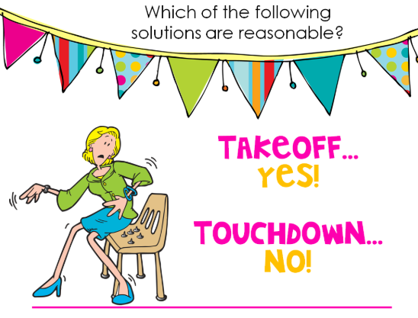
ISLAMIC EDUCATIONAL COLLEGE DATE: // 2025
SUBJECT: Grammar
GRADE: 9
UNIT: 4
Lesson: 1
OUTCOMES
Name the auxiliary verbs that you know
What are the functions of helping/auxiliaries verbs ?
WARM UP
REAL LIFE APPLICATION
CRITICAL THINKING
PREASSESSMENT
PRESENTATION
DIFFERENTIATION
FEEDBACK
FORMATIVE ASSESSMENT
EXIT TICKET

Slide 15
We use auxiliaries (helping verbs) because they support the main verb and give extra meaning to the sentence.
🔹 Functions of helping verbs:
Form tenses
She is reading. (present continuous)
They have finished. (present perfect)
Make negatives
I don’t like coffee.
She isn’t here.
Ask questions
Do you play football?
Is he coming?
Form passive voice
The homework was done.
The car is being washed.
Show possibility, necessity, or ability (modals)
She can swim.
We must study.
It might rain.
Be
Do
Have
Modal verbs: can , should, will ,…

Slide 16
ISLAMIC EDUCATIONAL COLLEGE DATE:
SUBJECT: Grammar
GRADE: 9
UNIT: 1
Lesson: 1
OUTCOMES
CRITICAL THINKING
03:00 minutes
WARM UP
Analyze : How can you tell if words like be, have, do, or modals are acting as a main verb or as a helping verb in a sentence? Give one example for each case.
PREASSESSMENT
PRESENTATION
FORMATIVE ASSESSMENT
FEEDBACK
DIFFERENTIATION
REAL LIFE APPLICATION
BUZZ IN
CRITICAL THINKING
EXIT TICKET

Slide 17
FEEDBACK
Be
Main verb: She is a teacher.
Helping verb: She is running.
Have
Main verb: I have a car.
Helping verb: I have finished my homework.
Do
Main verb: I do my homework every day.
Helping verb: Do you like pizza?
Modal (can, must, should, etc.)Always helping verbs: She can swim. (swim is the main verb).

Slide 18
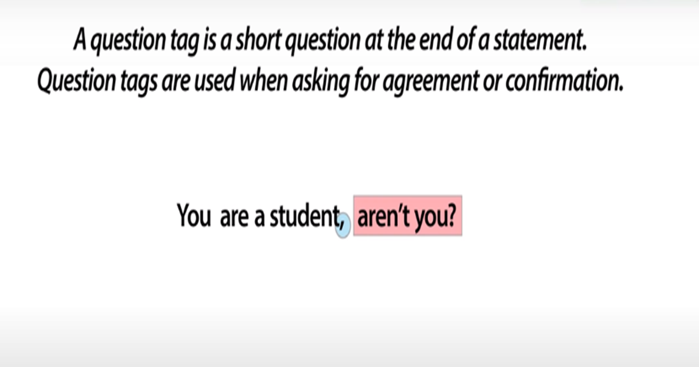
ISLAMIC EDUCATIONAL COLLEGE DATE: // 2025
SUBJECT: Grammar
GRADE: 9
UNIT: 4
Lesson: 1
OUTCOMES
05:00 minutes
WARM UP
REAL LIFE APPLICATION
CRITICAL THINKING
PREASSESSMENT
PRESENTATION
DIFFERENTIATION
FEEDBACK
FORMATIVE ASSESSMENT
EXIT TICKET

Slide 19
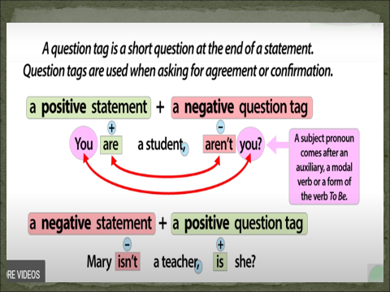

Slide 20
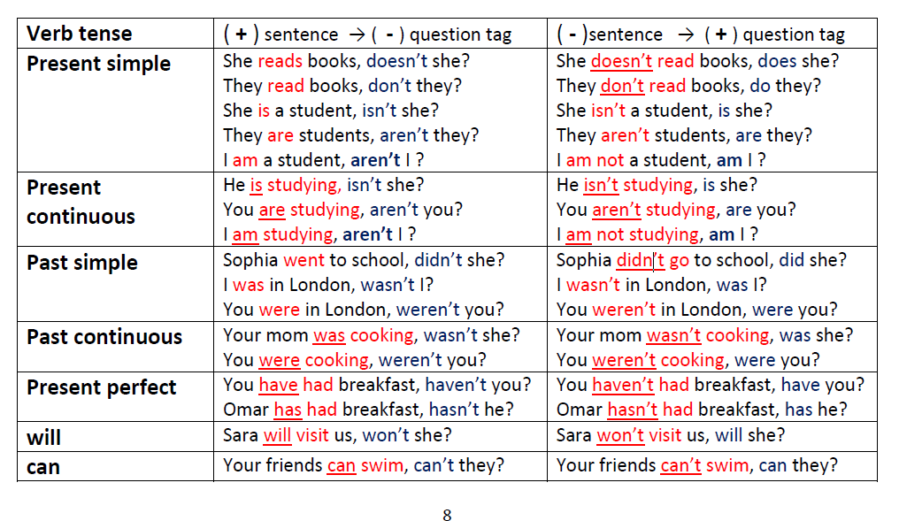

Slide 21

ISLAMIC EDUCATIONAL COLLEGE DATE:
SUBJECT: Grammar
GRADE: 9
UNIT: 1
Lesson: 1
OUTCOMES
05:00 minutes
Differentiation
WARM UP
Students 2+3
Students 1+4
PREASSESSMENT
Activity: “Challenge Statements”
Students work in pairs.
Each student writes 5 statements (real or imagined).
exchange papers with their partner, who must add the correct question tag to each statement.
Extra challenge: act out the dialogue using intonation to show certainty, surprise, or doubt
Match the sentences in Column A with the correct question tags in Column B.
PRESENTATION
FORMATIVE ASSESSMENT
FEEDBACK
DIFFERENTIATION
REAL LIFE APPLICATION
CRITICAL THINKING
EXIT TICKET

Slide 22
Column A
You’re a student, _e__
She can swim, _c__
They aren’t late, __b_
We have English today, _g__
He isn’t your brother, _h__
It’s a beautiful day, __a_
You don’t like coffee, f_
We should recycle, _d__
Column B – Question Tags a) isn’t it? b) are they? c) can’t she? d) shouldn’t we? e) aren’t you? f) do you? g) don’t we? h) is he?

Slide 23

ISLAMIC EDUCATIONAL COLLEGE DATE:
SUBJECT: Grammar
GRADE: 9
UNIT: 1
Lesson: 1
OUTCOMES
02:00 minutes
WARM UP
In your notebook , write three statements then add a question tag to each one
PREASSESSMENT
PRESENTATION
FORMATIVE ASSESSMENT
FEEDBACK
DIFFERENTIATION
REAL LIFE APPLICATION
CRITICAL THINKING
EXIT TICKET

Slide 24
This is your book, _________________?
That was a great movie, _______________?
These aren’t fresh, _____________?
There is a problem, _____________?
isn’t it
wasn’t it
are there
isn’t there
BUZZ IN

Slide 25
This / That / These
They are demonstrative pronouns (pointing words).
When they act as the subject of the sentence, the tag matches the demonstrative.
This is my bag, isn’t it? → this = subject.
That was funny, wasn’t it? → that = subject.
These are my friends, aren’t they? → these = subject.
There
It is an introductory / existential subject (it introduces the idea of something existing).
The tag always repeats there:
There is a problem, isn’t there?
There weren’t many people, were there?

Slide 26
Watch out for negative words (not only not). Words like never, hardly, scarcely, rarely, seldom, little, few all make the sentence negative in meaning.
He never talks in class, _____________?
does he

Slide 27

ISLAMIC EDUCATIONAL COLLEGE DATE: / / 2025
SUBJECT: Grammar
GRADE: 9
UNIT: 1
Lesson: 1
OUTCOMES
Formative assessment
WARM UP
PREASSESSMENT
Performance : Pair Work .
Time : 2 Minutes.
PRESENTATION
FORMATIVE ASSESSMENT
FEEDBACK
DIFFERENTIATION
REAL LIFE APPLICATION
CRITICAL THINKING
EXIT TICKET

Slide 28
ISLAMIC EDUCATIONAL COLLEGE DATE:
SUBJECT: Grammar
GRADE: 9
UNIT: 1
Lesson: 1
OUTCOMES
02:00 minutes
WARM UP
How do you ask for agreement or confirmation after let’s? give examples
PREASSESSMENT
PRESENTATION
FORMATIVE ASSESSMENT
FEEDBACK
DIFFERENTIATION
REAL LIFE APPLICATION
CRITICAL THINKING
EXIT TICKET

Slide 29
Scenario: Anna and Sara are sitting at home on a Friday evening. Anna: “I’m bored. What should we do?” Sara: “Let’s go to the park and have some ice cream,__________?”
Suggestions with let’s
Let’s go to the cinema, shall we?
Let’s not go to the cinema, shall we?

Slide 30

Read the following examples , what type of pronouns are somebody and nobody?
Give more examples of them.
Everyone is here, aren’t they?
No one called, did they?

Slide 31
ISLAMIC EDUCATIONAL COLLEGE DATE:
SUBJECT: Grammar
GRADE: 9
UNIT: 1
Lesson: 1
OUTCOMES
CRITICAL THINKING
03:00 minutes
WARM UP
Analyze and answer :
What do these indefinite pronouns refer to?
PREASSESSMENT
PRESENTATION
Something is wrong, isn’t it?
Nothing happened, did it?
FORMATIVE ASSESSMENT
FEEDBACK
DIFFERENTIATION
REAL LIFE APPLICATION
BUZZ IN
CRITICAL THINKING
EXIT TICKET

Slide 32
When indefinite pronouns refer to things (something, anything, nothing, everything), we usually use it in the tag.
Examples:
Everything is ready, ?
Anything can happen, ?
👉 So:
People → they
Things → it
isn’t it
can’t it

Slide 33
With indefinite pronouns like everyone, everybody, someone, somebody, no one, nobody, anyone, anybody (refer to people)→ we usually use they in the tag.
✅ Examples:
Anybody can join, ________________?
Nobody attended the event, __________________?
⚡ Key points:
Pronoun in the tag is they
If the sentence is negative (nobody, no one), the tag is positive: → Nobody came, did they?
If the sentence is positive, the tag is negative: → Everybody likes pizza, don’t they?
can’t they
did they

Slide 34
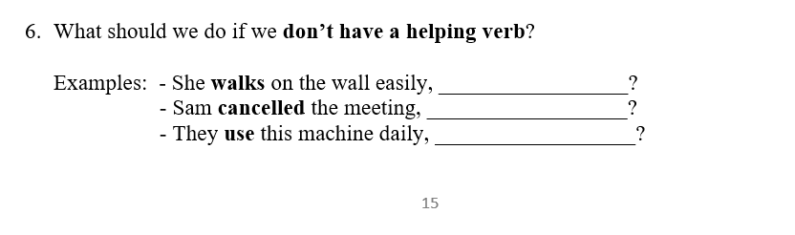

ISLAMIC EDUCATIONAL COLLEGE DATE: // 2025
SUBJECT: Grammar
GRADE: 9
UNIT: 4
Lesson: 1
OUTCOMES
02:00 minutes
WARM UP
REAL LIFE APPLICATION
CRITICAL THINKING
PREASSESSMENT
PRESENTATION
DIFFERENTIATION
FEEDBACK
FORMATIVE ASSESSMENT
EXIT TICKET

Slide 35
Suggestions with let’s
Let’s go to the cinema, shall we?
Let’s not go to the cinema, shall we?

Slide 36
Exit Ticket

Slide 37
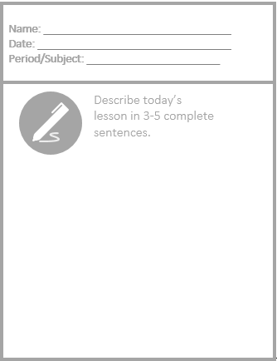
Exit Ticket

