Slide 1





Grade 5 National
What’s a folktale?

Slide 2




Story elements
Watch this short video and write on your whiteboards
Setting :Where does the story take place ?
Characters : main characters
Plot : How does the main character interact and solve the problem ?
Theme : What’s the message or the moral in the story ?

Slide 3

Warm up:

Slide 4
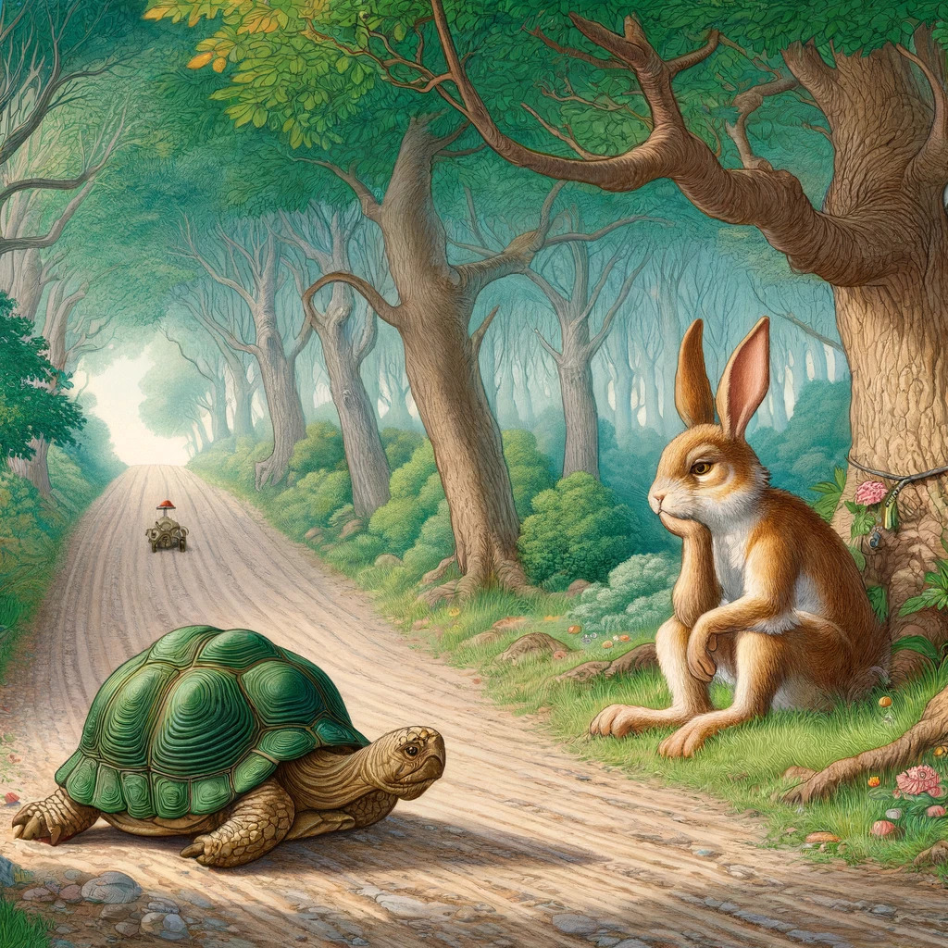

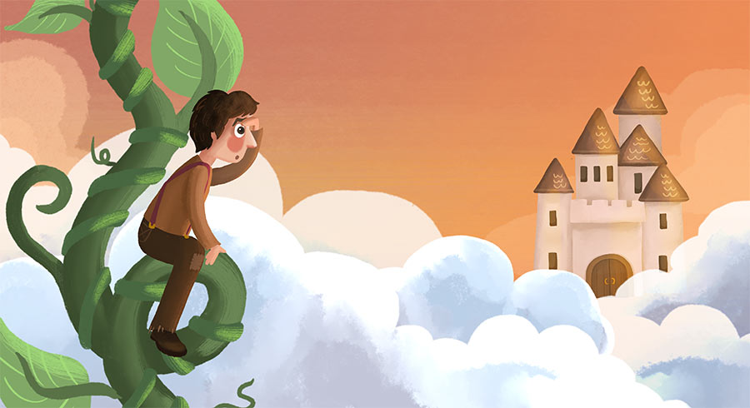
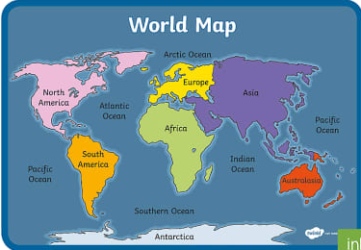
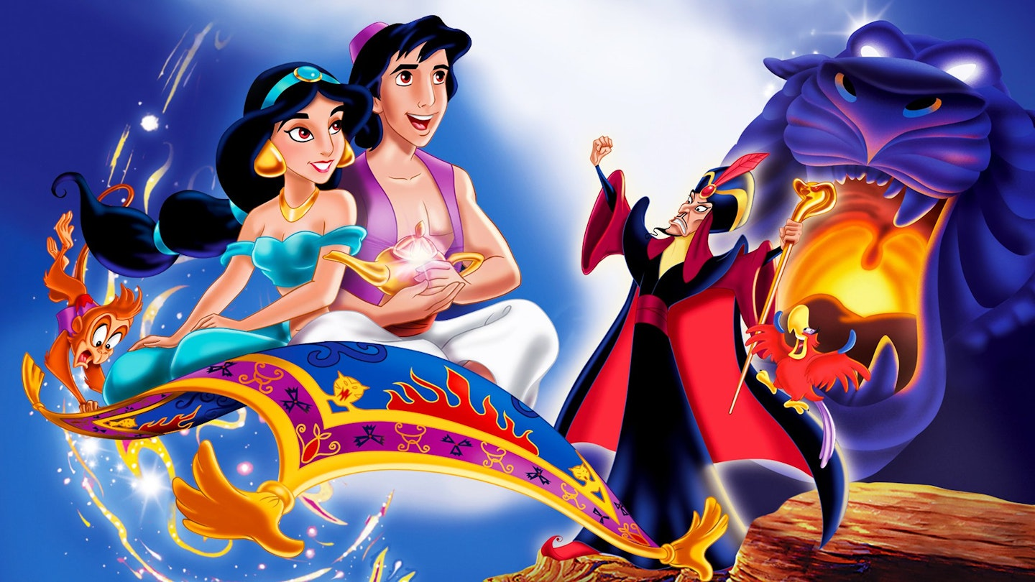

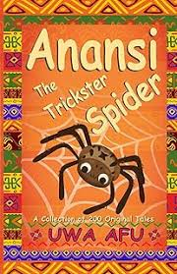
How many stories do know ?
Folktales come from all over the world

Slide 5





Use Pair Share (Kagan Strategy)
(Students take turns sharing and listening)
Folktale
a traditional story, originally part of an oral tradition, passed down from generation to generation (verbally) by word of mouth.

Slide 6




1
Choose a title
2
Choose Character
Steps of writing a folktale
3
Choose setting
(Place and Time)
4
Create a problem , find the solution (moral).

Slide 7



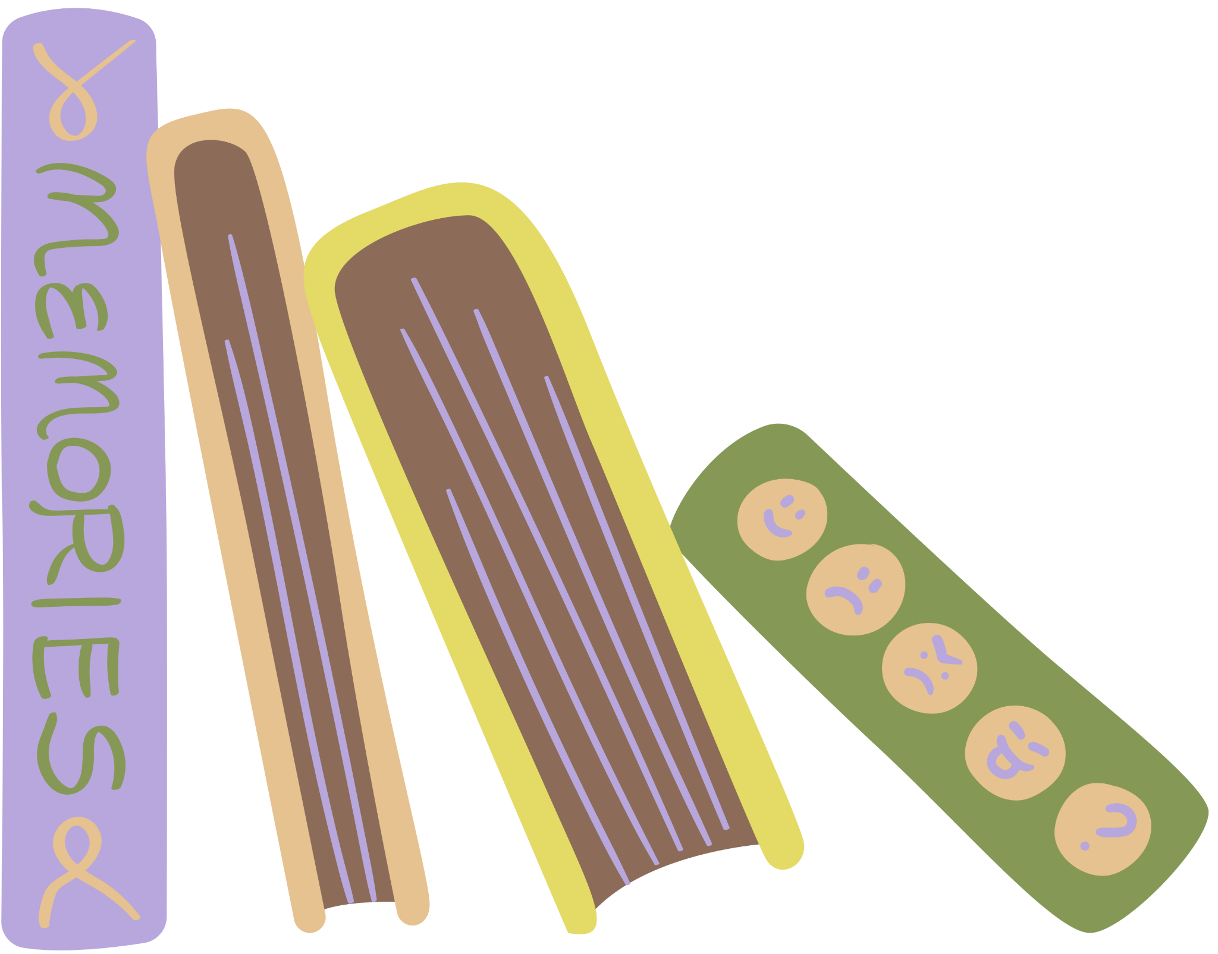
The fast rabbit
Shared Writing Activity
long ago in a small village, there was a boy who dont listen to his mother. He like to played all day and was go to the river even when his mother tell him not to. The river was look quiet, but it have strong currents.
One day, the boy run to the river without asking his mother permission. He sit on the bank and throw stones in the water. Suddenly, a giant fish come out and said, “Why you disturb my home?” The boy was scare and say nothing.
The fish grab him with its tail and was carry him into the river. Just then, his mother arrive and cry, “Please let my son go, he promise he never bother you again.” The fish open its mouth and the boy fall down on the sand. From that day, he was obey his mother.
Let’s help the author to find the mistakes in this folktale

Slide 8
The Mischievous Boy
Long ago, in a peaceful little village, there lived a mischievous boy who never listened to his mother. He loved playing all day and often wandered down to the river, even though his mother always warned him not to. The river seemed calm on the surface, but it hid dangerous, swirling currents beneath.
One hot afternoon, the boy sneaked away to the river without asking his mother’s permission. He perched on the grassy bank, tossing pebbles into the sparkling water. Suddenly, a giant fish burst from the river and thundered, “Why do you disturb my home?” The boy trembled with fear and could not answer a word.
The fish lashed its tail and almost dragged him into the rushing water. Just then, his mother rushed to the riverbank, crying, “Please, mighty fish, let my son go! He promises never to trouble you again.” The fish released him with a splash, and the boy collapsed safely onto the sand. From that day on, he listened carefully to his mother’s words and never dared disobey again.
Shared Writing Activity
Let’s discuss the criteria this writing

Slide 9
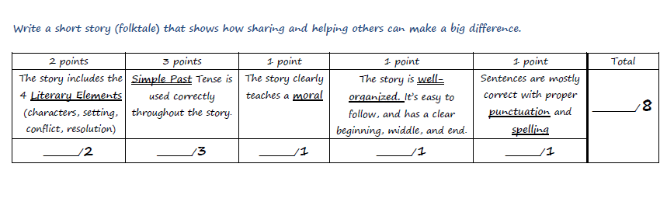
Writing Criteria
Let’s discuss the criteria in this writing

Slide 10
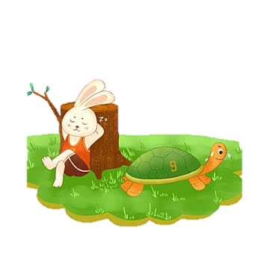
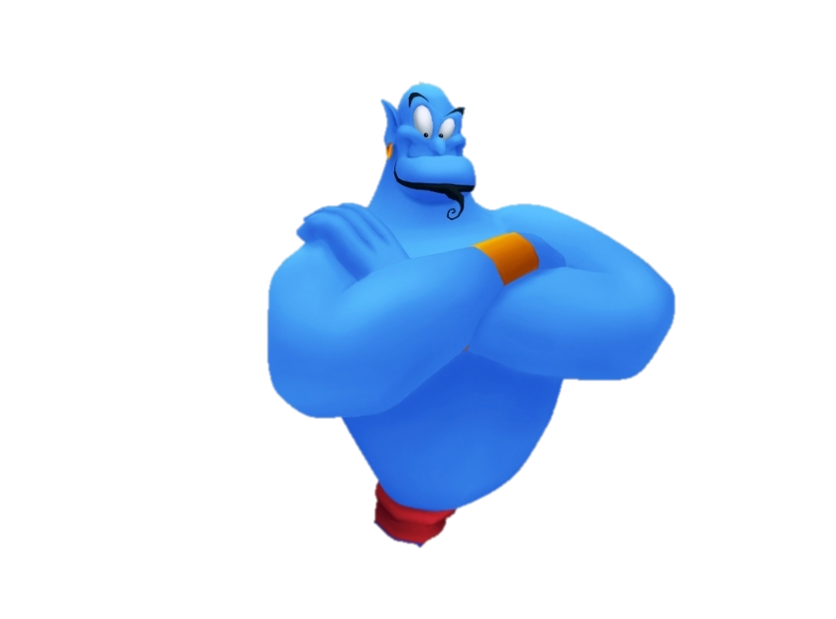
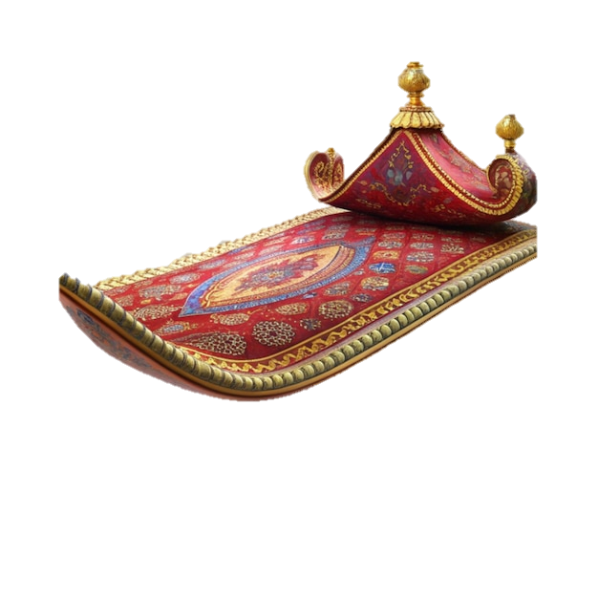
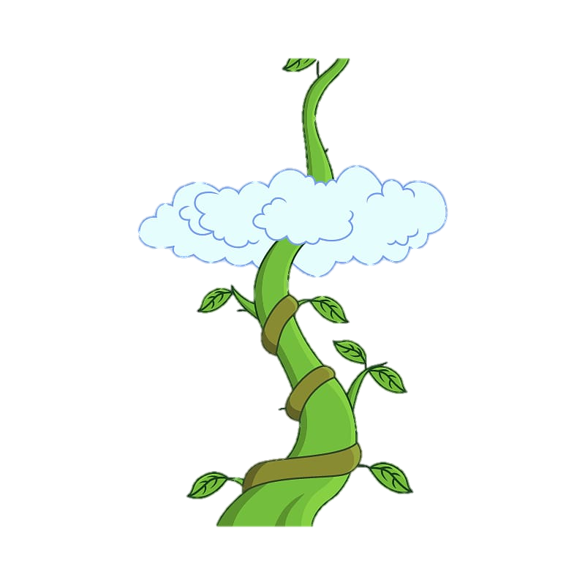

Characters in Folktales

Slide 11
Title :
Long ago, in a __________ (place), there lived a __________ (character). This character was very __________ (adjective) and loved to __________ (verb). One day, while walking near the __________ (place), the character met a __________ (magical creature). The creature said, “If you __________ (verb), I will __________ (verb) for you.” The character agreed, but instead of listening, they __________ (verb) and caused __________ (problem). At last, the character realized their mistake and __________ (verb). From that day on, they learned that __________ (moral/lesson).
Fill in the blank to complete the folktale

Slide 12
Title : The Magical Fish
Long ago, in a small village, there lived a clever rabbit. This character was very curious and loved to explore. One day, while walking near the river, the rabbit met a magical fish. The creature said, “If you help me, I will grant a wish for you.” The rabbit agreed, but instead of listening, he played tricks and caused trouble. At last, the rabbit realized his mistake and apologized. From that day on, he learned that kindness is always rewarded.
Fill in the blank to complete the folktale

Slide 13
NOW YOU CAN WRITE YOUR FOLKTALE

