Slide 1

Unit: 4 “ The Story of my Life”
Lesson: Grammar .
Subject: Relative Pronouns.
Grade: 9

Slide 2
LESSON 1

Slide 3



SUBJECT: Grammar
GRADE: 9
UNIT: 1
Lesson: 1
LESSON
OBJECTIVES
00:30 minute
WARM UP
Objectives
PREASSESSMENT
Lesson’s Objectives
1. Identify relative pronouns’ function .
2. Use relative pronouns correctly
PRESENTATION
FORMATIVE ASSESSMENT
FEEDBACK
DIFFERENTIATION
REAL LIFE APPLICATION
CRITICAL THINKING
EXIT TICKET

Slide 4
SUBJECT: Grammar
GRADE: 9
UNIT: 1
Lesson: 1
OUTCOMES
WARM UP
01:30 minutes
WARM UP
Real Life Application
Each student gets a slip of paper with a word (famous person, animal, or object).The slip is stuck on your back – don’t look at it!
Walk around and ask yes/no questions like:Am I a person who helps sick people?Am I an animal that lives in Africa?Am I a thing which people use to call their friends?
Keep asking until you guess who/what you are.
PRESENTATION
FORMATIVE ASSESSMENT
FEEDBACK
DIFFERENTIATION
REAL LIFE APPLICATION
CRITICAL THINKING
EXIT TICKET

Slide 5



SUBJECT: Grammar
GRADE: 9
UNIT: 1
Lesson: 1
OUTCOMES
WARM UP
What types of pronouns do we have in English ?
Real Life Application
CRITICAL THINKING
FORMATIVE ASSESSMENT
FEEDBACK
DIFFERENTIATION
REAL LIFE APPLICATION
PRESENTATION
EXIT TICKET

Slide 6

ISLAMIC EDUCATIONAL COLLEGE DATE: /2/ 2025
SUBJECT: Grammar
GRADE: 9
Unit: 4
Lesson: 1
OUTCOMES
CRITICAL THINKING
WARM UP
REAL LIFE APPLICATION
🔹 Critical Thinking Questions
Students 1 : Why do you think English has words like who, which, that to connect sentences instead of keeping them separate?
Student 2 : How does using relative clauses make communication clearer or more interesting?
Student 3 : In your language, do you join sentences in a similar way? How does it compare to English?
Student 4 : Can using relative clauses ever make a sentence confusing? Why/why not?
CRITICAL THINKING
PREASSESSMENT
FEEDBACK
FORMATIVE ASSESSMENT
PRESENTATION
DIFFERENTIATION
BUZZ IN
EXIT TICKET

Slide 7
Relative pronouns :
who | subject pronoun for people only. E.g. The man who helped me was old.
Whom | Object pronoun for people only The man whom I saw was old.
Which | subject and object pronoun used for things only. E.g. The book, which I saw, was red.
Whose | used for possessions. E.g. The man whose house was for sale was old.
Where | used for places. E.g. The restaurant where we met was downtown.
When | used for times. E.g. The day when we met was cloudy.

Slide 8


ISLAMIC EDUCATIONAL COLLEGE DATE: / / 2025
SUBJECT: Grammar
GRADE: 9
UNIT:4
Lesson: 1
OUTCOMES
WARM UP
Pre assessment
REAL LIFE APPLICATION
CRITICAL THINKING
PREASSESSMENT
PRESENTATION
DIFFERENTIATION
FORMATIVE ASSESSMENT
FEEDBACK
EXIT TICKET

Slide 9
ISLAMIC EDUCATIONAL COLLEGE DATE: / / 2025
SUBJECT: Grammar
GRADE: 9
UNIT:4
Lesson: 1
OUTCOMES
Part A – Multiple Choice
Which word can replace the blank?
“The man ___ is wearing a blue hat is my uncle.”
a) which
b) who
c) where
WARM UP
REAL LIFE APPLICATION
CRITICAL THINKING
PREASSESSMENT
PRESENTATION
DIFFERENTIATION
FORMATIVE ASSESSMENT
FEEDBACK
EXIT TICKET

Slide 10
ISLAMIC EDUCATIONAL COLLEGE DATE:
SUBJECT: Grammar
GRADE: 9
UNIT:4
Lesson: 1
OUTCOMES
Which sentence is correct?
a) This is the book who I bought yesterday.
b) This is the book which I bought yesterday.
c) This is the book where I bought yesterday.
WARM UP
REAL LIFE APPLICATION
CRITICAL THINKING
PREASSESSMENT
PRESENTATION
DIFFERENTIATION
FORMATIVE ASSESSMENT
FEEDBACK
EXIT TICKET

Slide 11
*
The musician who wrote this song is
( subject/ person)
Canadian.
* The teacher who explained the lesson is
( subject/ person) smart .
People

Slide 12
1- My previous house, which was quite small, was in Coventry.
2- I did well in chemistry, which was always my favorite subject.
3- The car which I like to own is very expensive .
Things

Slide 13
What is a relative clause or Adjective Clause :
Subject | Relative clause | the verb of the sentence | The complement of the sentence
The man | who helped me | Is | a doctor
The table | which I bought yesterday | Matches | the furniture
The girl | whose dog died | Is | sad

Slide 14

Islamic Educational College
English
Unit 1
Grade 9
Why is it called an adjective clause?
What is the function of the adjective clause ?
The tall man smiled.
The man who had long hair smiled. =
Because the adjective clause( relative clause) modifies (describes) the noun that comes before just like adjectives.

Slide 15

ISLAMIC EDUCATIONAL COLLEGE DATE: / / 2025
SUBJECT: Grammar
GRADE: 9
UNIT: 4
Lesson: 1
OUTCOMES
Formative assessment
WARM UP
PREASSESSMENT
Performance : Pair Work .
Time : 2 Minutes.
PRESENTATION
FORMATIVE ASSESSMENT
FEEDBACK
DIFFERENTIATION
REAL LIFE APPLICATION
CRITICAL THINKING
EXIT TICKET

Slide 16

1. The relative pronoun that is used to modify people is ________________
2. The relative pronoun that is used to modify things is ______________
3. The expression which starts with a relative pronoun is called _________
4. relative clauses are called adjective clauses _____________
Formative assessment

Slide 17
1. The little girl whose doll was lost is sad.
2. The woman whose car is a BMW is coming tonight.
3. The teacher whose car was broken lives in my neighborhood .
Which girl is sad ?
What does the girl have ?
Am I modifying the girl by saying that she did something or that she has something ?

Slide 18
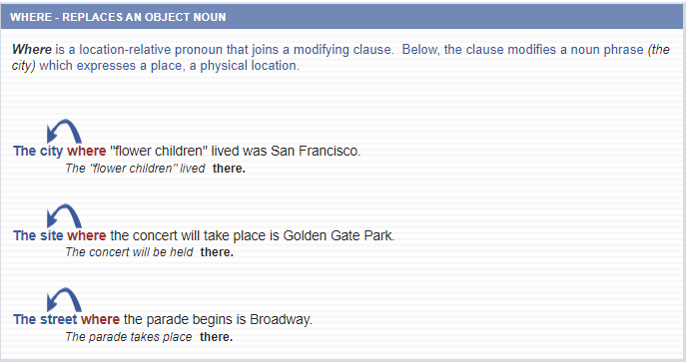
Where :
Where

Slide 19
Which VS Where
1- This is the hospital where I was born .
2- This is the hospital which we read about .
1- This is the restaurant where I met my best friend .
2- This is the restaurant which is always busy .
1- This is the street where I lost my keys .
2- This is the street which I hate the most .

Slide 20
1. The author, whom I met at the book signing, is dead. Subject+ verb
2. Do you know someone whom I can talk about global warming. Subject + verb
3. Morality is simply the attitude we adopt towards people whom we dislike.
Subject+ verb
Whom

Slide 21
1- There are many reasons why I love teaching .
2- It is the reason why I hate arguing .
Why

Slide 22
When
1- The fourth of July when the US gained independence, is my favorite holiday.
2- The summer when I graduated from university was long and hot.
.

Slide 23
The witnesses whom I interviewed
( object/ person) gave conflicting evidence.

Slide 24
The man whom I met was a doctor .
The girl whom my mom helped is kind

Slide 25
The summer was long and hot. I graduated from university in the summer.
→ The summer when I graduated from university was long and hot.

Slide 26
I talked to a man. His wife had died the year before. (whose)
His
Her + Noun
Their
Our
I talked to a man . The man’s wife
I talked to a man . Whose wife had died the year before .
I talked to a man whose wife had died the year before .

Slide 27
The dog is over there. The dog's / its owner lives next door.
→ The dog whose owner lives next door is over there.
The little girl is sad. The little girl's / her doll was lost.
→ The little girl whose doll was lost is sad.
The woman is coming tonight. Her car is a BMW.
→ The woman whose car is a BMW is coming tonight.
The house belongs to me. Its roof is very old.
→ The house whose roof is old belongs to me.

Slide 28
ISLAMIC EDUCATIONAL COLLEGE DATE: / 5/ 2025
SUBJECT: Grammar
GRADE: 9
UNIT: 4
Lesson: 1
OUTCOMES
02:00 minutes
Differentiation
WARM UP
Students 1+3
Students 2+4
PREASSESSMENT
PRESENTATION
FORMATIVE ASSESSMENT
Complete the sentences with the correct relative pronoun
Complete the sentences with the correct relative pronoun
FEEDBACK
DIFFERENTIATION
REAL LIFE APPLICATION
CRITICAL THINKING
EXIT TICKET

Slide 29
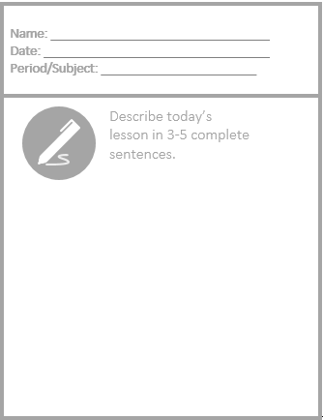
Exit Ticket

Slide 30
LESSON 2

Slide 31
SUBJECT: Grammar
GRADE: 9
UNIT: 1
Lesson: 1
LESSON
OBJECTIVES
00:30 minute
WARM UP
Objectives
PREASSESSMENT
Lesson’s Objectives
1.Join sentences using relative pronouns
PRESENTATION
FORMATIVE ASSESSMENT
FEEDBACK
DIFFERENTIATION
REAL LIFE APPLICATION
CRITICAL THINKING
EXIT TICKET

Slide 32
SUBJECT: Grammar
GRADE: 9
UNIT: 1
Lesson: 1
OUTCOMES
WARM UP
01:30 minutes
WARM UP
1 Warm-up Activity (5–7 minutes)
Activity: “Guess the Person / Place / Thing”
Prepare slips with people, places, objects, events (similar to the previous “Who Am I?” activity).
Stick a slip on each student’s back.
Students walk around asking yes/no questions using relative clauses:
  “Am I a person who teaches students?”
  “Am I a place where people go to study?”
  “Am I a thing which people use to call each other?”
Discuss how two ideas were joined into one sentence using a relative pronoun.
Real Life Application
PRESENTATION
FORMATIVE ASSESSMENT
FEEDBACK
DIFFERENTIATION
REAL LIFE APPLICATION
CRITICAL THINKING
EXIT TICKET

Slide 33
ISLAMIC EDUCATIONAL COLLEGE DATE: / / 2025
SUBJECT: Grammar
GRADE: 9
Unit: 4
Lesson: 1
OUTCOMES
CRITICAL THINKING
WARM UP
Critical Thinking Questions (5 minutes)
Why do writers and speakers join two sentences with relative pronouns instead of keeping them separate?
How does the meaning change if you use the wrong relative pronoun?
In your opinion, which relative pronouns are most useful in daily conversation and why?
Can relative clauses make a sentence more precise or more confusing? Explain.
REAL LIFE APPLICATION
CRITICAL THINKING
PREASSESSMENT
FEEDBACK
FORMATIVE ASSESSMENT
PRESENTATION
DIFFERENTIATION
BUZZ IN
EXIT TICKET

Slide 34
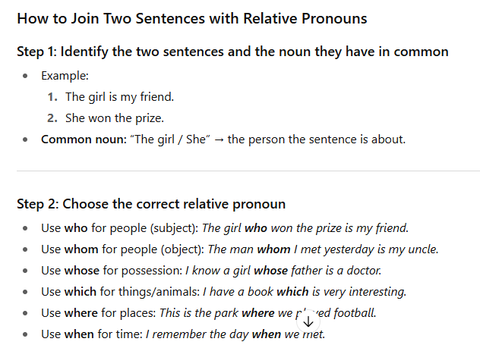

Slide 35
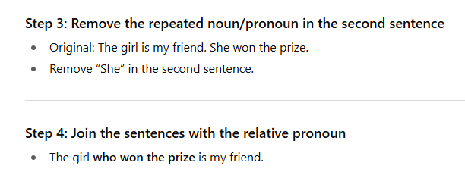

Slide 36
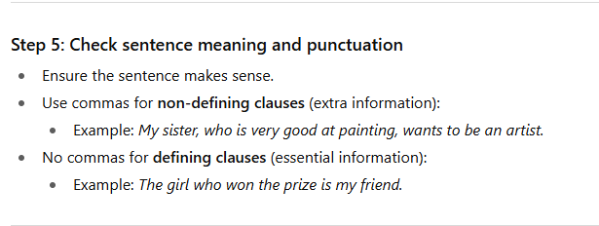

Slide 37
ISLAMIC EDUCATIONAL COLLEGE DATE: / / 2025
SUBJECT: Grammar
GRADE: 9
UNIT: 1
Lesson: 1
OUTCOMES
02:00 minutes
Differentiation
WARM UP
Students 1+3
Students 2+4
PREASSESSMENT
PRESENTATION
FORMATIVE ASSESSMENT
Write 6 sentences using relative pronouns.
Join the given sentences using the suitable relative pronouns
FEEDBACK
DIFFERENTIATION
REAL LIFE APPLICATION
CRITICAL THINKING
EXIT TICKET

Slide 38
SUBJECT: Grammar
GRADE: 9
UNIT:1
Lesson: 1
OUTCOMES
Task: Use Relative Pronouns to Join Sentences
Instructions:
Think of a person, place, object, or event from your life.
Write two short sentences about it.
  Example: My brother is very funny. He always makes me laugh.
Join the two sentences using a relative pronoun:
  who, whom, whose, which, where, when, or why
  Example: My brother, who always makes me laugh, is very funny.
Repeat this for 3–5 sets of sentences.
Share your sentences with a partner or the class and explain which relative pronoun you used and why.
Tip: Ask yourself:
Am I talking about a person, thing, place, time, or reason?
Which relative pronoun fits best for that noun?
WARM UP
Real Life Application
CRITICAL THINKING
FORMATIVE ASSESSMENT
FEEDBACK
DIFFERENTIATION
REAL LIFE APPLICATION
PRESENTATION
EXIT TICKET

Slide 39
SUBJECT: Grammar
GRADE: 9
UNIT: 1
Lesson: 1
OUTCOMES
Students 2+4
Students 1+3
WARM UP
Make a mini poster or sentence strips.
Write 5 sentences joined using relative pronouns (who, whom, whose, which, where, when, why).
Example: The teacher who helps us is very kind.
Add small illustrations for each sentence.
Make a story poster, comic strip, or descriptive paragraph.Include 5–7 sentences using different relative pronouns.Example: The girl, who loves painting, went to the gallery where she saw works that inspired her.Decorate your poster with drawings, photos, or symbols to represent the sentences.Highlight or color-code each relative pronoun
Real Life Application
CRITICAL THINKING
FORMATIVE ASSESSMENT
FEEDBACK
DIFFERENTIATION
REAL LIFE APPLICATION
PRESENTATION
EXIT TICKET

Slide 40
Exit Ticket

