Slide 1

Unit: 1 “ Grandmother Spider Brings the Sun”
Lesson: Grammar .
Subject: Question Tags .
Grade: 9

Slide 2
LESSON 1

Slide 3



SUBJECT: Grammar
GRADE: 9
UNIT: 4
Lesson: 1
LESSON
OBJECTIVES
00:30 minute
WARM UP
Objectives
PREASSESSMENT
1- To recognize different types of questions in English .
2- Identify helping verbs and their functions .
3-structure question tags correctly with helping verbs.
PRESENTATION
FORMATIVE ASSESSMENT
FEEDBACK
DIFFERENTIATION
REAL LIFE APPLICATION
CRITICAL THINKING
EXIT TICKET

Slide 4
SUBJECT: Grammar
GRADE: 9
UNIT: 4
Lesson: 1
OUTCOMES
WARM UP
01:30 minutes
WARM UP
🌟 Warming-up Activity (5 minutes)
Activity: “True or False Chat”
Write 5 simple statements on the board (some true, some false), e.g.:
You are students.
The sun rises in the west.
We are in an English class.
Lions can swim.
I am your math teacher.
Real Life Application
PRESENTATION
FORMATIVE ASSESSMENT
FEEDBACK
DIFFERENTIATION
REAL LIFE APPLICATION
CRITICAL THINKING
EXIT TICKET

Slide 5


SUBJECT: Grammar
GRADE: 9
UNIT: 1
Lesson: 1
OUTCOMES
What types of questions are there?
WARM UP
Real Life Application
CRITICAL THINKING
FORMATIVE ASSESSMENT
FEEDBACK
DIFFERENTIATION
REAL LIFE APPLICATION
PRESENTATION
EXIT TICKET

Slide 6

ISLAMIC EDUCATIONAL COLLEGE DATE: / / 2025
SUBJECT: Grammar
GRADE: 9
Unit: 4
Lesson: 1
OUTCOMES
CRITICAL THINKING
WARM UP
Why do people add short questions (like isn’t it? or don’t you?) at the end of a sentence when speaking?
Do you think question tags are only for asking questions, or can they also show politeness, surprise, or agreement? Why?
How do question tags help in real conversations compared to just saying a statement?
In your language, do people use a similar way to confirm or check information? How is it different from English?
REAL LIFE APPLICATION
CRITICAL THINKING
PREASSESSMENT
FEEDBACK
FORMATIVE ASSESSMENT
PRESENTATION
DIFFERENTIATION
EXIT TICKET
BUZZ IN

Slide 7


ISLAMIC EDUCATIONAL COLLEGE DATE
SUBJECT: Grammar
GRADE: 9
UNIT:4
Lesson: 1
OUTCOMES
WARM UP
Pre assessment
REAL LIFE APPLICATION
CRITICAL THINKING
PREASSESSMENT
PRESENTATION
DIFFERENTIATION
FORMATIVE ASSESSMENT
FEEDBACK
EXIT TICKET

Slide 8
Tom: Hey, Sarah! ___ you ( be) coming to the game tonight?
01
02
03
Are
Is
Do

Slide 9
Sarah: Yes, I ___ ( be) planning to go. What about you?
01
02
03
are
am
have

Slide 10
Tom: I ___ ( do) not know yet. I have a lot of homework.
01
02
03
was
am
do

Slide 11
Sarah: That’s too bad. I heard the team ___ ( be) playing really well this season.
01
02
03
are
is
do

Slide 12

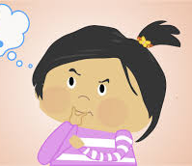
Pair Work 1 minute
Why do we use auxiliaries ? What are the functions of helping verbs ?

Slide 13
ISLAMIC EDUCATIONAL COLLEGE DATE: // 2025
SUBJECT: Grammar
GRADE: 9
UNIT: 4
Lesson: 1
OUTCOMES
WARM UP
REAL LIFE APPLICATION
1- To form a question : What is your name? 2- To form the negative form: she isn’t happy. 3- The main verb in a sentence : she is happy . 4- To support another verb: she is laughing.
CRITICAL THINKING
PREASSESSMENT
PRESENTATION
DIFFERENTIATION
FEEDBACK
FORMATIVE ASSESSMENT
EXIT TICKET

Slide 14
I am late , ________?
aren’t I

Slide 15

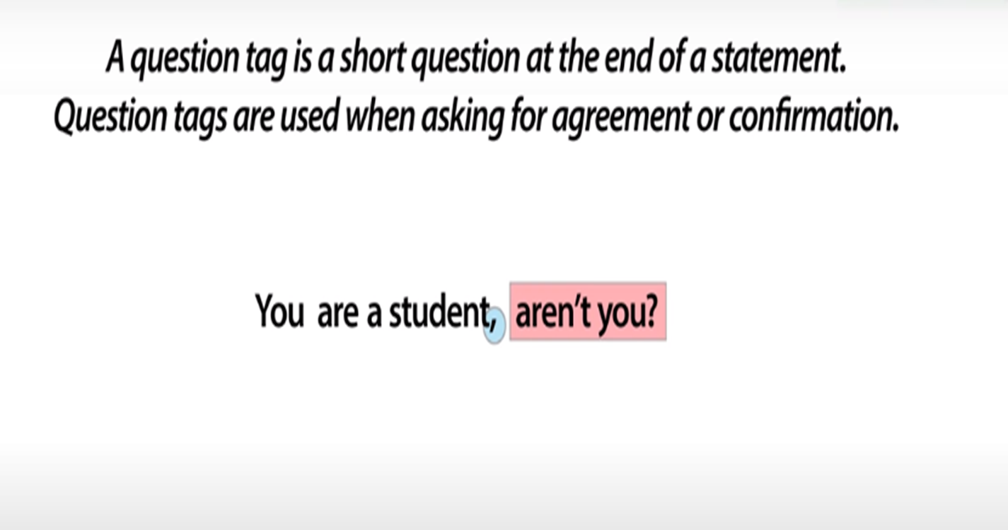




Slide 16
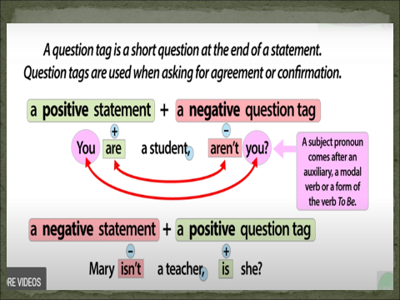

Slide 17
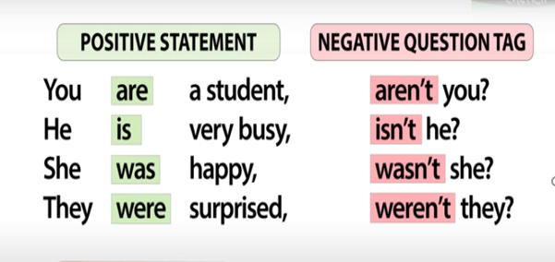

Slide 18

ISLAMIC EDUCATIONAL COLLEGE DATE: / / 2025
SUBJECT: Grammar
GRADE: 9
UNIT: 4
Lesson: 1
OUTCOMES
Formative assessment
WARM UP
PREASSESSMENT
Performance : Pair Work .
Time : 2 Minutes.
PRESENTATION
FORMATIVE ASSESSMENT
FEEDBACK
DIFFERENTIATION
REAL LIFE APPLICATION
CRITICAL THINKING
EXIT TICKET

Slide 19
ISLAMIC EDUCATIONAL COLLEGE DATE:
SUBJECT: Grammar
GRADE: 9
UNIT: 1
Lesson: 1
OUTCOMES
02:00 minutes
Differentiation
WARM UP
Students 1+3
Students 2+4
PREASSESSMENT
Activity: “Challenge Statements”
Students work in pairs.
Each student writes 5 unusual or surprising statements (real or imagined).
exchange papers with their partner, who must add the correct question tag to each statement.
Extra challenge: act out the dialogue using intonation to show certainty, surprise, or doubt
Match the sentences in Column A with the correct question tags in Column B.
PRESENTATION
FORMATIVE ASSESSMENT
FEEDBACK
DIFFERENTIATION
REAL LIFE APPLICATION
CRITICAL THINKING
EXIT TICKET

Slide 20
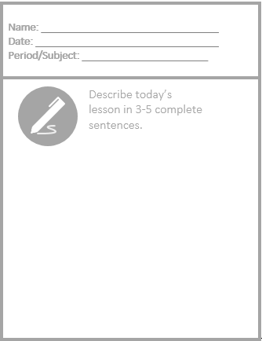
Exit Ticket

