Slide 1

Unit: 1
Lesson: Vocabulary
Subject: Compound Words.
Grade: 9

Slide 2


ISLAMIC EDUCATIONAL COLLEGE DATE:
SUBJECT: Vocabulary
GRADE: 9
UNIT: 1
Lesson: 1
LESSON
OBJECTIVES
OBJECTIVES:
Define the new words and recognize their parts of speech .
Use the new words in sentences correctly .
Recognize the meaning of “compound words “.
Join words together to form correct compound words .
01:00 minute
WARM UP
PREASSESSMENT
PRESENTATION
FORMATIVE ASSESSMENT
FEEDBACK
DIFFERENTIATION
REAL LIFE APPLICATION
CRITICAL THINKING
EXIT TICKET

Slide 3

ISLAMIC EDUCATIONAL COLLEGE DATE: / / 2025
SUBJECT: Vocabulary
GRADE: 10
UNIT: 4
Lesson: 1
OUTCOMES
WARM UP:
https://wordwall.net/resource/2146384/english/compound-words
01:00 minute
WARM UP
PREASSESSMENT
PRESENTATION
FORMATIVE ASSESSMENT
FEEDBACK
DIFFERENTIATION
REAL LIFE APPLICATION
CRITICAL THINKING
EXIT TICKET

Slide 4


ISLAMIC EDUCATIONAL COLLEGE DATE:
SUBJECT: Vocabulary
GRADE: 10
UNIT: 4
Lesson: 1
OUTCOMES
01:00 minute
WARM UP
PREASSESSMENT
PRESENTATION
FORMATIVE ASSESSMENT
What is a compound word? What types of compound words can you think of ?
FEEDBACK
DIFFERENTIATION
REAL LIFE APPLICATION
CRITICAL THINKING
EXIT TICKET
BUZZ IN

Slide 5

Islamic Educational College
English
Unit 1
Grade 9
Word Study : Compound Words .
Compound Words
When two words are used together to produce a new meaning, a compound is formed.
Compound words can be written in three ways:
Open compounds (spelled as two words, e.g., ice cream),
Closed compounds (joined to form a single word, e.g., everyone)
Hyphenated compounds (two words joined by a hyphen, e.g., long-term). Sometimes, more than two words can form a compound (e.g., mother-in-law).

Slide 6
Islamic Educational College
English
Unit 1
Grade 9
Page :
Word Study : Compound Words .
Open Compound Word
Open compound words are formed when two words remain separate on the page but are used together to create a new idea with a specific meaning. For example, “high ” and “school” are used to form the open compound word “High school”. Other examples of open compounds include:
peanut butter
ice cream
living room
post office

Slide 7
Islamic Educational College
English
Unit 1
Grade 9
Word Study : Compound Words .
Closed-Form Compound Word
Closed compound words are formed when two fully independent, unique words are combined to create a new word. For example, you would combine “grand” and “mother” to create the closed-form word “grandmother”. In a sentence, this would look like, “My grandmother is coming over.” These are the most common types of compound words.
For example: snowball , mailbox , grandfather..

Slide 8
Islamic Educational College
English
Unit 1
Grade 9
Page : 7
Word Study : Compound Words .
Hyphenated Compound Word
Hyphenated compound words are formed when two separate words are joined together by a hyphen. Examples of hyphenated compound words include:
check-in
father-in-law
long-term
up-to-date
mother-in-law
one-half

Slide 9
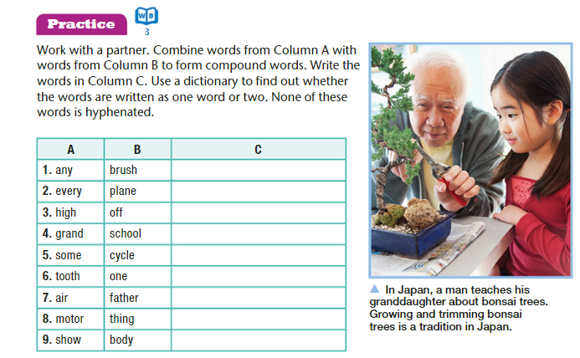


ISLAMIC EDUCATIONAL COLLEGE DATE: / / 2025
SUBJECT: Vocabulary
GRADE: 10
UNIT: 4
Lesson: 1
OUTCOMES
Differentiation
02:00 minutes
WARM UP
PREASSESSMENT
PRESENTATION
FORMATIVE ASSESSMENT
FEEDBACK
DIFFERENTIATION
REAL LIFE APPLICATION
CRITICAL THINKING
Students 1+3 :
Classify the following compound words
Students 2+4 :
Combine words from column A with words from column B to form compound words.
EXIT TICKET

Slide 10
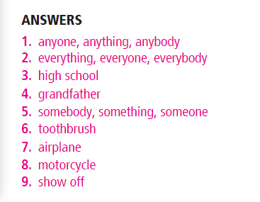
ISLAMIC EDUCATIONAL COLLEGE DATE: 9 + 10 /2/2025
SUBJECT: Vocabulary
GRADE: 10
UNIT: 4
Lesson: 1
OUTCOMES
WARM UP
PREASSESSMENT
PRESENTATION
FORMATIVE ASSESSMENT
FEEDBACK
DIFFERENTIATION
REAL LIFE APPLICATION
CRITICAL THINKING
EXIT TICKET

Slide 11


ISLAMIC EDUCATIONAL COLLEGE DATE:
SUBJECT: Vocabulary
GRADE: 10
UNIT: 4
Lesson: 1
OUTCOMES
EXIT TICKT
Write 2 things you have learnt today.
02:00 minutes
WARM UP
PREASSESSMENT
PRESENTATION
FORMATIVE ASSESSMENT
FEEDBACK
DIFFERENTIATION
REAL LIFE APPLICATION
CRITICAL THINKING
EXIT TICKET

