Slide 1

Unit: 1 “ Grandmother Spider Brings the Sun”
Lesson: Vocabulary .
Subject: what is a myth ? .
Grade: 9

Slide 2
LESSON 1

Slide 3



SUBJECT: Vocabulary
GRADE: 9
UNIT: 1
Lesson: 1
LESSON
OBJECTIVES
00:30
WARM UP
Objectives
PREASSESSMENT
*Recognize the meaning of a myth and its characteristics .
Differentiate between the literal meaning and the figurative meaning of a word.
PRESENTATION
FORMATIVE ASSESSMENT
FEEDBACK
DIFFERENTIATION
REAL LIFE APPLICATION
CRITICAL THINKING
EXIT TICKET

Slide 4

SUBJECT: Vocabulary
GRADE: 9
UNIT: 1
Lesson: 1
OUTCOMES
WARM UP
4 minutes
WARM UP
Real Life Application
PRESENTATION
Think (1 minute):Think about stories you know that explain natural events (🌞 why the sun rises, 🍂 why seasons change, 🐺 how animals got their features).Write down 1–2 ideas.
Pair (2 minutes):Turn to your partner. Take turns sharing your ideas using Rally Robin (one idea each, back and forth).
Share (3 minutes):Choose the most interesting idea from your pair.
Share it with the whole class.
FORMATIVE ASSESSMENT
FEEDBACK
DIFFERENTIATION
REAL LIFE APPLICATION
CRITICAL THINKING
EXIT TICKET

Slide 5
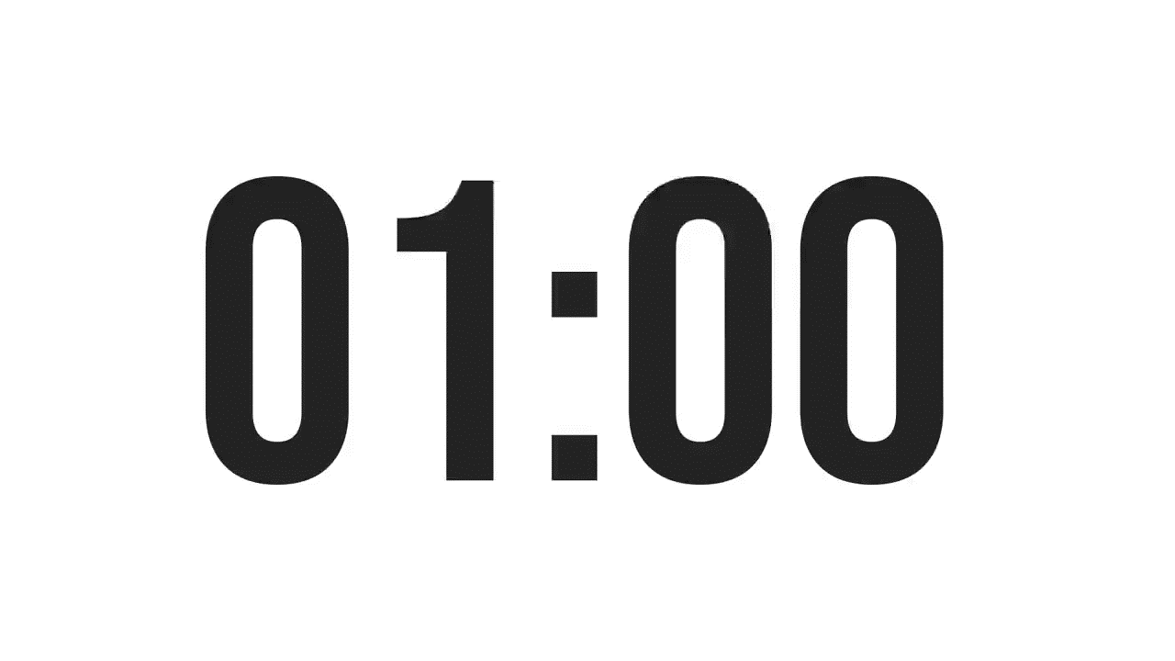

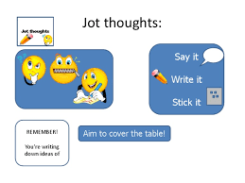
SUBJECT: Vocabulary
GRADE: 9
UNIT: 1
Lesson: 1
OUTCOMES
WARM UP
What are myths ?
Real Life Application
CRITICAL THINKING
FORMATIVE ASSESSMENT
FEEDBACK
DIFFERENTIATION
REAL LIFE APPLICATION
PRESENTATION
EXIT TICKET

Slide 6
ISLAMIC EDUCATIONAL COLLEGE DATE: /2/ 2025
SUBJECT:Vocabulary
GRADE: 9
Unit: 1
Lesson: 1
OUTCOMES
📖 Myth for Class
Differentiation
WARM UP
REAL LIFE APPLICATION
📖 Myth for Class
Read the following myth .
Each student in each group answers the given questions .
CRITICAL THINKING
PREASSESSMENT
FEEDBACK
FORMATIVE ASSESSMENT
Flexible grouping :
After you are done , students 1 . 2 .3 .4 gather together and discuss your answers.
PRESENTATION
DIFFERENTIATION
EXIT TICKET

Slide 7
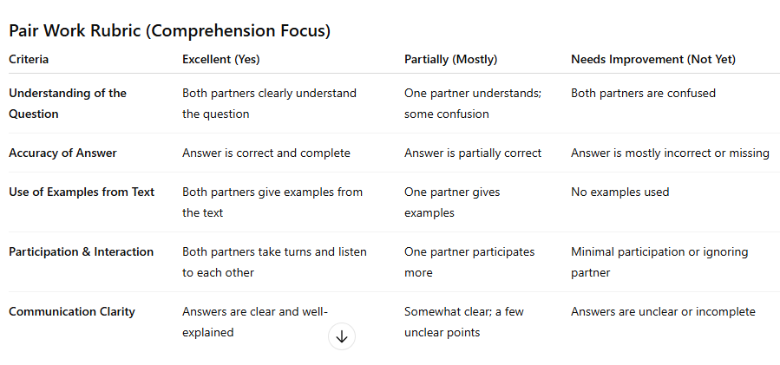

Slide 8
Based on the previous task .What is a Myth ?
* Story * Scientific *Magic * *Gods/Goddesses * Supernatural beings
*Explains natural phenomena, the origins of the world. * Animals
*Natural element *There is moral lesson stated at the end. *Based on a true story

Slide 9
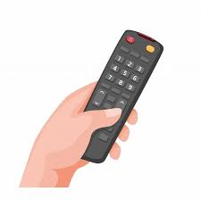

ISLAMIC EDUCATIONAL COLLEGE DATE: / / 2025
SUBJECT: vocabulary
GRADE: 9
UNIT:1
Lesson: 1
OUTCOMES
WARM UP
Pre assessment
REAL LIFE APPLICATION
CRITICAL THINKING
PREASSESSMENT
PRESENTATION
DIFFERENTIATION
FORMATIVE ASSESSMENT
FEEDBACK
EXIT TICKET

Slide 10
ISLAMIC EDUCATIONAL COLLEGE DATE: / / 2025
SUBJECT: Grammar
GRADE: 9
UNIT:4
Lesson: 1
OUTCOMES
What do we call the people, animals, or creatures in a story?
a) Plot b) Characters c) Setting
WARM UP
REAL LIFE APPLICATION
CRITICAL THINKING
PREASSESSMENT
PRESENTATION
DIFFERENTIATION
FORMATIVE ASSESSMENT
FEEDBACK
EXIT TICKET

Slide 11
ISLAMIC EDUCATIONAL COLLEGE DATE: / / 2025
SUBJECT: Grammar
GRADE: 9
UNIT:4
Lesson: 1
OUTCOMES
The time and place where a story happens is called:
a) Theme b) Setting c) Conflict
WARM UP
REAL LIFE APPLICATION
CRITICAL THINKING
PREASSESSMENT
PRESENTATION
DIFFERENTIATION
FORMATIVE ASSESSMENT
FEEDBACK
EXIT TICKET

Slide 12
ISLAMIC EDUCATIONAL COLLEGE DATE: / / 2025
SUBJECT: Grammar
GRADE: 9
UNIT:4
Lesson: 1
OUTCOMES
Which element of a story tells us what happens from the beginning, middle, and end?
a) Plot b) Characters c) Setting
WARM UP
REAL LIFE APPLICATION
CRITICAL THINKING
PREASSESSMENT
PRESENTATION
DIFFERENTIATION
FORMATIVE ASSESSMENT
FEEDBACK
EXIT TICKET

Slide 13
ISLAMIC EDUCATIONAL COLLEGE DATE: / / 2025
SUBJECT: Grammar
GRADE: 9
UNIT:4
Lesson: 1
OUTCOMES
The message or lesson the author wants readers to learn is called:
WARM UP
REAL LIFE APPLICATION
CRITICAL THINKING
PREASSESSMENT
a) Theme b) Conflict c) Setting
PRESENTATION
DIFFERENTIATION
FORMATIVE ASSESSMENT
FEEDBACK
EXIT TICKET

Slide 14
ISLAMIC EDUCATIONAL COLLEGE DATE: / / 2025
SUBJECT: Grammar
GRADE: 9
UNIT: 1
Lesson: 1
OUTCOMES
- The word comes from the Greek word" mythos" which means "story " or" word" .
- Myths are fictional stories that are part of a group's shared cultural identity .
- Myths explain the origin of something in the natural world .
- Myths often include nonhuman characters such as Gods and animals.
- Myths were passed down orally that’s why they have distinctive rhythms.
WARM UP
REAL LIFE APPLICATION
CRITICAL THINKING
PREASSESSMENT
PRESENTATION
DIFFERENTIATION
FEEDBACK
FORMATIVE ASSESSMENT
EXIT TICKET

Slide 15

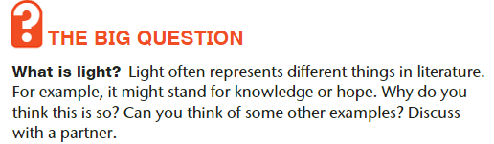
Islamic Educational College
What is light?
Literal meaning vs. Figurative meaning .
Literal meaning : the brightness that comes from the sun, fire, etc. and from electrical devices, and that allows things to be seen.
Figurative meaning : knowledge , love , hope ….etc. .

Slide 16
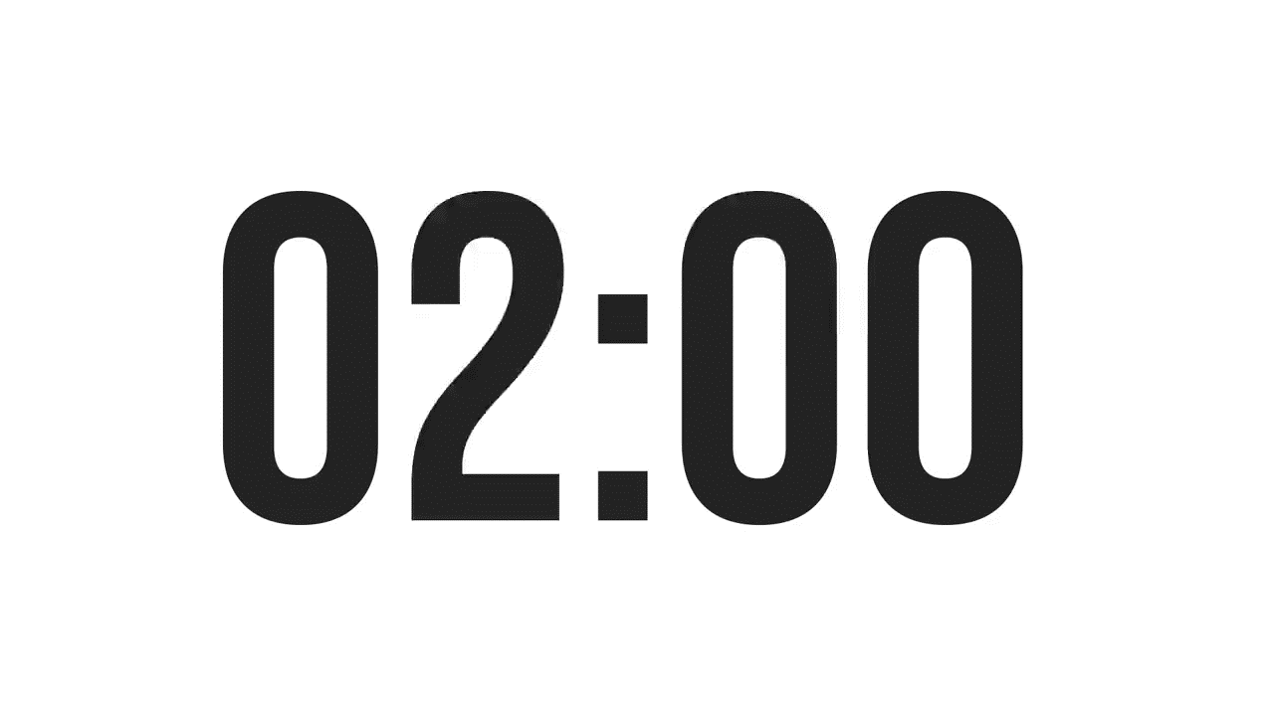
ISLAMIC EDUCATIONAL COLLEGE DATE: / / 2025
SUBJECT: Vocabulary
GRADE: 9
UNIT: 1
Lesson: 1
OUTCOMES
Formative assessment
WARM UP
Performance : Pair Work .
Time : 2 Minutes.
PREASSESSMENT
PRESENTATION
Task: Literal vs Figurative Meaning
👉 Read the following sentences. Decide if the underlined phrase shows a literal meaning (the exact, direct meaning of the words) or a figurative meaning (a hidden or imaginative meaning).
🔹 Instructions for Students:
Write L if it’s literal meaning.
Write F if it’s figurative meaning.
Then, explain the figurative meaning in your own words.
Students 2+4
Write as many sentences as you can using words that have literal meanings and figurative meanings
Students 1+4
FORMATIVE ASSESSMENT
FEEDBACK
DIFFERENTIATION
REAL LIFE APPLICATION
CRITICAL THINKING
EXIT TICKET

Slide 17
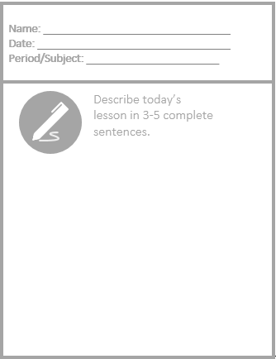
Exit Ticket

