Slide 1

Unit: 1
Lesson: Grandmother Spider Brings the Sun.
Subject: Reading part 1
Grade: 9

Slide 2


ISLAMIC EDUCATIONAL COLLEGE DATE:
SUBJECT: Reading
GRADE: 9
UNIT: 4
Lesson: 1
LESSON
OBJECTIVES
OBJECTIVES:
1. to read for specific details in the myth
2. to identify the meanings of the new words in the text
3. to value the role of teamwork.
01:00 minute
WARM UP
PREASSESSMENT
PRESENTATION
FORMATIVE ASSESSMENT
FEEDBACK
DIFFERENTIATION
REAL LIFE APPLICATION
CRITICAL THINKING
EXIT TICKET

Slide 3
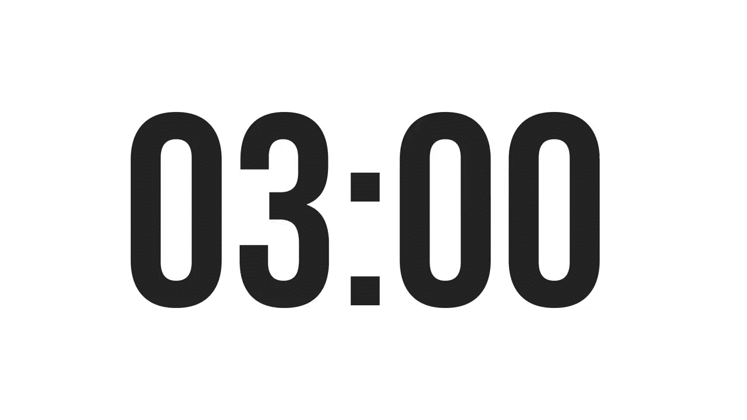
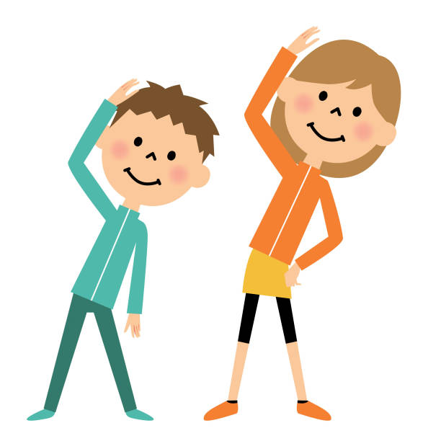

ISLAMIC EDUCATIONAL COLLEGE DATE:
SUBJECT: Reading
GRADE: 9
UNIT:1
Lesson: 1
OUTCOMES
03:00 minutes
“Imagine one side of the world has sunlight, and the other side is always dark. You live in the dark part, and it’s causing problems for everyone because they keep bumping into each other. You and the other animals must figure out how to bring some light to your side.”
WARM UP
PREASSESSMENT
PRESENTATION
FORMATIVE ASSESSMENT
FEEDBACK
Pair
1 min.
Think
I min.
Share
1 min.
DIFFERENTIATION
REAL LIFE APPLICATION
CRITICAL THINKING
EXIT TICKET

Slide 4
ISLAMIC EDUCATIONAL COLLEGE
SUBJECT: Reading
GRADE: 9
UNIT:1
Lesson: 1
OUTCOMES
PREASSESSMENT:
WARM UP
Question 1: Which of the following best defines a myth?
A) A humorous anecdote passed down through generations.
B) A traditional story explaining natural or social phenomena, typically involving supernatural beings or events.
C) A factual historical account of significant events.
D) A scientific explanation based on empirical evidence.
PREASSESSMENT
PRESENTATION
FORMATIVE ASSESSMENT
FEEDBACK
DIFFERENTIATION
REAL LIFE APPLICATION
CRITICAL THINKING
EXIT TICKET
IRS

Slide 5
ISLAMIC EDUCATIONAL COLLEGE
SUBJECT: Reading
GRADE: 9
UNIT: 1
Lesson: 1
OUTCOMES
PREASSESSMENT:
WARM UP
Question 2: One primary characteristic of myths is that they:
A) Are always written in poetic form.
B) Involve gods, goddesses, or supernatural forces.
C) Are set in the future.
D) Focus exclusively on real-life events without embellishment.
PREASSESSMENT
PRESENTATION
FORMATIVE ASSESSMENT
FEEDBACK
DIFFERENTIATION
REAL LIFE APPLICATION
CRITICAL THINKING
EXIT TICKET
IRS

Slide 6
ISLAMIC EDUCATIONAL COLLEGE
SUBJECT: Reading
GRADE: 9
UNIT: 1
Lesson: 1
OUTCOMES
PREASSESSMENT:
WARM UP
Question 3: Myths often serve to:
A) Entertain without conveying any deeper meaning.
B) Provide a literal account of historical events.
C) Explain the origins of the world and human existence.
D) Detail scientific discoveries.
PREASSESSMENT
PRESENTATION
FORMATIVE ASSESSMENT
FEEDBACK
DIFFERENTIATION
REAL LIFE APPLICATION
CRITICAL THINKING
EXIT TICKET
IRS

Slide 7
ISLAMIC EDUCATIONAL COLLEGE
SUBJECT: Reading
GRADE: 9
UNIT: 1
Lesson: 1
OUTCOMES
PREASSESSMENT:
WARM UP
Question 4: Myths are typically passed down through:
A) Scientific journals.
B) Oral tradition and storytelling.
C) Legal documents.
D) Commercial advertisements.
PREASSESSMENT
PRESENTATION
FORMATIVE ASSESSMENT
FEEDBACK
DIFFERENTIATION
REAL LIFE APPLICATION
CRITICAL THINKING
EXIT TICKET
IRS

Slide 8
Before Reading questions :
• What do you think this selection will be about? Why do you think that?
• What characters do you think might be in this story?
• What do you know about the topic of this unit?
• What are you wondering about as you look at the pictures of this text?

Slide 9
A long time ago it is said that half the world had the sun, but the other side of the world was very dark. It was so dark that all the animals were always bumping into each other and getting lost. Wolf lived on this side of the world. He was tired of everybody bumping into him and asking him for directions, for you see, Wolf could see in the nighttime. Wolf gathered all the animals together in a big cave. He got up in front of them and crossed his arms, and he said, “I am tired of everybody bumping into me and asking me for directions.” “I have an idea,” he said. “I think we should go to the other side of the world and ask them for a piece of their sun. I think if we’re nice, they’ll give us a piece.” Another animal jumped up. This was Coyote, known as the trickster because he lies and cheats and steals. Coyote said, “No, no, no, no, no! I don’t think we should be so nice! If they’re so nice, how come they haven’t offered us a piece of their sun?” The other animals nodded in agreement. “I have a better idea,” Coyote said. “I think we should sneak over there and just steal a piece. ”Steal a piece!” said Wolf. “What are you talking about, Coyote?” “Calm down, calm down, calm down,” Coyote said. “We’re not going to steal a big piece. We’ll only take a little piece. They’ll never even miss it.”

Slide 10


ISLAMIC EDUCATIONAL COLLEGE
SUBJECT: Reading
GRADE: 9
UNIT: 1
Lesson: 1
OUTCOMES
Part 1
05:00 minutes
WARM UP
PREASSESSMENT
Students 1+ 3 :
Read the first Part of the text and then answer the given questions using rally coach strategy
Students 2+ 4 :
Read the first Part of the text and then answer the given questions using rally coach strategy
PRESENTATION
FORMATIVE ASSESSMENT
FEEDBACK
DIFFERENTIATION
REAL LIFE APPLICATION
CRITICAL THINKING
EXIT TICKET

Slide 11

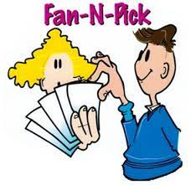
ISLAMIC EDUCATIONAL COLLEGE
SUBJECT: Reading
GRADE: 9
UNIT: 1
Lesson: 1
OUTCOMES
FORMATIVE ASSESSMENT:
WARM UP
PREASSESSMENT
PRESENTATION
FORMATIVE ASSESSMENT
FEEDBACK
DIFFERENTIATION
REAL LIFE APPLICATION
CRITICAL THINKING
EXIT TICKET

Slide 12
Then all the animals began asking, “Who is going to go to the other side of the world? How will they get there?” Everybody had an idea, but none seemed quite right. Then from the back of the room came a small voice. “Hey, I’ll go! I’ll go!” Wolf said, “Who is that? Come down here. I can’t see you. ”Down to the front of the room came a little round animal with chubby cheeks. He was shy and quiet. He stood up in front of all the animals, and as he looked at all those hundreds of eyes looking back at him, he got kind of scared. He looked out over the crowd of animals and he said in his timid voice, “Hi. M-m-m-my name is Possum. I think I can go to the other side of the world. You see, I’ve got these long, sharp claws, and I think I can dig a tunnel. And when I go all the way to the other side of the world, I’ll take a piece of the sun and I’ll hide it in my big, bushy tail.” And Wolf said, “Oh, a tunnel! That’s the best idea yet!” So Possum went to the big wall of dirt at the back of the cave, stuck in his sharp claws, and began to dig and dig and dig and dig, faster and faster and faster and faster. Possum disappeared inside the tunnel, and soon he had gone all the way to the other side of the world

Slide 13
ISLAMIC EDUCATIONAL COLLEGE
SUBJECT: Reading
GRADE: 9
UNIT: 1
Lesson: 1
OUTCOMES
Part 2
05:00 minutes
WARM UP
PREASSESSMENT
Students 1+ 3 :
Read the previous Part of the text and then answer the given questions using rally coach strategy
Students 2+ 4 :
Read the previous Part of the text and then answer the given questions using rally coach strategy
PRESENTATION
FORMATIVE ASSESSMENT
FEEDBACK
DIFFERENTIATION
REAL LIFE APPLICATION
CRITICAL THINKING
EXIT TICKET

Slide 14
ISLAMIC EDUCATIONAL COLLEGE
SUBJECT: Reading
GRADE: 9
UNIT: 1
Lesson: 1
OUTCOMES
FORMATIVE ASSESSMENT:
WARM UP
PREASSESSMENT
PRESENTATION
FORMATIVE ASSESSMENT
FEEDBACK
DIFFERENTIATION
REAL LIFE APPLICATION
CRITICAL THINKING
EXIT TICKET

Slide 15
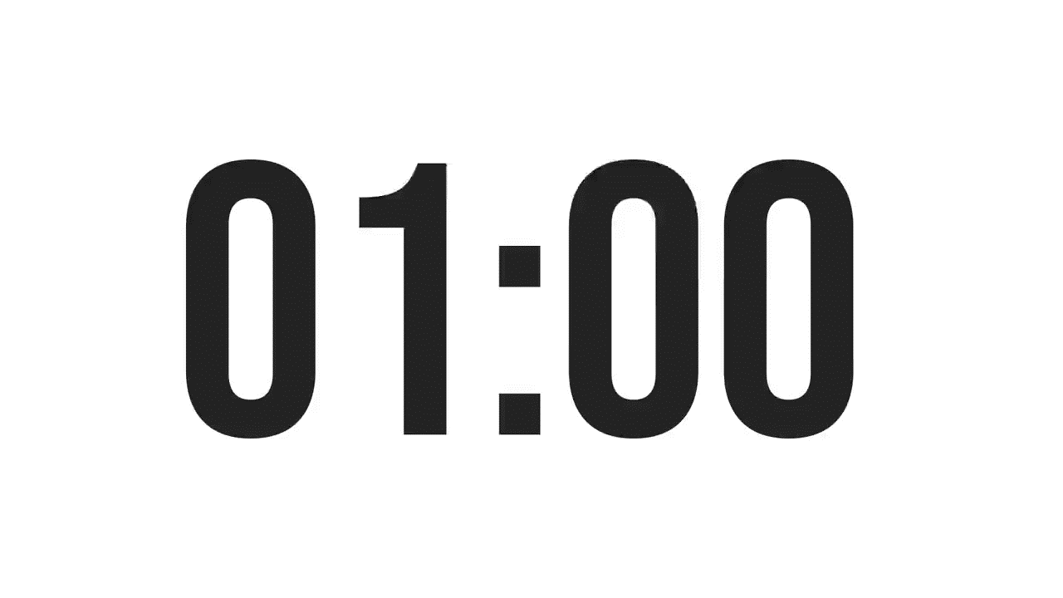
ISLAMIC EDUCATIONAL COLLEGE
SUBJECT: Reading
GRADE: 9
UNIT: 1
Lesson: 1
REAL LIFE APPLICATION:
Choose a question , think about it ND THEN SHARE IT WITH YOUR GROUP
Instructions: Read parts 1 and 2 of the story carefully. Then answer the questions below. Use examples from your own life or people you know.
Cooperation: How did the animals help each other in the story? Can you think of a time you worked with someone to solve a problem? What happened?
Jealousy or Envy: Did any animals act out of jealousy or selfishness? Have you ever felt jealous of someone? How did you handle it?
Problem-Solving: The animals had to find ways to help Grandmother Spider with the light. Can you describe a time when you or your friends had to solve a difficult problem together? What strategy did you use?
Consequences of Actions: How did the animals’ actions affect the story’s outcome? Can you give an example from your life where your choice made a positive or negative difference?
OUTCOMES
01:00 minute
WARM UP
PREASSESSMENT
PRESENTATION
FORMATIVE ASSESSMENT
FEEDBACK
DIFFERENTIATION
REAL LIFE APPLICATION
CRITICAL THINKING
EXIT TICKET
BUZZ IN

Slide 16
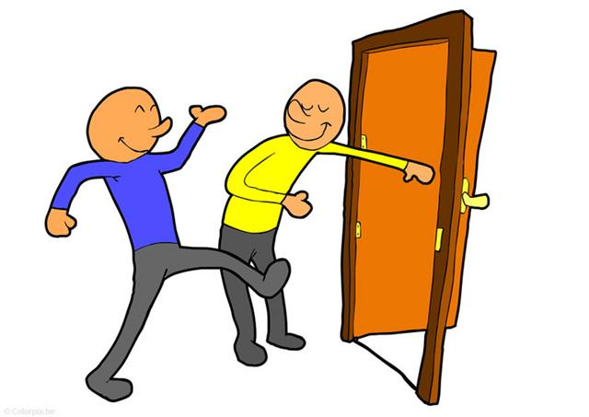
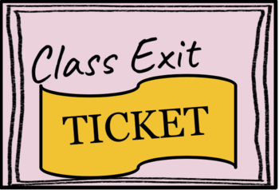
ISLAMIC EDUCATIONAL COLLEGE DATE:
SUBJECT: Reading
GRADE: 9
UNIT: 1
Lesson: 1
OUTCOMES
EXIT TICKT
What did you learn from today’s lesson ?
02:00 minutes
WARM UP
PREASSESSMENT
PRESENTATION
FORMATIVE ASSESSMENT
FEEDBACK
DIFFERENTIATION
REAL LIFE APPLICATION
CRITICAL THINKING
EXIT TICKET
BUZZ IN

