Slide 1

Unit: 1
Lesson: Grandmother Spider Brings the Sun.
Subject: Reading parts 5+6
Grade: 9

Slide 2


ISLAMIC EDUCATIONAL COLLEGE DATE:
SUBJECT: Vocabulary
GRADE: 10
UNIT: 4
Lesson: 1
LESSON
OBJECTIVES
01:00 minute
WARM UP
PREASSESSMENT
Lesson’s Objectives:
1- Demonstrate understanding of the main ideas and key details of the text.
Value : never underestimate anyone because of their size , age or gender
PRESENTATION
FORMATIVE ASSESSMENT
FEEDBACK
DIFFERENTIATION
REAL LIFE APPLICATION
CRITICAL THINKING
EXIT TICKET

Slide 3

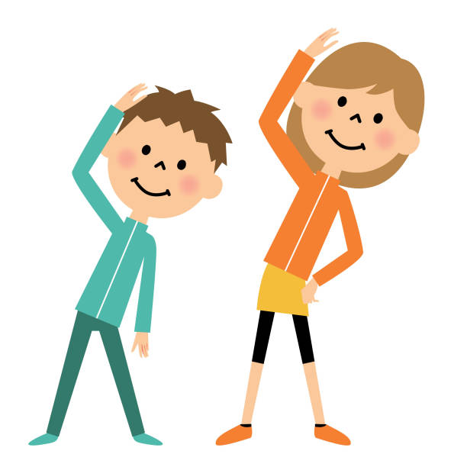
ISLAMIC EDUCATIONAL COLLEGE DATE:
SUBJECT: Vocabulary
GRADE: 10
UNIT: 4
Lesson: 1
OUTCOMES
Revision on the previous material
02:00 minutes
WARM UP
PREASSESSMENT
PRESENTATION
FORMATIVE ASSESSMENT
FEEDBACK
DIFFERENTIATION
REAL LIFE APPLICATION
CRITICAL THINKING
EXIT TICKET

Slide 4
Wolf said, “Possum’s burned his tail off and now Buzzard’s bald, and we still don’t have any sun. What are we going to do now?”A tiny voice from up above said, “Send me, I’ll go! Hey, send me, I’ll go! I’ll go!”Wolf looked all around, but he couldn’t tell where the voice was coming from. “Who is that? Where are you? Come down where I can see you.”Down from the corner of the ceiling squeaked the tiny voice: “Send meeeeeee!”And right there in front of Wolf landed a tiny spider. The spider looked up and Wolf looked down, and Wolf said, “Oh, no! Not you, Grandma! You can’t go to the other side of the world. You’re too old—and besides that, you’re too slow!”Well, this was Grandmother Spider. She had done many things to help the animals in her long life. She crossed her little arms and said, “I know I’m old. You don’t have to tell me I’m old. But I want to help my people one more time. I need a piece of clay about so big, and you’ll get me a piece, won’t you, son ?
Wolf went and got Grandmother Spider a piece of clay, and she sat in the middle of the room and began to chant. Soon she had worked the clay into a little bowl.She picked up that beautiful clay bowl and disappeared inside the tunnel. They say it took Grandma Spider a long, long, long, long time to get to the other side of the world.The Sun Guards were out now. They knew somebody was trying to steal some of their sun, and they stood in a tight circle around it. They weren’t going to let anybody through.The Sun Guards were mean-looking monsters. They had fire coming out of their heads. They had fire coming out of their mouths: Hissssss!And they held their weapons, ready for a fight.But Grandmother Spider was so tiny that they didn’t even see her. She sneaked between them, went up to the sun, took a little piece, put it in her clay bowl, and sneaked back past the Sun Guard.

Slide 5


ISLAMIC EDUCATIONAL COLLEGE
SUBJECT: Vocabulary
GRADE: 9
UNIT: 4
Lesson: 1
OUTCOMES
Part 3
05:00 minutes
WARM UP
PREASSESSMENT
Students 1+ 3 :
Read the previous Part of the text and then answer the given questions using rally coach strategy
Students 2+ 4 :
Read the previous Part of the text and then answer the given questions using rally coach strategy
PRESENTATION
FORMATIVE ASSESSMENT
FEEDBACK
DIFFERENTIATION
REAL LIFE APPLICATION
CRITICAL THINKING
EXIT TICKET

Slide 6


ISLAMIC EDUCATIONAL COLLEGE
SUBJECT: Vocabulary
GRADE:
UNIT: 4
Lesson: 1
OUTCOMES
FORMATIVE ASSESSMENT:
WARM UP
PREASSESSMENT
PRESENTATION
FORMATIVE ASSESSMENT
FEEDBACK
DIFFERENTIATION
REAL LIFE APPLICATION
CRITICAL THINKING
EXIT TICKET

Slide 7
ISLAMIC EDUCATIONAL COLLEGE
SUBJECT: Vocabulary
GRADE:
UNIT: 4
Lesson: 1
OUTCOMES
Padlet
WARM UP
PREASSESSMENT
🌿 Real-Life Application Task
Task:
Think about Grandmother Spider. She was small, old, and slow, yet she succeeded because she was wise, patient, and determined.
👉 Question for Students:
Can you give a real-life example (from school, family, or your community) where someone who seemed weak, small, or less powerful was able to succeed because of their cleverness, wisdom, or determination?
PRESENTATION
FORMATIVE ASSESSMENT
FEEDBACK
DIFFERENTIATION
REAL LIFE APPLICATION
CRITICAL THINKING
EXIT TICKET

Slide 8
She came back down the tunnel very slowly. It took her a long, long, long, long time to get to her side of the world. And as she got closer, something happened. The light inside her bowl began to grow. The little rays stretched out of the bowl.As she came out of the tunnel into the cave, that ball of light was growing. She could hardly even carry it.All the animals came running to help Grandmother Spider: blind Possum and bald Buzzard, Wolf and Coyote and Bear and Deer and all the others. But that ball of light just kept getting bigger and bigger and bigger and bigger, and it got so big that the animals had to squeeze it out of the cave, and as it squeezed out into the world it bounced up into the sky: Boingggg!It is said that from that day on, whenever Grandmother Spider would spin her web, the shape of the sun would be at the center. And you see, Grandmother Spider spins her web that way to this very day.

Slide 9
Differentiation in product
Performance : Group Work.
Task : Each group should add another animal character who tried to go the other side of the world to get a piece of the sun .Explain how the sun shaped that animal .
Time : 5 minutes .

Slide 10


Summative assessment
* I know all the characters in the myth and their roles
* I know the sequence of events and I can tell the story from my mind.
* I know why it is called a myth .

Slide 11
Review and Practice
ANSWERS1. Wolf is tired of the darkness because the animals are always bumping into him and asking for directions. He proposes that they ask the other side of the world for a piece of the sun.
2. Coyote thinks Wolf’s idea is too polite and nice.
3. Buzzard changes from proud and boastful to shy and embarrassed.
4. The myth explains why possums have a tail without fur and why buzzards are bald.
5. The author wishes the reader to respect Grandmother Spider the most. She is wise, thoughtful, willing, and determined.
6. The author uses sound effects, such as repetition and onomatopoeia, and informal language to make the story sound as though it is being told by a storyteller.
7. Answers will vary.
8. Answers will vary.
Possible answers: This myth explains how the sun came to the world and why some animals (such as the possum) look the way they do

Slide 12
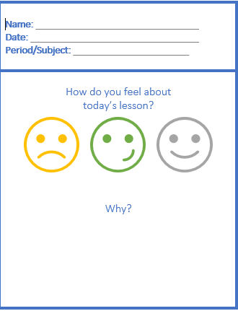
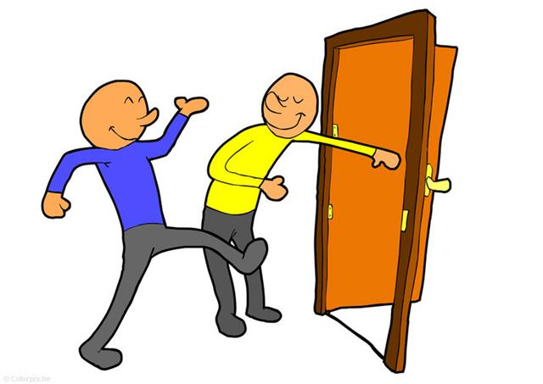

ISLAMIC EDUCATIONAL COLLEGE DATE:
SUBJECT: Vocabulary
GRADE: 9
UNIT: 1
Lesson: 1
OUTCOMES
EXIT TICKT
02:00 minutes
WARM UP
PREASSESSMENT
PRESENTATION
FORMATIVE ASSESSMENT
FEEDBACK
DIFFERENTIATION
REAL LIFE APPLICATION
CRITICAL THINKING
EXIT TICKET
BUZZ IN

