Slide 1

Unit: 1
Lesson: Grandmother Spider Brings the Sun.
Subject: Reading parts 5+6
Grade: 9

Slide 2


ISLAMIC EDUCATIONAL COLLEGE DATE:
SUBJECT: Vocabulary
GRADE: 10
UNIT: 4
Lesson: 1
LESSON
OBJECTIVES
01:00 minute
WARM UP
Lesson’s Objectives:
Students will be able to recall specific details and answer comprehension questions answer comprehension and critical thinking questions about the story
PREASSESSMENT
PRESENTATION
FORMATIVE ASSESSMENT
FEEDBACK
Students will be able to relate ideas from the story to real-life situations
DIFFERENTIATION
REAL LIFE APPLICATION
CRITICAL THINKING
EXIT TICKET

Slide 3
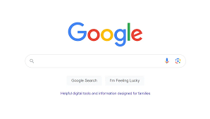

ISLAMIC EDUCATIONAL COLLEGE DATE:
SUBJECT: Reading
GRADE: 9
UNIT: 1
Lesson: 1
OUTCOMES
02:00 minutes
WARM UP
PREASSESSMENT
What is meant by derivation
PRESENTATION
FORMATIVE ASSESSMENT
FEEDBACK
DIFFERENTIATION
REAL LIFE APPLICATION
CRITICAL THINKING
EXIT TICKET

Slide 4
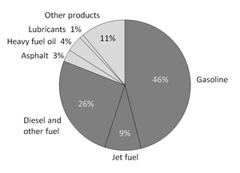
DERIVATION IS: the action of obtaining something from a source or origin.
Introduction
FEEDBACK
But in language, DERIVATION means:
the formation of a word by changing the form of the base or by adding affixes to it.
(“create” “creation/ creativity” “creative” “creatively)

Slide 5
ISLAMIC EDUCATIONAL COLLEGE DATE:
SUBJECT: Reading
GRADE: 9
UNIT: 1
Lesson: 1
OUTCOMES
02:00 minutes
WARM UP
PREASSESSMENT
What is a suffix?
Name some nouns suffixes
PRESENTATION
FORMATIVE ASSESSMENT
FEEDBACK
DIFFERENTIATION
REAL LIFE APPLICATION
CRITICAL THINKING
EXIT TICKET

Slide 6
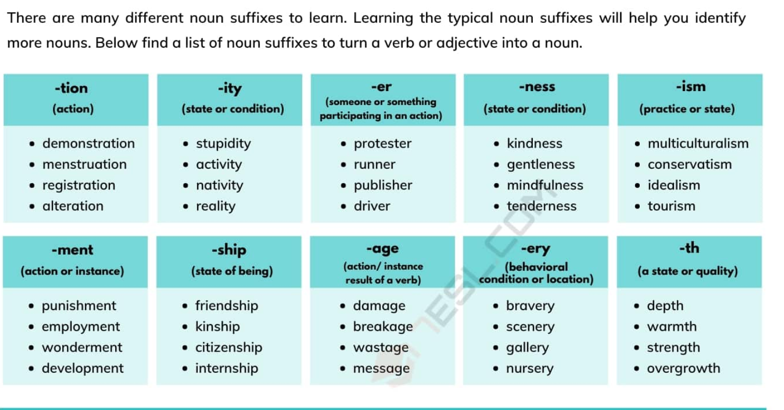
ISLAMIC EDUCATIONAL COLLEGE DATE:
SUBJECT: Comprehension
GRADE: 9
UNIT: 1
Lesson: 1
OUTCOMES
01:00 minutes
WARM UP
PREASSESSMENT
PRESENTATION
FORMATIVE ASSESSMENT
FEEDBACK
DIFFERENTIATION
REAL LIFE APPLICATION
CRITICAL THINKING
EXIT TICKET

Slide 7
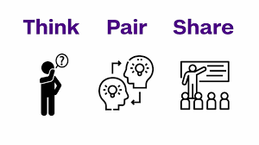
CRITICAL THINKING
Can suffixes help you guess the meaning of a word you don’t know? How?

Slide 8
NOUN
After prepositions (on, at, of, from, for, in, above, by, through …etc)
In hot weather our bodies are in danger of dehydration.
After possessive Adjectives ( my, her, its, his, your, their, our)
We have to study its effect on environment. .
After the articles (a, an, the)
The development of the project is in progress.
After these words -quantifiers- (some, any, much, many, a few, a little, one, two, another, other, this ………)
some, these, this, those, that, no, any, both, each, most, more)
We kept much information about the area.
This design is perfect.
(After Adjective).
The graduation ceremony was a very great occasion for
everyone.
(Before another noun (noun + noun = noun modifier)
health benefits, coffee table

Slide 9
REAL LIFE APPLICATION
Real-life application task: "Imagine you are writing a CV. Mention at least 3 nouns formed with suffixes that would make your CV stronger. For example: education

Slide 10

Strength
Invention
ISLAMIC EDUCATIONAL COLLEGE DATE:
SUBJECT: Comprehension
GRADE: 9
UNIT: 1
Lesson: 1
OUTCOMES
Students 2+ 3
Add suitable suffixes to change the following words into nouns then use them in sentences
Enter
Decide
perform
Students 2+ 4 :
The noun is given. Use it in a sentence/underline the suffix.
Strength
Invention
Attendance
01:30 minutes
WARM UP
PREASSESSMENT
PRESENTATION
FORMATIVE ASSESSMENT
FEEDBACK
DIFFERENTIATION
REAL LIFE APPLICATION
CRITICAL THINKING
EXIT TICKET

Slide 11
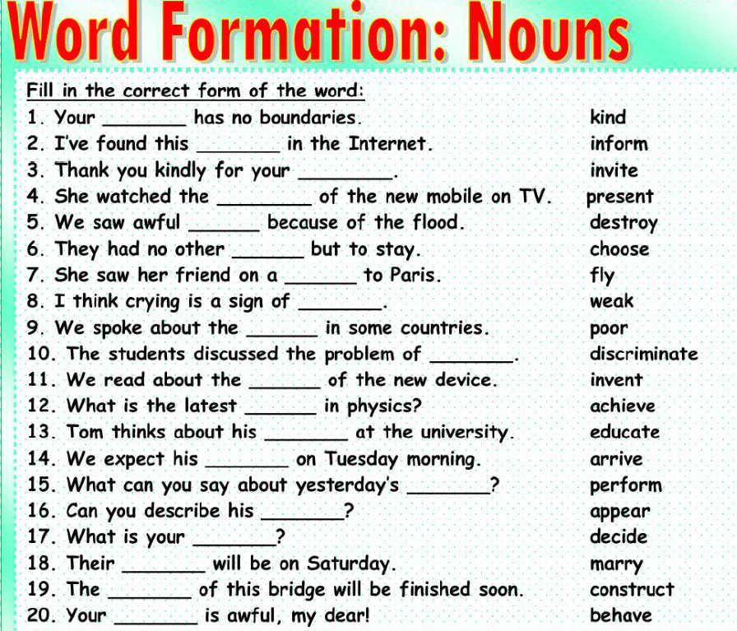

Slide 12
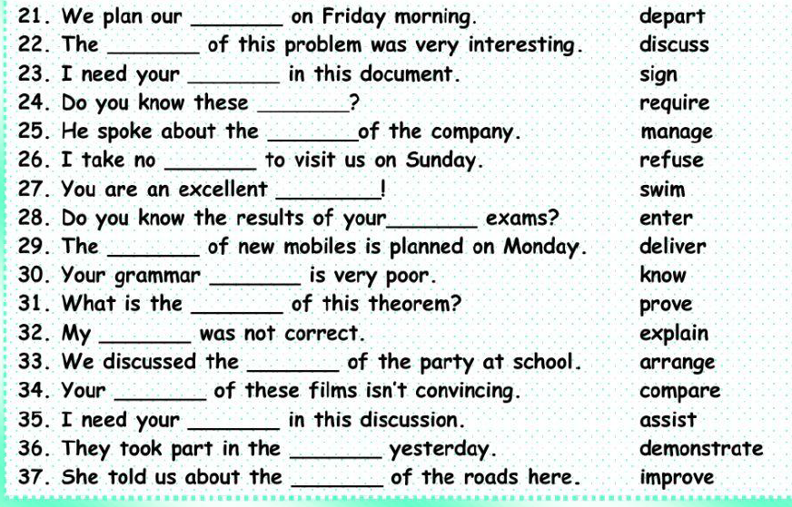

Slide 13
Kindness
Information
Invitation
Presentation
Destruction
Choice
Flight
Weakness
Poverty
Discrimination
Invention
Achievement
Education
Arrival
Performance
Appearance
Decision
Marriage
Construction
behaviour
Departure
Discussion
Signature
Requirement
Management
Refusal
Swimmer
Entrance
Delivery
Knowledge
Proof
Explanation
Arrangement
Comparison
Assistance
Demonstration
improvement

Slide 14
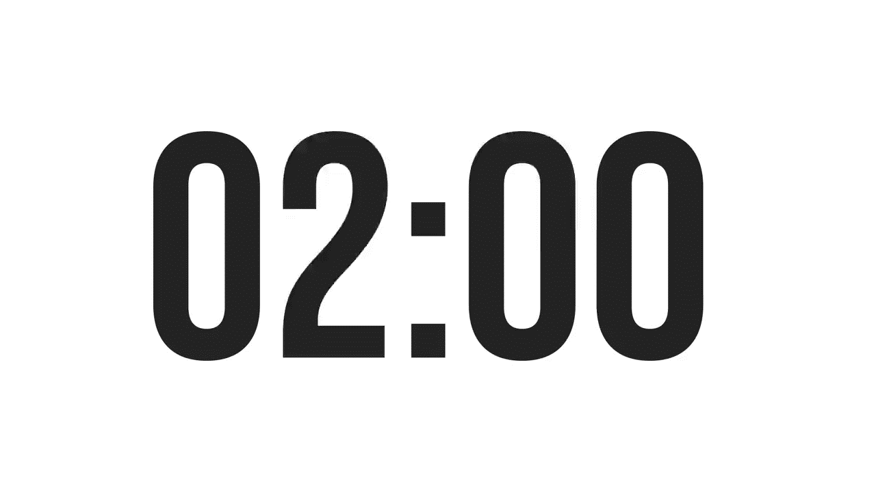

ISLAMIC EDUCATIONAL COLLEGE DATE:
SUBJECT: Vocabulary
GRADE: 9
UNIT: 1
Lesson: 1
OUTCOMES
EXIT TICKT
02:00 minutes
WARM UP
PREASSESSMENT
Write a word change it into a noun use in a sentence
PRESENTATION
FORMATIVE ASSESSMENT
FEEDBACK
DIFFERENTIATION
REAL LIFE APPLICATION
CRITICAL THINKING
EXIT TICKET
BUZZ IN

Slide 15
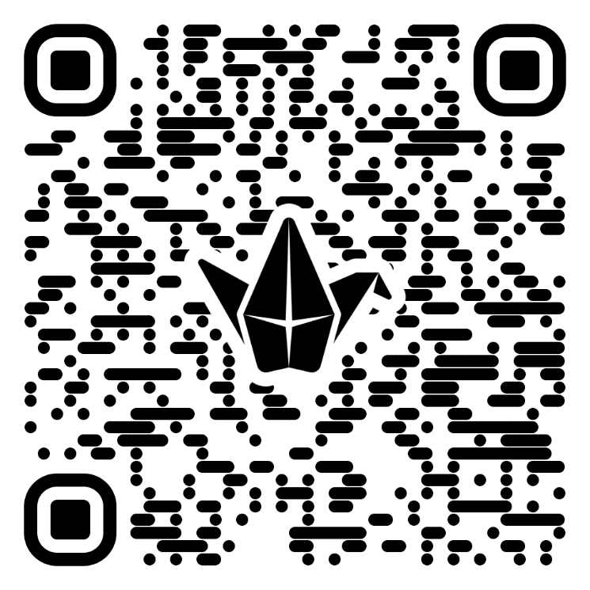
EXIT TICKT
What did you learn from today’s lesson ?
https://padlet.com/alselaweamneh/a-lesson-you-learned-ombexa33pnfjxh89

