Slide 1

Unit: 3
Lesson: Let’s Eat
Subject: Simple, Compound and Complex Sentences
Grade: 10

Slide 2


ISLAMIC EDUCATIONAL COLLEGE DATE: / / 2025 :
SUBJECT: Grammar
GRADE: 8
UNIT: 4
Lesson: 2
LESSON
OBJECTIVES
OBJECTIVES:
To distinguish between simple, compound and complex sentences
To complete the different related tasks, practices and activities successfully
01:00 minute
WARM UP
PREASSESSMENT
PRESENTATION
FORMATIVE ASSESSMENT
FEEDBACK
DIFFERENTIATION
REAL LIFE APPLICATION
CRITICAL THINKING
EXIT TICKET

Slide 3

ISLAMIC EDUCATIONAL COLLEGE DATE: / / 2025
SUBJECT: Grammar
GRADE: 8
UNIT: 4
LESSON: 2
OUTCOMES
WARM UP:
Solve the riddle.
Riddle:
I am not alive, but I grow; I don’t have lungs, but I can blow. I don’t have a mouth, but water kills me. What am I?
Is it 1. candle or 2. fire?
Answer: Fire
01:00 minute
WARM UP
PREASSESSMENT
PRESENTATION
FORMATIVE ASSESSMENT
FEEDBACK
DIFFERENTIATION
REAL LIFE APPLICATION
CRITICAL THINKING
EXIT TICKET
IRS

Slide 4
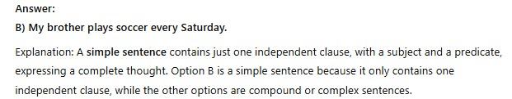
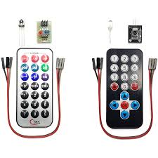
ISLAMIC EDUCATIONAL COLLEGE DATE: / / 2025
SUBJECT: Grammar
GRADE: 8
UNIT: 4
LESSON: 2
PREASSESSMENT:
Question:
Which of the following is a simple sentence?
A) Even though I was tired, I stayed up late to finish my project. B) My brother plays soccer every Saturday. C) When I finish my homework, I will watch TV. D) I wanted to go to the park, but it started raining.
OUTCOMES
01:00 minute
WARM UP
PREASSESSMENT
PRESENTATION
FORMATIVE ASSESSMENT
FEEDBACK
DIFFERENTIATION
REAL LIFE APPLICATION
CRITICAL THINKING
EXIT TICKET

Slide 5
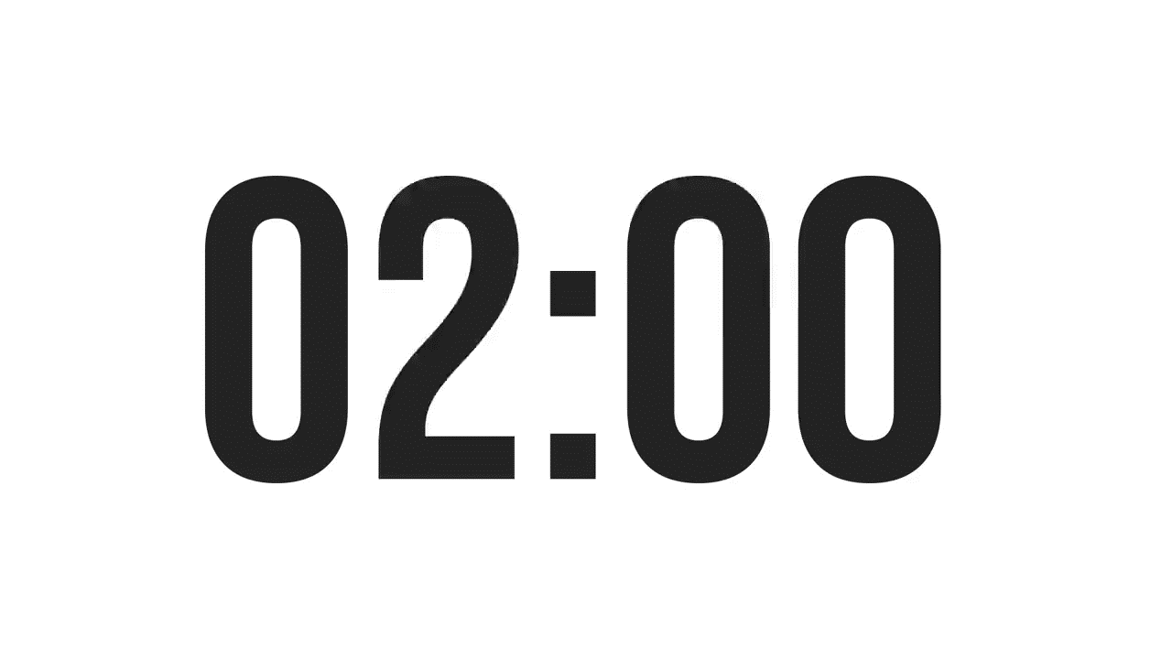
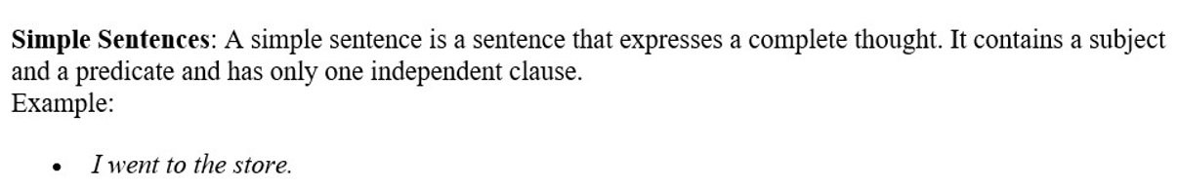
ISLAMIC EDUCATIONAL COLLEGE DATE: / / 2025 :
SUBJECT: Grammar
GRADE: 8
UNIT: 4
LESSON: 2
OUTCOMES
PRESENTATION I:
WARM UP
PREASSESSMENT
PRESENTATION
FORMATIVE ASSESSMENT
FEEDBACK
DIFFERENTIATION
My sister loves to hike.
My friends and I have been working for the same company since 2015.
We ate outside and swam in the lake all week.
REAL LIFE APPLICATION
CRITICAL THINKING
EXIT TICKET

Slide 6

What is a clause?
What types of clauses are there?

Slide 7

Practice forming simple sentences
* Take turns giving examples of simple sentences

Slide 8
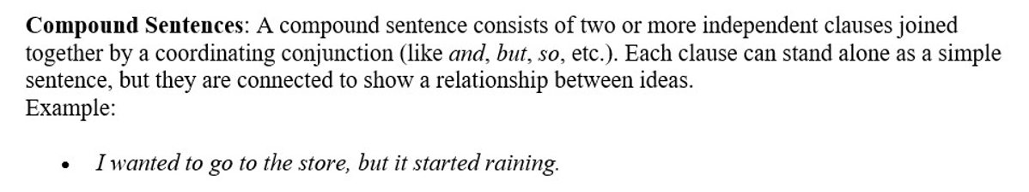
ISLAMIC EDUCATIONAL COLLEGE DATE: / / 2025 :
SUBJECT: Grammar
GRADE: 8
UNIT: 4
LESSON: 2
OUTCOMES
PRESENTATION I:
WARM UP
PREASSESSMENT
PRESENTATION
FORMATIVE ASSESSMENT
FEEDBACK
DIFFERENTIATION
REAL LIFE APPLICATION
CRITICAL THINKING
EXIT TICKET

Slide 9
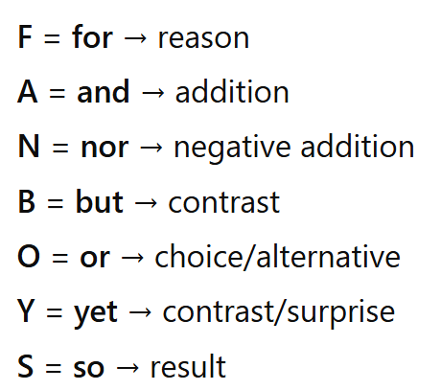
For – I stayed home, for I was feeling sick.
And – She likes reading, and she enjoys writing.
Nor – She hasn’t called me, nor has she sent a message..
But – I wanted to go out, but it started raining.
Or – We can watch a movie, or we can play a game.
Yet – She is very tired, yet she keeps working..
So – I was hungry, so I made a sandwich.

Slide 10
With “nor” the helping (auxiliary) verb comes first in the clause that follows.
This is called subject–auxiliary inversion.
Structure: Negative clause, nor + helping verb + subject + main verb ...
Examples:
I don’t like apples, nor do I like oranges.
Helping verb: do
Subject: I
Main verb: like
She hasn’t finished her homework, nor has she started studying.
Helping verb: has
Subject: she
Main verb: started
Tip: Common helping verbs include do, does, did, has, have, had, is,
are, was, were, can, will, should.

Slide 11
Compound sentences are made by joining two independent clauses (each could be a sentence on its own) using coordinating conjunctions.
The FANBOYS are the main coordinating conjunctions:
Structure
Independent clause, coordinating conjunction Independent clause

Slide 12
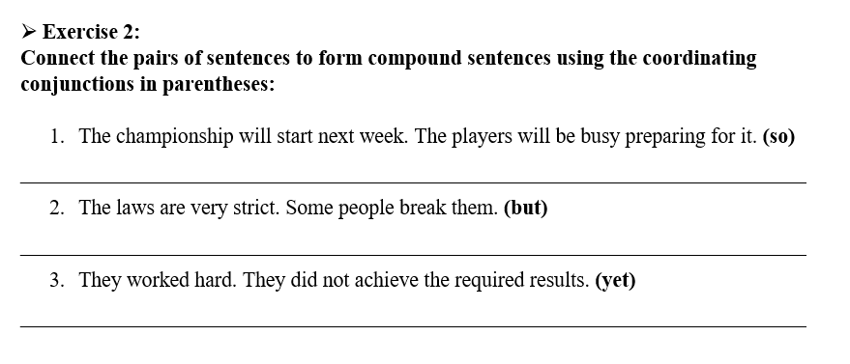
FORMATIVE ASSESSMENT
Individual work
Page 7
EXIT TICKET

Slide 13
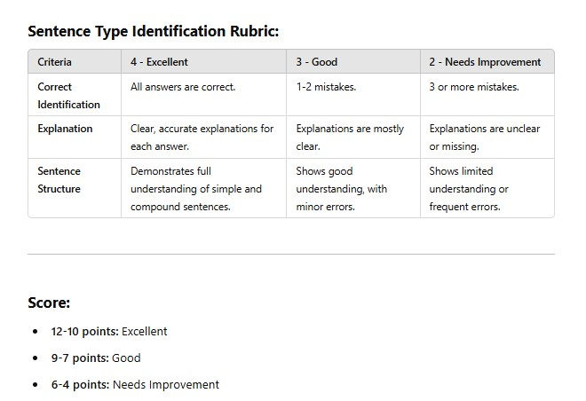

Slide 14

ISLAMIC EDUCATIONAL COLLEGE DATE: / 5/ 2025
SUBJECT: Grammar
GRADE: 9
UNIT: 4
Lesson: 1
OUTCOMES
02:00 minutes
Differentiation
WARM UP
Students 2+3
Students 1+4
PREASSESSMENT
PRESENTATION
FORMATIVE ASSESSMENT
Match and use the correct coordinating conjunction
Complete the sentences with the correct coordinating conjunctions
FEEDBACK
DIFFERENTIATION
REAL LIFE APPLICATION
CRITICAL THINKING
EXIT TICKET

Slide 15
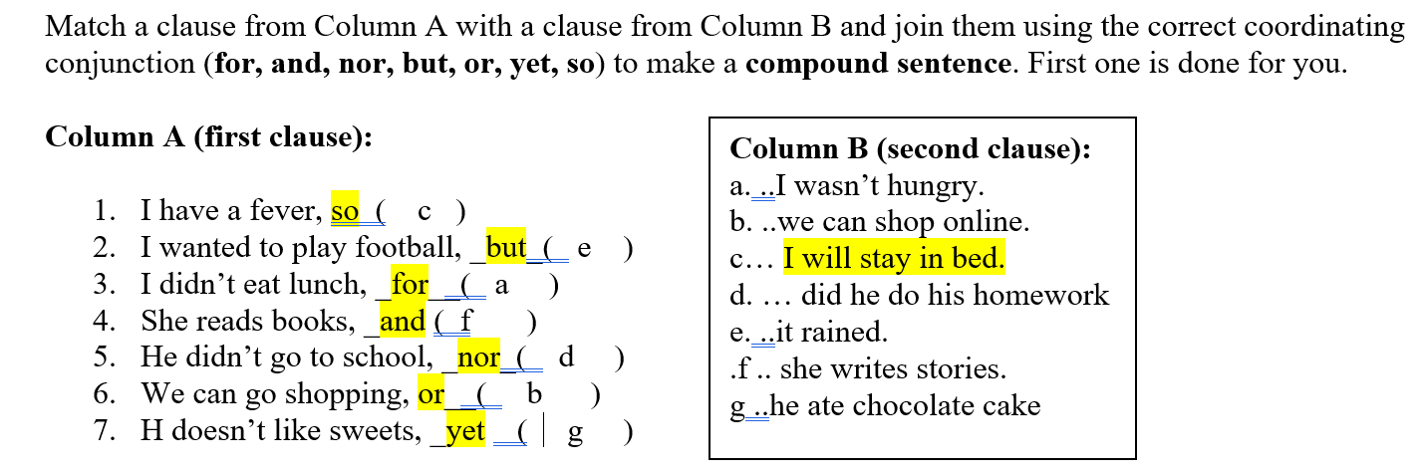
FEEDBACK

Slide 16

WARM UP
The cat chased the mouse and caught it.
Simple 2. compound
She sings beautifully, and she also plays the piano.
1.Simple 2. compound
3.The teacher and the students laughed at the joke.
1. Simple 2. compound
4.He doesn’t like coffee, nor does he drink tea.
1. Simple 2. compound

Slide 17
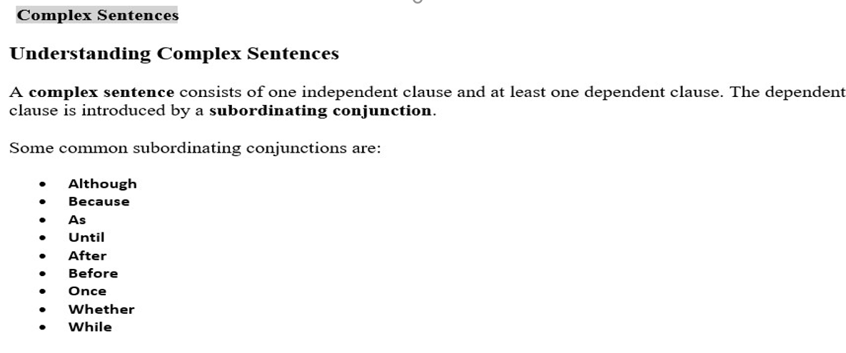
ISLAMIC EDUCATIONAL COLLEGE DATE: / / 2025 :
SUBJECT: Grammar
GRADE: 8
UNIT: 4
LESSON: 2
OUTCOMES
PRESENTATION II:
WARM UP
PREASSESSMENT
PRESENTATION
FORMATIVE ASSESSMENT
FEEDBACK
DIFFERENTIATION
REAL LIFE APPLICATION
CRITICAL THINKING
EXIT TICKET

Slide 18
because, since → show reason/cause I stayed home because it was raining.
although, even though, though → show contrast Although he was tired, he finished his homework.
Even though he was tired, he finished his homework.
Although: despite the fact that (even though is a stronger form of although
Though: but (it makes the other part surprising)
if, unless, provided that → show condition You can’t go out unless you finish your work.
when, while, after, before, until → show time Call me when you arrive.
Relative pronouns: whose, whom, who …

Slide 19
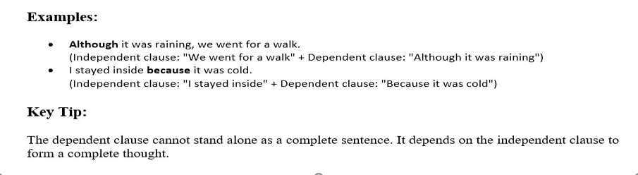
ISLAMIC EDUCATIONAL COLLEGE DATE: / / 2025 :
SUBJECT: Grammar
GRADE: 8
UNIT: 4
LESSON: 2
OUTCOMES
PRESENTATION II:
WARM UP
PREASSESSMENT
PRESENTATION
FORMATIVE ASSESSMENT
FEEDBACK
DIFFERENTIATION
REAL LIFE APPLICATION
CRITICAL THINKING
EXIT TICKET

Slide 20
A complex sentence contains one independent clause and at least one dependent clause.
Complex sentences help provide more information on the main point.
A complex sentence shows the relationship between two or more ideas more effectively than a simple sentence
Independent clause subordinating conjunction dependent clause
The entire neighborhood was plunged into darkness because the power went out unexpectedly.
subordinating conjunction dependent clause, Independent clause
Because the power went out unexpectedly, the entire neighborhood was plunged into darkness.

Slide 21
ISLAMIC EDUCATIONAL COLLEGE DATE: / 5/ 2025
SUBJECT: Grammar
GRADE: 9
UNIT: 4
Lesson: 1
OUTCOMES
02:00 minutes
Differentiation
WARM UP
Students 2+3
Students 1+4
PREASSESSMENT
PRESENTATION
FORMATIVE ASSESSMENT
Match and use the correct subbordinating conjunction
Complete the sentences with the correct subbordinating conjunctions
FEEDBACK
DIFFERENTIATION
REAL LIFE APPLICATION
CRITICAL THINKING
EXIT TICKET

Slide 22
Use the right subordinating conjunction to join the sentences. (because, if, although, even though, since, when, while, unless)
1.She didn’t answer the phone because she was in class.
2.I’ll lend you my notes if you promise to return them.
3. Although the movie was boring ,We stayed until the end.
4.He was nervous although/even though he had prepared well for the exam.

Slide 23
CRITICAL THINKING
If you only used simple sentences in a paragraph, how would it sound?
Think of a news headline, a poem, and a science explanation. Which type of sentence would fit each best, and why?

Slide 24
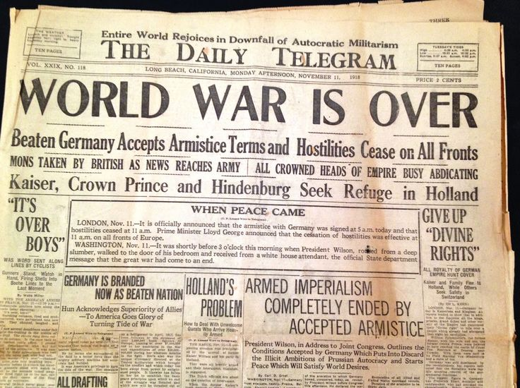
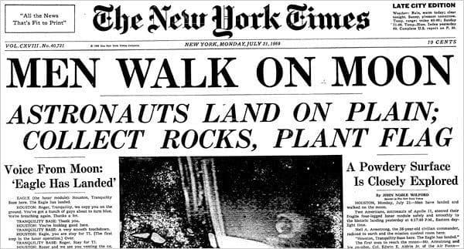
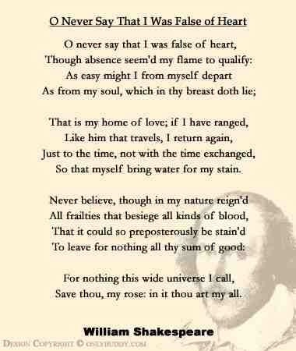

Slide 25

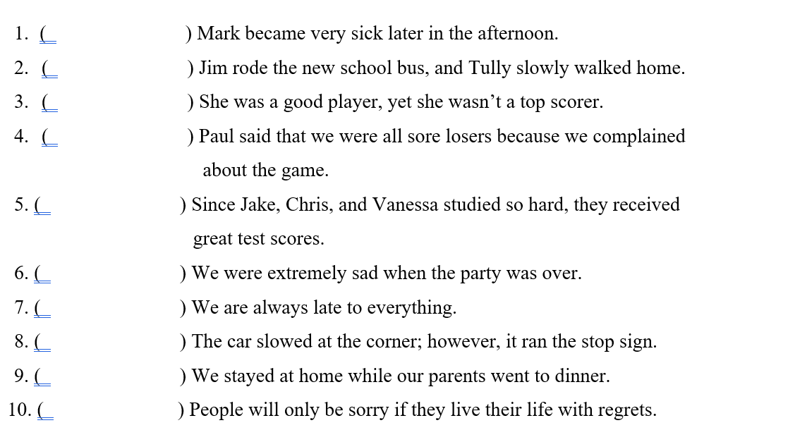
Simple
Compound
Compound
Complex
Complex
Complex
Simple
Compound
Complex
Complex

Slide 26
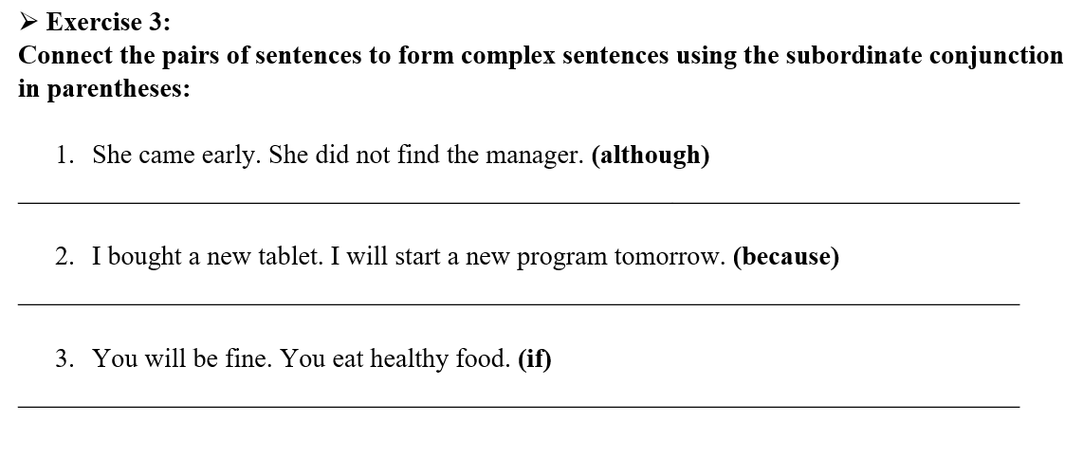

Slide 27
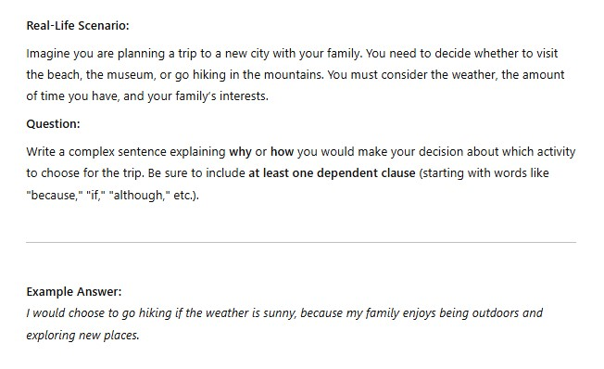
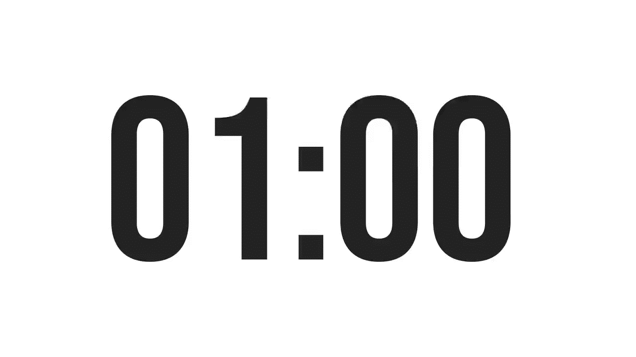
ISLAMIC EDUCATIONAL COLLEGE DATE: / / 2025 :
SUBJECT: Grammar
GRADE: 8
UNIT: 4
LESSON: 2
OUTCOMES
REAL LIFE APPLICATION:
01:00 minute
WARM UP
PREASSESSMENT
PRESENTATION
FORMATIVE ASSESSMENT
FEEDBACK
DIFFERENTIATION
REAL LIFE APPLICATION
CRITICAL THINKING
EXIT TICKET
BUZZ IN

Slide 28
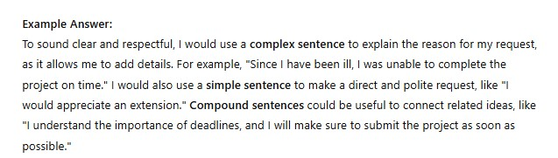
ISLAMIC EDUCATIONAL COLLEGE DATE: / / 2025 :
SUBJECT: Grammar
GRADE: 8
UNIT: 4
LESSON: 2
OUTCOMES
REAL LIFE APPLICATION:
01:00 minute
WARM UP
PREASSESSMENT
PRESENTATION
FORMATIVE ASSESSMENT
FEEDBACK
DIFFERENTIATION
REAL LIFE APPLICATION
CRITICAL THINKING
EXIT TICKET
BUZZ IN

Slide 29

ISLAMIC EDUCATIONAL COLLEGE DATE: / / 2025 :
SUBJECT: Grammar
GRADE: 8
UNIT: 4
LESSON: 2
OUTCOMES
CRITICAL THINKING:
Critical Thinking Question:
You are writing a letter to your principal to request an extension on a school project. You want to express your reasons clearly, but you also want to sound respectful and professional.
Question: What types of sentences would be most effective to use in your letter? Explain why you would choose simple, compound, or complex sentences in different parts of the letter. Provide at least two examples: one for expressing a reason, and one for making a polite request.
01:00 minute
WARM UP
PREASSESSMENT
PRESENTATION
FORMATIVE ASSESSMENT
FEEDBACK
DIFFERENTIATION
REAL LIFE APPLICATION
CRITICAL THINKING
EXIT TICKET
BUZZ IN

Slide 30
ISLAMIC EDUCATIONAL COLLEGE DATE: / / 2025 :
SUBJECT: Grammar
GRADE: 8
UNIT: 4
LESSON: 2
OUTCOMES
EXIT TICKET:
Open the box then decide if the sentence is simple, compound or complex.
https://wordwall.net/resource/14281793/english/simple-compound-and-complex-sentences
02:00 minutes
WARM UP
PREASSESSMENT
PRESENTATION
FORMATIVE ASSESSMENT
FEEDBACK
DIFFERENTIATION
REAL LIFE APPLICATION
CRITICAL THINKING
EXIT TICKET
IRS

