Slide 1

Unit: 4 “ The Story of my Life”
Lesson: Grammar .
Subject: Relative Pronouns.
Grade: 9

Slide 2
LESSON 1

Slide 3



SUBJECT: Grammar
GRADE: 9
UNIT: 1
Lesson: 1
LESSON
OBJECTIVES
00:30 minute
WARM UP
Objectives
PREASSESSMENT
Lesson’s Objectives
1. Identify relative pronouns’ function .
2. Use relative pronouns correctly
PRESENTATION
FORMATIVE ASSESSMENT
FEEDBACK
DIFFERENTIATION
REAL LIFE APPLICATION
CRITICAL THINKING
EXIT TICKET

Slide 4

SUBJECT: Grammar
GRADE: 9
UNIT: 1
Lesson: 1
OUTCOMES
WARM UP
01:30 minutes
WARM UP
Chain game
Take turns speaking
Define the words using using
Where Which Who
Teacher
Student
School
Park
Phone
Real Life Application
PRESENTATION
FORMATIVE ASSESSMENT
FEEDBACK
DIFFERENTIATION
REAL LIFE APPLICATION
CRITICAL THINKING
EXIT TICKET

Slide 5
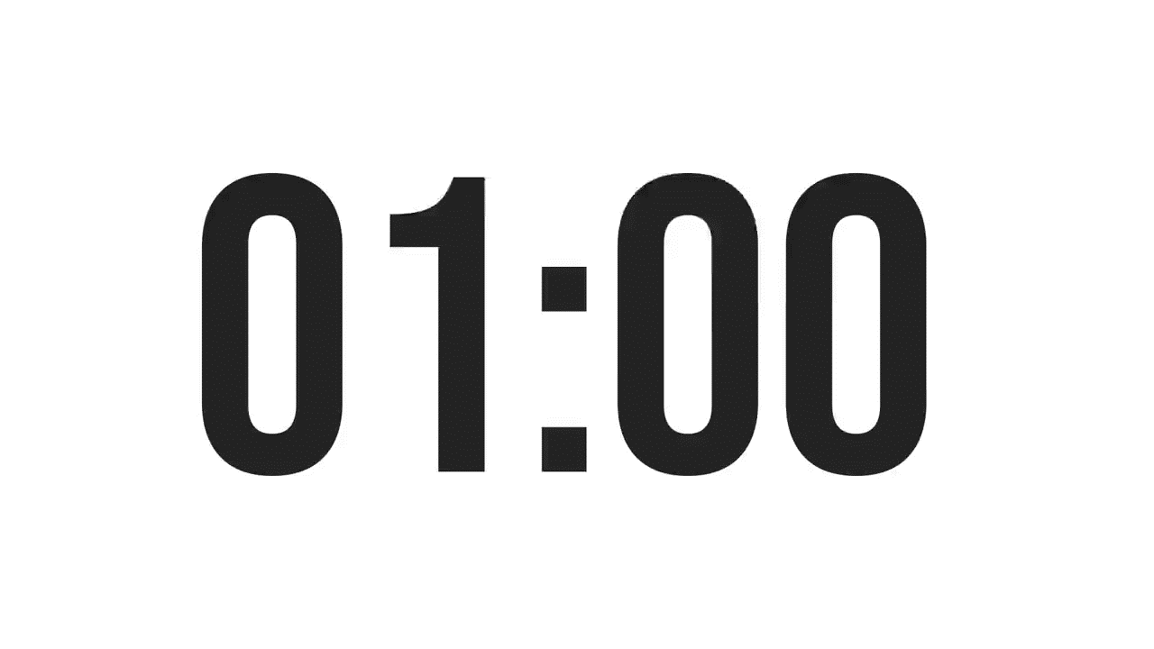


SUBJECT: Grammar
GRADE: 9
UNIT: 1
Lesson: 1
OUTCOMES
WARM UP
What types of pronouns do we have in English ?
Real Life Application
CRITICAL THINKING
FORMATIVE ASSESSMENT
FEEDBACK
DIFFERENTIATION
REAL LIFE APPLICATION
PRESENTATION
EXIT TICKET

Slide 6
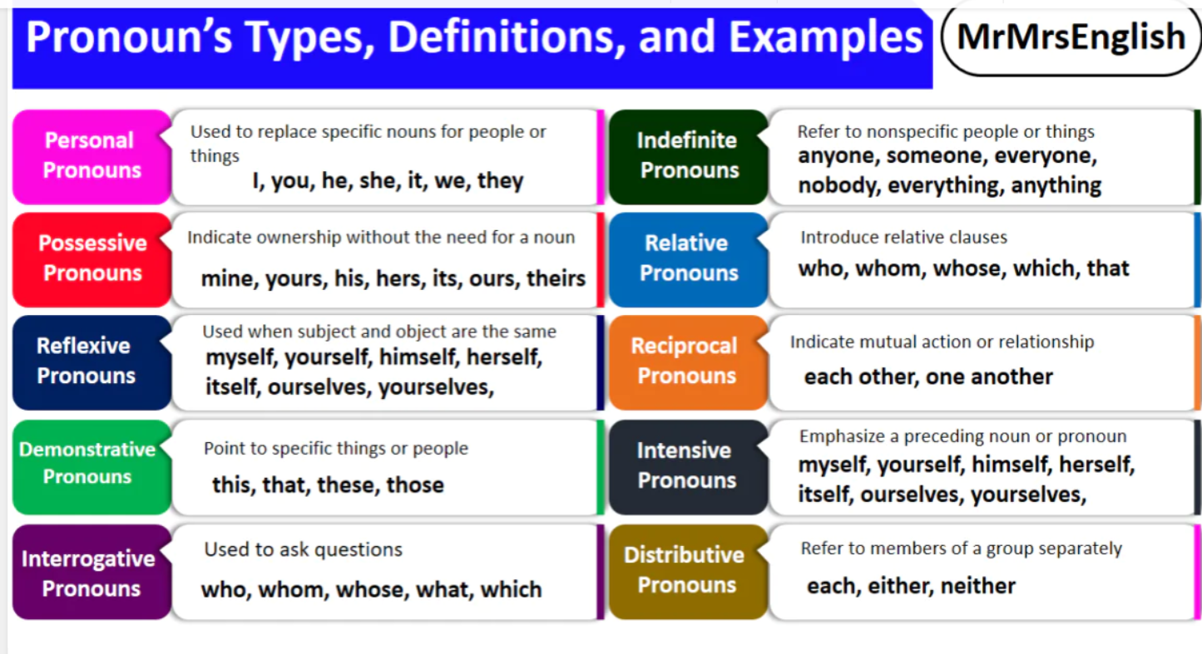
FEEDBACK

Slide 7
ISLAMIC EDUCATIONAL COLLEGE DATE: /2/ 2025
SUBJECT: Grammar
GRADE: 9
Unit: 4
Lesson: 1
OUTCOMES
CRITICAL THINKING
WARM UP
🔹 Why do you think English has words like who, which, that to connect sentences instead of keeping them separate?
REAL LIFE APPLICATION
CRITICAL THINKING
PREASSESSMENT
FEEDBACK
FORMATIVE ASSESSMENT
PRESENTATION
DIFFERENTIATION
BUZZ IN
EXIT TICKET

Slide 8

ISLAMIC EDUCATIONAL COLLEGE DATE: / / 2025
SUBJECT: Grammar
GRADE: 9
UNIT:4
Lesson: 1
OUTCOMES
WARM UP
Pre assessment
REAL LIFE APPLICATION
CRITICAL THINKING
PREASSESSMENT
https://create.kahoot.it/share/relative-pronouns/0d6feac3-a510-44a5-8a13-6cf469cd9eb9
PRESENTATION
DIFFERENTIATION
FORMATIVE ASSESSMENT
FEEDBACK
EXIT TICKET

Slide 9
Relative pronouns :
Who | subject pronoun for people only. E.g. The man who helped me was old.
Whom | Object pronoun for people only The man whom I saw was old.
Whose | used for possessions. E.g. The man whose house was for sale was old.
Which | subject and object pronoun used for things only. E.g. The book, which I saw, was red.
Where | used for places. E.g. The restaurant where we met was downtown.
When | used for times. E.g. The day when we met was cloudy.
Why | Refers to a reason E.g. That’s the reason why I cancelled the meeting
That | Refers to both people and things Works as the subject and object E.g. The boss didn’t like the guy that you brought The cake that you baked was delicious

Slide 10


Slide 11
* The musician who wrote this song is Canadian. * The teacher who explained the lesson is smart .
Who
People

Slide 12
1- My previous house, which was quite small, was in Coventry. 2- I did well in chemistry, which was always my favorite subject. 3- The car which I like to own is very expensive .
Things

Slide 13
The boy whom I met yesterday is very friendly.
I met a boy The boy is very friendly
I : subject
Met: verb
Boy: object
Subject + verb
People

Slide 14
1. The author, whom I talked to is well-known. The action is “ I talked to” who is doing the talking? Who is receiving the action?
Whom
Subject + verb
The author who talked to me is well-known.
The action is “ talked to” who is doing the talking? Who is receiving the action?

Slide 15
I talked to a man. His wife /the man’s wife had died the year before. His Her + Noun Their Our I talked to a man Whose wife had died the year before .

Slide 16
The dog is over there. The dog's / its owner lives next door.
→ The dog whose owner lives next door is over there.
The woman is coming tonight. Her car is a BMW.
→ The woman whose car is a BMW is coming tonight.
The house belongs to me. Its roof is very old.
→ The house whose roof is old belongs to me.
Whose: People/animals/things:
it modifies a noun by showing relationship/ownership

Slide 17
Relative pronouns are used to join clauses
What is a clause?

Slide 18
What is a relative clause or Adjective Clause :
Subject | Relative clause | the verb of the sentence | The complement of the sentence
The man | who helped me | Is | a doctor
The table | which I bought yesterday | Matches | the furniture
The girl | whose dog died | Is | sad

Slide 19

Islamic Educational College
CRITICAL THINKING
English
Unit 1
Grade 9
Why are relative clauses called adjective clauses?
What is the function of the adjective clause ?
The tall man smiled.
The man who had long hair smiled. =

Slide 20
Because the adjective clause( relative clause) modifies (describes) the noun that comes before just like adjectives.

Slide 21

ISLAMIC EDUCATIONAL COLLEGE DATE: / 5/ 2025
SUBJECT: Grammar
GRADE: 9
UNIT: 4
Lesson: 1
OUTCOMES
02:00 minutes
Differentiation
WARM UP
Students 2+3
Students 1+4
PREASSESSMENT
PRESENTATION
FORMATIVE ASSESSMENT
Complete the sentences with the correct relative pronoun
Complete the sentences with the correct relative pronoun
FEEDBACK
DIFFERENTIATION
REAL LIFE APPLICATION
CRITICAL THINKING
EXIT TICKET

Slide 22
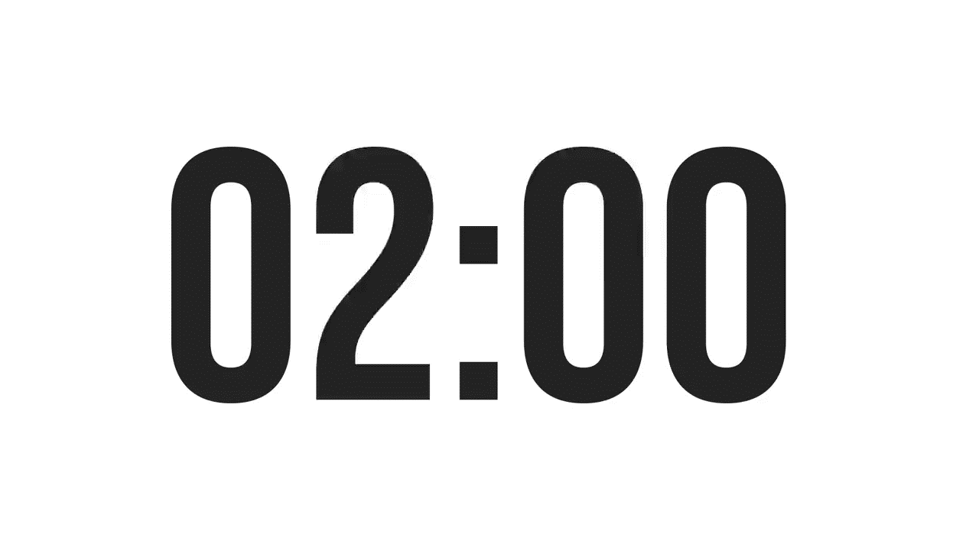
ISLAMIC EDUCATIONAL COLLEGE DATE: / / 2025
SUBJECT: Grammar
GRADE: 9
UNIT: 4
Lesson: 1
OUTCOMES
Formative assessment
WARM UP
PREASSESSMENT
Performance : Pair Work .
Time : 2 Minutes.
PRESENTATION
FORMATIVE ASSESSMENT
FEEDBACK
DIFFERENTIATION
REAL LIFE APPLICATION
CRITICAL THINKING
EXIT TICKET

Slide 23
1. The relative pronoun that is used to modify people is ________________ 2. The relative pronoun that is used to modify things is ______________ 3. The expression which starts with a relative pronoun is called _________ 4. relative clauses are _____________
Formative assessment

Slide 24
ISLAMIC EDUCATIONAL COLLEGE DATE: / / 2025
SUBJECT: Grammar
GRADE: 9
UNIT:4
Lesson: 1
OUTCOMES
WARM UP
Pre assessment
REAL LIFE APPLICATION
CRITICAL THINKING
PREASSESSMENT
PRESENTATION
https://create.kahoot.it/share/relative-pronouns-2/649b3dfe-0ec1-4f2c-9fcb-ddd19f36c73d
DIFFERENTIATION
FORMATIVE ASSESSMENT
FEEDBACK
EXIT TICKET

Slide 25
When
1- The fourth of July when the US gained independence, is my favorite holiday.
2- The summer when I graduated from university was long and hot.
.
Key points
“When” replaces a time expression (like day, moment, year) in the main clause.
Usually used in defining relative clauses, giving essential information.

Slide 26
This is the park where we first met.” Central Park, where we first met, is very beautiful.” Where” is a relative pronoun used to refer to a place. It introduces a relative clause giving more information about a location mentioned in the main clause.
Where

Slide 27

Which VS Where
1- This is the hospital _______I was born .
2- This is the hospital ________ we read about .
1- This is the restaurant ________ I met my best friend .
2- This is the restaurant ________ is always busy .
1- This is the street _______ I lost my keys .
2- This is the street __________ I hate the most .
where
which
where
which
where
which
If it’s the place where something happens, use where. Otherwise, use which for the thing or place itself.”

Slide 28
1- There are many reasons why I love teaching . 2- It is the reason why I hate arguing .
Why
Why” = connects a reason with the action that explains it
Always use a noun like “reason” before “why.”

Slide 29
that
Can replace who or which in most cases.
Cannot replace where or why.
Used in defining clauses only (you can’t use it in non-defining clauses with commas).
People:
This is the man that helped me. ✅
“That helped me” → gives essential info about the man.
Things:
I like the book that you gave me. ✅
“That you gave me” → essential info about the book.

Slide 30
ISLAMIC EDUCATIONAL COLLEGE DATE: /2/ 2025
SUBJECT: Grammar
GRADE: 9
Unit: 4
Lesson: 1
OUTCOMES
CRITICAL THINKING
WARM UP
🔹
In your language, do you join sentences in a similar way? How does it compare to English?
REAL LIFE APPLICATION
CRITICAL THINKING
PREASSESSMENT
FEEDBACK
FORMATIVE ASSESSMENT
PRESENTATION
DIFFERENTIATION
BUZZ IN
EXIT TICKET

Slide 31
REAL LIFE APPLICATION
Which relative pronouns are most useful in daily conversation and why?

Slide 32
Task: Complete the sentences with the correct relative pronoun when/that/why/where).
I like the car that you bought
This is the house where I grew up in.
That is the reason why he was late.
I remember the day when we went to the zoo
Task: Complete the sentences with the correct relative pronoun.(where, that, when, why)
She remembers the day when she won the first prize.
Do you know the reason why he didn’t come to class?
That’s the restaurant where we had dinner last night.
I like the book that you gave me.
The city where he was born is famous
I’ll never forget the moment when I said goodbye to my family.
I don’t understand the reason why he is angry.
The dress that she bought is beautiful

Slide 33
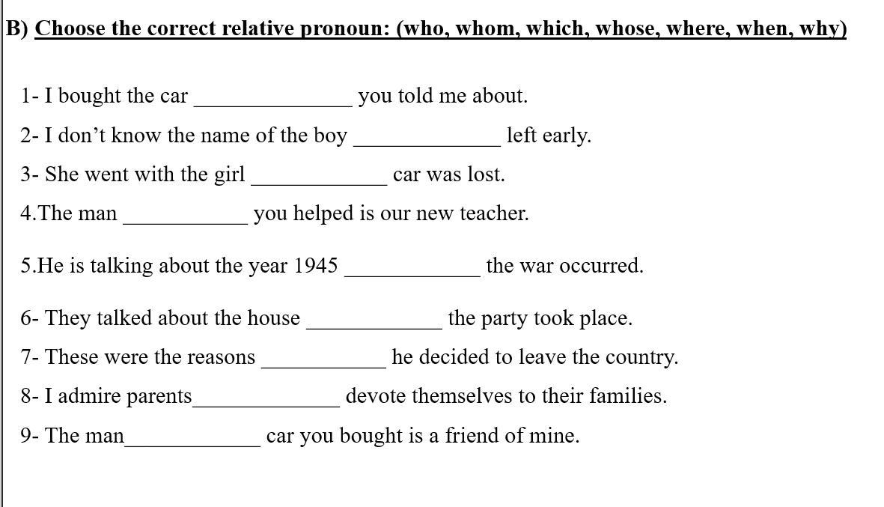
which
who
whose
whom
when
where
why
who
whose

Slide 34
ISLAMIC EDUCATIONAL COLLEGE DATE: / 5/ 2025
SUBJECT: Grammar
GRADE: 9
UNIT: 4
Lesson: 1
OUTCOMES
02:00 minutes
Differentiation
WARM UP
Students 1+3
Students 2+4
PREASSESSMENT
PRESENTATION
FORMATIVE ASSESSMENT
Complete the sentences with the correct relative pronoun
Complete the sentences with the correct relative pronoun
FEEDBACK
DIFFERENTIATION
REAL LIFE APPLICATION
CRITICAL THINKING
EXIT TICKET

Slide 35

Write a sentence using one of the relative pronouns we learned today
EXIT TICKET
https://padlet.com/alselaweamneh/bulletin-board-qlgm7pd39mp0q5za

Slide 36
which
who
whose
whom
when
where
why
who
whose

Slide 37

ISLAMIC EDUCATIONAL COLLEGE DATE: / / 2025
SUBJECT: Grammar
GRADE: 9
Unit: 4
Lesson: 1
OUTCOMES
CRITICAL THINKING
WARM UP
Critical Thinking Questions (5 minutes)
Why do writers and speakers join two sentences with relative pronouns instead of keeping them separate?
How does the meaning change if you use the wrong relative pronoun?
In your opinion, which relative pronouns are most useful in daily conversation and why?
Can relative clauses make a sentence more precise or more confusing? Explain.
REAL LIFE APPLICATION
CRITICAL THINKING
PREASSESSMENT
FEEDBACK
FORMATIVE ASSESSMENT
PRESENTATION
DIFFERENTIATION
BUZZ IN
EXIT TICKET

Slide 38
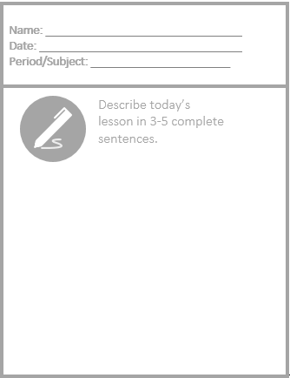
Exit Ticket

