Slide 1


Stone Soup pp.30 and 31
Unit: 1
Big Question: What are the pros and cons of sharing?
Genre: Folktale

Slide 2

Outcomes By the end of this lesson, students are expected to
Big Question
Major Events
reflect on the theme of sharing and explain how it benefits the characters in the story
summarize and retell
the major events using past tense verbs

Slide 3

IRS

Slide 4
IRS
Why did John decide to trade his iron pot?
1. He wanted a new pot.
2. He was hungry.
3. He was tired of carrying it.
4. He needed money.

Slide 5
IRS
Why did John decide to trade his iron pot?
1. He wanted a new pot.
2. He was hungry.
3. He was tired of carrying it.
4. He needed money.

Slide 6
IRS
What did the farmer’s wife do when John asked for food?
1. She gave him food.
2. She invited him inside.
3. She wanted to buy the pot.
4. She said food was scarce.

Slide 7
IRS
What did the farmer’s wife do when John asked for food?
1. She gave him food.
2. She invited him inside.
3. She wanted to buy the pot.
4. She said food was scarce.

Slide 8
IRS
What did John do after finding a stone and gathering sticks and wood?
1. He built a blazing fire.
2. He built a cottage.
3. He traded the stone and wood.

Slide 9
IRS
What did John do after finding a stone and gathering sticks and wood?
1. He built a blazing fire.
2. He built a cottage.
3. He traded the stone and wood.

Slide 10
IRS
What did John do when the water began to boil?
1. He drank the water.
2. He added vegetables.
3. He dropped the stone into the pot.

Slide 11
IRS
What did John do when the water began to boil?
1. He drank the water.
2. He added vegetables.
3. He dropped the stone into the pot.

Slide 12
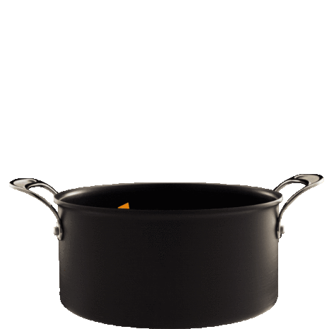

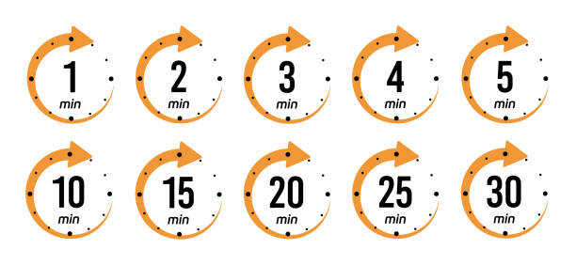
Warm-up Activity What’s in the pot?
Imagine you’re making a soup. In pairs, share what ingredients you would add to the pot.

Slide 13

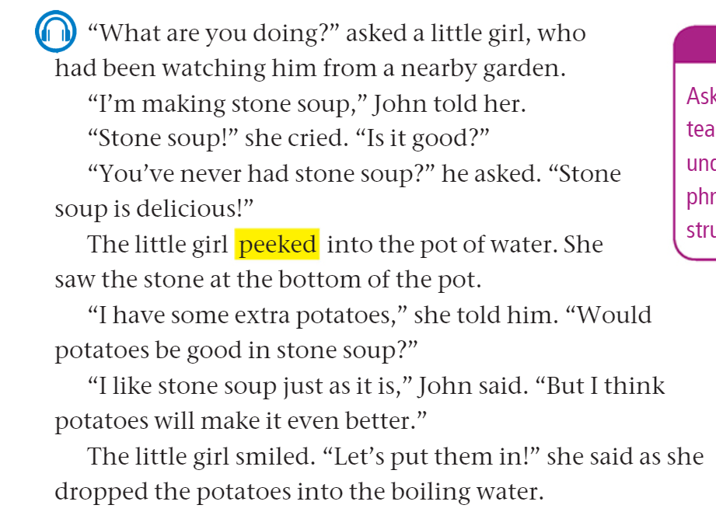
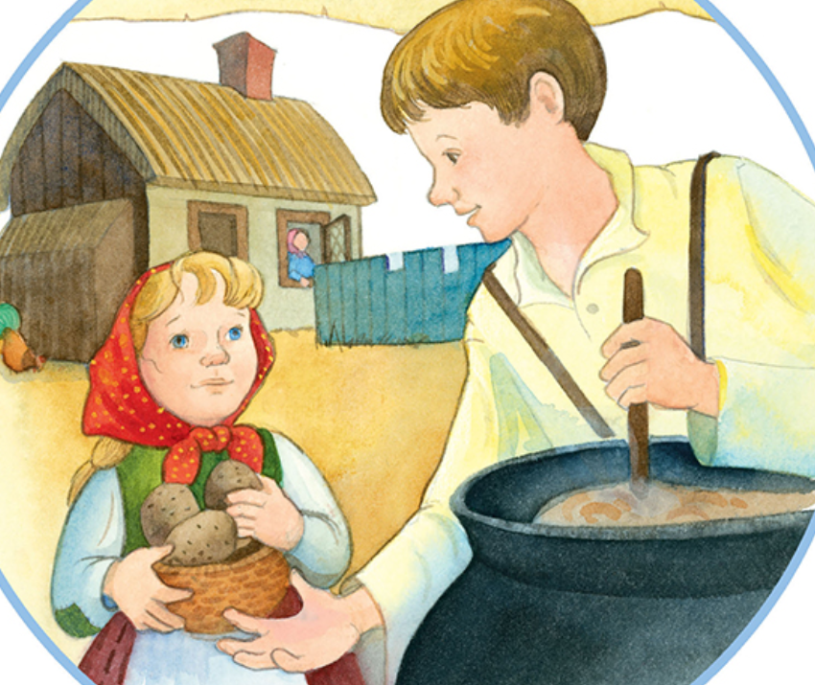
page 30

Slide 14


Discussion Questions on p.30
1. What does the little girl do after John tells her about the stone soup?
2. What does the little girl see when she peeks into the pot of water?
3. What does the little girl offer to add to the stone soup?
4. How does John feel about adding potatoes to the stone soup?
5. What do you think will happen next in the story after they add the potatoes?
6. What do the following pronouns refer to?
her (line 3), it (line 4), them (line 13)

Slide 15
Feedback
1. What does the little girl do after John tells her about the stone soup?
2. What does the little girl see when she peeks into the pot of water?
3. What does the little girl offer to add to the stone soup?
4. How does John feel about adding potatoes to the stone soup?
5. What do you think will happen next in the story after they add the potatoes?
6. What do the following pronouns refer to?
her (line 3), it (line 4), them (line 13)

Slide 16
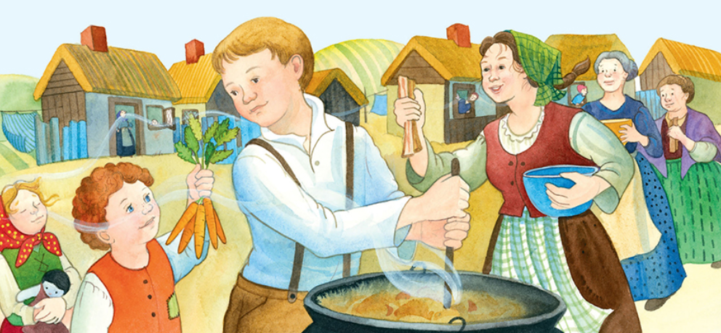
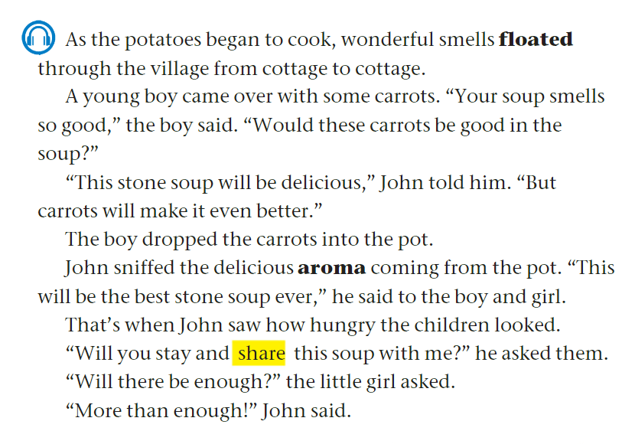
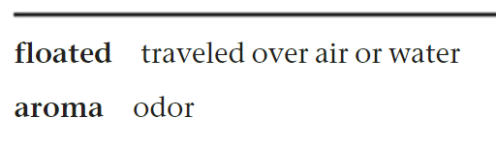
page 31

Slide 17
Discussion Questions on p.31
1. What does the boy offer to add to the stone soup?
2. How does the stone soup smell?
Find evidence from the text to support your answer.
3. What made John ask the children to stay and share the soup with him?
4. What was the little girl worried about?
5. Identify two major events that occur on this page.
6. What details does the illustration help you learn that are not mentioned in the story?
7. Does John think there will be enough soup to share with the children? How do you know?
8. What do the following pronouns refer to?
him (line 6), it (line 7), them (line 12)

Slide 18
Feedback
1. What does the boy offer to add to the stone soup?
2. How does the stone soup smell?
Find evidence from the text to support your answer.
3. What made John ask the children to stay and share the soup with him?
4. What was the little girl worried about?
5. Identify two major events that occur on this page.
The boy adds carrots to the soup, and John offers to share the soup with the two children.
The soup smells delicious.

Slide 19
Feedback
6. What details does the illustration help you learn that are not mentioned in the story?
The illustration shows that other people in the village wanted to add ingredients to John’s stone soup.
7. Does John think there will be enough soup to share with the children? How do you know?
8. What do the following pronouns refer to?
him (line 6), it (line 7), them (line 12)
Yes

Slide 20
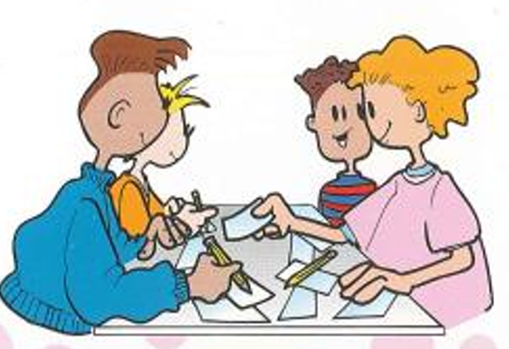
Jot Thoughts
Look for verbs in the simple past tense (both regular and irregular).
Each time you find a verb, write it on one sticky note (one verb= one note).
Keep writing until you cannot find more verbs.
Place your notes in the center of the table.
Then, work together to sort the verbs into two groups:
Regular verbs (end with –ed)
Irregular verbs (change form)

Slide 21
Feedback
Look for verbs in the simple past tense (both regular and irregular).
Each time you find a verb, write it on one sticky note (one verb= one note).
Keep writing until you cannot find more verbs.
Place your notes in the center of the table.
Then, work together to sort the verbs into two groups:
Regular verbs (end with –ed)
Irregular verbs (change form)

Slide 22

Linking to Life
What is something you have that could make others happy if you shared it?

Slide 23
Differentiation
Student’s Number | Task
1 + 3 | Create a new character who adds a different ingredient. How does this change the soup?
2 + 4 | List 3 major events in order. Use simple sentences. (word bank: girl, peeked, added, potatoes, boy, carrots, soup, shared)

Slide 24


Buzz in!
Critical Thinking:
Why did the villagers trust John enough to put food in his soup?

Slide 25
IRS

Slide 26
IRS
Who helped John make the soup?
1. the farmer’s wife
2. his mother
3. the two children
4. No one helped John.

Slide 27
IRS
Who helped John make the soup?
1. the farmer’s wife
2. his mother
3. the two children
4. No one helped John.

Slide 28
IRS
What does the word floated mean?
1. traveled over air or water
2. collected
3. very bright and hot
4. odor

Slide 29
IRS
What does the word floated mean?
1. traveled over air or water
2. collected
3. very bright and hot
4. odor

Slide 30
IRS
Which sentence uses the word aroma correctly?
1. He could taste the aroma of the soup.
2. The aroma of the rain was loud.
3. She wore a beautiful aroma round her neck.
4. The aroma of the cookies filled the kitchen.

Slide 31
IRS
Which sentence uses the word aroma correctly?
1. He could taste the aroma of the soup.
2. The aroma of the rain was loud.
3. She wore a beautiful aroma round her neck.
4. The aroma of the cookies filled the kitchen.
= a nice smell

Slide 32



- John made the soup alone without any help.
- One major event is when the girl dropped the potatoes into the boiling water.
- Sharing the potatoes made the soup better.
- The theme of the story is “Don’t trust strangers.”
- The theme of the story is “Sharing makes things easier and brings people together.”

