Slide 1



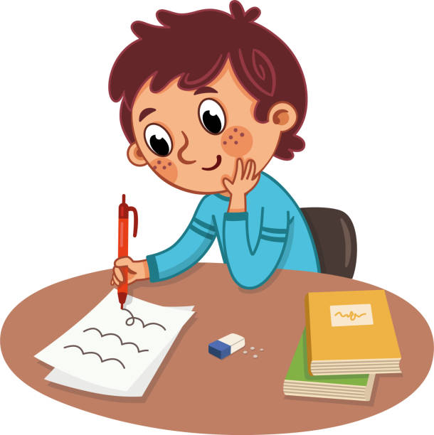
Unit : One
Major : English
Lesson :Descriptive Writing
Grade : 4

Slide 2

Outcomes
Students will be able to:
Identify the parts of the descriptive paragraph.
Write a title and a topic sentence.

Slide 3
Warm-Up
f | t | n | a | s | a | l | p
a | r | a | l | u | p | o | p
m | e | m | o | s | e | w | a
o | t | c | e | f | r | e | p
u | d | e | d | w | o | r | c
s | g | n | i | z | a | m | a
amazing
famous
popular
perfect
Crowded
awesome
Buzz in

Slide 4
Pre-assessment
https://wordwall.net/resource/2962479/english/noun-adjective-or-verb
Random pick

Slide 5
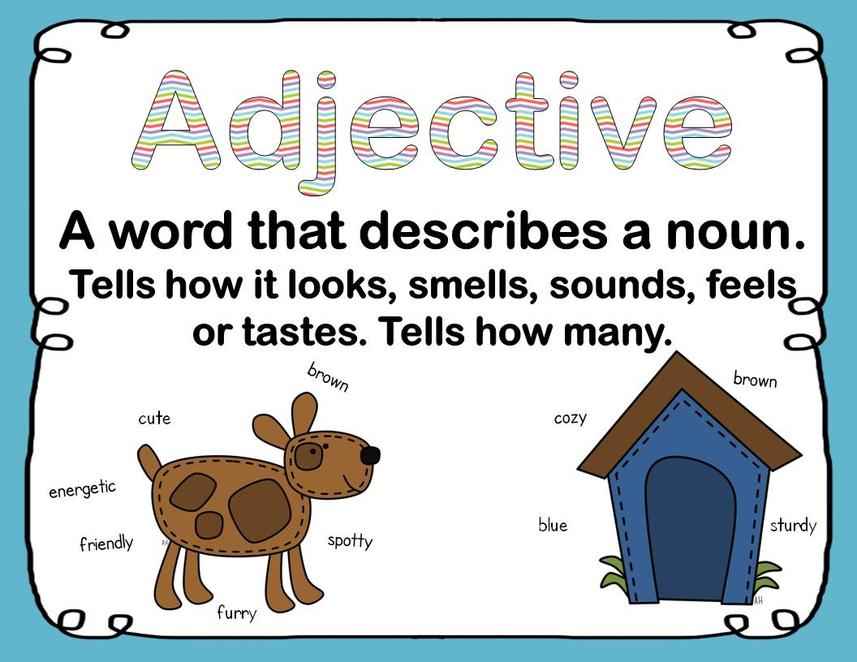

What does the word adjective mean?
Presentation
Write as

Slide 6
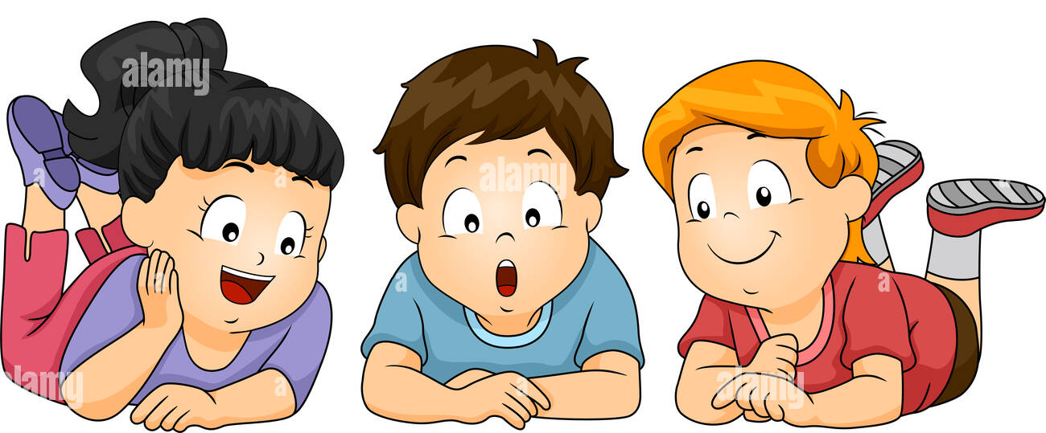
Presentation
What is this?
My Lovely Friend
My favorite friend is Anna . Anna is a very beautiful and charming girl. She is taller than me . She has straight brown hair and brown eyes. The thing I admire most about Anna is that she is protective and likes to look after people. For me, I am proud to say that I have such loyal and helpful friend.

Slide 7

Presentation
What is this paragraph about?
My Lovely Friend
My favorite friend is Anna . Anna is a very beautiful and charming girl. She is taller than me . She has straight brown hair and brown eyes. The thing I admire most about Anna is that she is protective and likes to look after people. For me, I am proud to say that I have such loyal and helpful friend.

Slide 8
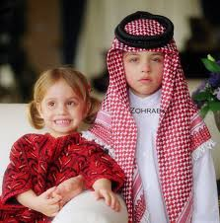
Critical Thinking
Real life application
Do you think siblings can be real friends? Why? Why not?
Buzz in

Slide 9
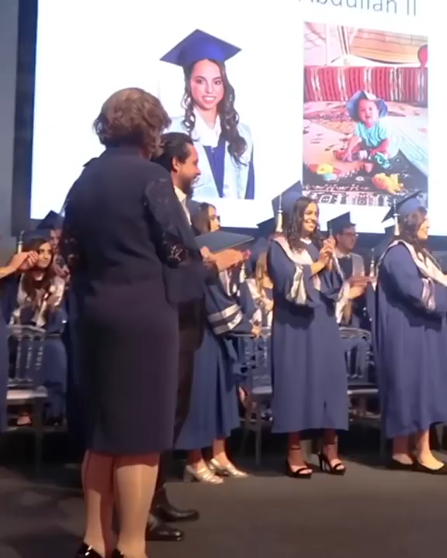

Slide 10
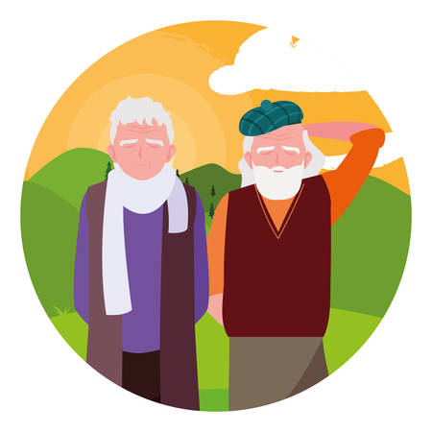
Integration with other subjects.
Who were Prophet Mohmmad’s friends?
Abu Bakr
Omar Ibn al-Khattab
Othman Ibn Affan
Ali Ibn Abi Talib
Buzz in

Slide 11

Presentation
What is the first thing we think about when we start our writing?

Slide 12

The Title

Slide 13

What are the rules of writing a title?
Presentation
Every word in the title should start
with capital letter.
It should be general.
No full stops ( .) in the title.
EYE–CATCHING.

Slide 14
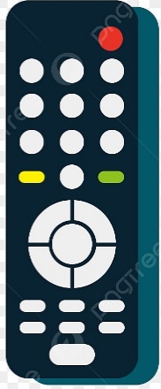
Formative assessment
Parts of the paragraph
My Lovely Friend
My favorite friend is Anna . Anna is a very beautiful and charming girl. She is taller than me . She has straight brown hair and brown eyes. The thing I admire most about Anna is that she is protective and likes to look after people. For me, I am proud to say that I have such loyal and helpful friend.
1
2
3
4
5
6
IRS / Mini Board

Slide 15
Formative assessment
Parts of the paragraph
My Lovely Friend
My favorite friend is Anna . Anna is a very beautiful and charming girl. She is taller than me . She has straight brown hair and brown eyes. The thing I admire most about Anna is that she is protective and likes to look after people. For me, I am proud to say that I have such loyal and helpful friend.
Title

Slide 16
Differentiation
Differentiation
1. Read the following titles and find the mistakes.
a. My Favorite school Subject.
b. My lovely school
C. my amazing friend.
2. Circle the correct title.
a. We have an enormous gym in our school.
b. My Lovely School

Slide 17


Slide 18
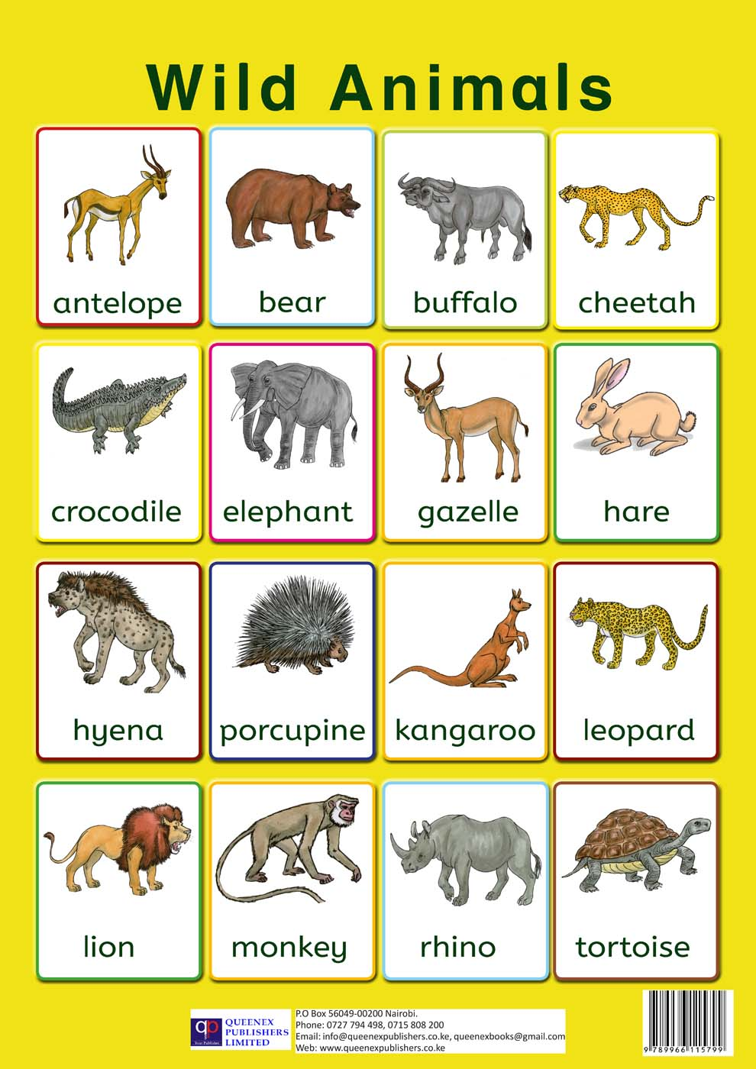
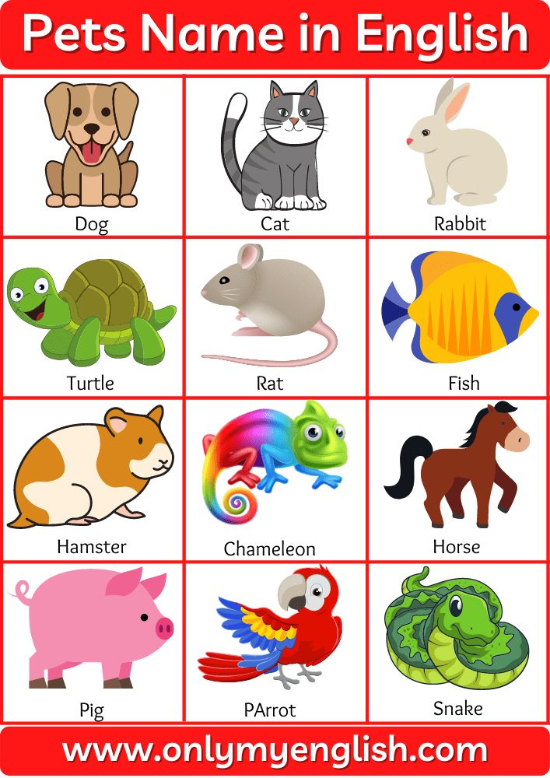
Presentation
Main idea

Slide 19
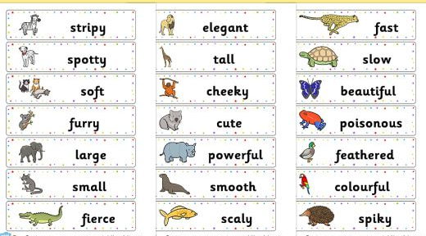
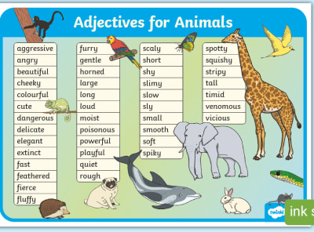
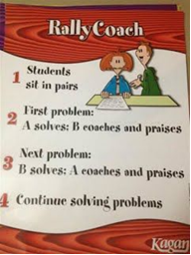
Application
Write a title for the following topic:
“Your Favorite Animal”

Slide 20
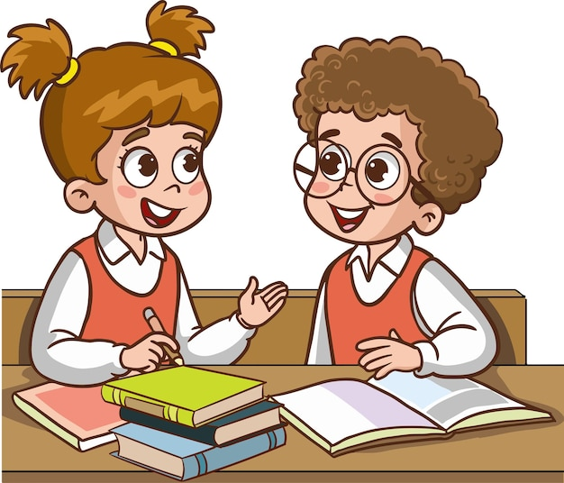
Share your title with your friend

Slide 21

What did you learn?

Slide 22
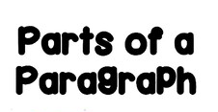
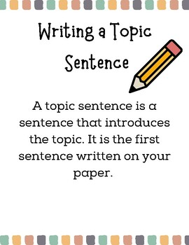
Presentation

Slide 23

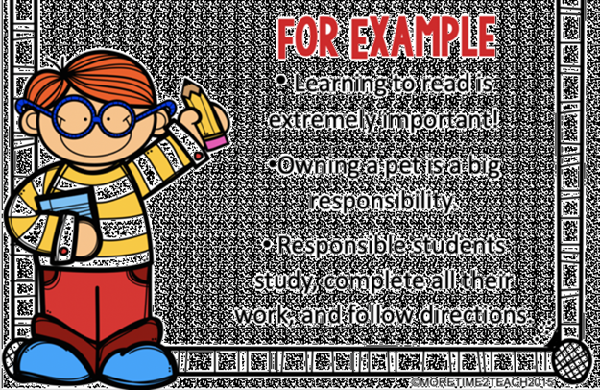
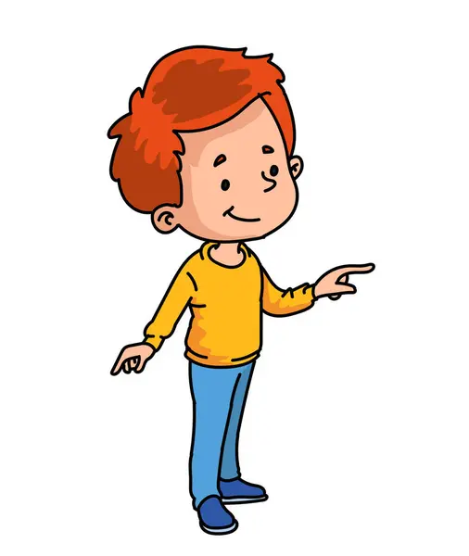
Presentation

Slide 24

How to write a good topic sentence?
Presentation
Stay Focused: Ensure it relates
directly to the paragraph’s content.
Engage the Reader: Use interesting language
to grab attention.
Be Clear: State the main idea clearly.

Slide 25
Formative assessment
Parts of the paragraph
My Lovely Friend
My favorite friend is Anna . Anna is a very beautiful and charming girl. She is taller than me . She has straight brown hair and brown eyes. The thing I admire most about Anna is that she is protective and likes to look after people. For me, I am proud to say that I have such loyal and helpful friend.
1
2
3
4
5
6
Buzz in

Slide 26
Formative assessment
Parts of the paragraph
My Lovely Friend
My favorite friend is Anna . Anna is a very beautiful and charming girl. She is taller than me . She has straight brown hair and brown eyes. The thing I admire most about Anna is that she is protective and likes to look after people. For me, I am proud to say that I have such loyal and helpful friend.
Title
Topic Sentence

Slide 27

Differentiation
2. Read the following sentences and find the mistakes.
My lovely school is the best. Noor is kind and fun to be around. She has curly hair and bright blue eyes that light up when she laughs. ……………
1. Circle the correct topic sentence.
a. My best friend, Lily, is a bright light in my life.
b.My lovely cat
c.At the end of the day, all great shows have to come to a conclusion.

Slide 29
Application
Write a topic sentence for the topic:
“My Favorite Friend”
Notebook

Slide 30

Share your topic sentence with your friend

Slide 31
Summative assessment
The topic sentence in the following paragraph is ………..
My Lovely Friend
Cats are small, playful and creatures. Bella is the name of my pet cat. I love her white and black fur, small paws, tiny claws, and a cute little tail. She enjoys eating fish, meat, mashed eggs, and many other foods. When I get home from school, she rushes up to me and starts licking my hands. Bella was a stray cat we adopted when she was just three months old. Bella does not want much attention, but she enjoys being around us. I love Bella a lot.
My Lovely Friend
Cats are small, playful and creatures
I love Bella a lot.
IRS

Slide 32
What did you learn?

