Slide 1




Unit : One
Major : English
Lesson :Descriptive Writing
Grade : 4

Slide 2

Outcomes
Students will be able to:
Identify parts of a descriptive paragraph.
Write details and conclusion

Slide 3
Warm-Up
Game
https://www.hangmanwords.com/play/custom?g=dGFzdHklMEF5dW1teSUwQW1vdXRoLXdhdGVyaW5nJTBBRGVsaWNpb3VzJTBBQXJvbWF0aWMlMEE=
Buzz in

Slide 4


Search
What does “Full of Beans "mean?
Buzz in

Slide 5
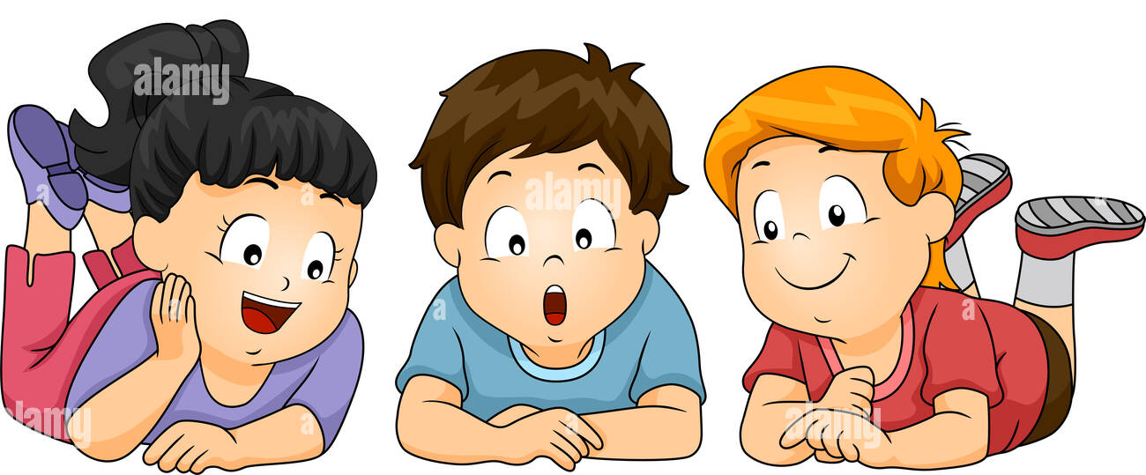
Pre-assessment
What is this?
My Lovely Friend
I usually make friends easily, so I have a lot of friends . My favorite friend is Anna .Anna is a very beautiful and charming girl .She is taller than me .She has straight brown hair and brown eyes. By nature Anna is pretty kind and lovely. The thing I admire most about Anna is that she is protective and likes to look after people. For me, friendship is the most important thing in the world. I am proud to say that I have such loyal and helpful friend.

Slide 6

What are the rules of writing a title?
Previous learning
Every word in the title should start with Capital letter.
It Should be general
No Full stops ( .) in the title
Eye catching

Slide 7
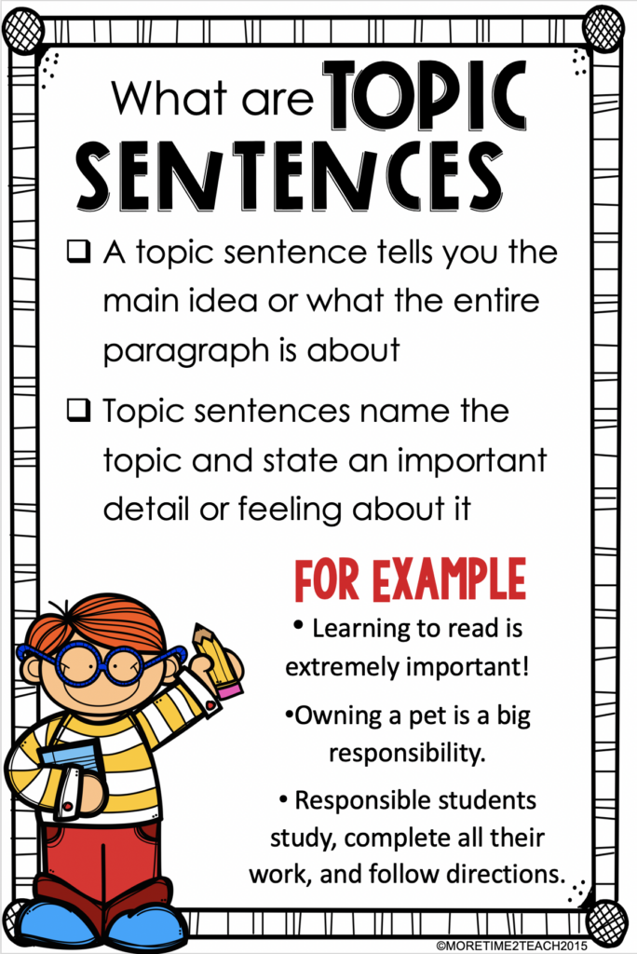
What is a topic sentence?
Previous learning

Slide 8
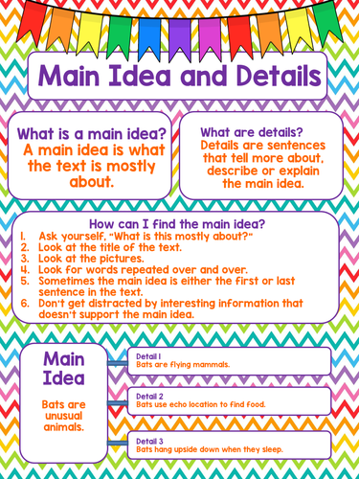
Presentation
What is the next Part of the paragraph?

Slide 9
Formative assessment
Parts of the paragraph
My Lovely Friend
I usually make friends easily, so I have a lot of friends . My favorite friend is Anna .Anna is a very beautiful and charming girl .She is taller than me .She has straight brown hair and brown eyes. By nature Anna is pretty kind and lovely. The thing I admire most about Anna is that she is protective and likes to look after people. For me, friendship is the most important thing in the world. I am proud to say that I have such loyal and helpful friend.
1
2
3
4
5
5
5

Slide 10
Formative assessment
Parts of the paragraph
My Lovely Friend
I usually make friends easily, so I have a lot of friends . My favorite friend is Anna .Anna is a very beautiful and charming girl .She is taller than me .She has straight brown hair and brown eyes. By nature Anna is pretty kind and lovely. The thing I admire most about Anna is that she is protective and likes to look after people. For me, friendship is the most important thing in the world. I am proud to say that I have such loyal and helpful friend.
Title
Topic Sentence
Supporting detail 1
Supporting detail 2
Supporting detail 3
Supporting detail 4

Slide 11
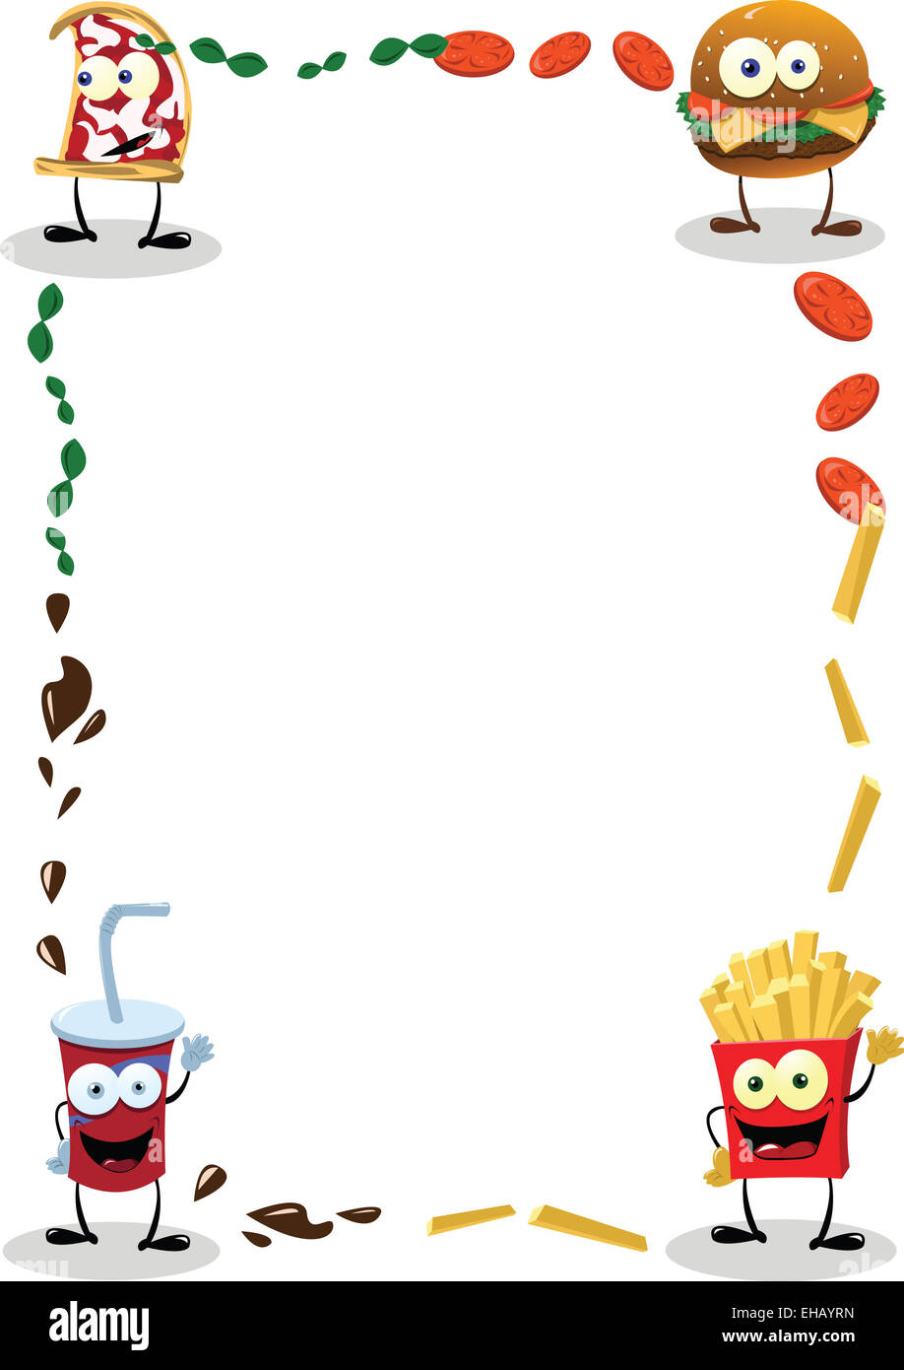
Here are a few tips for your writing skills and get the descriptive language just right:
Presentation
Use surprising words. ...
Remember sensory details. ...
Make use of figurative language. ...
Think about who is doing the describing. ...
Be wary of over-description. ...
Read good examples of descriptive writing.

Slide 12
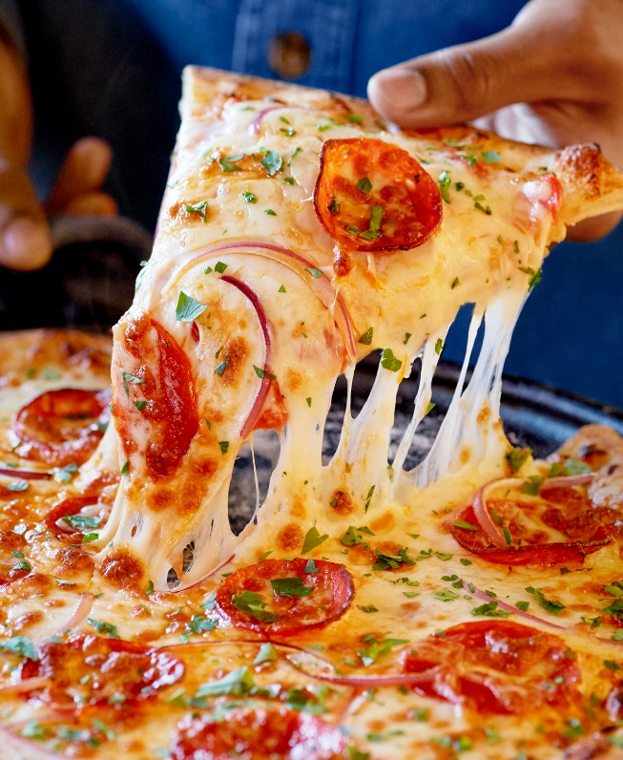
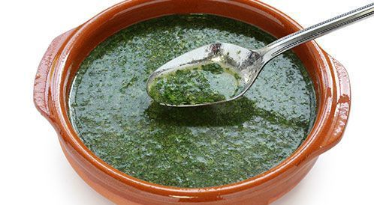
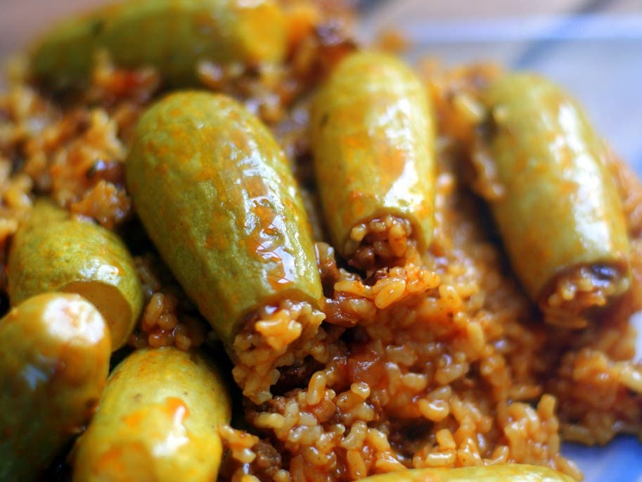
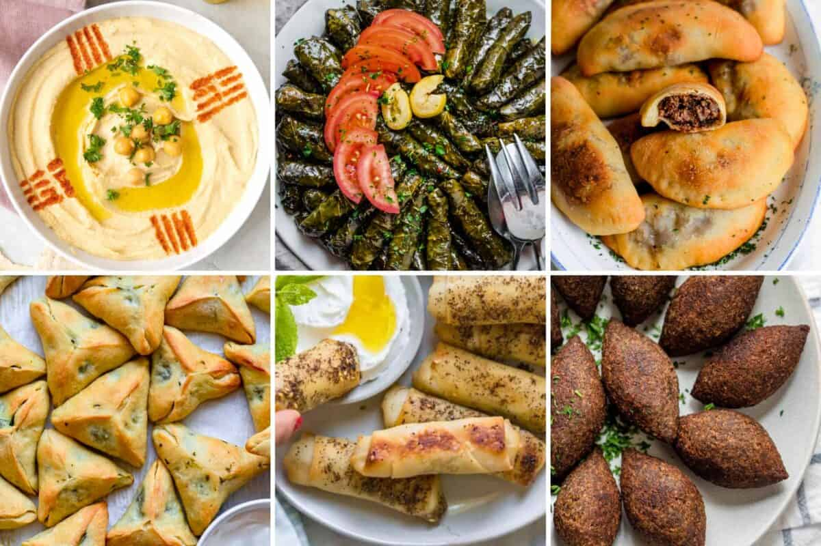
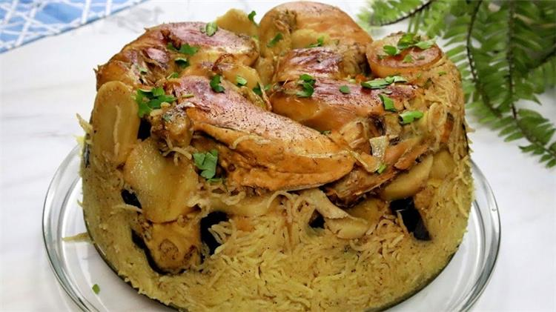
Presentation
Main idea

Slide 13
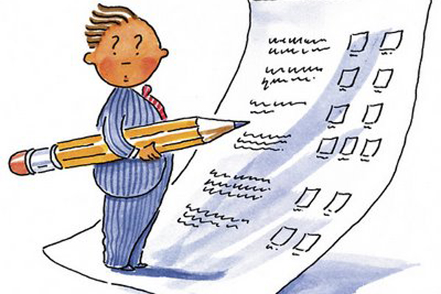
Differentiation
1. Circle the detailed sentences.
a. My Favorite Teacher
b. she doesn’t just teach from books. She tells us to be good people and to be kind to our friends.
c. My lovely school
2. Write details for the following topic sentence. ( 4 sentences at least)
Mrs. Anaya is my favorite teacher at IEC School. ………..

Slide 14
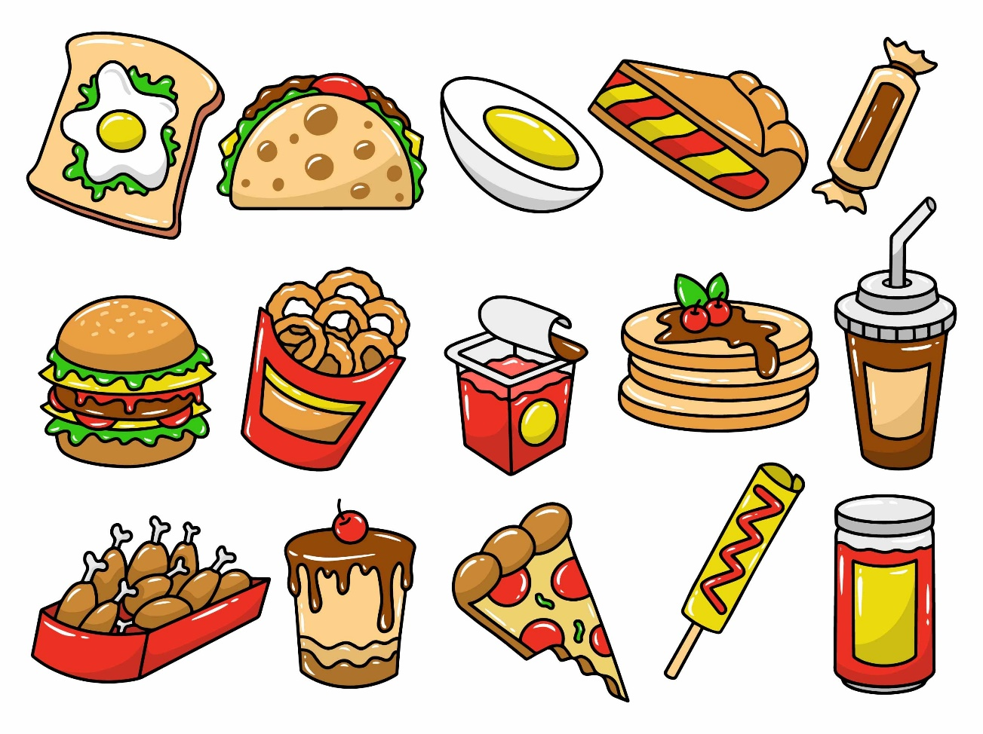


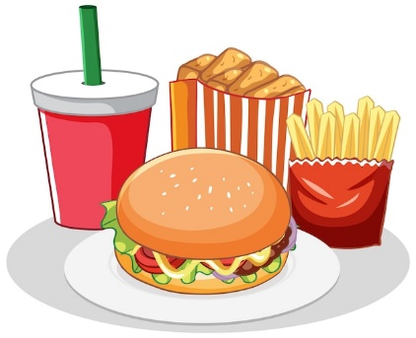
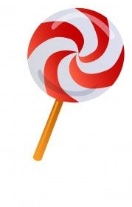
Application
Write a detail sentence for the following topic:
“Your Favorite Meal”
Where You Had It: Mention the restaurant or location, or if it's homemade.
Visual Description: Describe the burger's look. Talk about the layers, colors, and how it’s presented.
Main Components: Detail the key ingredients
Taste: Describe the flavors—savory, spicy, tangy. How do the ingredients complement each other?
Notebook

Slide 15
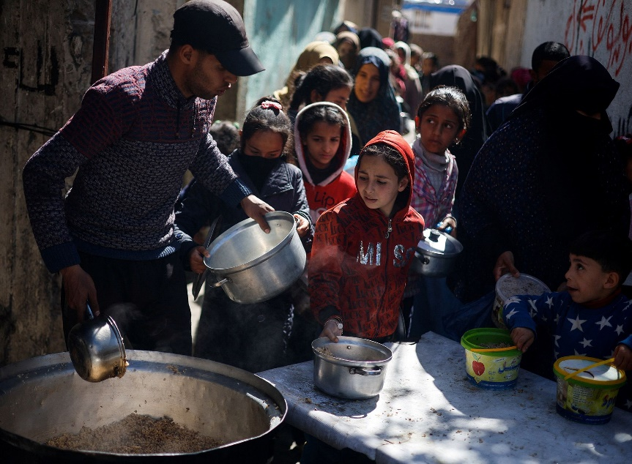
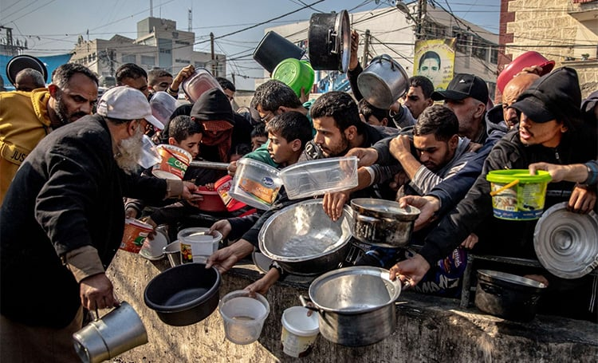
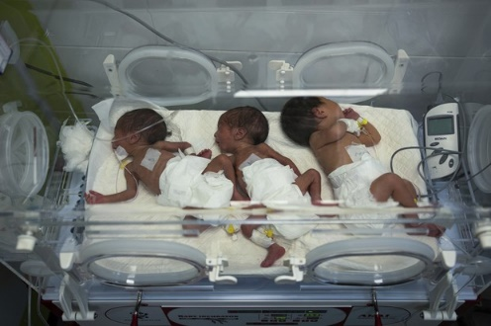
Critical Thinking
Real life application
Do you think that we can help people in Gaza where food is scarce? How?
Buzz in

Slide 16
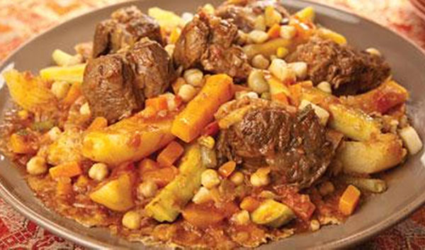
Integration with other subjects.
What was Prophet Mohmmad’s favorite meal?
According to a number of hadith (Quranic sayings or teachings), Mohammed considered tharid “
Buzz in

Slide 17
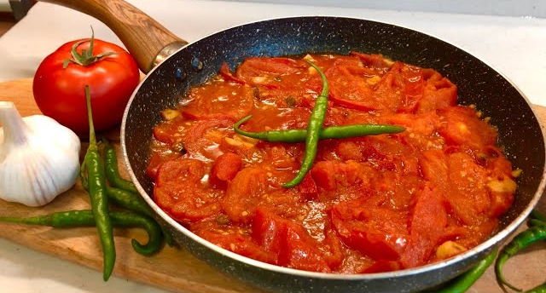
Integration with other subjects.
What is King Abdullah II favorite meal?
My favourite dish is galayet bandora (tomato stew) and those who served with me in the army know that nothing beats having galayet bandora while sitting on the ground next to an armoured tank. I prefer the simple life.
Buzz in

Slide 18

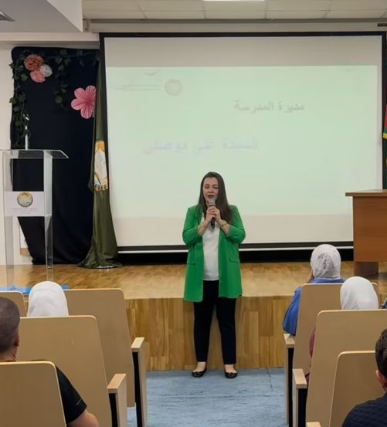
What is the school principle favorite meal?

Slide 19

Summative assessment
A detail in the following paragraph is ………..
My Lovely Friend
Cats are small, playful and creatures. Bella is the name of my pet cat. I love her white and black fur, small paws, tiny claws, and a cute little tail. She enjoys eating fish, meat, mashed eggs, and many other foods. When I get home from school, she rushes up to me and starts licking my hands. Bella was a stray cat we adopted when she was just three months old. Bella does not want much attention, but she enjoys being around us. I love Bella a lot.
My Lovely Friend
She enjoys eating fish, meat, mashed eggs, and
many other foods.
3. I love Bella a lot.
IRS

Slide 20
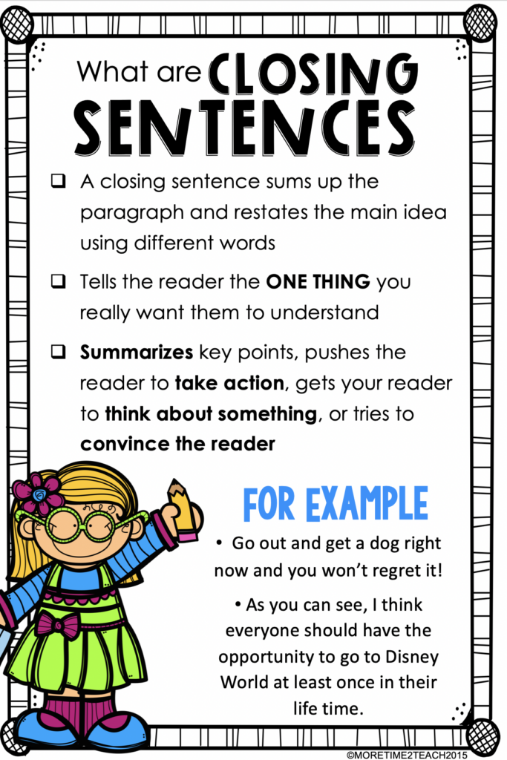
What is a conclusion sentence?
Presentation

Slide 21
Formative assessment
Parts of the paragraph
My Lovely Friend
I usually make friends easily, so I have a lot of friends . My favorite friend is Anna .Anna is a very beautiful and charming girl .She is taller than me .She has straight brown hair and brown eyes. By nature Anna is pretty kind and lovely. The thing I admire most about Anna is that she is protective and likes to look after people. For me, friendship is the most important thing in the world. I am proud to say that I have such loyal and helpful friend.
1
2
3
4
5
5
5

Slide 22
Formative assessment
Parts of the paragraph
My Lovely Friend
I usually make friends easily, so I have a lot of friends . My favorite friend is Anna .Anna is a very beautiful and charming girl .She is taller than me .She has straight brown hair and brown eyes. By nature Anna is pretty kind and lovely. The thing I admire most about Anna is that she is protective and likes to look after people. For me, friendship is the most important thing in the world. I am proud to say that I have such loyal and helpful friend.
Title
Topic Sentence
Supporting detail 1
Supporting detail 2
Supporting detail 3
Supporting detail 4
Concluding sentence

Slide 23

Differentiation
1. Circle the conclusion sentence.
a. My Favorite Teacher
b. she doesn’t just teach from books. She tells us to be good people and to be kind to our friends.
c. My lovely school
2. Write conclusion sentence for the following topic sentence.
Mrs. Anaya is my favorite teacher at IEC School. ………..

Slide 24
Application
Write a conclusion for the following topic:
“Your Favorite Meal”
Reflect on why this meal is meaningful to you. What memories or feelings does it evoke?
Recommendation: Encourage others to try this meal.
Final Thought: End with a memorable statement that captures the essence of your favorite meal. This could be a quoteor a personal touch that sums up your experience.
Notebook

Slide 25
Summative assessment
The conclusion in the following paragraph is ………..
My Lovely Friend
Cats are small, playful and creatures. Bella is the name of my pet cat. I love her white and black fur, small paws, tiny claws, and a cute little tail. She enjoys eating fish, meat, mashed eggs, and many other foods. When I get home from school, she rushes up to me and starts licking my hands. Bella was a stray cat we adopted when she was just three months old. Bella does not want much attention, but she enjoys being around us. I love Bella a lot.
Cats are small, playful and creatures .
Bella was a stray cat we adopted when she was
just three months old.
3. I love Bella a lot.
IRS

Slide 26

What did you learn?

