Slide 1
The Simple present of be verbs
Day:
Date:
Grade 4
Unit 1

Slide 2
Outcomes:
1. Identify the forms of the verb ”be” in the present simple.
2. Form affirmative, negative and question sentences using be verbs

Slide 3
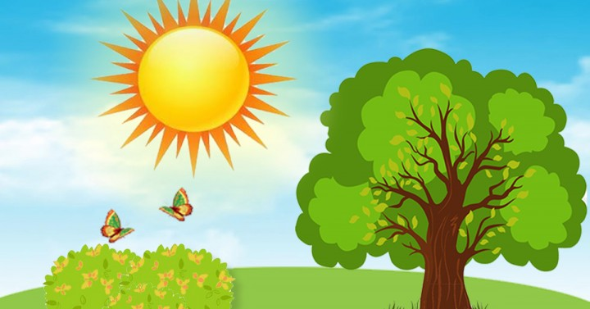
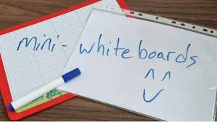
Warm up+ real life application (3 MIN)
Describe the weather…
-The weather is………..
-It is ...........................
-Describe your favorite weather.

Slide 4

Pre-assessment 1:30 min
Describe yourself or your friend using I am or she/he is
in your own words…………….
Mini boards

Slide 5
Critical thinking/ 1 min
-Look at these two sentences
1.I am a student
2.They are students
-Why do we use different forms of “be verbs” in these sentences.
Buzz in/ 1MIN

Slide 6
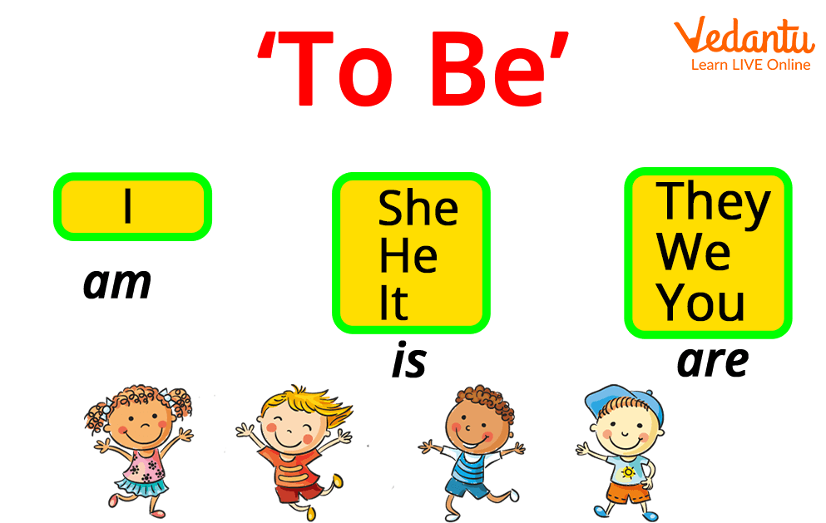
Presentation / affirmative

Slide 7
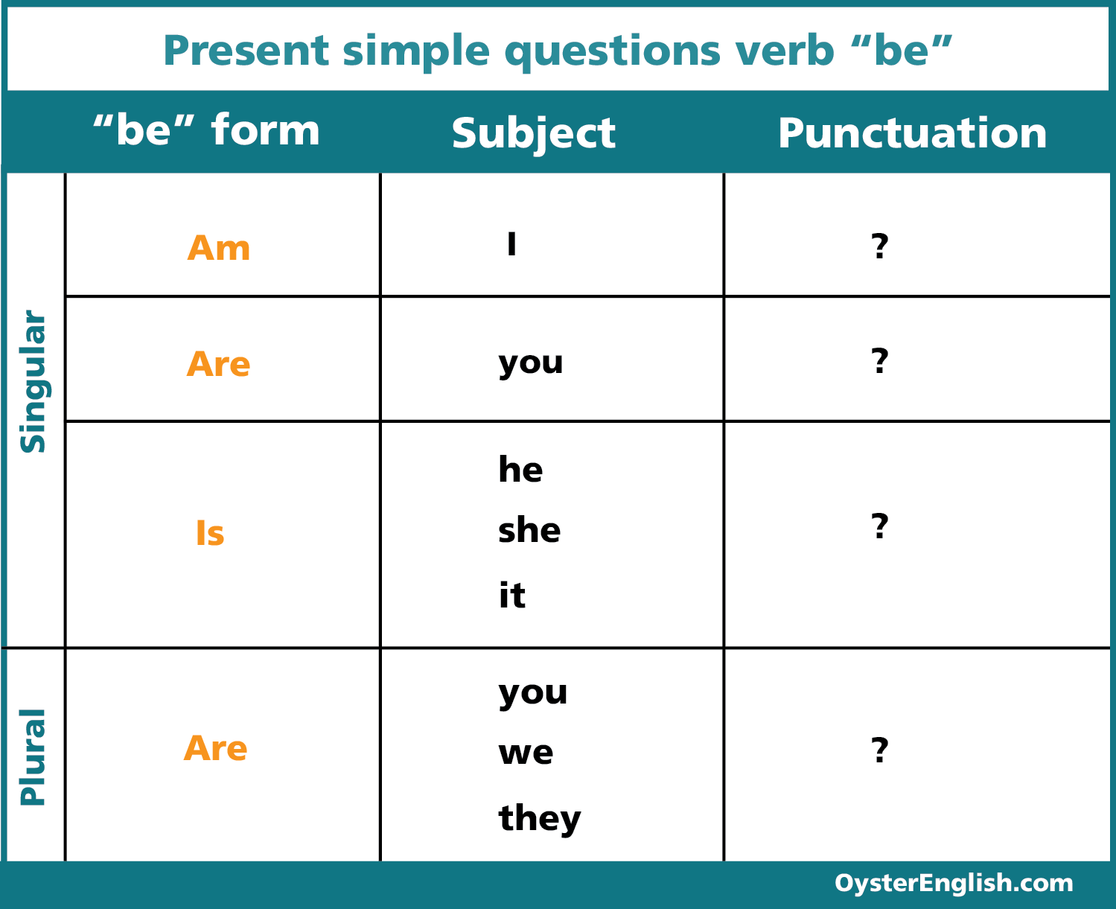
Interrogative sentence

Slide 8
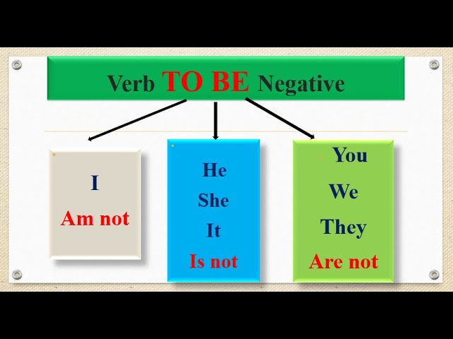
presentation

Slide 9
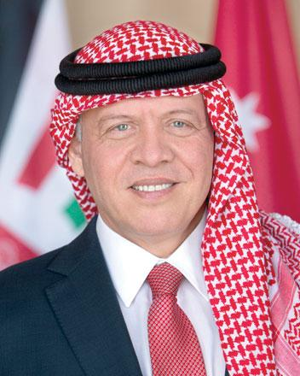
Look at the picture and write a sentence using verb to be.
Who is he?

Slide 10

Singular
-The boy is excited about reading stories
- The boy isn’t excited about writing
Plural
-The girls are excited about reading stories.
- The girls aren’t excited about writing
Rally Robin /2 min

Slide 11
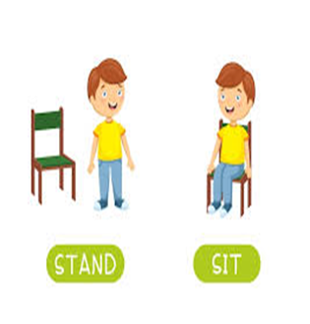
If the sentence is correct "take off" (stand up).
If the sentence is incorrect"touch down" (sit down).
1.We are always busy at school.
2.Are Laila the most beautiful girl in the room?
Take off/ Touch down

Slide 12

Formative assessment (3MIN)
I _______ a student.
She _______ my best friend.
We _______ very happy today.
It _______ sunny outside.
They _______ at school now.
You _______ from Spain.
He _______ a good singer.
The books _______ on the table.

Slide 13
Formative assessment / Feedback(2 MIN)
Negative form:
I _______ tired.
She _______ in the garden.
They _______ brothers.
It _______ cold today.

Slide 14
Differentiation - 5 MIN
Students 4:
Write 2 sentences using the verb to be in the present simple
…………………………………………………………………………………………………….…………………………………………
Students 4:
Fill in the blank with the correct be verb:
1.Penguins…………. (be) smart.
2.My friend …………. (be/not) sad.
Students 2:
Students 1:
Choose the correct answer:
Sami ……… taller than Salem. (are/ is)
2. Children ……….. Intelligent.( is/are)
Find and correct the mistakes :
1.My brother and I is good at football.
2.I are not happy.

Slide 15


1 min/ Search
Find a picture for who is the king of Australia .

Slide 16
Summative assessment/ 2 min
A. Are she a student? The sentence is……….
1.True
2.False
B. They are not sad anymore. The sentence is………………
1.Affirmative
2. Negative
IRS

Slide 17
Feedback / 2 min
A. Are she a student? The sentence is……….
1.True
2.False
B. They are not sad anymore. The sentence is………………
1.Affirmative
2. Negative
IRS

Slide 18
closure
What did I learn?

