Slide 1
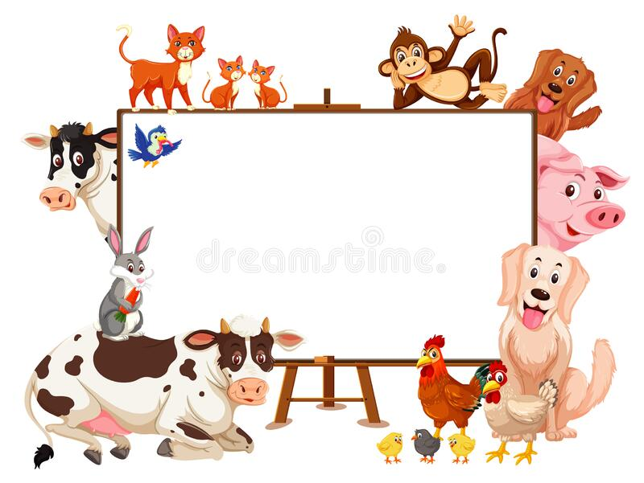
Taking Care of the Young

Slide 2
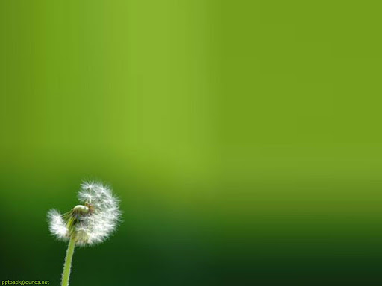
Let’s Begin with the end In mind
By the end of today's class, students will: ​
Recognize the meanings of new words.​
2. Use them correctly in sentences.​
Page 8

Slide 3
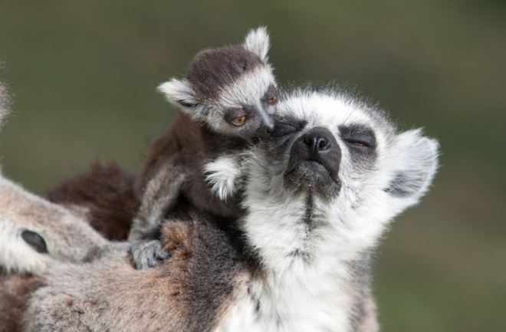
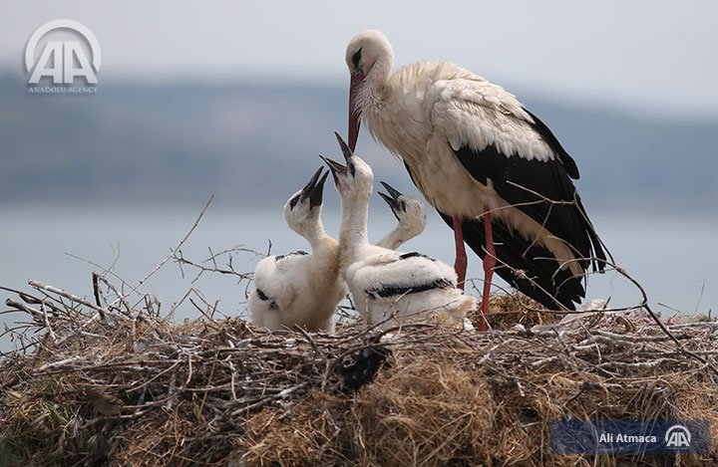
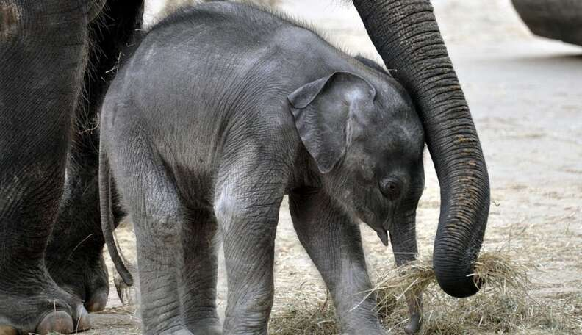

Lead in
Talk about the following pictures.
Which animals take care of their young?

Slide 4

Pre assessment
Look at the following words.
If you know 3words and more ,Take off!
young
protect
secure
Communicate

Slide 5
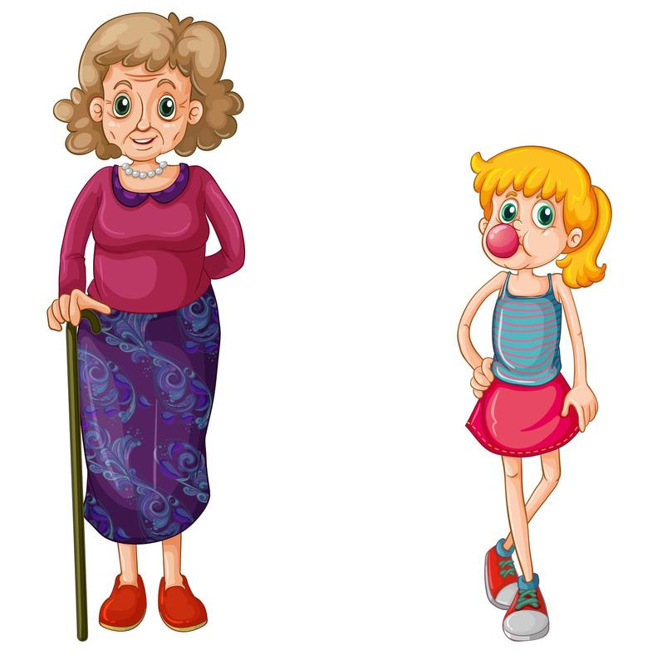
Young
(Adjective)
Example
the young girl loves her grandmother.
Meaning
not grown up

Slide 6
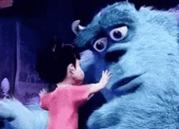
protect
(verb)
Example
We should protect the environment.
Meaning
To keep someone or something safe

Slide 7

secure
(adjective)
Example
I don’t feel secure when I am alone at home.
Meaning
safe from harm

Slide 8
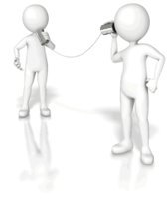
communicate
(verb)
Example
Animals communicate in their own ways.
Meaning
express and change ideas and thoughts.

Slide 9
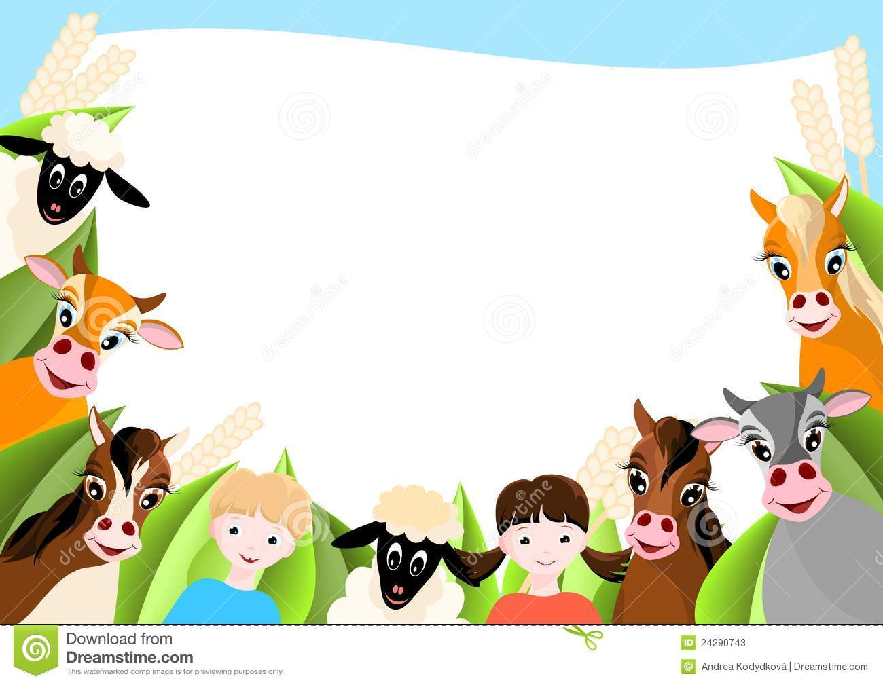
Formative assessment I Round table
1-2 min
secure – communicate – protect- young
Babies and young animals need to feel __________ to grow up healthy and strong.
Parents __________ their children from danger by keeping them safe.
It’s important for babies to __________ when they need something, like food or comfort.
When animals are __________, they need extra care from their parents.

Slide 10
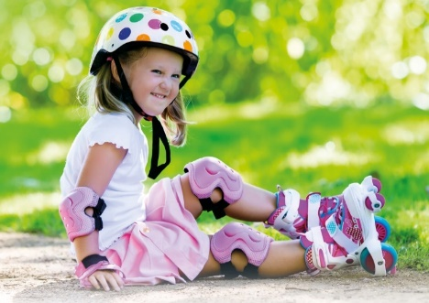
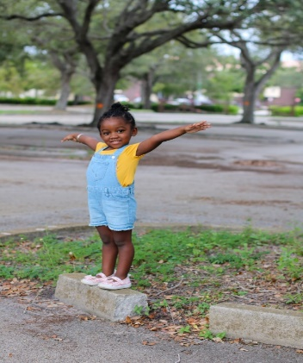
Differentiation I 2 min
Students 1:
Use the following words in 2 meaningful sentences:
Communicate, protect
Students 3:
Fill in the blanks with the correct word:
I ______ with my friends using my phone.
I feel _______ when I hug my mom .
Students 2:
Choose the correct answer:
This bike helmet will protect your head .
( verb \ Noun \Adjective)
I feel secure when my dad is with me .
( verb \ Noun \Adjective)
Students 4:
Match the words with the pictures.
Young
Protect

Slide 11
Real-life application I 30 seconds I Buzz in
Can you think of a way you communicate your friends?

Slide 12
Critical Thinking 30 seconds I buzz in
What are some dangers that young children might face? How to protect them?

Slide 13
Summative assessment I irs I
1 min
My hat _______ me from the sun.
1. young
2. communicate
3. protect
A very nice _____ man greeted us at the door.
1.secure
2. young
3. protect
We __________ with our friends by talking and listening.
1. young
2. protect
3. communicate

Slide 14
closure I 1 min
Choose a word you learnt today and write a sentence.
Mini-Boards

Slide 15
Let’s Begin with the end In mind
By the end of today's class, students will: ​
Recognize the meanings of new words.​
2. Use them correctly in sentences.​
Page 10

Slide 16
Target Vocabulary:
goal
challenge
involve
Page 8

Slide 17

goal
(Noun)
Example
My goal this year is to read 20 books.
Meaning
Something you want to achieve

Slide 18
Real-life application I 30 seconds I Buzz in
Think of a goal you want to achieve this year? What steps will you take to reach it?

Slide 19
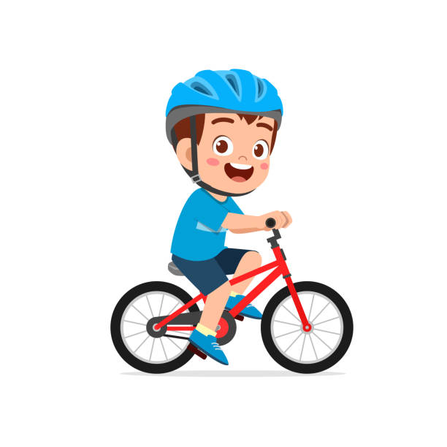
challenge
(Noun)
Example
Learning to ride a bike was a fun challenge
Meaning
Something that is hard to do

Slide 20
Critical Thinking I 30 seconds I buzz in
What is a challenge you faced, and how did you solve it?

Slide 21

Involve
(verb)
Example
The school play will involve everyone in the class.
Meaning
Include or be part of

Slide 22
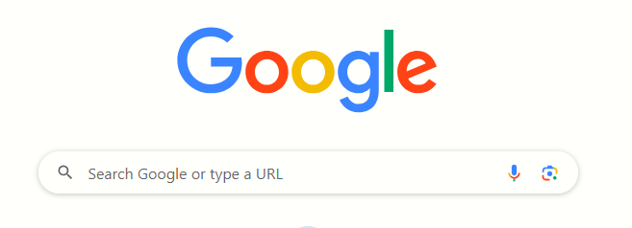
Search: 30 Seconds I Random Pick
Search: Synonyms of “involve”

Slide 23
Formative assessment I Rally coach I
1-2 min
Goal- challenge- involve
The teacher tried to __________ all the students in the group project.
Climbing the big hill was a tough __________ for me.
My __________ for this year is to learn how to swim.

Slide 24


Differentiation I 2 min
Students 1:
Use the following words in 2 meaningful sentences:
Goal , challenge
Students 3:
Fill in the blanks with the correct word:
The new project will __________ working with different teams.
Solving the puzzle was a real __________ for the class.
My __________ for this year is to improve my drawing skills.
Students 2:
Choose the correct answer:
My goal last year was to get a job.
( verb \ Noun \Adjective)
2. The football game was a real challenge .
( verb \ Noun \Adjective)
3. This project can involve all the students .
( verb \ Noun \Adjective)
Students 4:
Match the words with the pictures.
involve
Challange

Slide 25
Summative assessment I irs I
1 min
The group project will ________ working together to create a presentation." 1. Challenge 2. Goal 3. Involve
Her ________ for the summer is to finish reading all the books on her list.
1. Involve 2. Goal 3. Challenge
Running a marathon is a big ________ for many people.
1. Goal 2. Involve 3. Challenge

Slide 26
closure I 1 min
Choose a word you learnt today and write a sentence.
Mini-Boards

