Slide 1

Taking Care of the Young

Slide 2

By the end of today's class, students will: ​
Recognize the meanings of new words.​
2. Use them correctly in sentences.​
Page 10

Slide 3

Warm up/ 2 min
Silent acting challenge

Slide 4

Lead in
How did people communicate 50 years ago?.

Slide 5
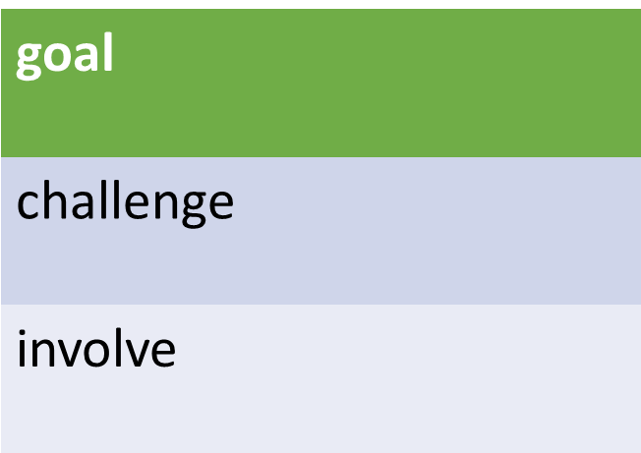

Pre assessment
Look at the following words.
If you know the three words ,Take off!

Slide 6

goal
(Noun)
Example
My goal this year is to read 20 books.
Meaning
Something you want to achieve

Slide 7
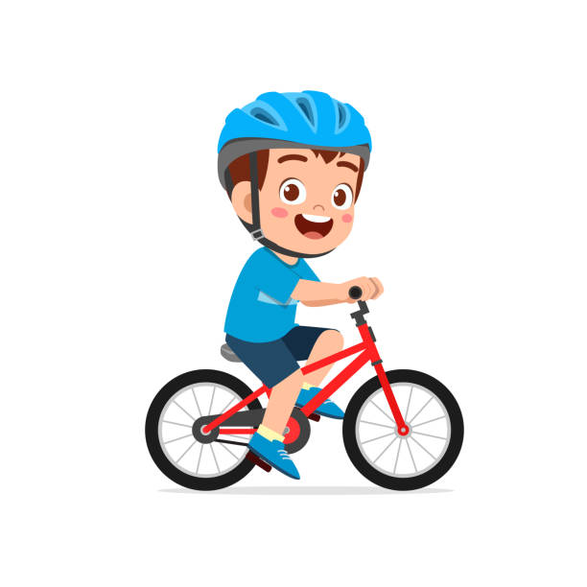
challenge
(Noun)
Example
Learning to ride a bike was a fun challenge
Meaning
Something that is hard to do

Slide 8

Involve
(verb)
Example
The school play will involve everyone in the class.
Meaning
Include or be part of

Slide 9
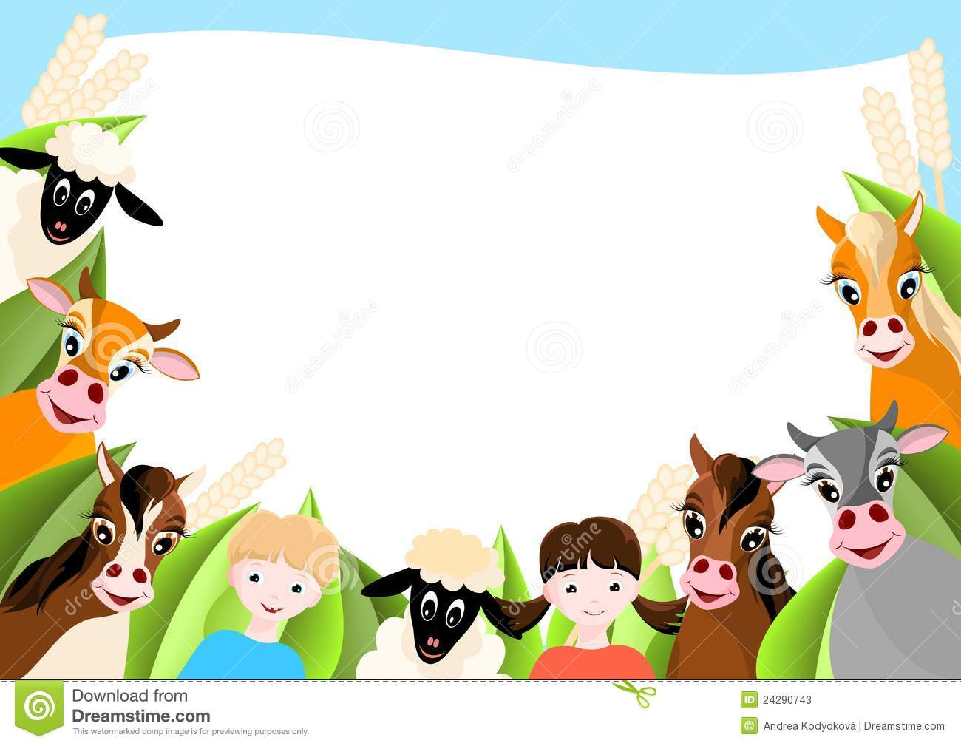

Search: 30 Seconds I Random Pick
Search: Synonyms of “involve”

Slide 10
Formative assessment I Rally coach I
1-2 min
Goal- challenge- involve
The teacher tried to __________ all the students in the group project.
Climbing the big hill was a tough __________ for me.
My __________ for this year is to learn how to swim.

Slide 11
Real-life application I 30 seconds I Buzz in
Think of a goal you want to achieve this year? What steps will you take to reach it?

Slide 12
Critical Thinking I 30 seconds I buzz in
What is a challenge you faced, and how did you solve it?

Slide 13


Differentiation 2 min
Students 1:
Use the following words in 2 meaningful sentences:
Goal , challenge
Students 3:
Fill in the blanks with the correct word:
The new project will __________ working with different teams.
Solving the puzzle was a real __________ for the class.
My __________ for this year is to improve my drawing skills.
Students 2:
Choose the correct answer:
My goal last year was to get a job.
( verb \ Noun \Adjective)
2. The football game was a real challenge .
( verb \ Noun \Adjective)
3. This project can involve all the students .
( verb \ Noun \Adjective)
Students 4:
Match the words with the pictures.
involve
Challange

Slide 14
Summative assessment I irs I
1 min
The group project will ________ working together to create a presentation." 1. Challenge 2. Goal 3. Involve
Her ________ for the summer is to finish reading all the books on her list.
1. Involve 2. Goal 3. Challenge
Running a marathon is a big ________ for many people.
1. Goal 2. Involve 3. Challenge

Slide 15
closure I 1 min
Choose a word you learnt today and write a sentence.
Mini-Boards

