Slide 1
Taking Care Of The Young

Slide 2
LEAD IN - 2 MIN
When you go to the zoo, what’s the most thing that attracts you ? Why?

Slide 3
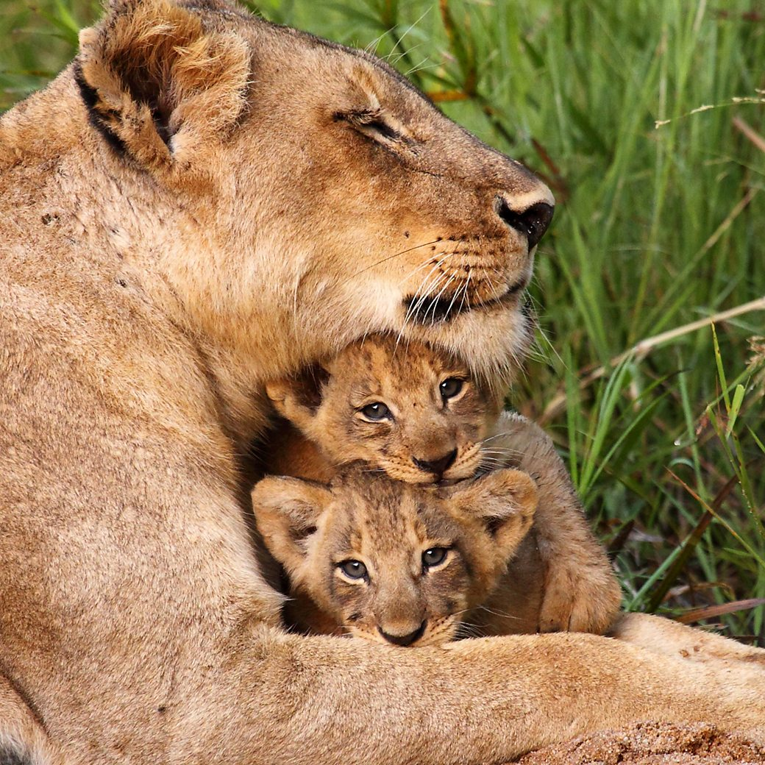

Pre-assessment -
2 MIN
Task 1:
Why is it important for animals to take care of their young?
1
2

Slide 4
Real-life application - 30 seconds
Buzz in
How are birds important in our life?
Give examples.

Slide 5

Task 1: Build Vocabulary
danger
something that can cause harm

Slide 6
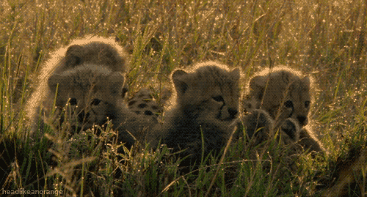
Task 1: Build Vocabulary
young
babies

Slide 7

Task 1: Build Vocabulary
secure
safe from harm

Slide 8
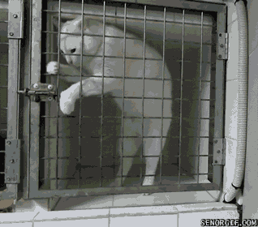
Task 1: Build Vocabulary
escape
run away

Slide 9

RoundTable - 1 MIN
(escape, danger, secure, young )
Fire is a big __________ for people.
The baby bird is still very __________.
The police work hard to keep the city __________.
The prisoner wanted to __________ from jail.

Slide 10
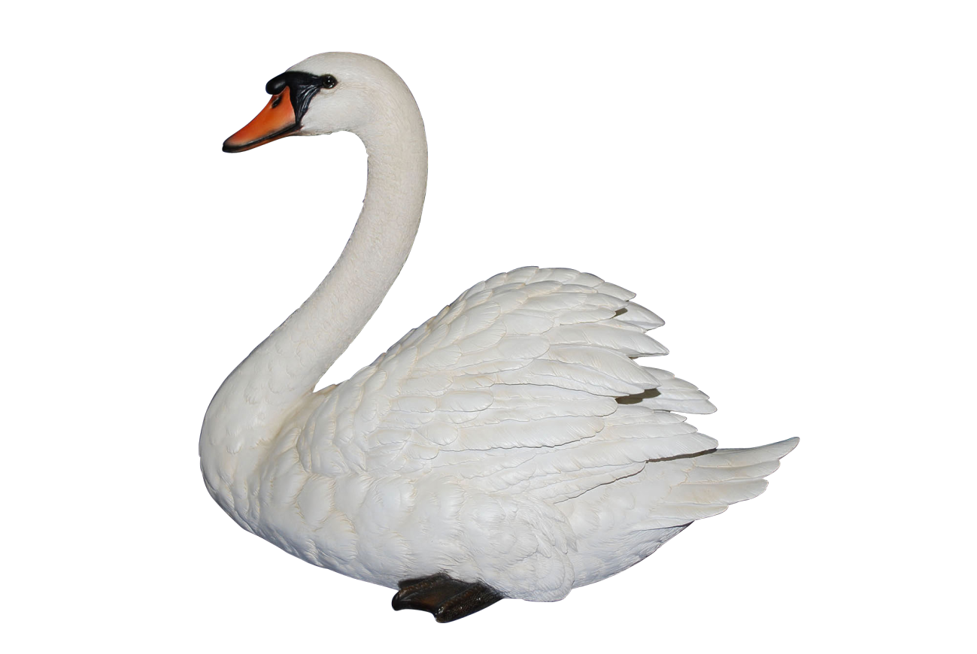
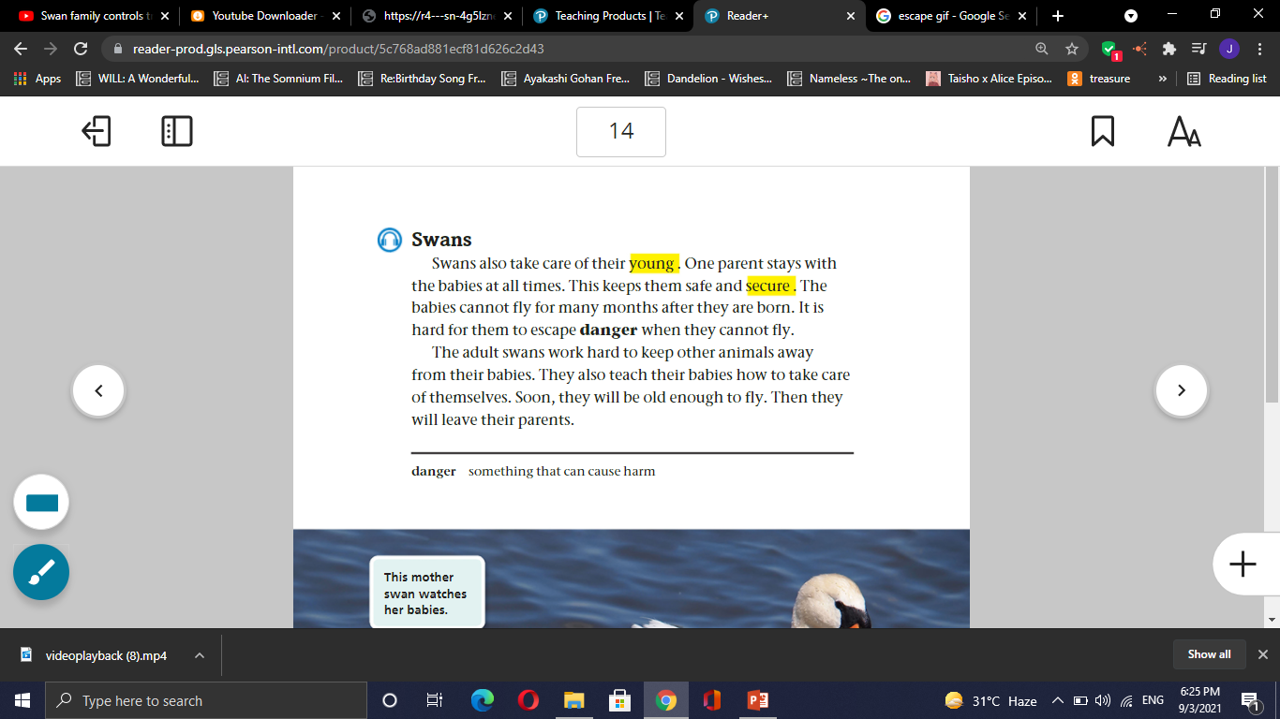

Task 2: Listen P (14)

Slide 11
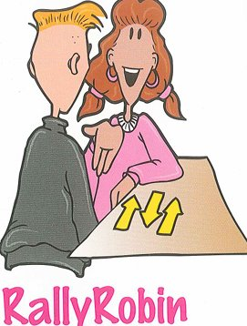
1- How do adult swans take care of their young? 2- Are the baby swans capable of escaping danger? Why? 3- The adults swans work hard to keep other animals away from their babies. Explain. 4- When are baby swans considered ready to leave their parents? 5- Quote from the passage a sentence that shows us that it takes a bit too long for a baby swan to fly. 6- Find a word that means: something that can cause harm ------------
Formative assessment l Rally Robin l 3 mins

Slide 12
1- How do adult swans take care of their young? 2- Are the baby swans capable of escaping danger? Why? 3- The adults swans work hard to keep other animals away from their babies. Explain. 4- When are baby swans considered ready to leave their parents? 5- Quote from the passage a sentence that shows us that it takes a bit too long for a baby swan to fly. 6- Find a word that means: something that can cause harm ------------
Formative assessment l Rally Robin l 3 mins
Random pick

Slide 13
Differentiation - 2 MIN
Students 1:
Give evidence that baby swans cannot live alone.
Students 3:
Why do swans work hard?
Students 2:
How do swans escape danger ?
Students 4:
Baby swans can fly when they are very young. T/F

Slide 14

Critical Thinking - 30 seconds
What might happen to the baby swans if they lost their parents?

Slide 15
1- Swans are birds. 1-True 2-False 2- Baby swans can escape dangers when they are 2 months old. 1-True 2-False 3- The baby swans can leave their parents when they can depend on themselves . 1-True 2-False
Summative assessment - IRS

Slide 16
Exit Ticket - 1 min
write one sentence you've learned today about swans.
Mini-Boards

