Slide 1
Taking Care Of The Young

Slide 2
Outcomes
By the end of today's class, students will:
1- read informational text about penguins.
2- answer text-based questions about informational passages.
3- Value taking care of the young.

Slide 3
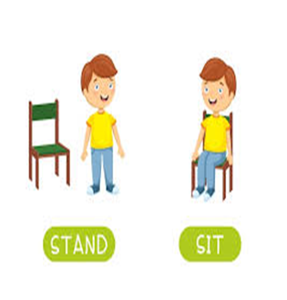
Warm up - 1 MIN
What is the genre of the text?
Take off/ Touch down
-If the genre is an informational text take off.
-If the genre is fable touch down.

Slide 4

PRE-ASSESSMENT - 2 MIN
What do you know about penguins?
Examples: 1- Where do they live? 2- What do they eat?

Slide 5
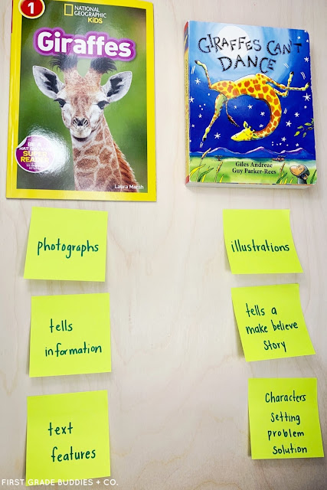
Rememeber:
that informational text
is nonfiction because it
tells about true events.

Slide 6



Task 3: Build Vocabulary
Human
person

Slide 7
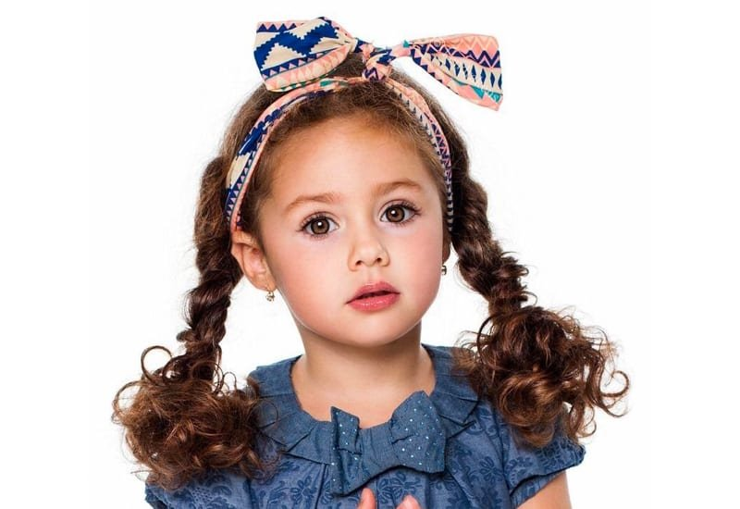

Task 3: Build Vocabulary
Female
girl or woman

Slide 8


Task 3: Build Vocabulary
Male
Boy or a man

Slide 9
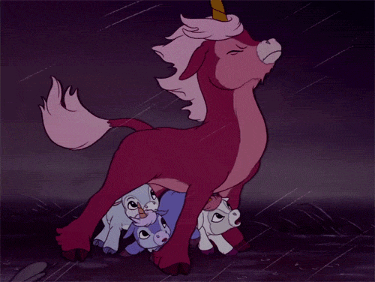

Task 3: Build Vocabulary
Protect
To keep safe

Slide 10
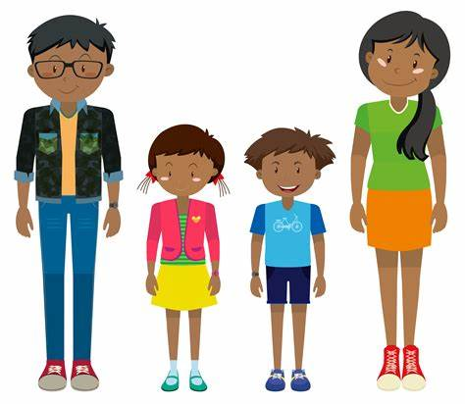
Task 3: Build Vocabulary
adults
fully grown -not kids

Slide 11
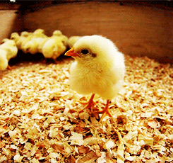
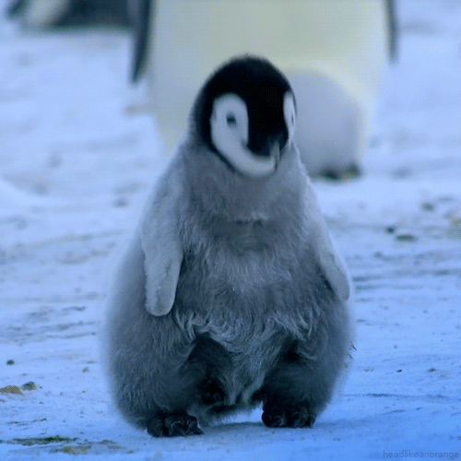
Task 3: Build Vocabulary
Chick
A young bird

Slide 12
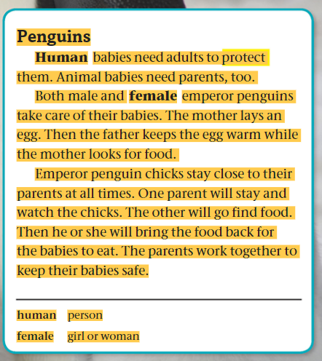

Task 4: Listen then read

Slide 13


Formative assessment l Rally Robin l 3 mins
1-What is the genre? ____________________________
2-Do human babies and animal babies need adults for the same reason? Explain. _____________________________________________________________ 3- Who takes care of emperor penguin eggs before they hatch? _________________ 4- Explain how do penguin parents have many roles?__________________________ 5- True/ False: a. Penguin Parents work together to protect their babies. ( ) b. The eggs must stay warm. ( )

Slide 14
Differentiation - 2 MIN
Students 1:
Why do penguin babies need their parents ?
Students 3:
Who brings food to the chicks?
Students 2:
How many eggs does the female penguin lay?
Students 4:
Baby penguins can live alone. T/F

Slide 15
Real-life application
30 seconds - Buzz in
Do humans or animals take care of their young for a longer period of time? Explain.

Slide 16
Critical Thinking - 30 seconds
Buzz in
How do you think penguins can live in cold weather?
Buzz in

Slide 17
Summative assessment - IRS
True/False
1- Animals don’t protect their young. 1-True 2-False 2- Both male and female emperor penguins take care of their young. 1-True 2-False

Slide 18
Exit Ticket - 1 min
Write one sentence you've learned today about penguin.
Mini-Boards

Slide 19
H.w
Draw a penguin in your notebook

