Slide 1
Big Question
P (2+3)

Slide 2
Outcomes:
Students will be able to :
Discuss unit theme and content.
Discuss how people help animals and how animals help people.
START

Slide 3

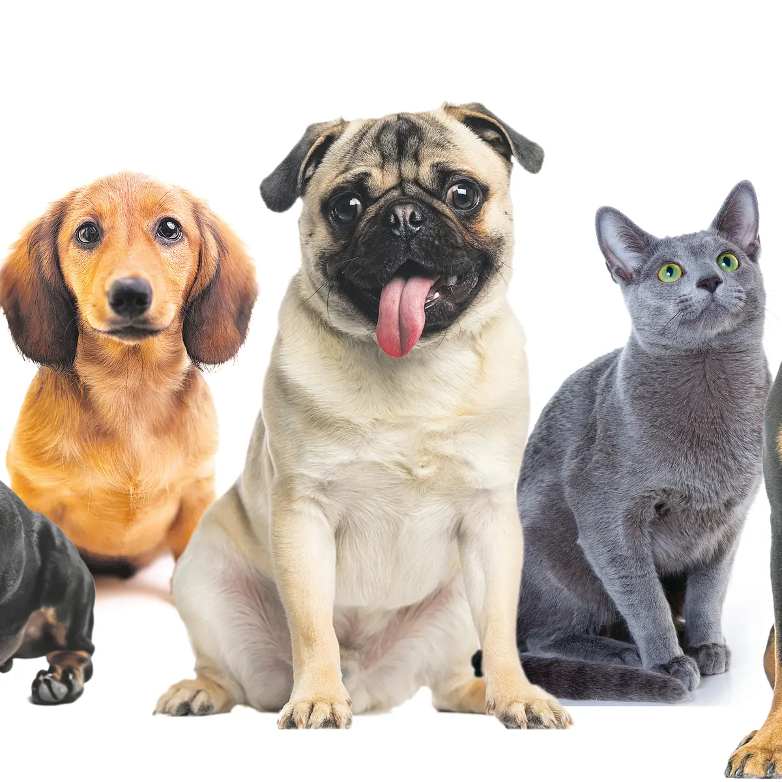
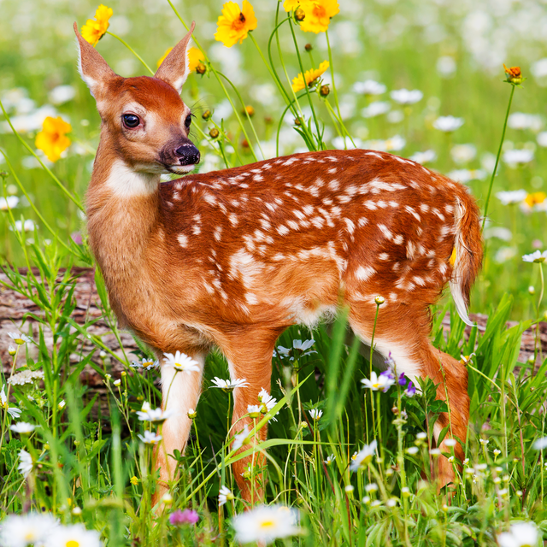
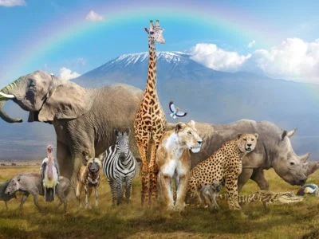
LEAD IN - 2 MIN
1-Talk about the following pictures.
2-Guess ! What is the topic of Unit 1?

Slide 4
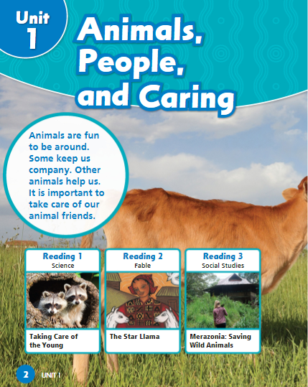
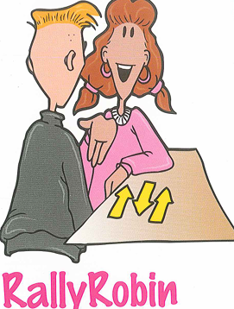
P (2)
PRE-ASSESSMENT - 2 MIN
1) Do you like to be around animals?
2) Why are animals important to us?

Slide 5
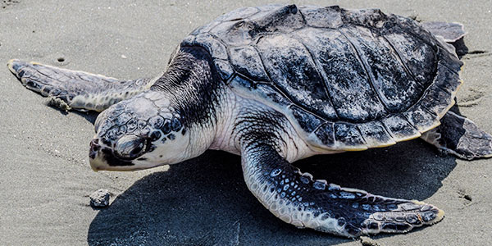
The Kemp’s Ridley sea turtle
Building Vocabulary

Slide 6
Endangered:
Building Vocabulary
at risk, not safe.

Slide 7
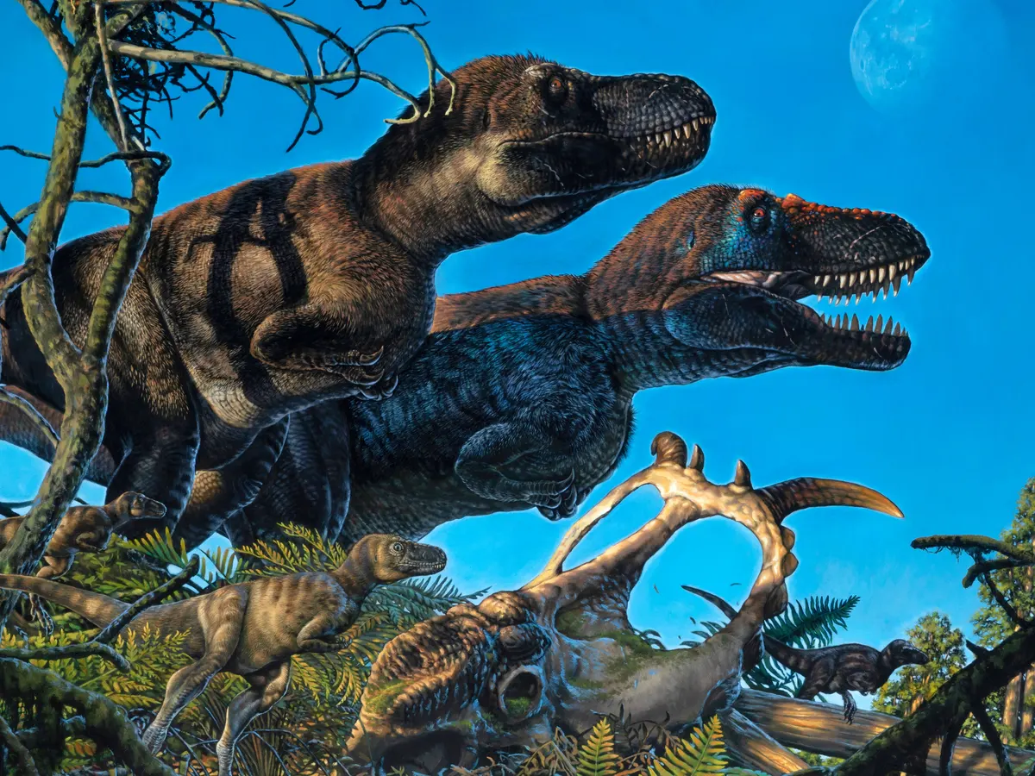
extinction:
Building Vocabulary
when something is no longer exists.

Slide 8
Presentation
This video talks about The Kemp’s Ridley sea turtle. Let’s watch it together.
Use your white boards and take notes.

Slide 9


Slide 10
Rally coach.
1-There are a few of Kemp’s ridely turtles in the wild,so they are : a-endangered b-extinct
2-Why did most of the turtles die in the last 50 years?
________________________________

Slide 11
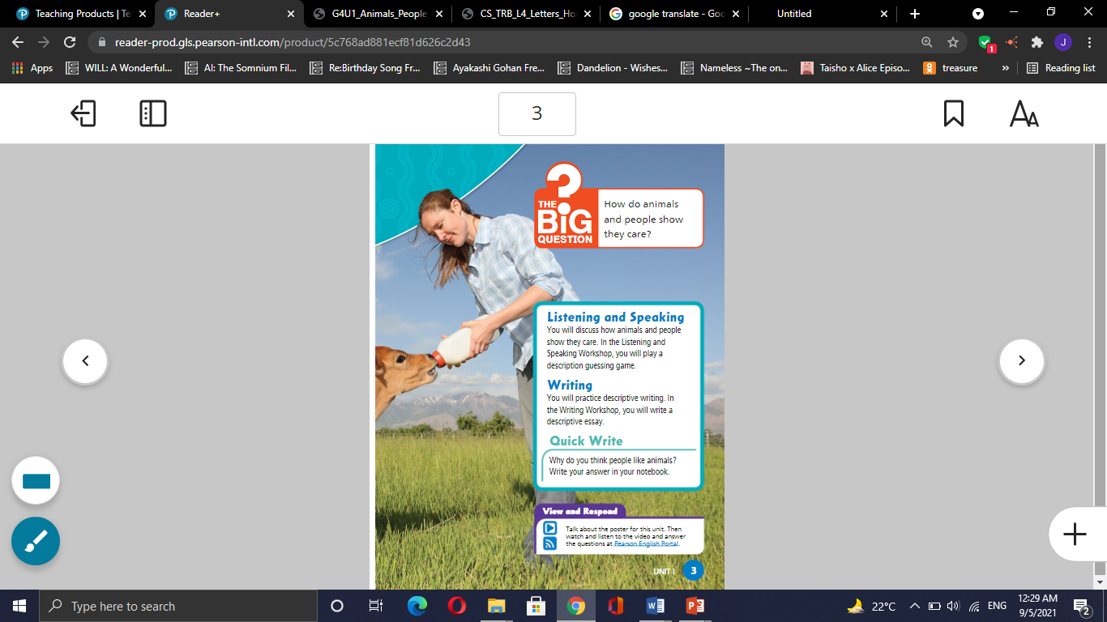
P (2)
Real Life Application
Do you have a pet?
How do you take care of it?

Slide 12

Critical Thinking - 30 seconds
Buzz in
How would you protect endangered animals?

Slide 13
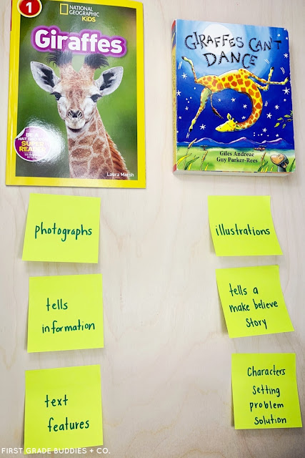
Rememeber:
that informational text
is nonfiction because it
tells about true events.

Slide 14
Differentiation - 2 MIN
Students 1: Mention 2 types of nonfiction genre ?
Students 3:
What is your favorite genre?
Students 2: Are fables fiction? Explain?
Students 4:
Short story is fiction. T/F

Slide 15


Slide 16
Summative assessment
1-Informational text is:
A-Fiction
B- Nonfiction
2-Kimp’s Ridely turtles are:
A- safe
B- endangered

Slide 17
It’s time to play a game
Closure
https://wordwall.net/resource/21155827

