Slide 1

OBJECTIVES
WARM UP
Unit: 3 - Let’s Eat
Lesson: Grammar
Subject: Relative Pronouns
Grade: 10
PREASSESSMENT
PRESENTATION
FORMATIVE ASSESSMENT
FEEDBACK
DIFFERENTIATION
REAL LIFE APPLICATION
CRITICAL THINKING
EXIT TICKET

Slide 2


SUBJECT
GRADE
UNIT
LESSON
01:00 minutes
Objective
Identify relative pronouns (who, whom, whose, which, that) and relative adverbs (where, when, why).
Understand what relative clauses are and their function in a sentence.
Join sentences using relative pronouns

Slide 3
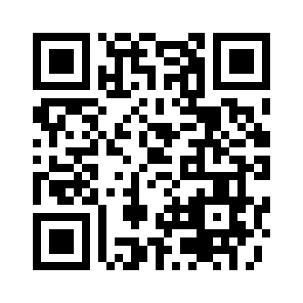

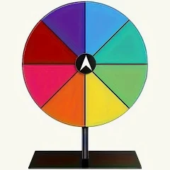
SUBJECT
GRADE
UNIT
LESSON
Knowing each other!
02:00 minutes
Warm-Up
https://wordwall.net/play/86770/102/364

Slide 4
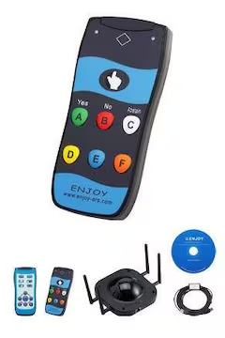
SUBJECT
GRADE
UNIT
LESSON
03:00 minutes
PRE-ASSESSMENT
1- Choose the correct relative pronoun to complete the sentence:
The girl ______ I was talking to is my cousin. 1) whose 2) whom 3) who
Do you like the song______ I wrote. 1) whose 2) when 3) which
IRS
https://create.kahoot.it/details/58082f06-b5b6-48f1-85dc-e36318f61a32

Slide 5
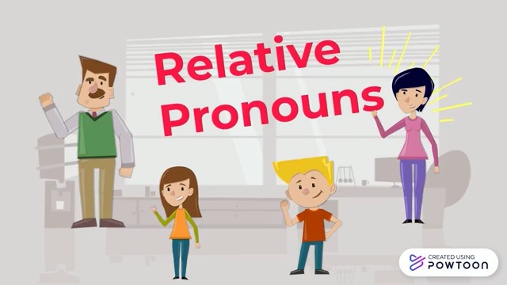
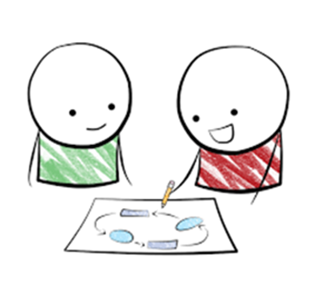
SUBJECT
GRADE
UNIT
LESSON
PRESENTATION
07:00 minutes
Take notes
while
watching☺

Slide 6
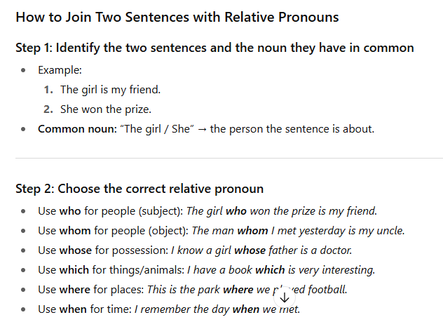

Slide 7
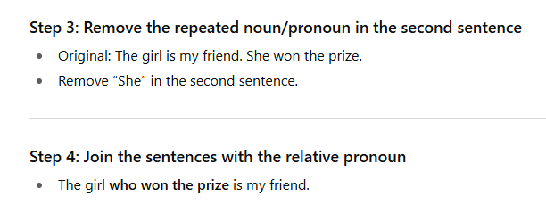
Place the relative clauses after the noun it describes

Slide 8
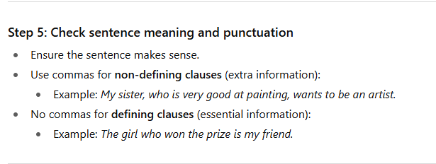

Slide 9
The shirt is too small I bought a shirt yesterday
Shirt : thing : which
The shirt which I bought yesterday is too small

Slide 10
This is the story of a man The man’s ideas saved lots of lives
Man’s : whose
This is the story of a man whose ideas saved lots of lives

Slide 11
Next week, I'm going to Spain My family lives in Spain
Spain/live : where
Next week I’m going to Spain ,Where my family lives.

Slide 12

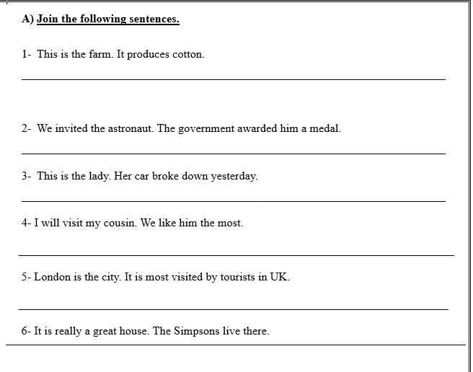

Slide 13
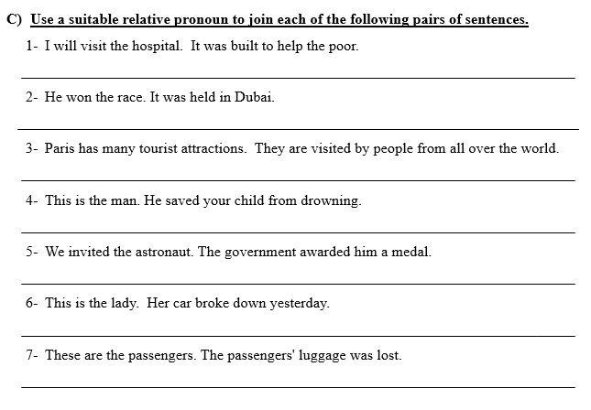

Slide 14


SUBJECT
GRADE
UNIT
LESSON
05:00 minutes
Formative Assessment
In 4 minutes:
Open your booklet/Page 13.
Do Q3 (8-12) .
1
2
3
4

Slide 15
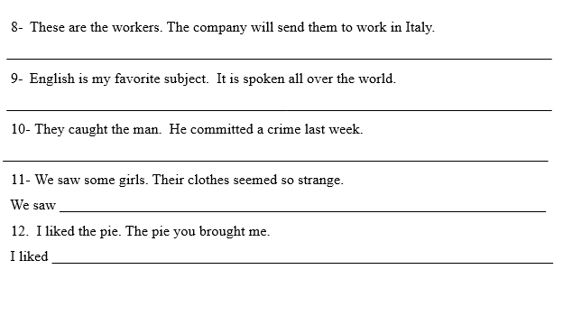
Formative Assessment

Slide 16
REAL LIFE APPLICATION
Which relative pronouns are most useful in daily conversation and why?

Slide 17
This is the man. The man stole my car.
This is the man who stole my car
Main clause /Independent clause
Relative clause /Dependent clause
Relative pronoun
A clause is a group of words that has a subject and a verb
Clauses could be independent(can stand alone ) or dependent(can’t stand alone)
A relative clause is a dependent clause that starts with a relative pronoun

Slide 18

Another name for relative clauses is ?

Slide 19
relative clauses modify (describe) the noun that comes before just like adjectives so we call them relative adjectives.

Slide 20
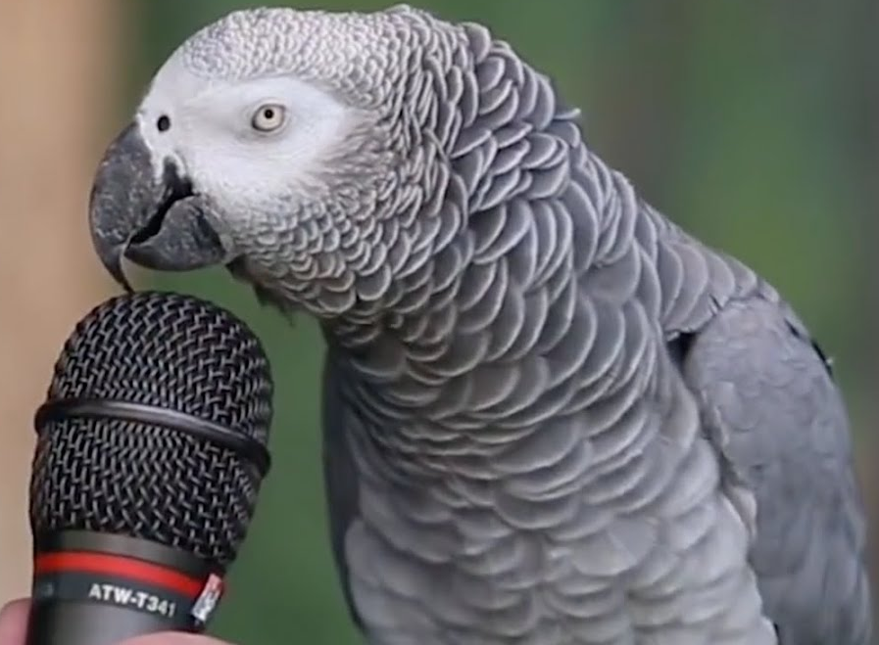


SUBJECT
GRADE
UNIT
LESSON
01:00 minutes
Critical Thinking
"Imagine you are writing a story about a magical island. You want to describe a talking parrot that helps lost travelers. Which relative pronoun would you use to describe the parrot, and why? Would you choose 'who' or 'which'? Explain your choice."

Slide 21

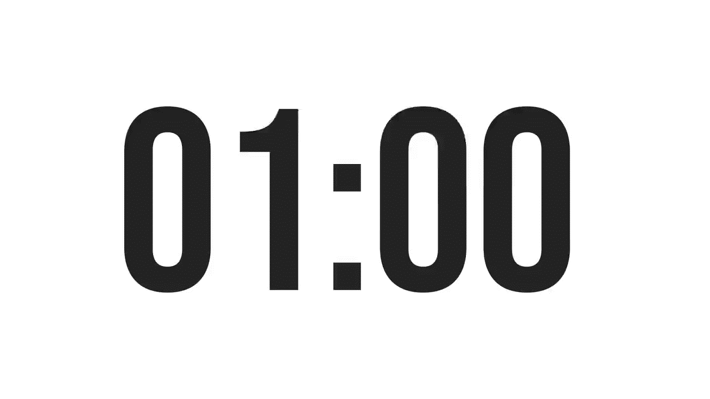
ISLAMIC EDUCATIONAL COLLEGE DATE: /2/ 2025
SUBJECT: Grammar
GRADE: 9
Unit: 4
Lesson: 1
OUTCOMES
CRITICAL THINKING
WARM UP
🔹
In your language, do you join sentences in a similar way? How does it compare to English?
REAL LIFE APPLICATION
CRITICAL THINKING
PREASSESSMENT
FEEDBACK
FORMATIVE ASSESSMENT
PRESENTATION
DIFFERENTIATION
BUZZ IN
EXIT TICKET

Slide 22
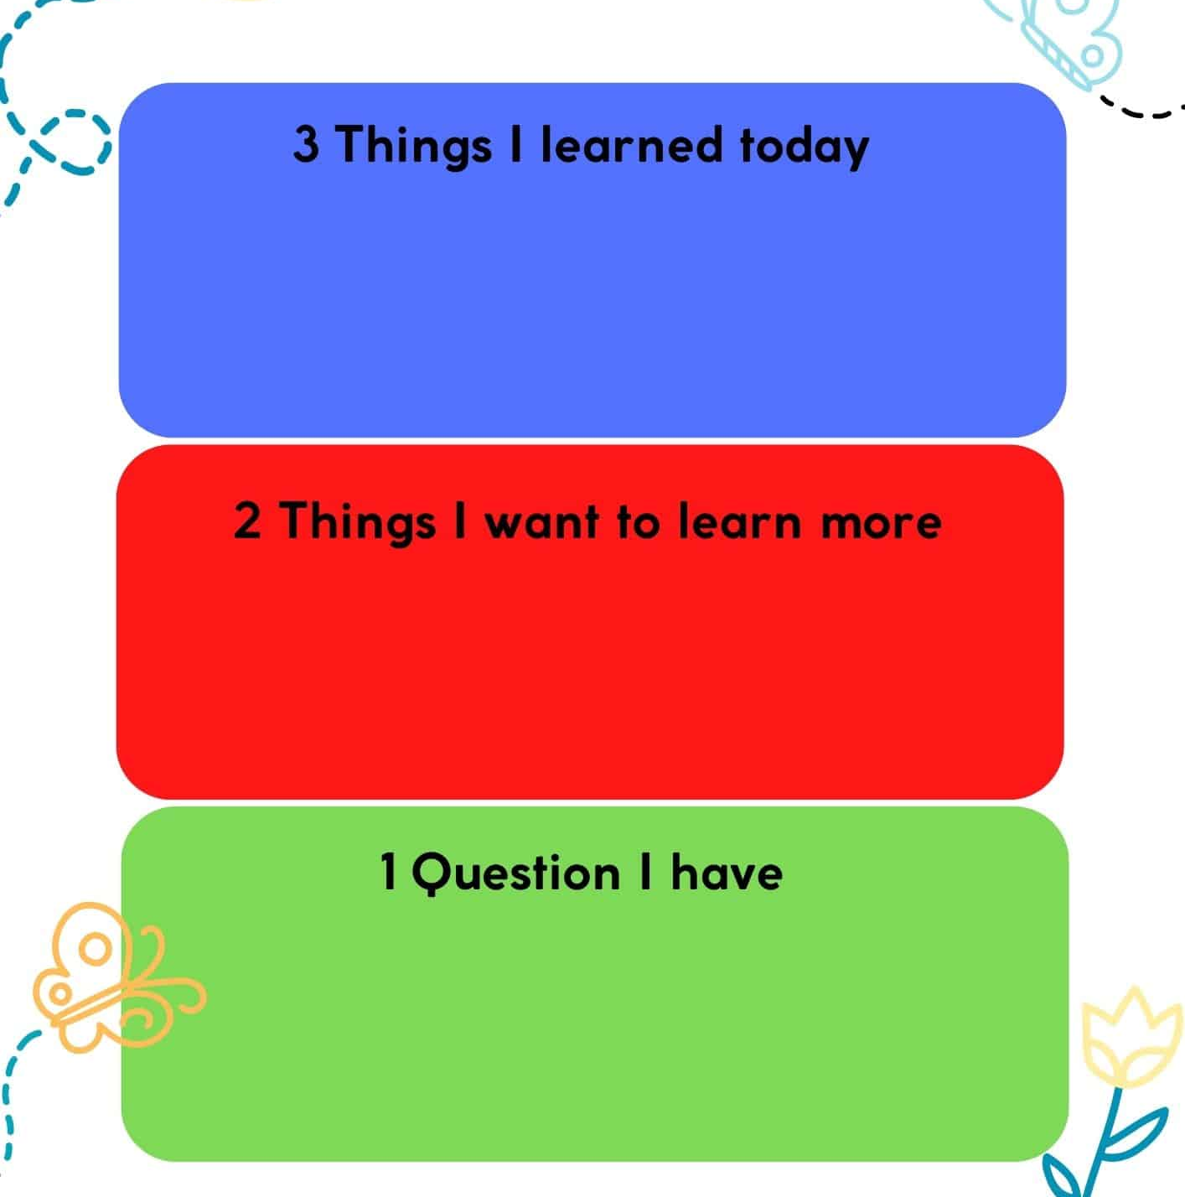
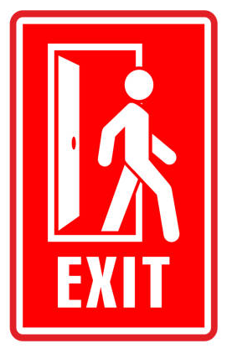
SUBJECT
GR ADE
UNIT
LESSON
OUTCOMES
Summative Assessment
01:00 minutes
WARM UP
PREASSESSMENT
PRESENTATION
FORMATIVE ASSESSMENT
FEEDBACK
DIFFERENTIATION
REAL LIFE APPLICATION
CRITICAL THINKING
EXIT TICKET

