Slide 1

OBJECTIVES
WARM UP
Unit: 3 - Let’s Eat
Lesson: Grammar
Subject: Relative Pronouns
Grade: 10
PREASSESSMENT
PRESENTATION
FORMATIVE ASSESSMENT
FEEDBACK
DIFFERENTIATION
REAL LIFE APPLICATION
CRITICAL THINKING
EXIT TICKET

Slide 2


SUBJECT
GRADE
UNIT
LESSON
01:00 minutes
Objective
Identify relative pronouns (who, whom, whose, which, that) and relative adverbs (where, when, why).
Understand what relative clauses are and their function in a sentence.

Slide 3
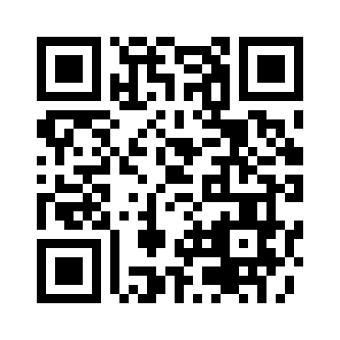

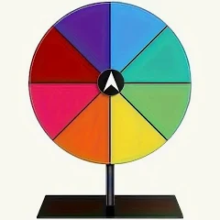
SUBJECT
GRADE
UNIT
LESSON
Knowing each other!
02:00 minutes
Warm-Up
https://wordwall.net/play/86770/102/364

Slide 4
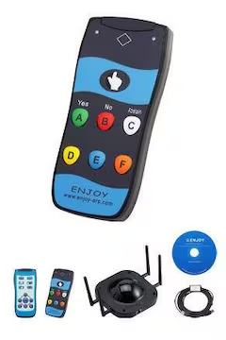
SUBJECT
GRADE
UNIT
LESSON
03:00 minutes
PRE-ASSESSMENT
1- Which relative pronoun is used for things or animals?
1) who 2) which 3) whom
2- Choose the correct relative pronoun to complete the sentence:
The girl ______ book was lost is looking for it.
1) whose 2) which 3) that
IRS

Slide 5
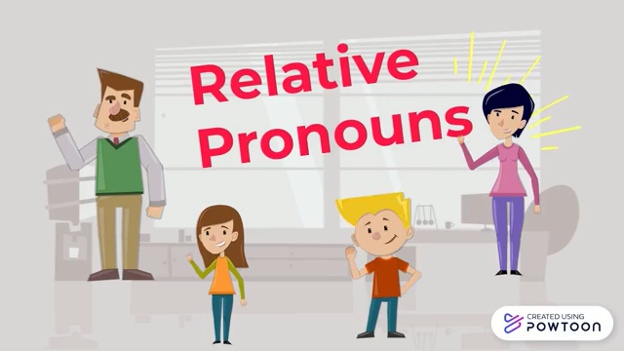
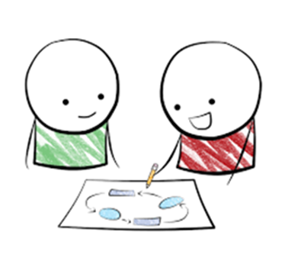
SUBJECT
GRADE
UNIT
LESSON
PRESENTATION
07:00 minutes
Take notes
while
watching☺

Slide 6
This is the man. The man stole my car.
This is the man who stole my car
Relative pronoun
Main clause /Independent clause
Relative clause /Dependent clause
Who - people(subject)

Slide 7
1. The author whom I talked to is well-known. The action is “ I talked to” who is doing the talking? I Who is receiving the action? The author (object)
Whom(objects)
Subject + verb
The author who talked to me is well-known.
The action is “ talked to” who is doing the talking? The author( subject) Who is receiving the action? me

Slide 8
1- My previous house, which was quite small, was in Coventry. 2- I did well in chemistry, which was always my favorite subject. 3- The car which I like to own is very expensive .
Things

Slide 9
I talked to a man. His wife /the man’s wife had died the year before. His Her + Noun Their Our I talked to a man Whose wife had died the year before .

Slide 10
The dog is over there. The dog's / its owner lives next door.
→ The dog whose owner lives next door is over there.
The woman is coming tonight. Her car is a BMW.
→ The woman whose car is a BMW is coming tonight.
The house belongs to me. Its roof is very old.
→ The house whose roof is old belongs to me.
Whose: People/animals/things:
it modifies a noun by showing relationship/ownership

Slide 11
When
1- The fourth of July when the US gained independence, is my favorite holiday.
2- The summer when I graduated from university was long and hot.
.
Key points
“When” replaces a time expression (like day, moment, year) in the main clause.
Usually used in defining relative clauses, giving essential information.

Slide 12
This is the park where we first met.” Central Park, where we first met, is very beautiful.” Where” is a relative pronoun used to refer to a place. It introduces a relative clause giving more information about a location mentioned in the main clause.
Where

Slide 13
1- There are many reasons why I love teaching . 2- It is the reason why I hate arguing .
Why
Why” = connects a reason with the action that explains it
Always use a noun like “reason” before “why.”

Slide 14
SUBJECT
GRADE
UNIT
LESSON
PRESENTATION
07:00 minutes
What are Relative Pronouns?
Relative pronouns are words that help connect a sentence by giving more information about a person, place, or thing. Some common relative pronouns are:
who → for people (e.g., The boy who is running is my friend.)
whom → for people (used less often) (e.g., The teacher whom we respect is kind.)
which → for animals and things (e.g., The book which I read was amazing.)
that → for people, animals, or things (e.g., The cake that she made was delicious.)
whose → shows possession (e.g., The girl whose dog is lost is sad.)
where → for places (e.g., This is the park where we play.)

Slide 15

Another name for relative clauses is ?

Slide 16
relative clauses modify (describe) the noun that comes before just like adjectives so we call them relative adjectives.

Slide 17
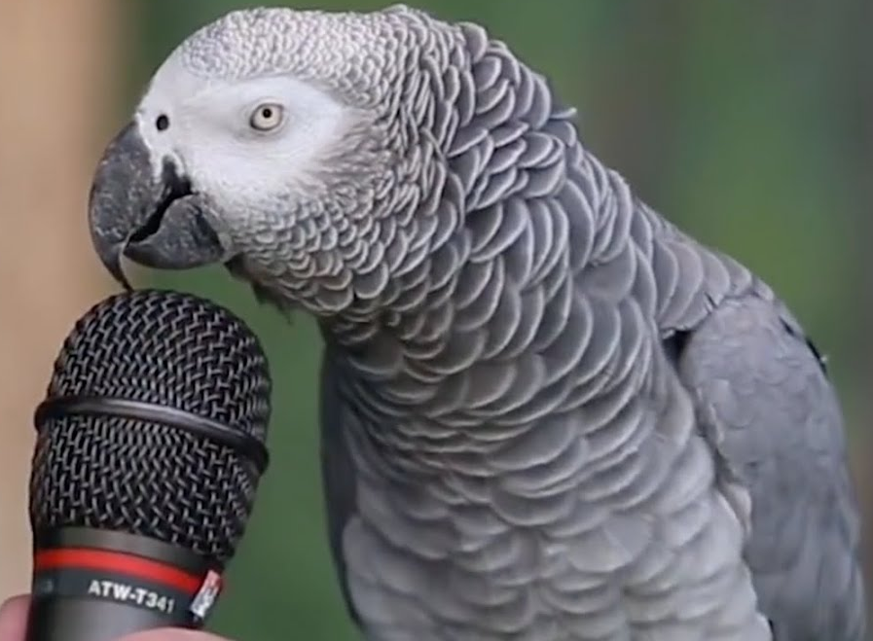


SUBJECT
GRADE
UNIT
LESSON
01:00 minutes
Critical Thinking
"Imagine you are writing a story about a magical island. You want to describe a talking parrot that helps lost travelers. Which relative pronoun would you use to describe the parrot, and why? Would you choose 'who' or 'which'? Explain your choice."

Slide 18

Which VS Where
1- This is the hospital _______I was born .
2- This is the hospital ________ we read about .
1- This is the restaurant ________ I met my best friend .
2- This is the restaurant ________ is always busy .
1- This is the street _______ I lost my keys .
2- This is the street __________ I hate the most .
where
which
where
which
where
which
If it’s the place where something happens, use where. Otherwise, use which for the thing or place itself.”

Slide 19
that
Can replace who or which in most cases.
Cannot replace where or why.
Used in defining clauses only (you can’t use it in non-defining clauses with commas).
People:
This is the man that helped me. ✅
“That helped me” → gives essential info about the man.
Things:
I like the book that you gave me. ✅
“That you gave me” → essential info about the book.

Slide 20


SUBJECT
GRADE
UNIT
LESSON
05:00 minutes
Formative Assessment
In 4 minutes:
Open your booklet.
Fill in the blanks with the suitable pronouns.
1
2
3
4

Slide 21
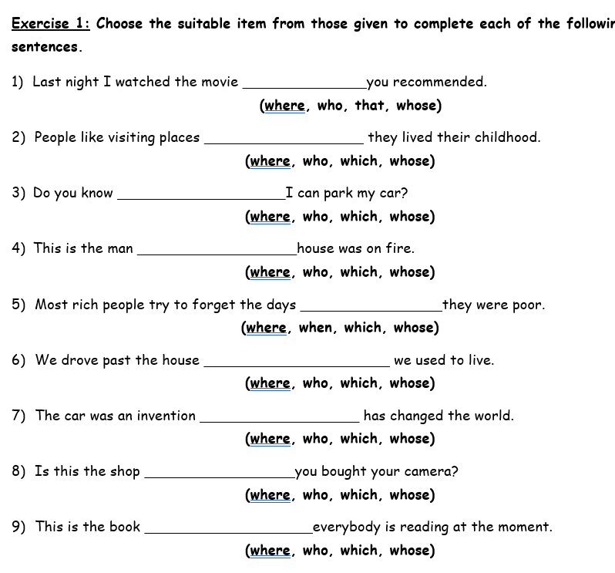


Slide 22

ISLAMIC EDUCATIONAL COLLEGE DATE: / 5/ 2025
SUBJECT: Grammar
GRADE: 9
UNIT: 4
Lesson: 1
OUTCOMES
02:00 minutes
Differentiation
WARM UP
Students 2+3
Students 1+4
PREASSESSMENT
PRESENTATION
FORMATIVE ASSESSMENT
Complete the sentences with the correct relative pronoun
Complete the sentences with the correct relative pronoun
FEEDBACK
DIFFERENTIATION
REAL LIFE APPLICATION
CRITICAL THINKING
EXIT TICKET

Slide 23
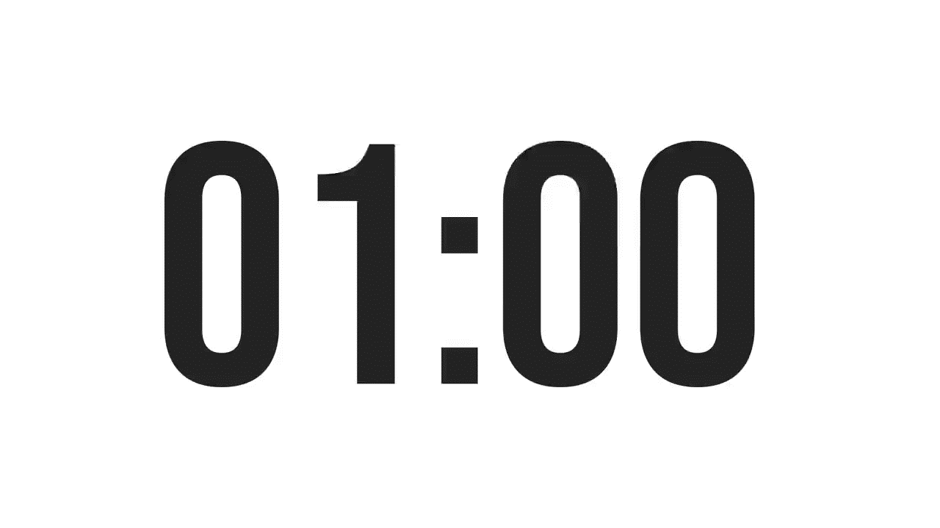
ISLAMIC EDUCATIONAL COLLEGE DATE: /2/ 2025
SUBJECT: Grammar
GRADE: 9
Unit: 4
Lesson: 1
OUTCOMES
CRITICAL THINKING
WARM UP
🔹
In your language, do you join sentences in a similar way? How does it compare to English?
REAL LIFE APPLICATION
CRITICAL THINKING
PREASSESSMENT
FEEDBACK
FORMATIVE ASSESSMENT
PRESENTATION
DIFFERENTIATION
BUZZ IN
EXIT TICKET

Slide 24
REAL LIFE APPLICATION
Which relative pronouns are most useful in daily conversation and why?

Slide 25
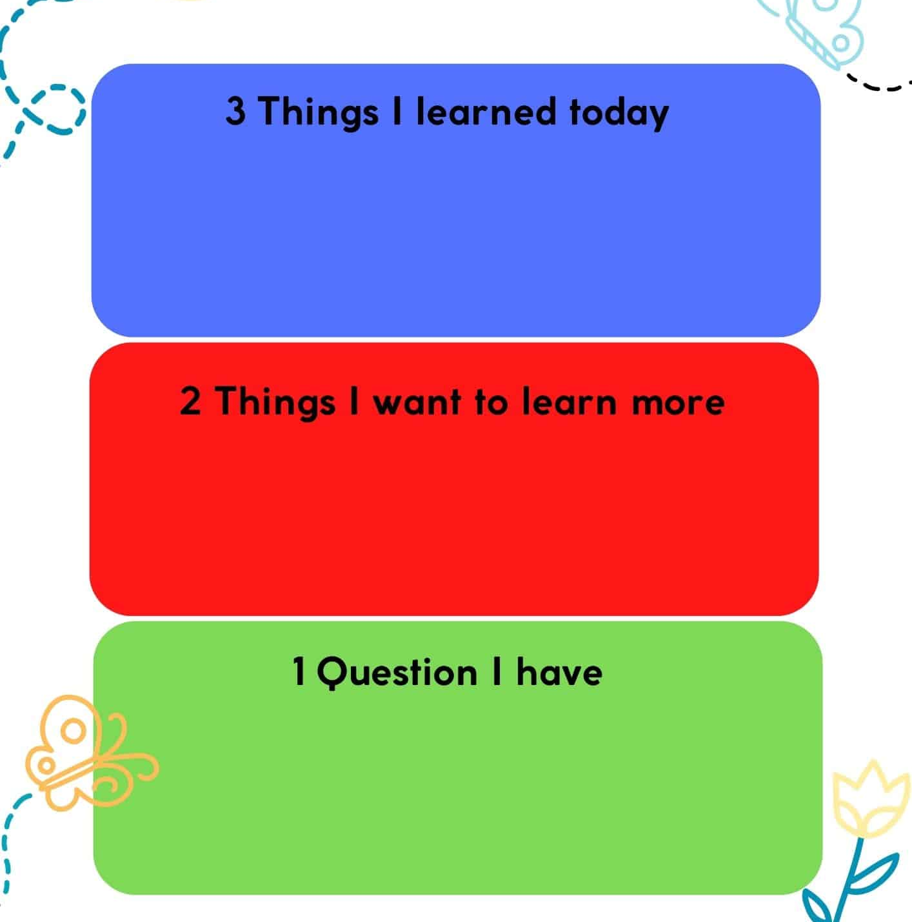
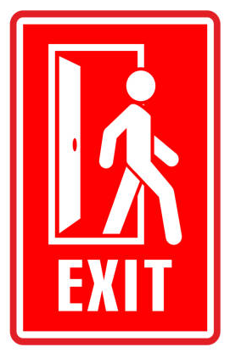
SUBJECT
GR ADE
UNIT
LESSON
OUTCOMES
Summative Assessment
01:00 minutes
WARM UP
PREASSESSMENT
PRESENTATION
FORMATIVE ASSESSMENT
FEEDBACK
DIFFERENTIATION
REAL LIFE APPLICATION
CRITICAL THINKING
EXIT TICKET

Slide 26
SUBJECT
GRADE
UNIT
LESSON
02:00 minutes
PRE-ASSESSMENT
IRS
1- Which sentence is wrong?
1- Frida Kahlo was the artist where painted many self-portraits.
2- Frida Kahlo was the artist who painted many self-portraits.
2- Which of the words below IS NOT a relative pronoun?
1- who
2- they

Slide 27
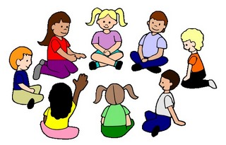
SUBJECT
GRADE
UNIT
LESSON
PRESENTATION
04:00 minutes
- describe a noun
- begin with a relative pronoun
(who – that – where)
- restrictive adjectival clauses
are essential to the meaning
and DO NOT require commas.
adjectival clauses
The book that I borrowed from the library is very
interesting.
("that I borrowed from the library" specifies which book.)
2. Students who study hard usually get good grades.
("who study hard" tells us which students.)
3.The car that has a flat tire belongs to my neighbor.
("that has a flat tire" identifies which car.)

Slide 28
The shirt is too small I bought a shirt yesterday
Shirt : thing : which
The shirt which I bought yesterday is too small

Slide 29
This is the story of a man The man’s ideas saved lots of lives
Man’s : whose
This is the story of a man whose ideas saved lots of lives

Slide 30
Next week, I'm going to Spain My family lives in Spain
Spain/live : where
Next week I’m going to Spain ,Where my family lives.

Slide 31
Analyze the four sentences. Which ones give essential information and which ones give extra information? How does the meaning change?
CRITICAL THINKING
Paris, which is the capital of France, is a beautiful city.
The woman who found my wallet handed it in to reception.
Mr. Sam, who teaches English, is kind.
I listened to the song which you sent me

Slide 32
FEEDBACK
Paris, which is the capital of France, is a beautiful city.
The woman who found my wallet handed it in to reception.
Mr. Sam, who teaches English, is kind.
I listened to the song which you sent me.
Extra
Essential
Extra
essential

Slide 33
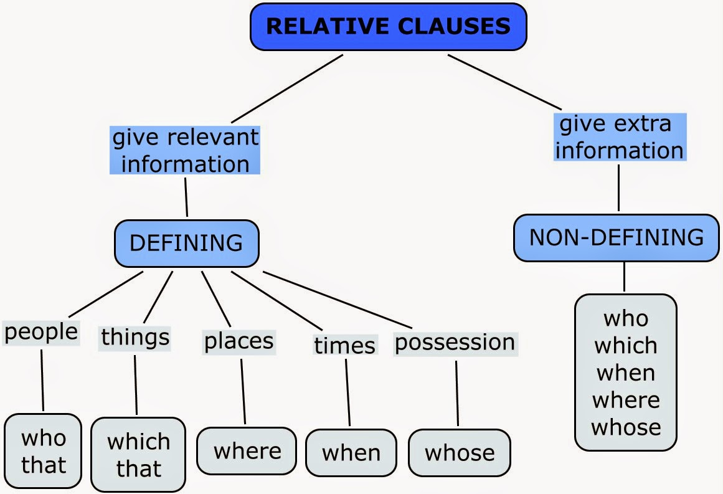

Slide 34
I listened to the song which you sent me.
I listened to the song that you sent me.
My car, which is over ten years old, still runs perfectly.
My car, that is over ten years old, still runs perfectly.

Slide 35
The person who phoned me last night is my teacher. - The person that phoned me last night is my teacher.
Mrs Pratt, who is very kind, is my teacher.
Mrs Pratt, that is very kind, is my teacher.

Slide 36
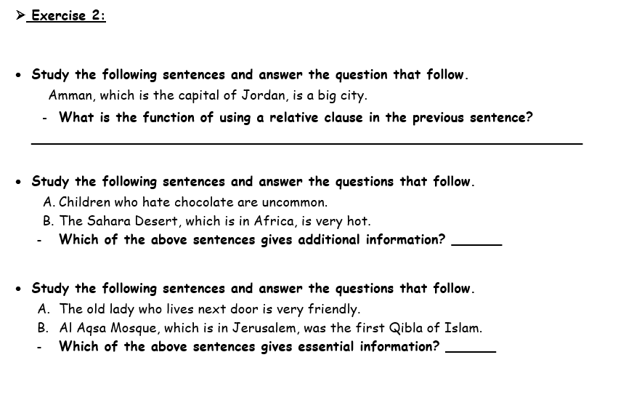
FORMATIVE ASSESSMENT
Booklet page 9

Slide 37
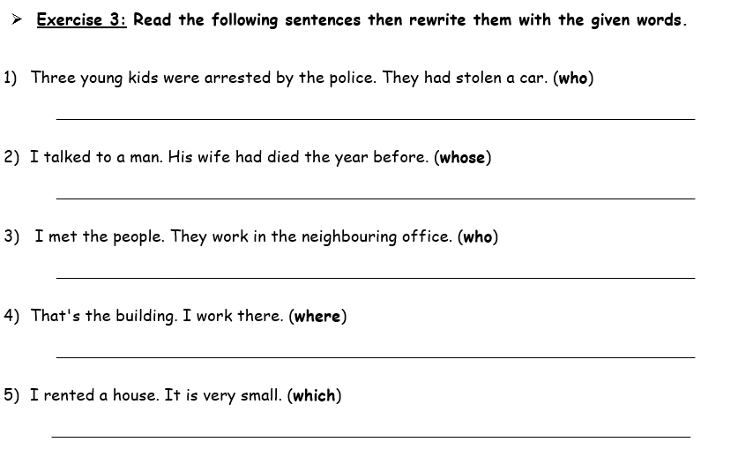

Slide 38
Three young kids who had stolen a car were arrested by the police. D
I talked to a man whose wife had died the year before. D
I met the people who work in the neighboring office. D
That's the building where I work. D
I rented a house, which is very small. N

Slide 39
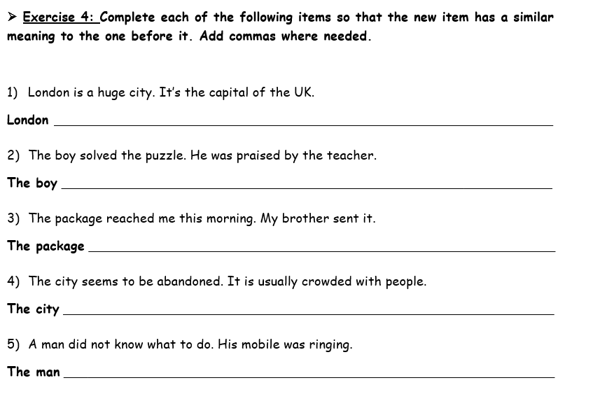

Slide 40
London, which is the capital of the UK, is a huge city. N
The boy who solved the puzzle was praised by the teacher. D
The package, which my brother sent, reached me this morning. D
The city, which is usually crowded with people, seems to be abandoned. N
The man whose mobile was ringing did not know what to do. D

Slide 41
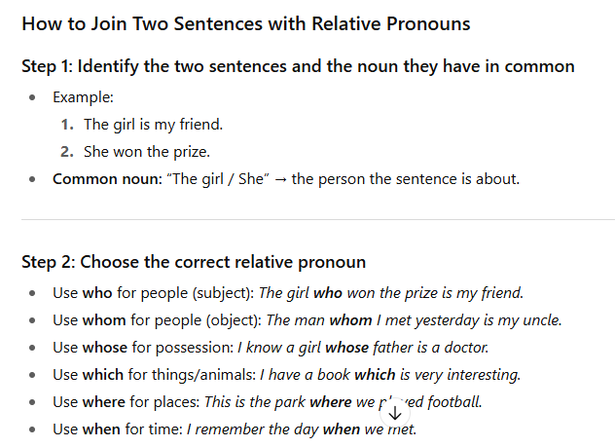

Slide 42
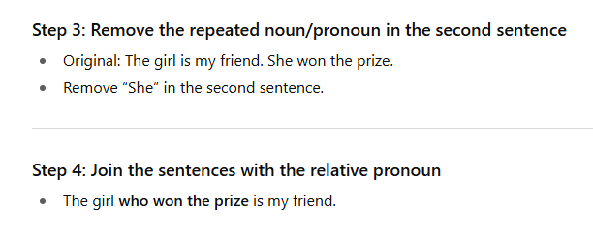

Slide 43
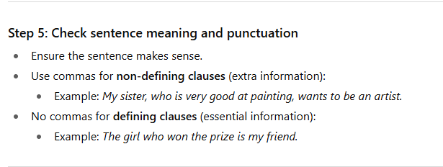

Slide 44
SUBJECT
GRADE
UNIT
LESSON
02:00 minutes
Warm-Up
https://create.kahoot.it/details/58082f06-b5b6-48f1-85dc-e36318f61a32

Slide 45
SUBJECT
GRADE
UNIT
LESSON
03:00 minutes
PRE-ASSESSMENT
1- Choose the correct relative pronoun to complete the sentence:
My brother who lives in London is a doctor.. 1) defining 2) non-defining
Morocco, which is in North Africa, attracts many tourists every year.
1) defining 2) non-defining
IRS

Slide 46

CRITICAL THINKING
Which sentence suggests that you have more than one brother?
My brother who lives in London is a doctor.
My brother, who lives in London, is a doctor.

Slide 47
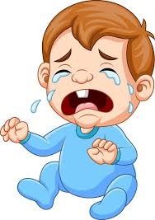
SUBJECT
GRADE
UNIT
LESSON
02:00 minutes
Critical Thinking
Think then add an adjectival clause to the sentence below.
I saw a baby.
I saw a baby ……………

Slide 48

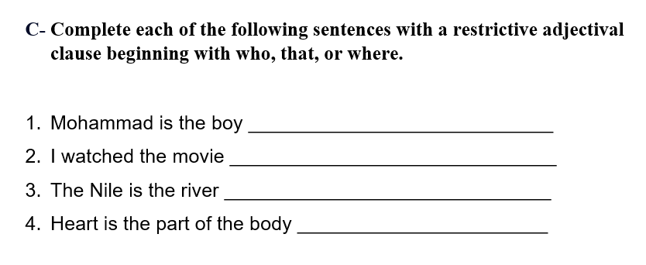
SUBJECT
GRADE
UNIT
LESSON
03:00 minutes
Formative Assessment

