Slide 1

OBJECTIVES
WARM UP
Unit: 3 - Let’s Eat
Lesson: Grammar
Subject: Relative Clauses+ Types of sentences
Grade: 10
PREASSESSMENT
PRESENTATION
FORMATIVE ASSESSMENT
FEEDBACK
DIFFERENTIATION
REAL LIFE APPLICATION
CRITICAL THINKING
EXIT TICKET

Slide 2


SUBJECT
GRADE
UNIT
LESSON
01:00 minutes
Objective
To use the different types of sentences correctly
To use the relative clauses and relative pronouns correctly

Slide 3
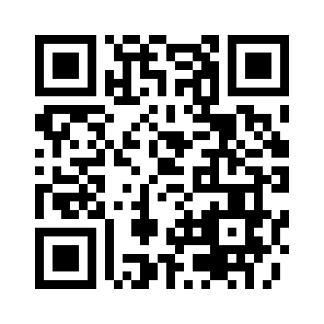

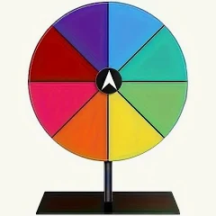
SUBJECT
GRADE
UNIT
LESSON
Knowing each other!
02:00 minutes
Warm-Up + preassessment
https://wordwall.net/play/86770/102/364

Slide 4
SUBJECT
GRADE
UNIT
LESSON
02:00 minutes
preassessment
The boy who won the race is my cousin.
Simple
Compound
Complex

Slide 5
SUBJECT
GRADE
UNIT
LESSON
02:00 minutes
preassessment
The woman ___ lives next door is very friendly.
Which
who
Whose

Slide 6
SUBJECT
GRADE
UNIT
LESSON
02:00 minutes
preassessment
I saw the car that my father bought last week.
Simple
Compound
Complex

Slide 7
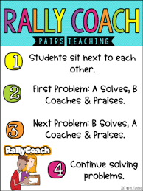
SUBJECT
GRADE
UNIT
LESSON
PRESENTATION
07:00 minutes
Join the two sentences and identify the type of sentence resulted. Post of padlet
Sara wanted to play outside.
It started to rain.
You can read a book.
You can watch TV.
Ali likes pizza.
He also likes pasta.
but
or
and

Slide 8
SUBJECT
GRADE
UNIT
LESSON
Feedback
07:00 minutes
Join the two sentences and identify the type of sentence resulted.
Sara wanted to play outside, but it started to rain.
You can read a book, or you can watch TV.
Ali likes pizza, and he also likes pasta.

Slide 9
SUBJECT
GRADE
UNIT
LESSON
PRESENTATION
07:00 minutes
Post of padlet
He was tired. He finished his homework. (although)
You study hard. You will pass the exam. (if)
She stayed home. She was not feeling well (since)

Slide 10
SUBJECT
GRADE
UNIT
LESSON
Feedback
07:00 minutes
Although he was tired, he finished his homework.
You will pass the exam if you study hard.
She stayed home since she was not feeling well.

Slide 11

SUBJECT
GRADE
UNIT
LESSON
PRESENTATION
03:00 minutes
The boy is very smart. He won the spelling competition.
This is the book. The teacher recommended it.
My uncle lives in Paris. He is coming to visit us next week.
Mount Everest is the highest mountain in the world. It attracts many climbers every year.

Slide 12
SUBJECT
GRADE
UNIT
LESSON
Feedback
07:00 minutes
Defining Relative Clauses
The boy who won the spelling competition is very smart.
This is the book that the teacher recommended.
Non-defining Relative Clauses
Sami, who lives in Paris, is coming to visit us next week.
Mount Everest, which is the highest mountain in the world, attracts many climbers every year.

Slide 13


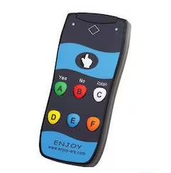
SUBJECT
GRADE
UNIT
LESSON
01:00 minutes
Critical Thinking
What is the difference in meaning:
My uncle, who is a doctor, is coming to visit us.
My uncle who is a doctor is coming to visit us.

Slide 14
SUBJECT
GRADE
UNIT
LESSON
05:00 minutes
Formative Assessment
Quizziz
1
2
3
4

Slide 15

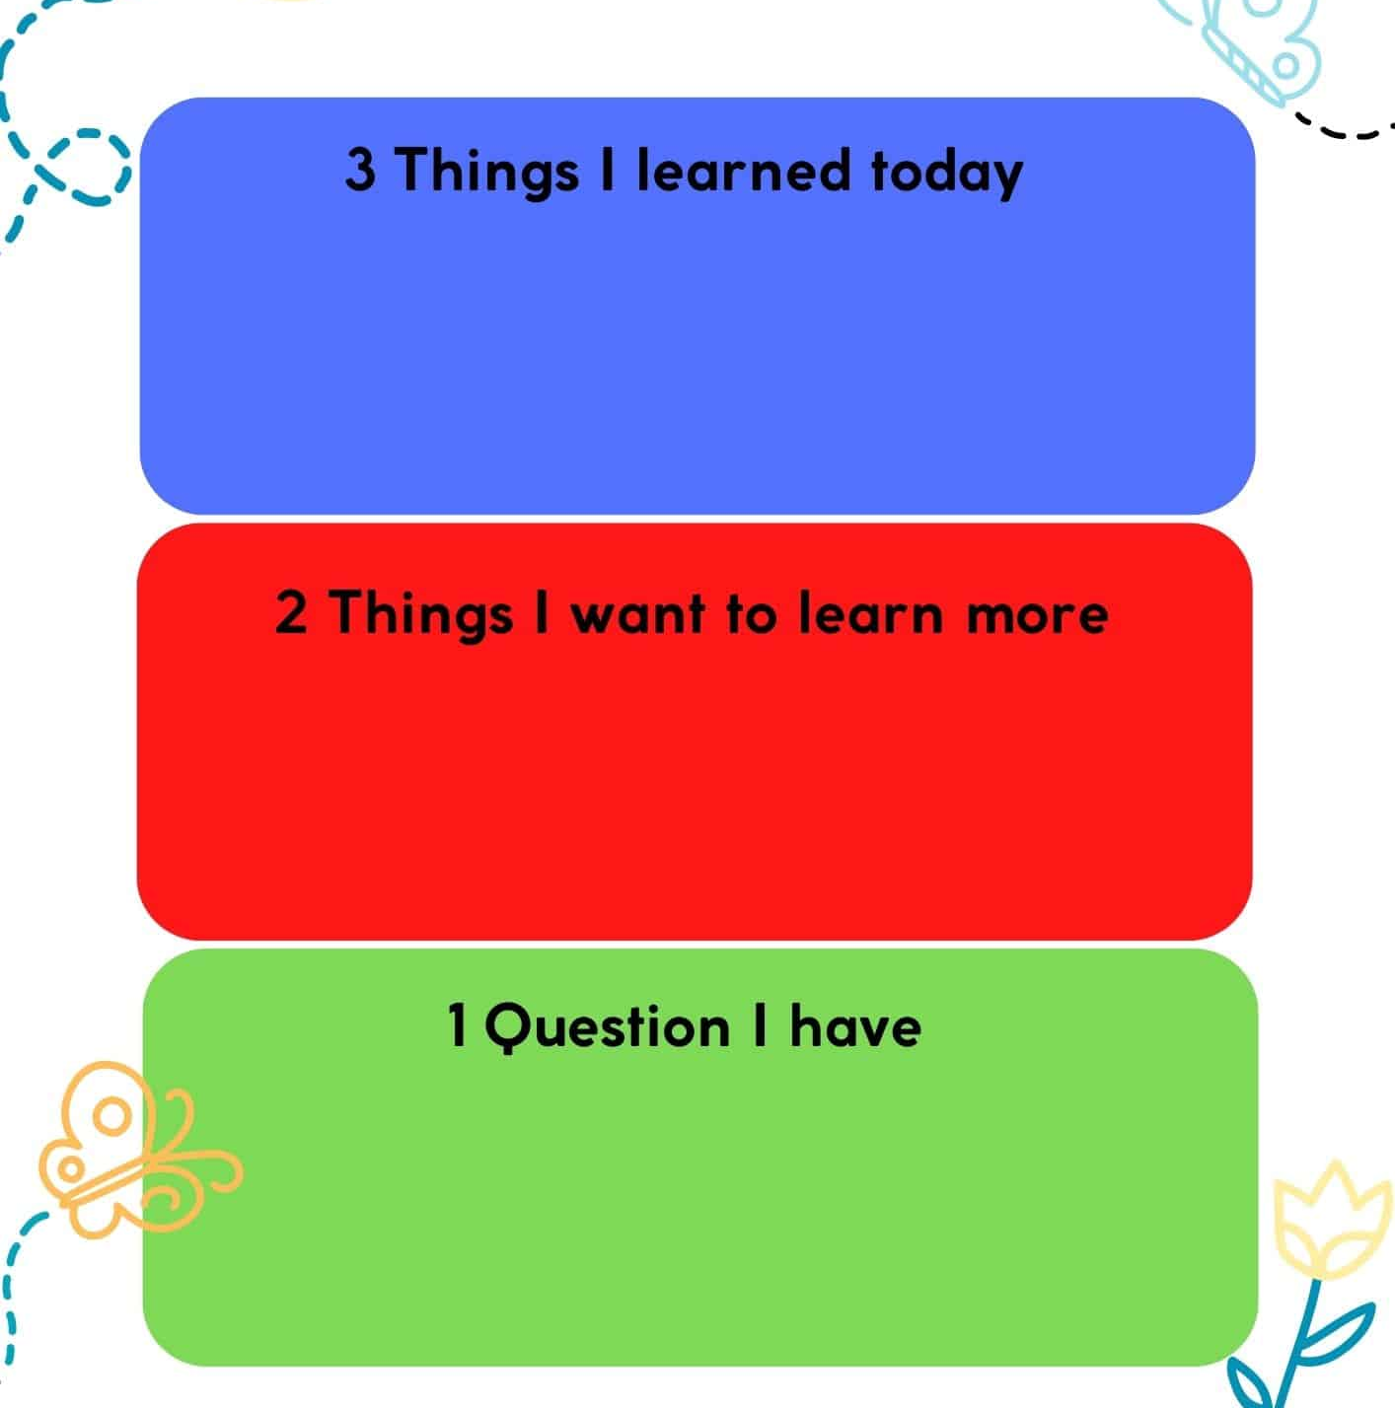

SUBJECT
GR ADE
UNIT
LESSON
OUTCOMES
Summative Assessment
01:00 minutes
WARM UP
PREASSESSMENT
PRESENTATION
FORMATIVE ASSESSMENT
FEEDBACK
DIFFERENTIATION
REAL LIFE APPLICATION
CRITICAL THINKING
EXIT TICKET

