Slide 1
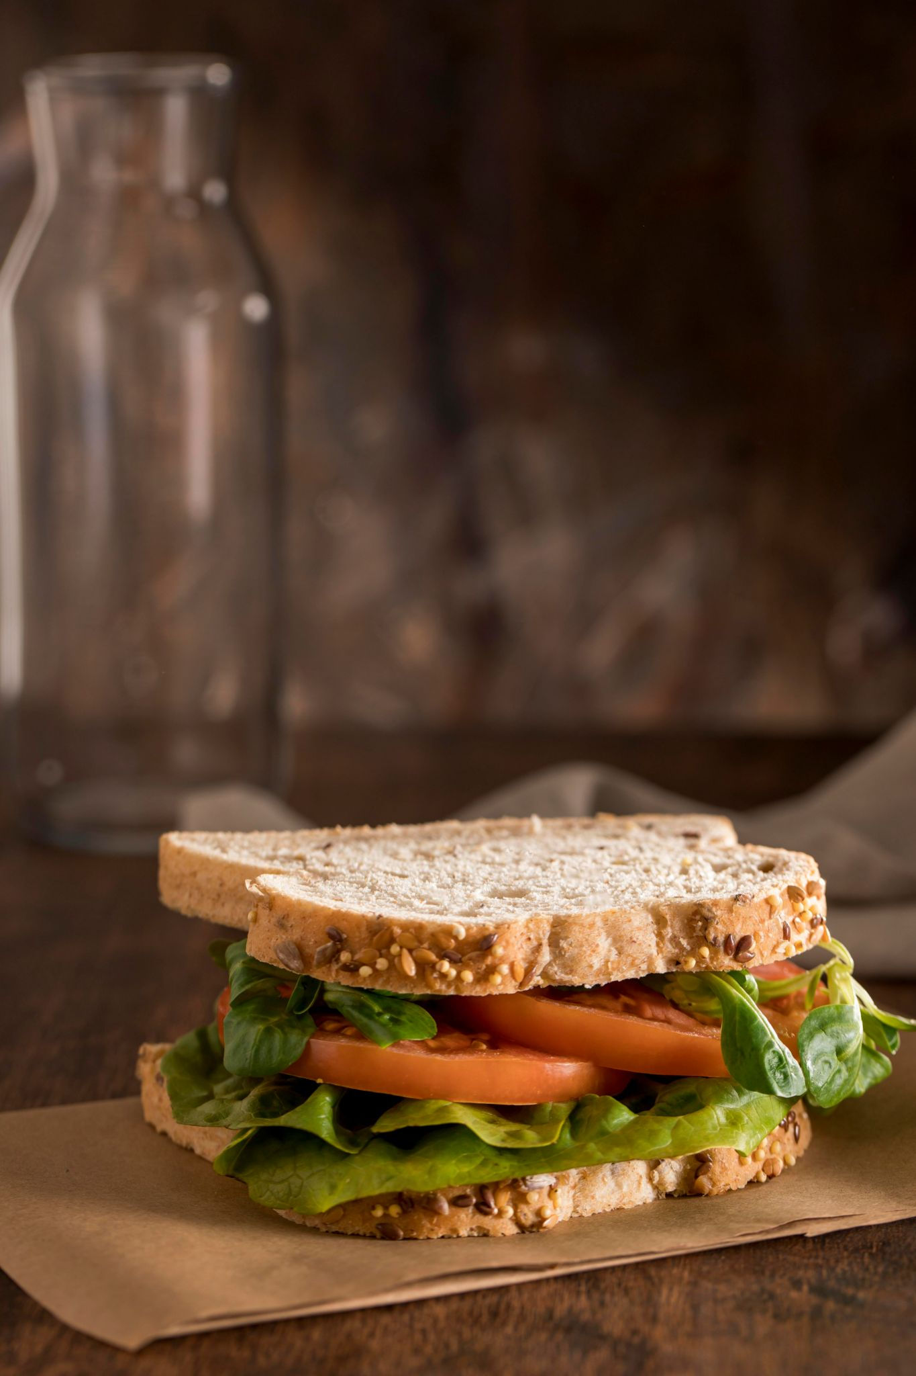


Unit : Two
Major : English
Lesson : Writing a Recipe
Grade : 4

Slide 2
Writing
recipe

Slide 3
Outcomes:
1
Recognize What a Recipe is
2
Identify Cooking Verbs and Utensils
3
Start Writing a Recipe

Slide 4
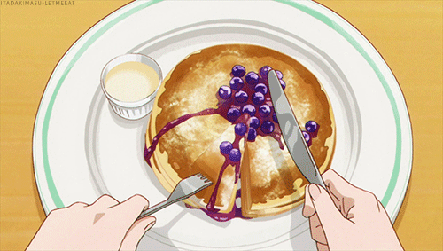
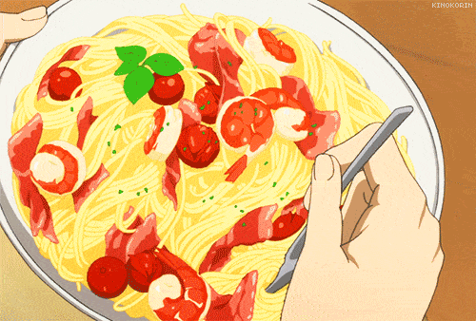
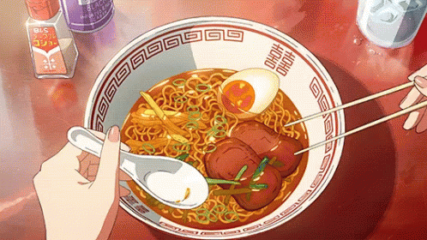
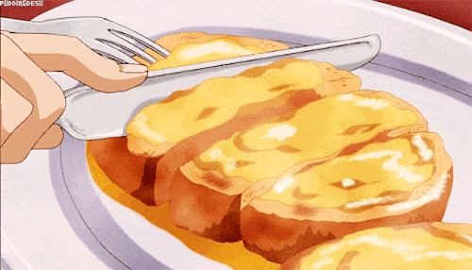
We all love food but do we know how to prepare it?

Slide 5

Warm-Up
Write as many adjectives as you can
Jot Thoughts

Slide 6

Pre-assessment
We start the Imperative sentence with:
1. a noun
2. a verb
3. an adjective
IRS
Notes:
Students can use their magic boards to write (F / V)

Slide 7
Feedback
We start the Imperative sentence with:
1. a noun
2. a verb
3. an adjective
IRS
Notes:
Students can use their magic boards to write (F / V)

Slide 8
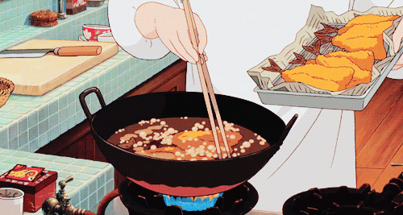
Presentation
I don’t know how to cook. That’s why I always search for recipes.

Slide 9
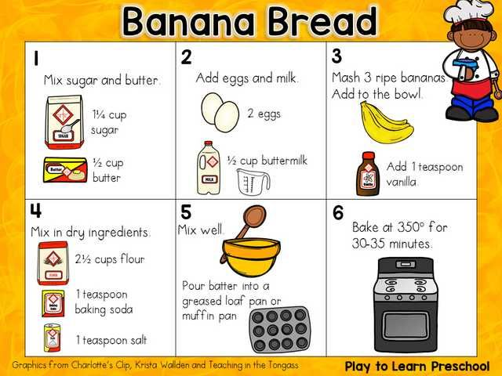
What is a recipe?
Presentation
1

Slide 10
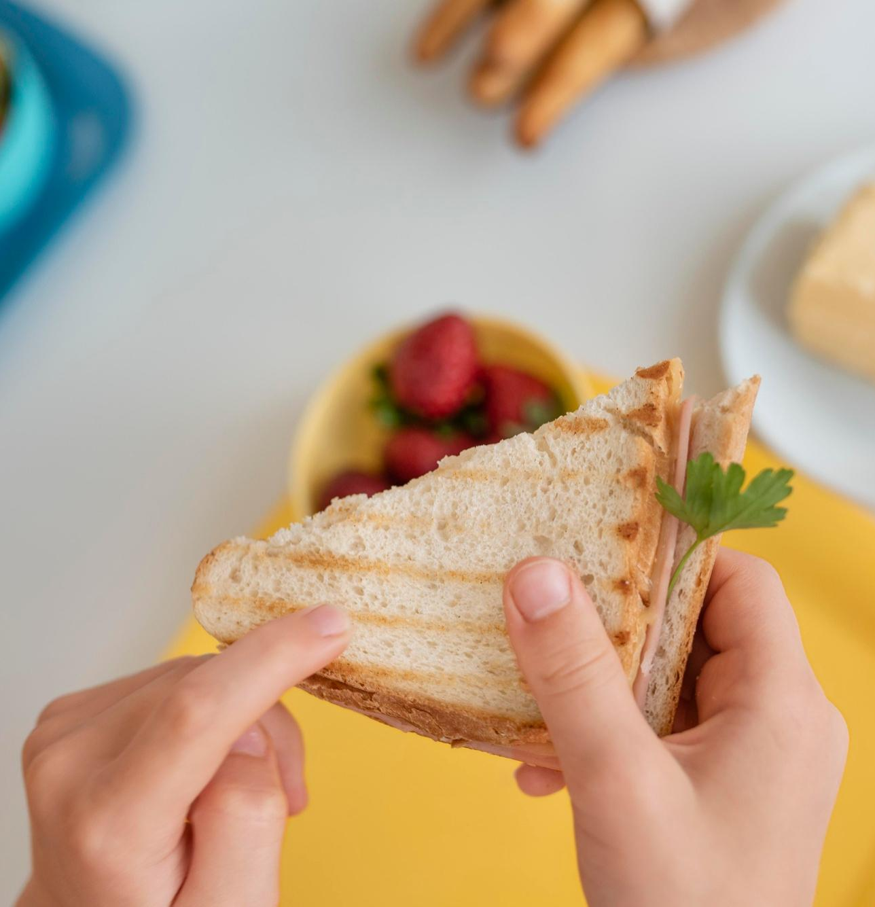
A recipe is
Presentation
A set of steps for preparing a dish.

Slide 11

Google Search
Presentation
Synonyms of a recipe

Slide 12
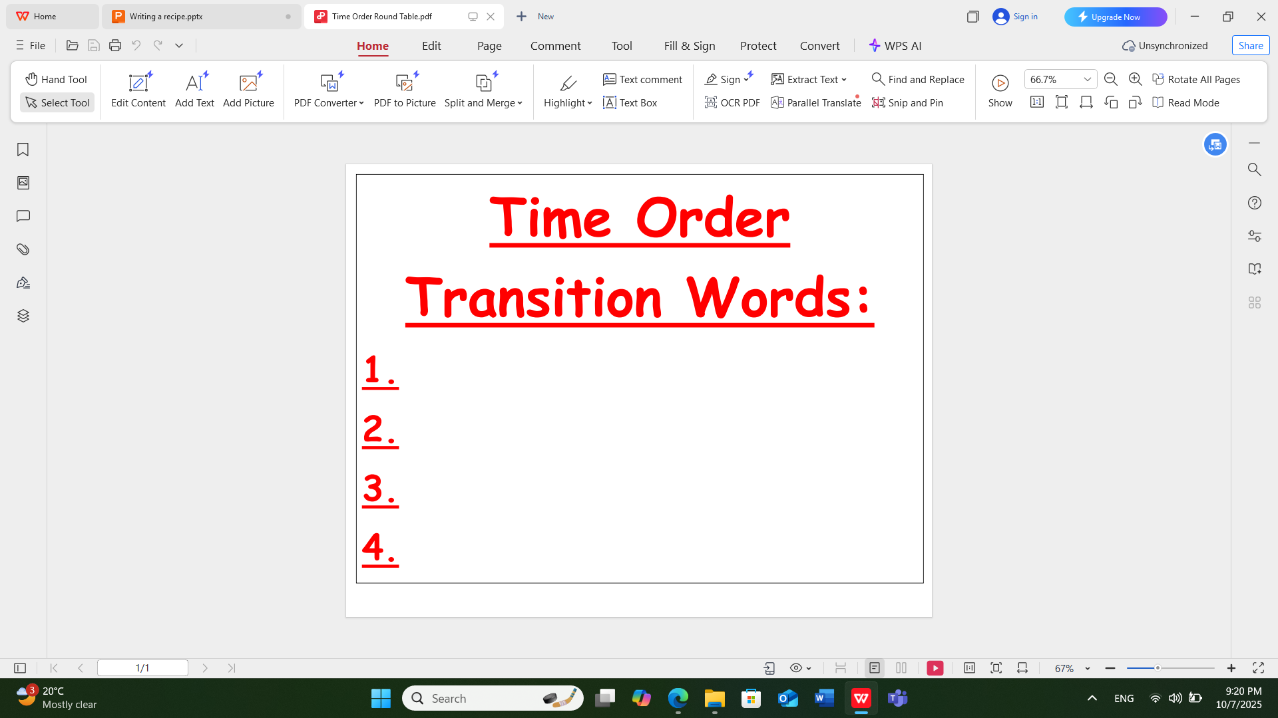

Presentation

Slide 13
Cooking Verbs and Utensils
Presentation
2

Slide 14
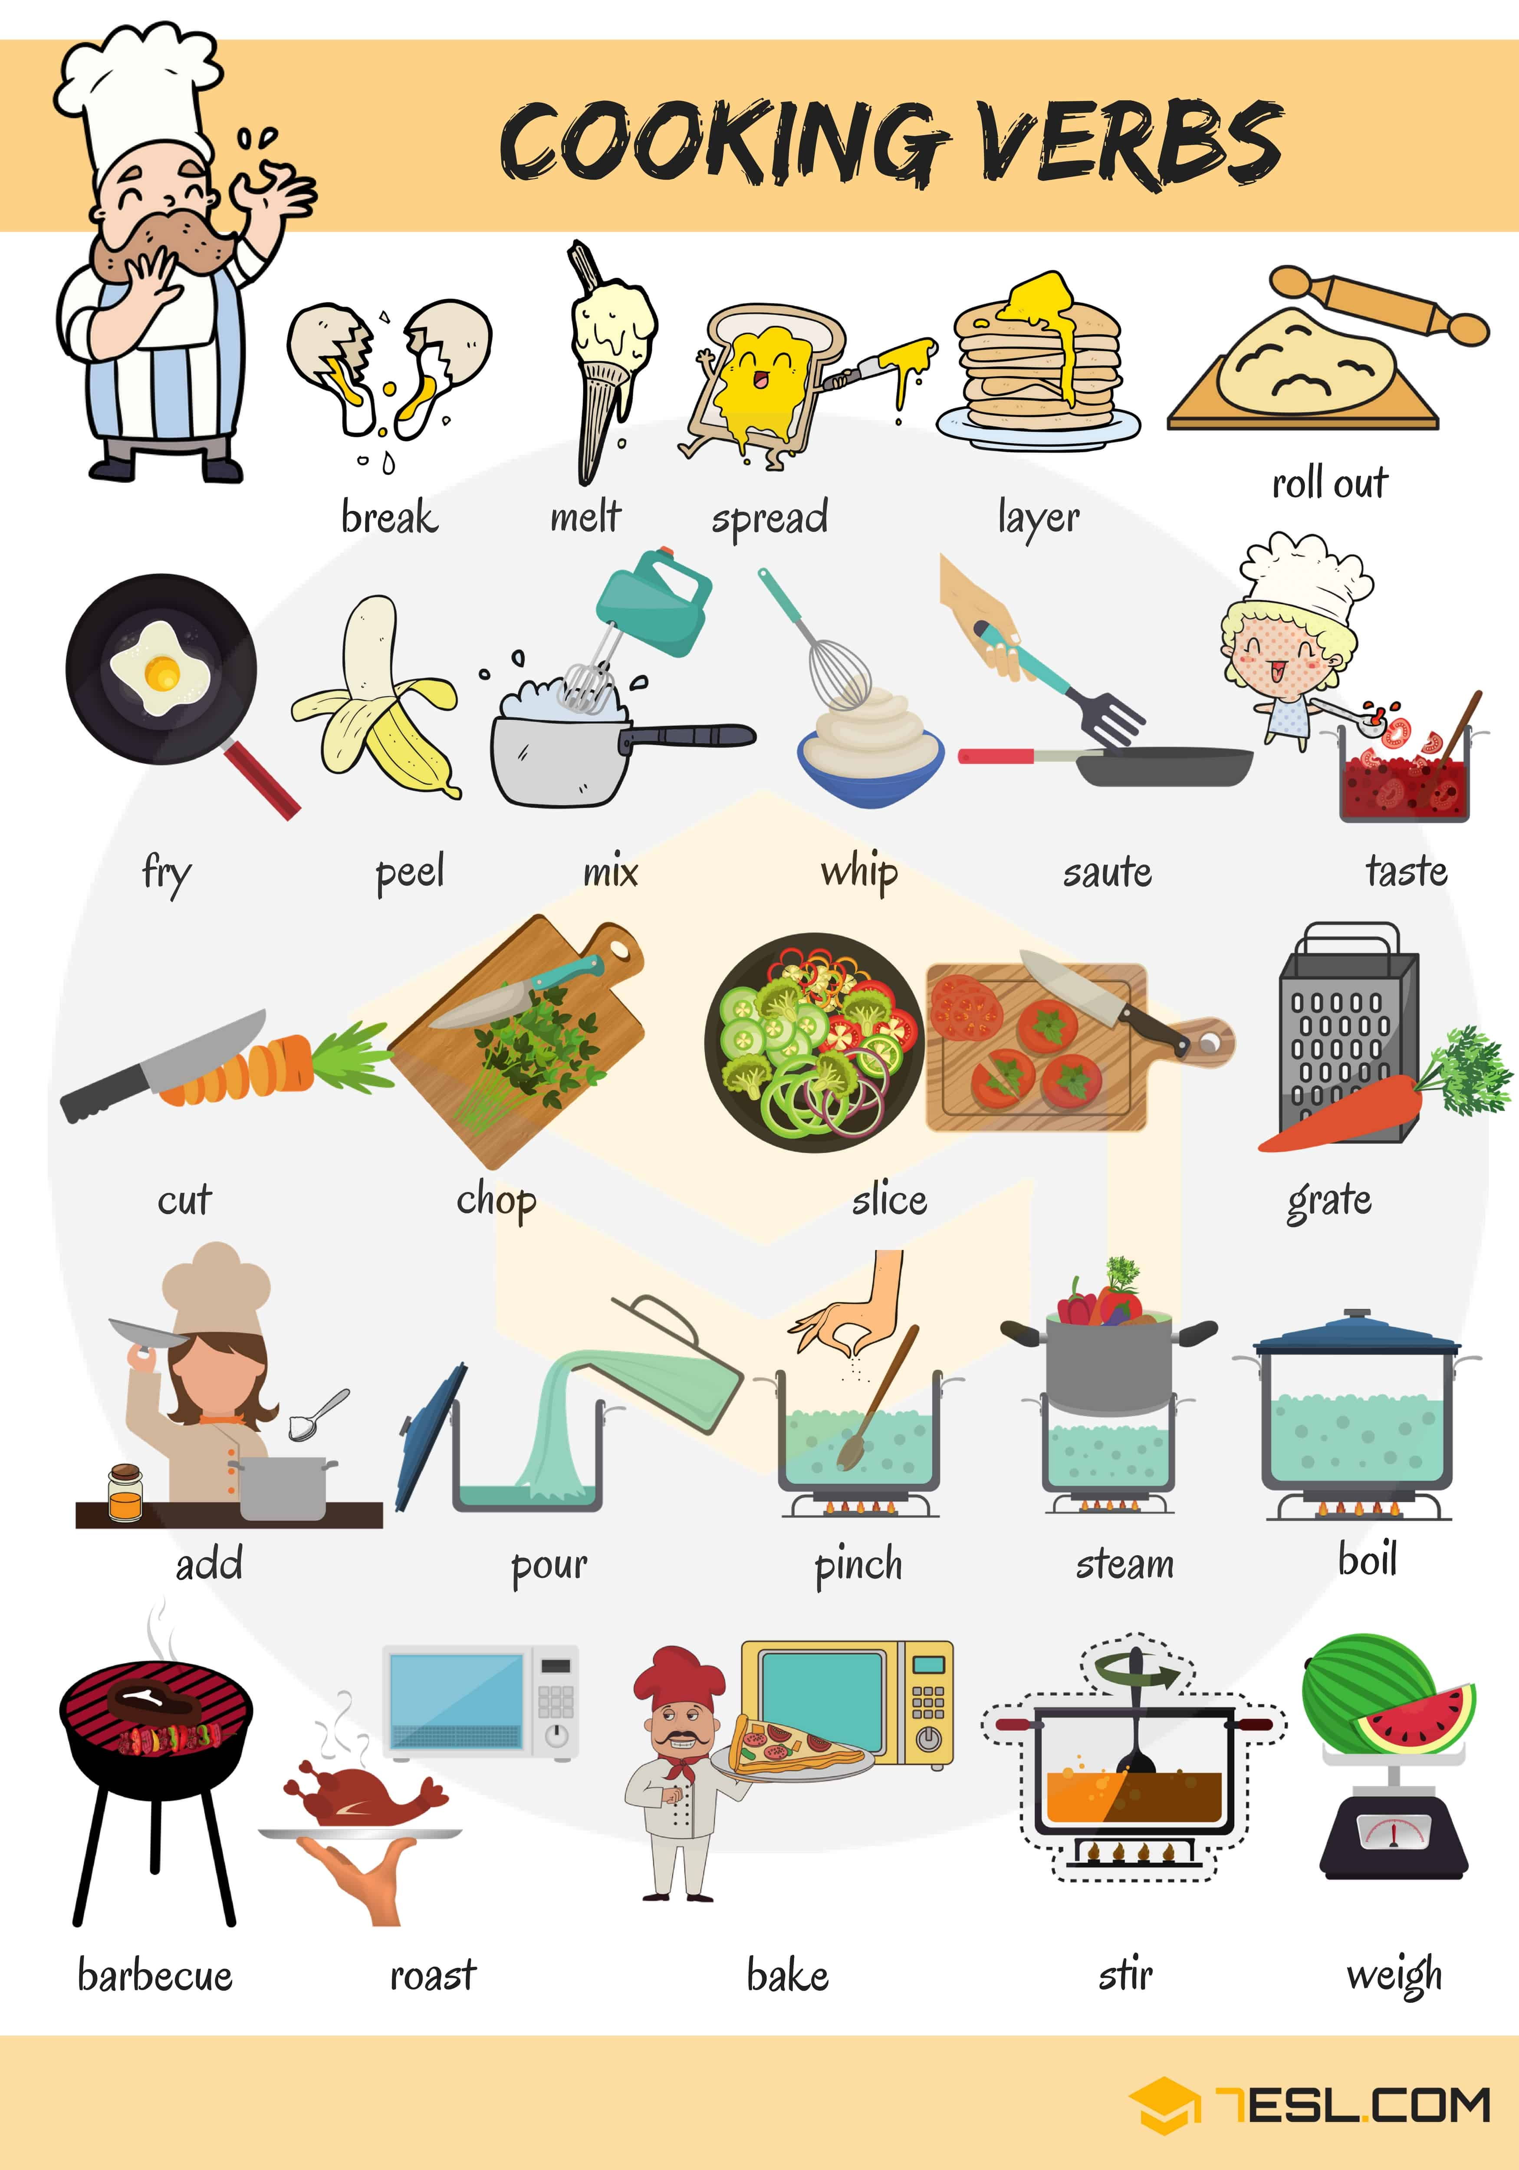
Presentation

Slide 15
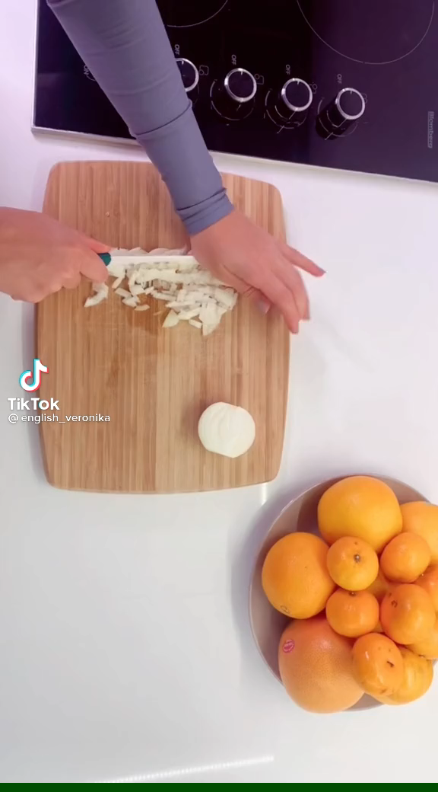
Presentation

Slide 16
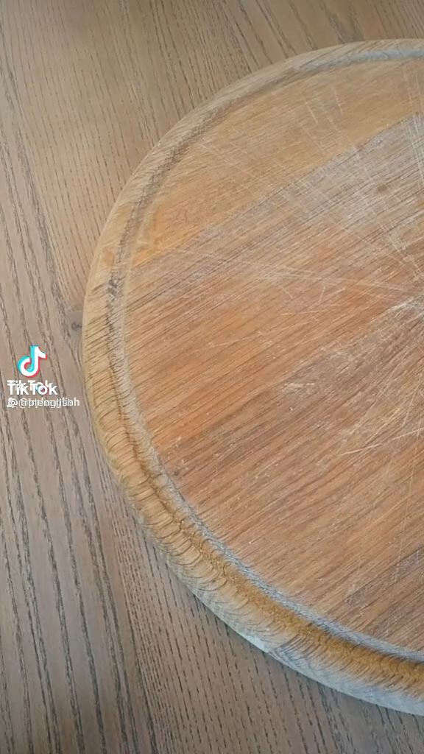
Presentation

Slide 17
Bing Videos
Presentation
Bing Videos

Slide 18
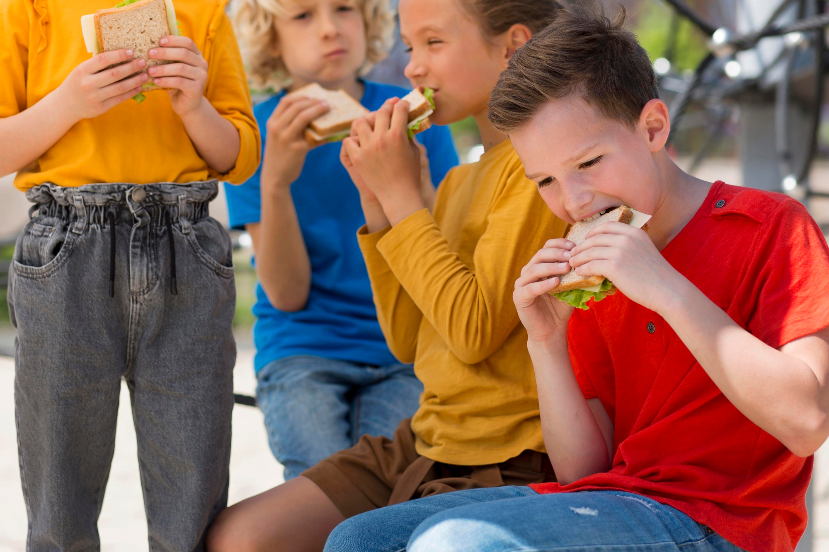
How to write a recipe
Presentation
3

Slide 19
Start with a title
Presentation
Make sure to pick a catchy title
The Title should be:
1- Centered
2- Catchy
3- Capitalized
1- My Delicious Peanut Butter Sandwich
2- Granny’s Peanut Butter Secrets
3- Five Minute Sandwich
4- The Perfect Sandwich

Slide 20
Start with a title
Formative assessment
Which of these titles is correct?
1- Spring Fruit Salad
2- You need 1 Minute to do a yummy Spagettie.
IRS
Notes:
After students write their titles/ ask their partners to check for them / Pair work

Slide 21
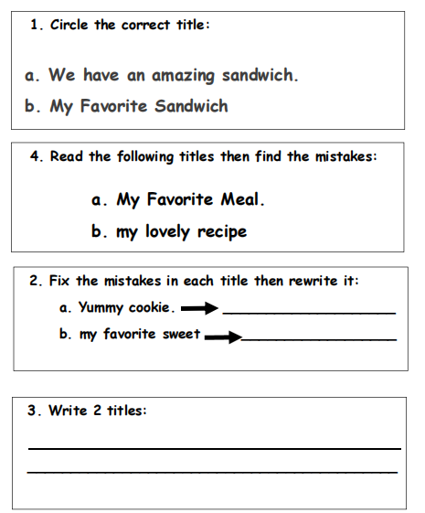

Differentiation & Feedback

Slide 22
Do you think it is important to try food from different cultures/WHY?
Critical Thinking
Buzz in

Slide 23
Real Life Application and Value
Bing Videos
What is the value that we can learn from this video?

Slide 24

Start with a title
Application
Make sure to pick a catchy title
Titles should be:
1- Centered
2- Catchy
3- Capitalized
Notebook
Notes:
After students write their titles on their Writing Notebooks / ask their partners to read then check / Pair work

Slide 25
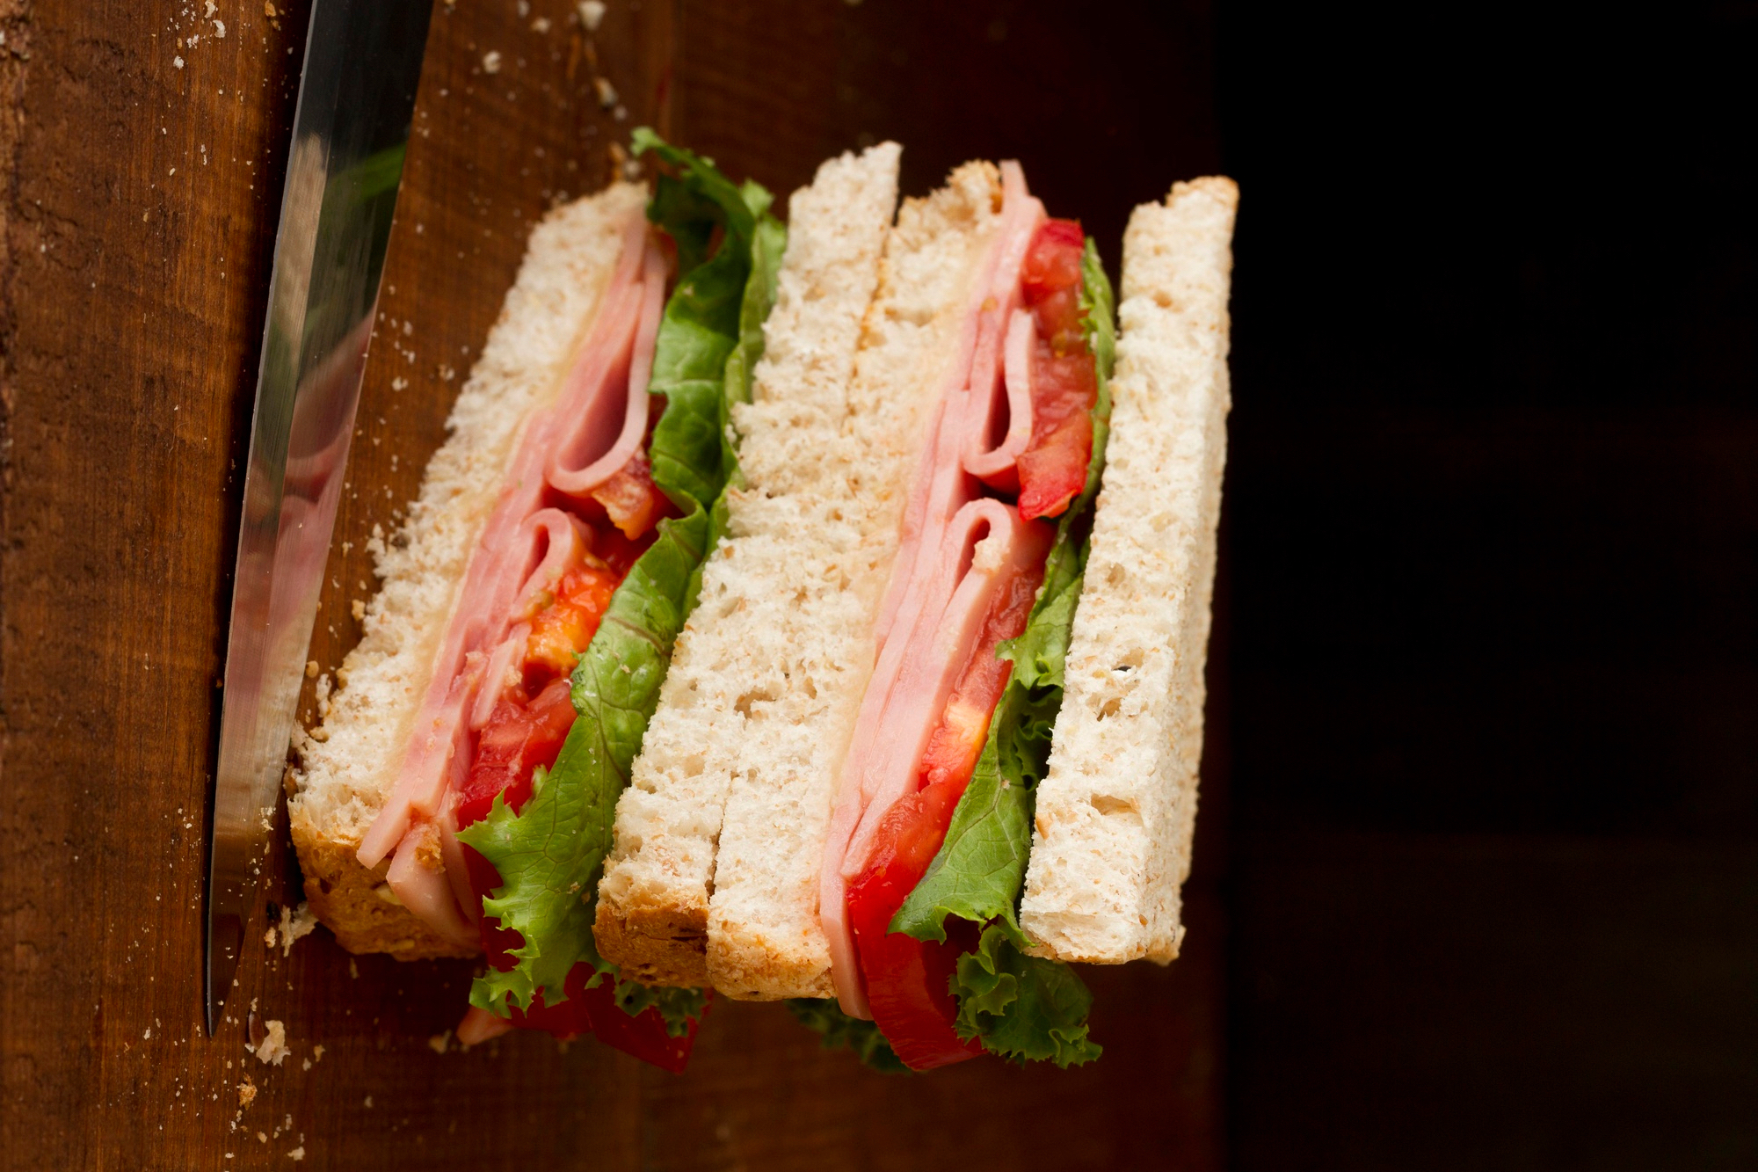
Start with your Topic Sentence :
Application
1-Today, I want to teach you how to make the best Peanut Butter sandwich.
2- I’m going to give you the steps to make a delicious
fruit Peanut Butter sandwich.
3- I am planning to share my secret Peanut Butter sandwich recipe with you.
Your topic sentence is the most important sentence in the paragraph. It tells the reader about the general idea. Don’t forget to:
1. leave a space at the beginning of it (Indentation).
2. Capitalize the 1st letter.
3. End it with a period.

Slide 26
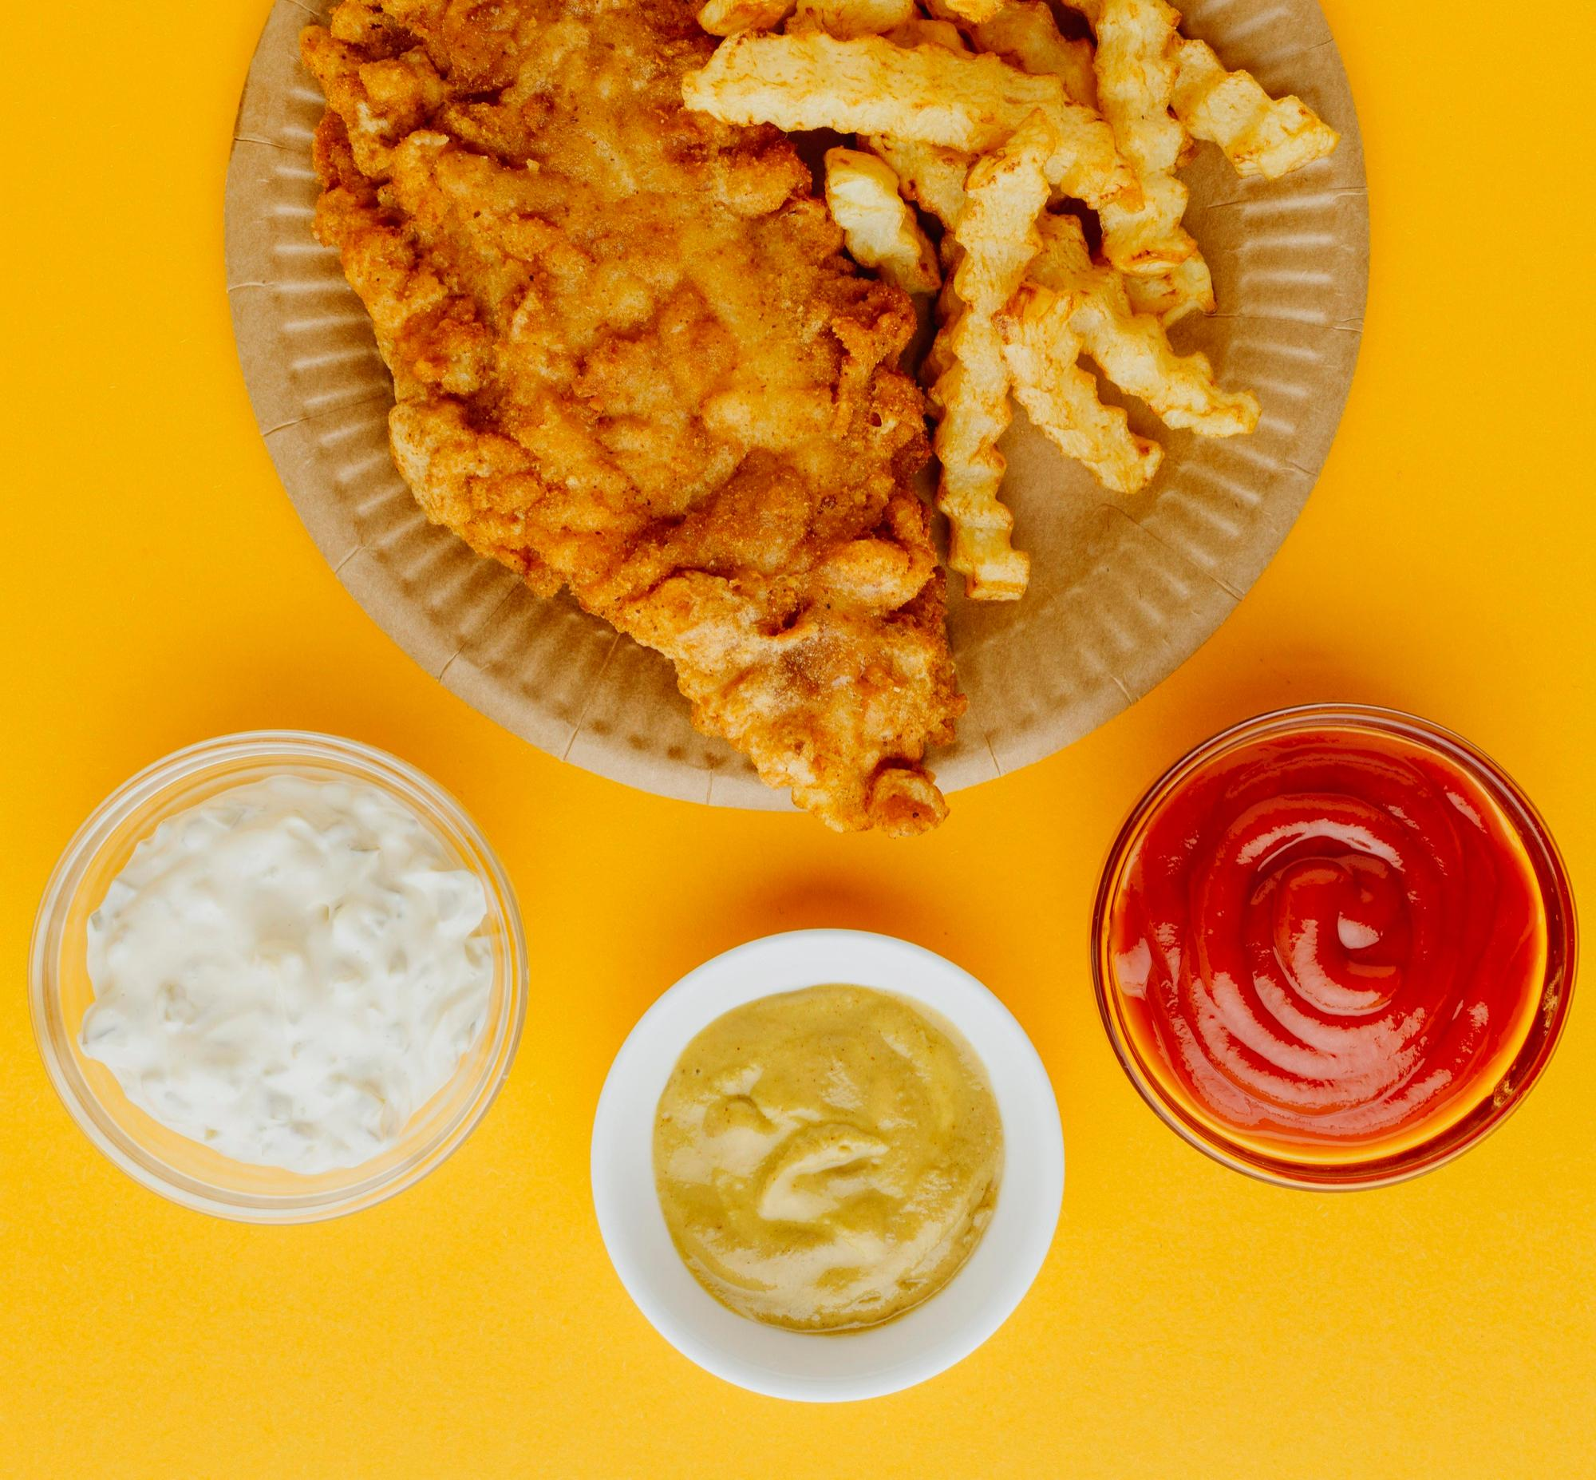
Use Imperative Verbs and Sequence Words /Time Order Transitions to add the supporting details
Application
First,
Next,
Then,
Last,
Finally,

Slide 27



Start by listing the steps in order
Application
Peanut Butter
BREAD
Fresh Fruit
Jam

Slide 28
Application
First, slice the bread. Then, spread the peanut butter. Next, add the jam. Finally, add some fresh fruit.
Notice that we add a comma (,) after sequence words (Time Order Transitions).

Slide 29
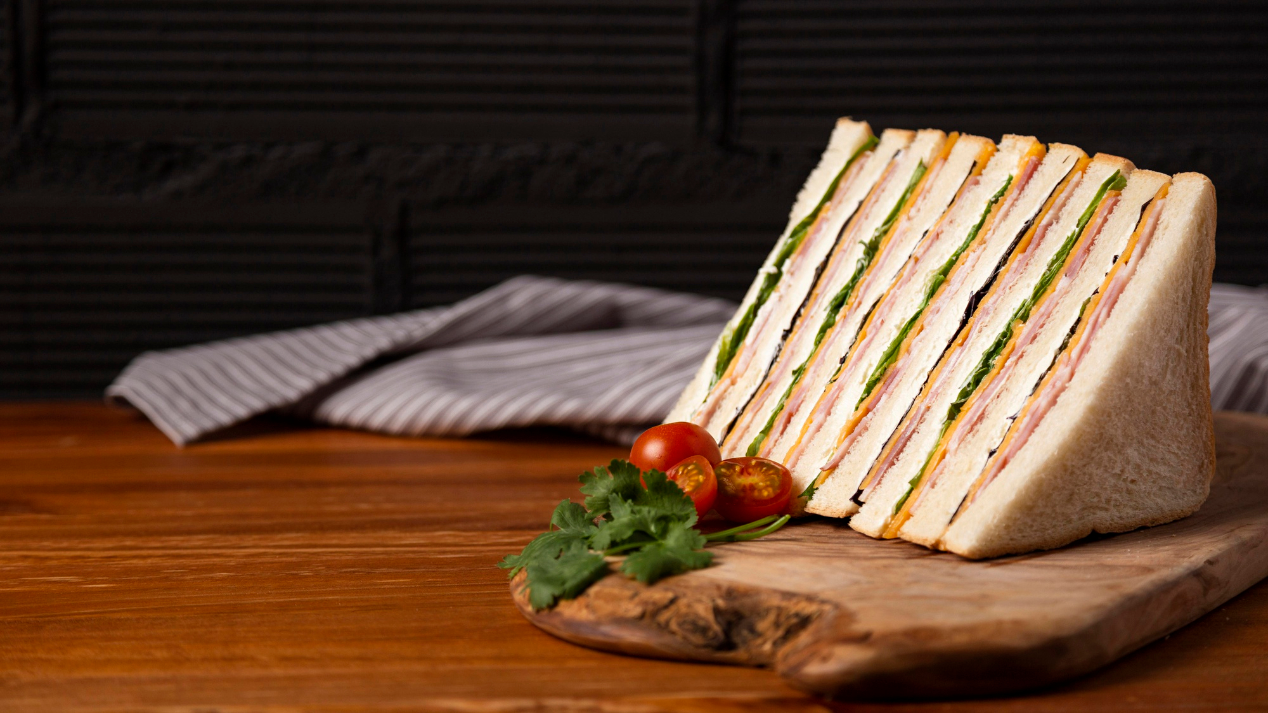
Application
Don’t forget to add a conclusion
1- Enjoy it!
2- Serve with a cup of tea. Yummy!
3- Here is my super easy recipe.
I hope you try it!

Slide 30
Summative assessment
The conclusion in the following paragraph is ………..
Delicious Peanut Butter Sandwich
Today, I want to teach you how to make the best peanut butter sandwich. We need bread, peanut butter, jam, banana or any fresh fruit you prefer. First, slice the bread. Next, spread the peanut butter. Then, add the jam. Finally, add some fresh fruit. Serve with a cup of tea or milk. Yummy!
Delicious Peanut Butter Sandwich
Today, I want to teach you how to make the best peanut butter sandwich.
Serve with a cup of tea or milk. Yummy!
IRS

Slide 31

What did we learn?

Slide 32

Homework
Write how to make a lemon juice.

