Slide 1
The Star Llama
Key Words

Slide 2

Outcomes:
Recognize the meanings of new words.​
Use them correctly in sentences.​
Value respecting others.

Slide 3
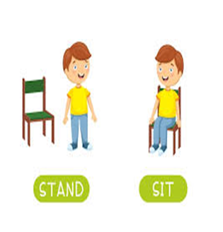

Warm up
If the sentence is correct take off.
If the sentence is not correct touch down.
1-We start writing a recipe with a title
2-We don’t use cooking verbs in the recipes.
Authentic

Slide 4
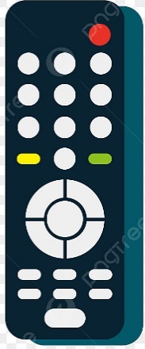
Pre- assessment
The conclusion in the following paragraph is ………..
Delicious Peanut Butter Sandwich
Today, I want to teach you how to make the best peanut butter sandwich. We need bread, peanut butter, jam, banana or any fresh fruit you prefer. First, slice the bread. Next, spread the peanut butter. Then, add the jam. Finally, add some fresh fruit. Serve with a cup of tea or milk. Yummy!
Authentic
Delicious Peanut Butter Sandwich
Today, I want to teach you how to make the best peanut butter sandwich.
Serve with a cup of tea or milk. Yummy!
IRS

Slide 5
Pre- assessment 4 students/ Random pick
https://wordwall.net/resource/166259/english/nouns-and-adjectives-remember-a-noun-is-a-name-of-a
Random pick
Authentic

Slide 6
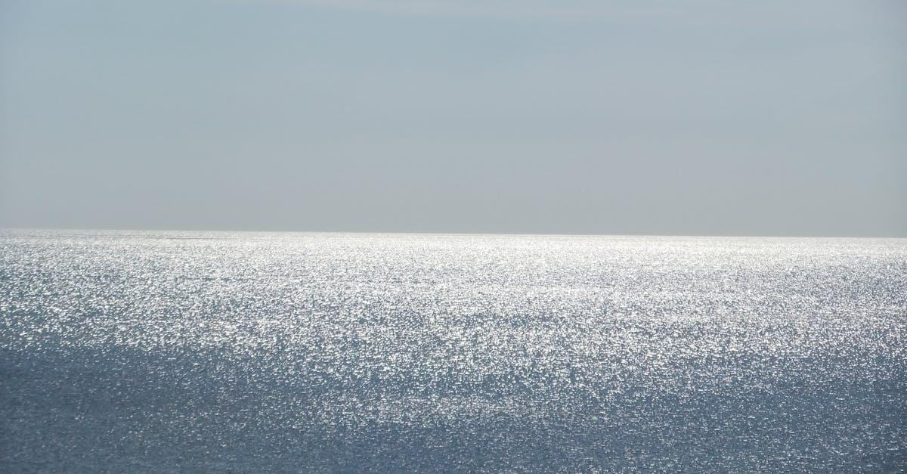
Shimmer
(Verb)
Example
The sea shimmers in the sunlight.
Meaning
to shine with a soft light

Slide 7
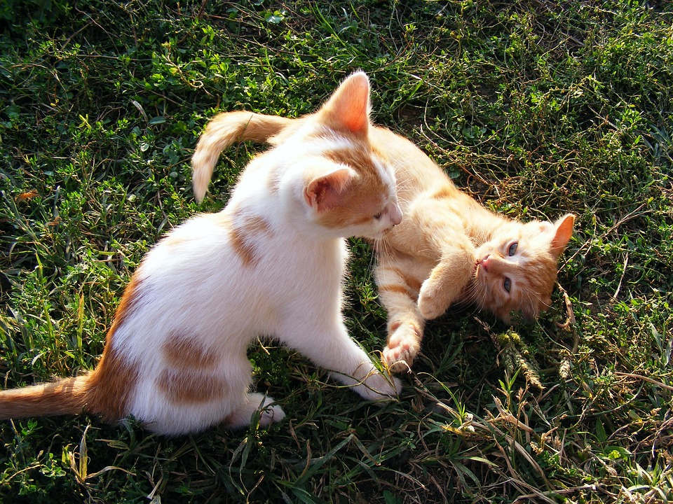
Frisky
(adjective)
Example
The kittens are frisky.
Meaning
lively and playful

Slide 8
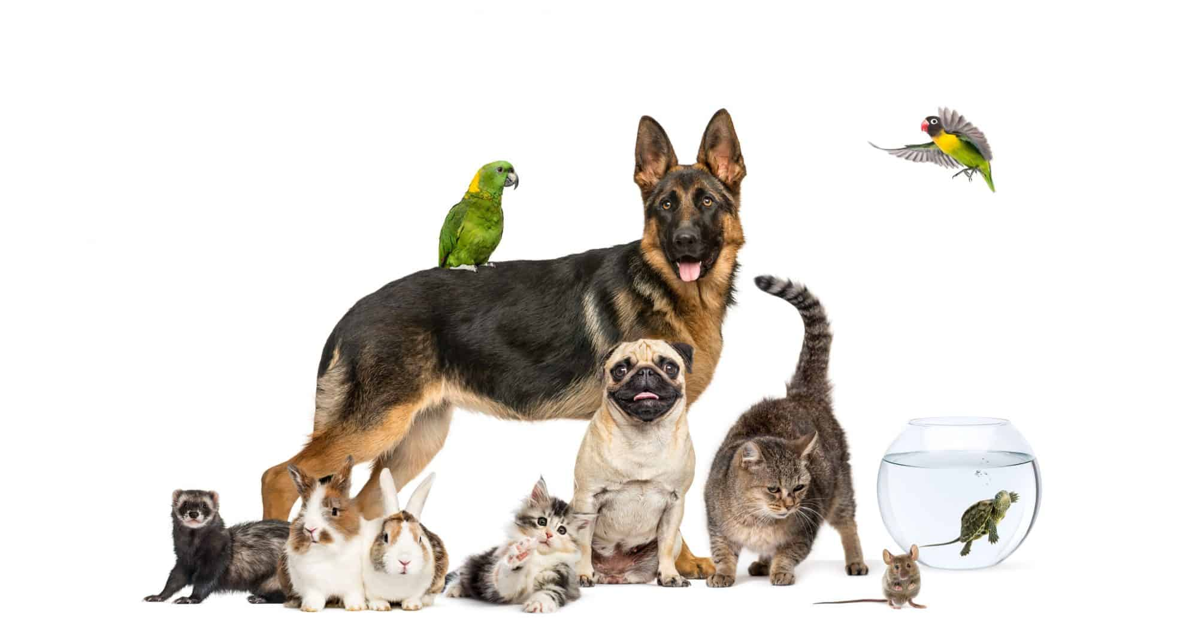
Can you describe your pet using the word 'frisky'?
REAL-LIFE APPLICATION I 1 min I BUZZ IN

Slide 9
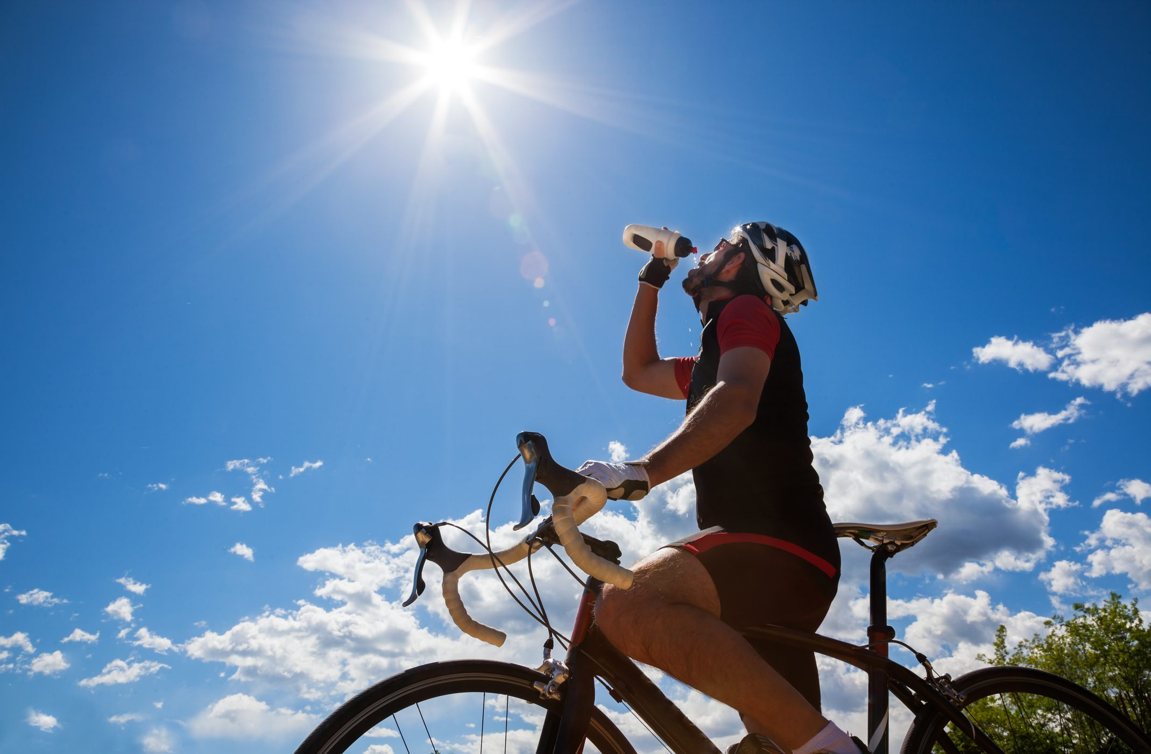
Warm
(adjective)
Example
a little hot
Meaning
The weather is warm in October.

Slide 10
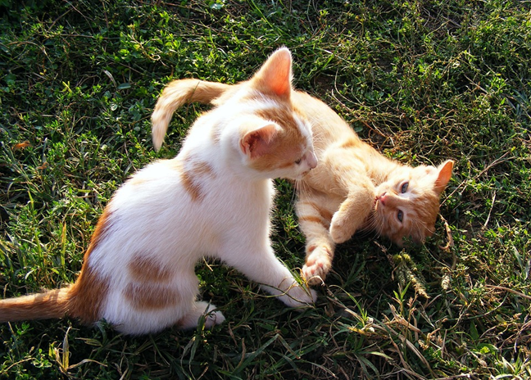
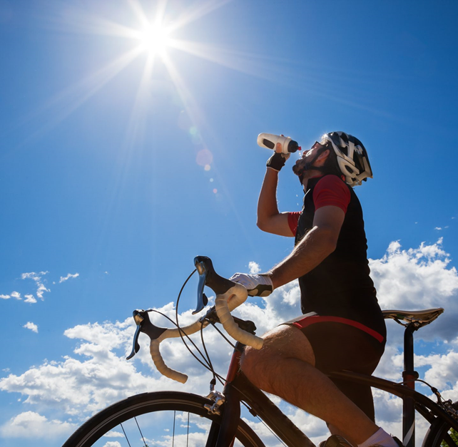

Rally Coach /2 min
Frisky
(adjective)
Shimmer
(Verb)
Warm
(adjective)
Write two sentences using the words
Authentic

Slide 11
Why is it important to drink water when you feel warm?
CRITICAL THINKING I 1 Min I BUZZ IN

Slide 12
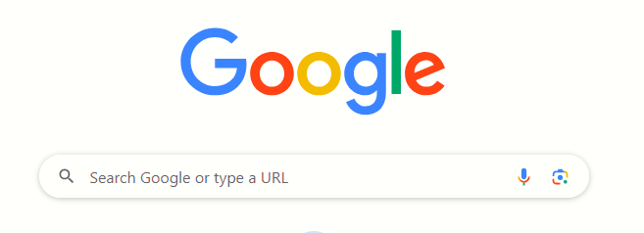
SEARCH: 30 SECONDS I RANDOM PICK
Search: Synonyms of “shimmer”

Slide 13
Formative assessment/ 2 min
- The puppy was feeling very _______ and kept running around the yard.
1- shimmer 2- frisky
IRS

Slide 14
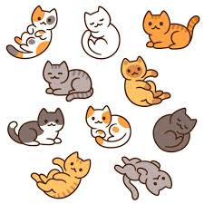
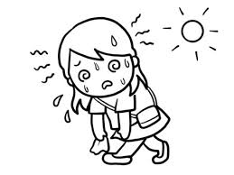
DIFFERENTIATION I 2 MIN
Students 3:
-Use the following words in 2 meaningful sentences: (shimmer, warm)
_______________________________________________________________________________
Students 2:
Shimmer/ frisky/ warm
Fill in the blanks with the correct word:
It's ______ today, let's play inside.
My puppy is very _______.
Students 4:
Choose the correct answer:
The stars shimmer in the sky.
( verb \ Noun \Adjective)
The kittens are frisky.
( verb \ Noun \Adjective)
Students 1:
Match the words with the pictures.
warm
frisky

Slide 15
Mini board /2 min
Frisky
(adjective)
Shimmer
(Verb)
Warm
(adjective)
Write a sentence using one the words
Authentic

Slide 16
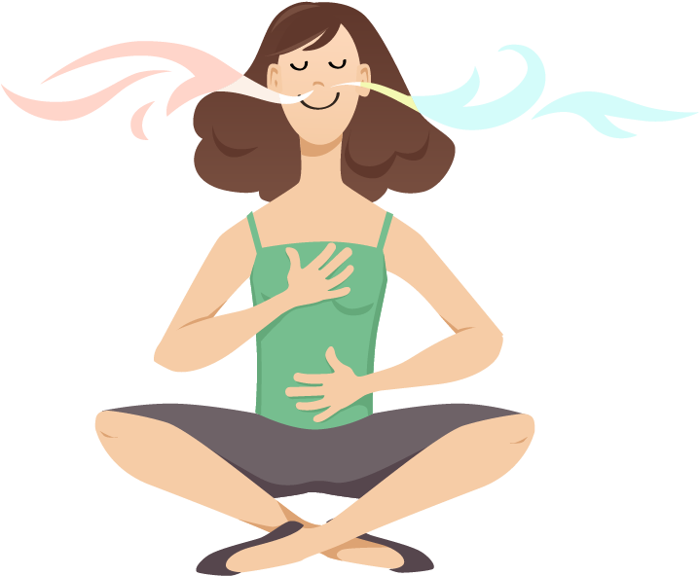
breath
(noun)
Example
She took a deep breath then cried.
Meaning
the air taken into the lungs

Slide 17
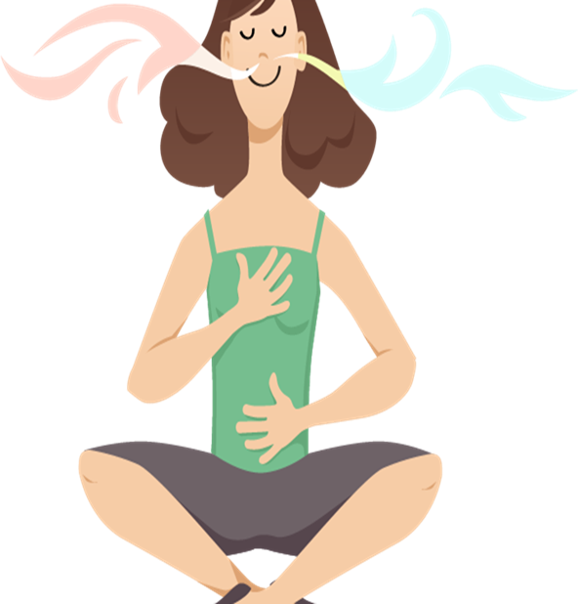
Practice
Let’s take a breath of fresh air.

Slide 18
Why is it important to take deep breaths when you feel nervous?
CRITICAL THINKING I 30 SECONDS I BUZZ IN

Slide 19
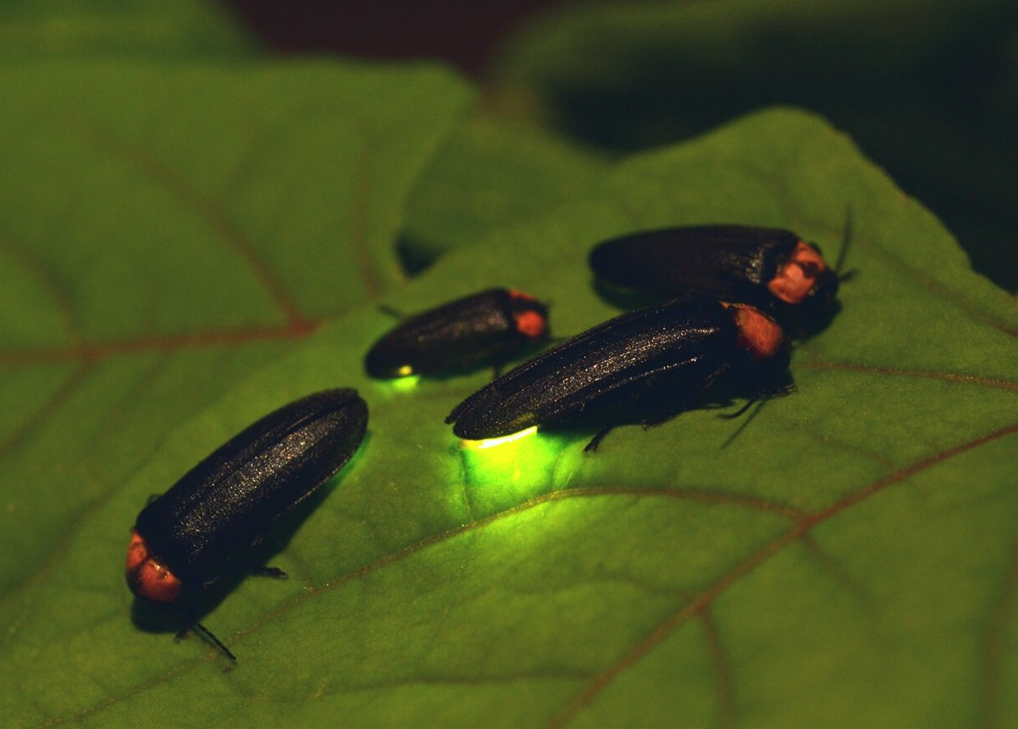
glowed
(verb)
Example
The fireflies glowed in the dark.
Meaning
Shined in the night

Slide 20
Rally Coach /2 min
breath (noun)
glowed (verb)
Write two sentences using the words
Authentic

Slide 21
If the sentence is true "take off" (stand up).
If the sentence is false "touch down" (sit down).
-The word “glowed” is a verb
Take off/ Touch down

Slide 22
Formative assessment/ 2 min
- After running up the hill, he took a deep _______.
1- glowed 2- breath
IRS

Slide 23
Formative assessment/ Feedback/ 2 min
- After running up the hill, he took a deep _______.
1- glowed 2- breath
IRS

Slide 24


1 min/ Search
Search: Synonyms of “breath”
Random pick

Slide 25
DIFFERENTIATION I 2 MIN
Students 3:
-Use the following words in 2 meaningful sentences: (breath, glowed)
_______________________________________________________________________________
Students 2:
glowed / breath
Fill in the blanks with the correct word:
We can hold our ______ when we do exercises.
Bugs _______ in the dark.
Students 4:
Choose the correct answer:
The snow glowed under the moonlight..
glowed is ( verb \ Noun \Adjective)
He held his breath under the water.
Breath is :( verb \ Noun \Adjective)
Students 1:
True/ False.
1-The word breath is a verb ______
2- The lava glowed .
glowed means “shined in the dark”___

Slide 26
SUMMATIVE ASSESSMENT I IRS I
1 MIN
1- It was ______________ last night, I didn’t need a jacket.
1. warm
  2. breath
  3. shimmer
4- Having a _____________ pet is a great fun.
  1.shimmer
  2. frisky
  3. breath
The stars ______________ brightly in the sky.
  1. warm
  2. glow
  3. frisky

Slide 27
closure
What did I learn?

Slide 28
H.W
Check the IEC APP to solve the worksheet

